Slide 1
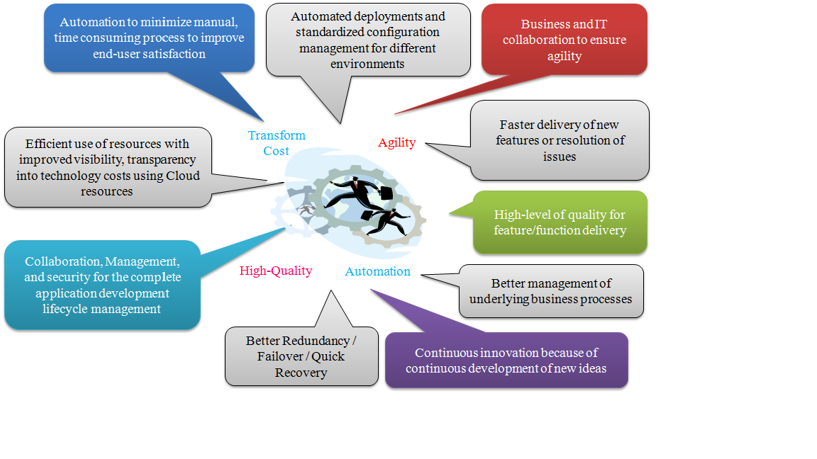
DevOps Overview

Slide 2
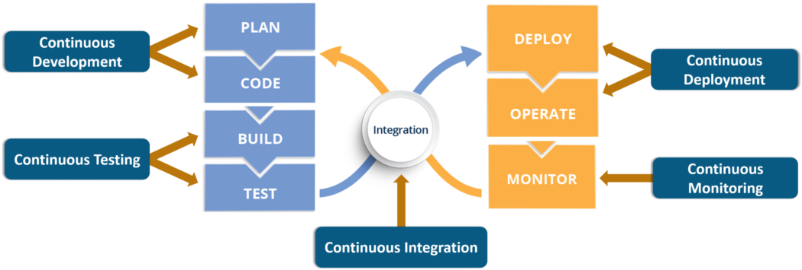
DevOps Cycle

Slide 3

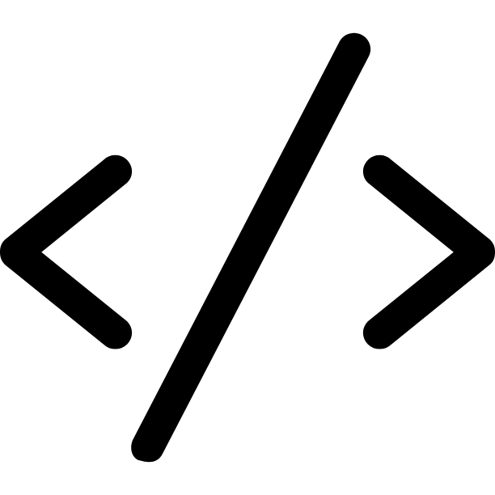






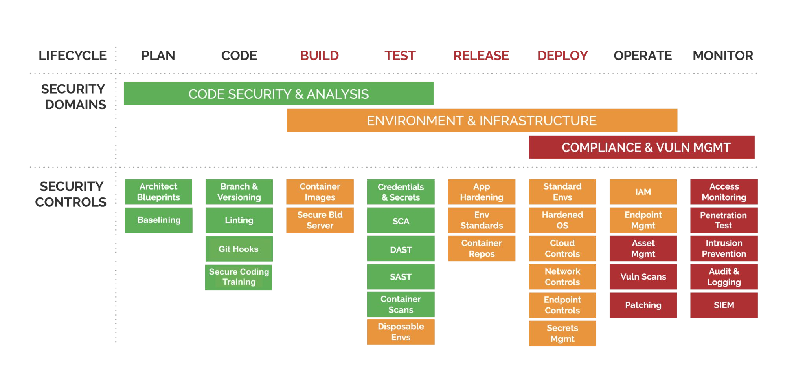
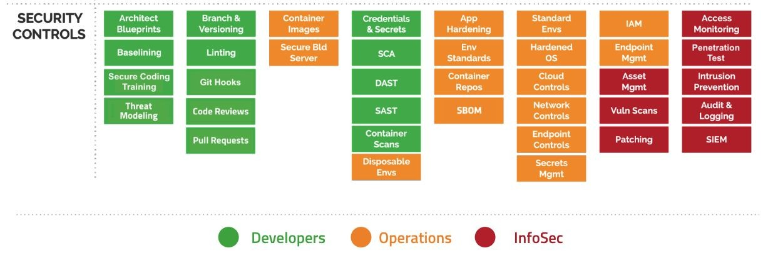
DevSecOps Cycle

Slide 4
DevOps Stack Tools
Source code management : Git, Bitbucket
Build management : Maven,Gradle, Nodejs
Testing tools : OWASP ZAP, AQUA
Repository management : Nexus, Artifactory
Continuous integration : Jenkins
Configuration provisioning : Terraform
Release management : Visual Studio, StackStorm
Cloud : AWS cloud
Container : AWS EKS Kubernetes
Deployment management : XCode Deploy
Collaboration : Jira, MS Team , Confluence
BI/Monitoring : PROFICIO
Logging : ELK Logstash

Slide 5
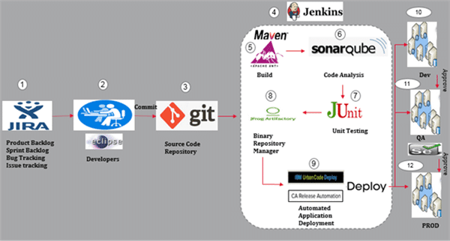
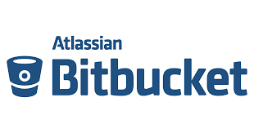

CI/CD Architecture

Slide 6
Flow of CI/CD Architecture
Typically, in an Agile process User Stories, Tasks, Defects etc., are all stored in JIRA and assigned to the Product Owners and Developers.
Developers pick up the tasks assigned to them and work on the development. The source code is version controlled and stored in GIT.
The developers commit their changes to the source code in GIT. Eventually, the code is shared among the developers using GitHub.
Jenkins which is the Continuous Integration tool pulls the code and, on every check-in, or based on a schedule the build is done using build tools like Maven or Gradle.

Slide 7
Flow of CI/CD Architecture
As the J2EE WAR files are produced, they are also version controlled and stored in a binary repository manager like Artifactory or Nexus.
6–8 Unit Testing using JUnit and Code Analysis with is also done
and automated.
Once the above process is completed the Continuous Delivery is performed
to different environments based on approvals using tools like Ansible Tower
/CA RA Continuous Testing (Functional and Acceptance Testing) is
invoked in the appropriate test environments using tools like Selenium.
10-12 Continuous Deployment/Monitoring would be an ongoing activity in the
Dev, QA and PROD environment

Slide 8
Bitbucket repository branching strategy
The master branch only contains finished work. All commits are tagged, since they represent releases. All releases happen from master.
The develop branch is where work on the next release happens. When work is finished here, develop is merged to master.
We use separate feature branches for all new features. Feature branches are merged to develop.
When a devastating bug is revealed in production, a hotfix branch is made where a bug fix is created. The hotfix branch is then merged to master, and a new release for production is made.
This usually translates to a version number with three or four parts: ° The first is major—changes here signal major changes in the code ° The second is for minor changes, which are backward API compatible ° The third is for bug fixes ° The fourth can be a build number.

Slide 9
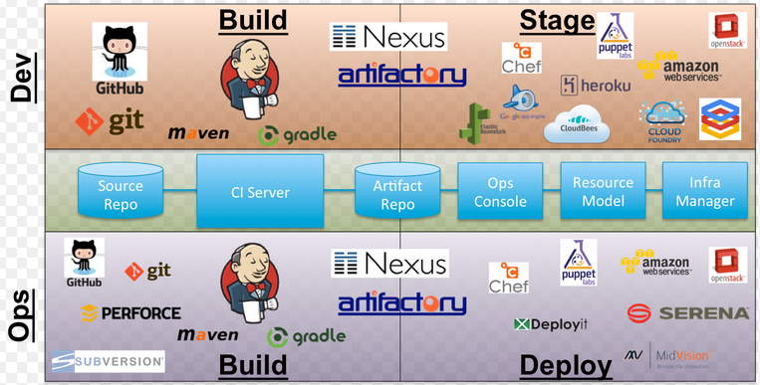
Continuous Integration / Continuous Deployment

Slide 10
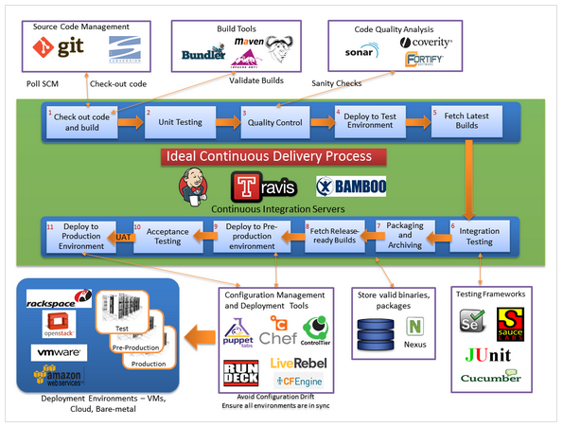
CI/CD Pipeline

Slide 11
DevOps Best Practices
Authentication
Enforce the use of two-factor authentication whenever possible to prevent a password leak leading to an account compromise.
Use limited-privileges accounts when integrating components like Jenkins and Docker Hub, and use one account per project, to compartmentalize the impact of an account leakage in reference to other projects.
Become proficient in using AWS IAM policies and use them to grant limited and specific permissions to infrastructure components.
Security
Sign Git commits and tags using PGP, and write scripts to review those signatures outside the CI/CD pipeline.
Evaluate how container signing could help bring increased trust to your infrastructure but be aware of its caveats.
Signing code and containers provides high assurance against fraudulent modifications but is hard to implement in practice.
Distribute secrets to systems securely using specialized tools like Mozilla Sops or HashiCorp Vault, and never store them in cleartext when at repositories.
The RRA has four components: information gathering, data dictionary, risk identification, and security recommendations.

Slide 12
DevOps Best Practices
Logging Trail
Collecting system logs through syslog is an easy way to quickly gain visibility into the behavior of services.
Infrastructure logs, such as NetFlow and AWS CloudTrail, are more resistant to attacks than system logs but may lack context and be harder to analyze.
Third parties such as GitLab sometimes provide audit logs that contain useful information about users’ activity.
A storage layer handles the retention of logs for a given period of time. Raw logs are often kept for 90 days, and metrics aggregates are kept forever.
Raw logs are useful to security investigations and, if the budget allows it, should be kept for longer than 90 days.

Slide 13
DevOps Best Practices
Network
Tools like Hindsight allow you to run custom plugins to analyze log data and trigger alerts.
GRR, MIG, and osquery are endpoint-security solutions that allow investigators to inspect the systems of their infrastructure in real time.
Analyzing network traffic with an IDS like Suricata and commercial rule-sets will catch common attack patterns and help protect the network.
System teams and external pen tests bring fresh security perspectives to an organization and increase the skills of DevOps teams.

Slide 14
Mobile CI/CD Best Practices
Mobile CI/CD are avalable on Bitrise.
Cloud-based alternatives can significantly cut down on those expenses and replace them with predictable, scalable pricing.
Bitrise uses features like user access systems, enforced 2FA, SAML SSO, GitHub,GitLab, Bitbucket SSO, and VM destruction after a build.
For more info please see bitrise-5-main-benefits-migrating-your-app-to-cloud-ci.pdf

Slide 15
Developers Best Practices
Check-in third-party JAR files, build scripts, other artifacts, and so on into the code repository.
Execute builds fully from the code repository: Use a clean build.
Automate the build using Maven or Ant, Gradle for Andriod and IOS.
Make the build self-testing: Create unit tests.
Commit all changes at least once a day per feature.
Every commit should be built to verify the integrity of changes.
Authenticate users and enforce access control (authentication and authorization).
Use alphanumeric characters for build names and avoid symbols.
Keep different build jobs to maintain granularity and manage operations in a better way. A single job for all tasks is difficult when trying to troubleshoot.
Do not schedule multiple jobs to start at the same time, or use a master-slave concept, where specific jobs are assigned to slave instances so that multiple build jobs can be executed at the same time.
It is advisable to use community plugins.

Slide 16
Developers Handy Tools
Please see the attached document for the tools.

