Slide 1

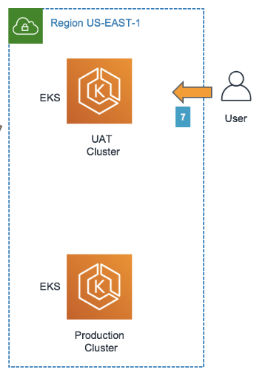

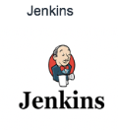


Logical Process flow diagram
AWS Cloud EKS
1
6
3
4
5
2
AWS Cli
Provision Jenkins server
Developers integrate code changes into the repository
Code changes trigger Jenkins pipeline
Jenkins build a new docker image
Deployment image to kubernetes(EKS)
Testing the deployment

