Slide 1



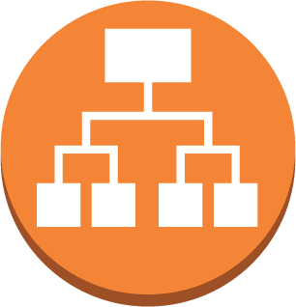

Architecture Diagram
Public subnet/AZ
Web/ DB server
Users
Application & Network Load Balancer
Public subnet/AZ
Auto Ec2 Web/DB server

Slide 2




Proposed Architecture Diagram
Public subnet/AZ
private subnet/AZ
NAT gateway/ securitygroup
RDS DB instance replica (multi-AZ)
Web/ App server
Users
Application & Network Load Balancer
Public subnet/AZ
private subnet/AZ
Internet
Web/App server
RDS DB instance
NAT gateway/ securitygroup

