Slide 1
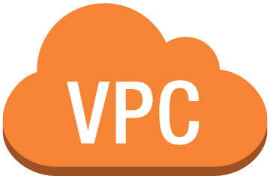
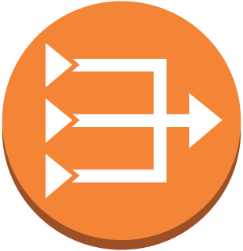

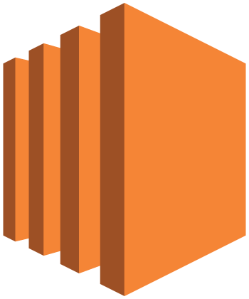

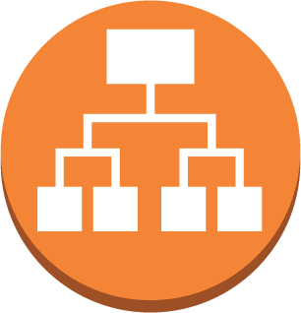



Symbiosis Architecture Diagram
Public subnet/AZ
private subnet/AZ
NAT gateway/ securitygroup
RDS DB instance standby (multi-AZ)
Web/ App server
Users
Application Load Balancer
Public subnet/AZ
private subnet/AZ
Internet
Web/App server
RDS DB instance
NAT gateway/ securitygroup

