Slide 1

NEIL GOGTE INSTITUTE OF TECHNOLOGY Kachavanisingaram Village, Hyderabad, Telangana. 5000058 DEPARTMENT OF CSE(AI&ML)
VIRTUAL MOUSE USING HAND GESTURE RECOGNITION
PRESENTED BY :-
245321748065 - AMBATI BALA SHREYAS REDDY
245321748095 – KOOKUTLA RISHI KUMAR
UNDER THE GUIDANCE OF:-
Mrs. M. Deepika
ASSISTANT PROFESSOR

Slide 2
CONTENTS
Abstract
Introduction
Objective
Existing System
Proposed System
Operating Environment
Architecture design
System Design
Output
Conclusion and Future scope

Slide 3
ABSTRACT
Integrates real-time camera and innovative hardware design for a groundbreaking approach to mouse control.
Uses computer vision to recognize gestures, replicating traditional mouse functions.
Recommends a complete hardware redesign for enhanced user control through cutting-edge camera technology.
Demonstrates the practicality of the system, performing tasks akin to standard mouse devices.

Slide 4
INTRODUCTION
On most VR-Headsets, the controller is not the easiest and most convenient to use.
The primary purpose of preprocessing is to present data for easy interpretation and processing on a system.
This project focuses on his process of extracting the greatest human hand features from the background and matching those features to detect hand movements.
Main Features –
User friendly.
Portable.
Covers simple operations - left mouse button drag , minimized.

Slide 5
OBJECTIVE
Revolutionize computer interaction through a Webcam-based Virtual Mouse, eliminating the need for physical mice.
Ensure seamless operation on various surfaces and environments with users facing the webcam for motion gestures.
Emphasize real-time image capture through camera as a prerequisite for the Virtual Mouse's functionality.
Prioritize user convenience with a universal input system, allowing the Virtual Mouse to adapt to any surface.

Slide 6
EXISTING SYSTEM
The current systems utilize either wired or wireless mice for cursor control and incorporate hand gestures for system monitoring.
The virtual mouse control system relies on webcams to capture colored hints, utilizing colored fingers as objects, commonly presented in red, green, and blue.
Within the color-monitored system, users can execute fundamental mouse actions, including minimize, drag, scroll up, scroll down, left-click, right-click with drag.
Static hand recognition in existing systems is complex and less user-friendly due to explicit action assignments.

Slide 7
PROPOSED SYSTEM
System works by identifying the hand gestures and determining the position of the cursor accordingly, but we prefer to run the algorithm in a real environment for the following reasons.
There are various conditions and scenarios that make it difficult reason.
Environmental noise.
Ambient light conditions
Different skin textures.

Slide 8
Contd…
The proposed system accommodates all skin tones and operates accurately in various lighting conditions.
Enables user interaction by clicking and using two fingers at a specific angle (15 degrees) without the need for traditional mouse devices.
Offers a user-friendly alternative to traditional mouse systems, eliminating the need for separate hardware devices.
The algorithm facilitates hand gesture recognition without requiring additional hardware, leveraging input from webcams.

Slide 9
OPERATING ENVIRONMENT
HARDWARE REQUIREMENTS:
System : Intel Core i5
Processor: Intel(R) Core(TM) i5-10300H CPU@ 2.50 GHz
Installed RAM: 8.00 GB
System Type: 64-bit OS, x64-based processor
Webcam: 720p HD Webcam

Slide 10
Contd…
SOFTWARE REQUIREMENTS:
Operating System: Windows 11
Toolkit: Image Acquisition and Processing
IDE: Pycharm
Programming language: Python

Slide 11
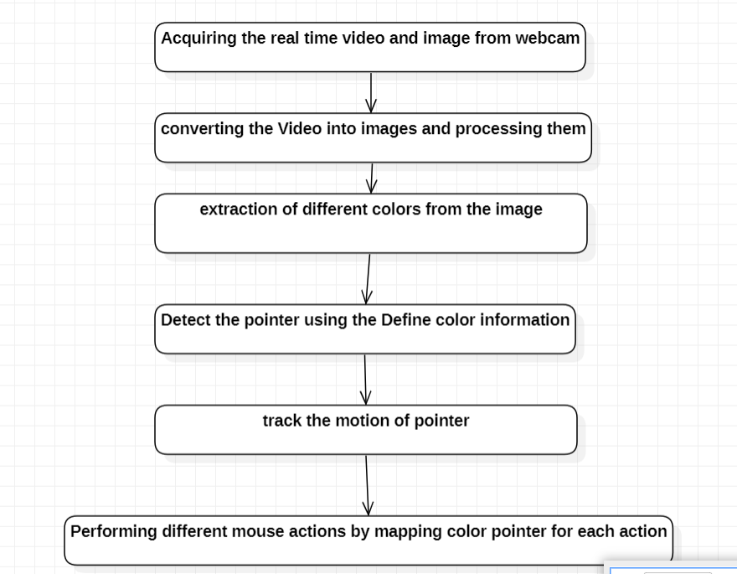
ARCHITECTURE DESIGN

Slide 12
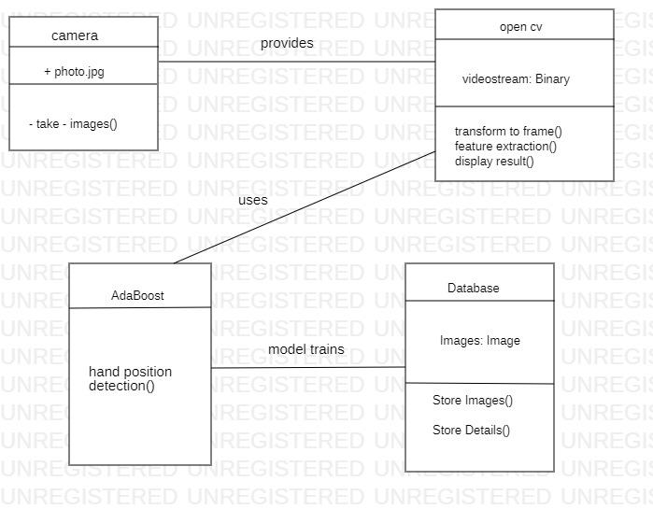
SYSTEM DESIGN
CLASS DIAGRAM

Slide 13
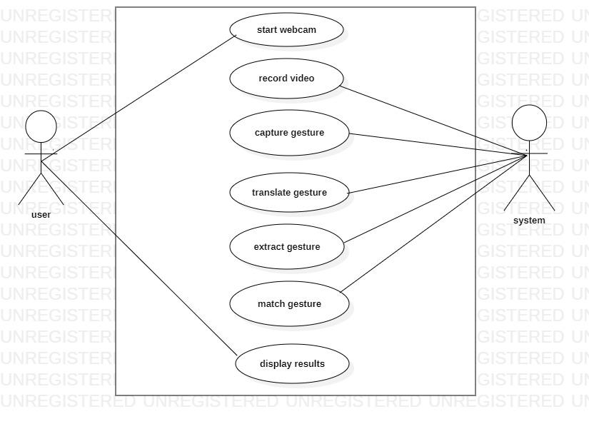
USE CASE DIAGRAM

Slide 14
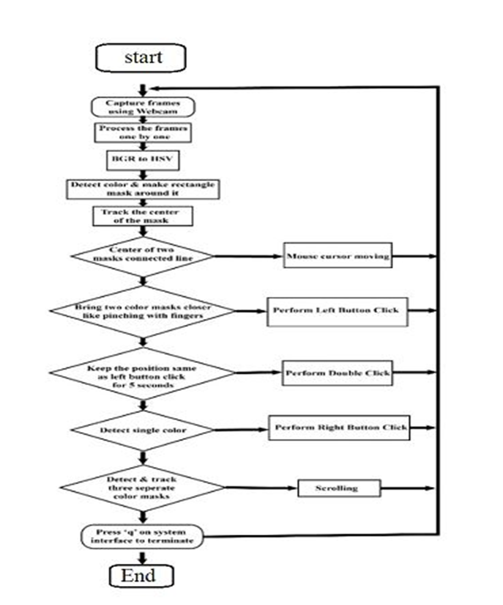
ACTIVITY DIAGRAM

Slide 15
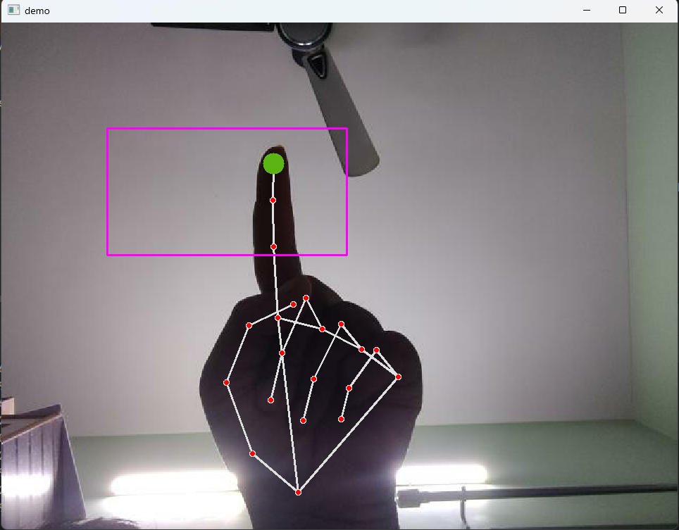
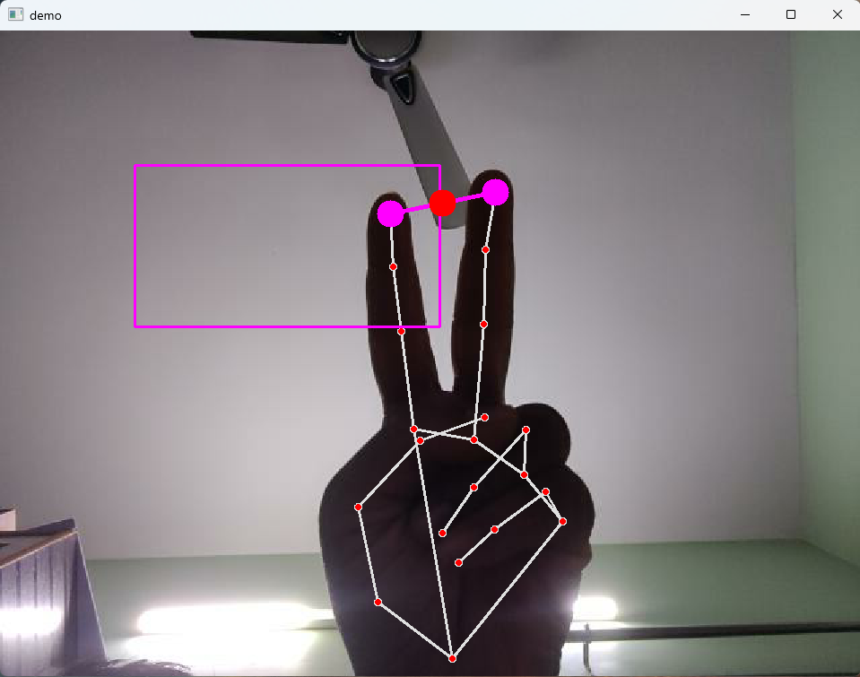
OUTPUT

Slide 16
CONCLUSION AND FUTURE SCOPE
The Webcam-based Virtual Mouse innovates human-computer interaction through real-time camera feedback and gesture recognition.
Its practicality is showcased through seamless standard mouse operations and proposed hardware redesign recommendations for enhanced user control.
With a user-friendly interface and portable design, it addresses challenges in current VR headset controllers, revolutionizing computer interaction for accessibility and user-centricity.
With the use of ambient light sensors, 3-D depth sensing cameras and seamless integration of hardware and the software into the VR- Headsets, a revolutionary method of controlling them will be put in place instead of flimsy Joysticks.

Slide 17


