Slide 1
Trees
Definition: A tree is a finite set of one or more nodes such that there is a specially designated node called the root ,the remaining nodes are partitioned into disjoint sets t1,t2,t3….tn are called sub trees of the root.

Slide 2
example
A
B
C
D
E
F
G
H
I
J
K
L

Slide 3
Tree Terminology
1 Node: This is the main component of any tree structure. The concept of node is same as that used in a linked list
2 Parent: A parent of a node is the immediate predecessor of a node
3 Child: The immediate successors of a node are called children's
4 Link: This is a pointer to a node in a tree. Three are two links LL and RL

Slide 4
5 Root: This is a Specially designated node which has no parent.
6 Leaf node: A node which doesn’t have child nodes such type of nodes are called leaf nodes
7 level: level is the rank in the hierarchy. The root node has level zero.
8 Height: The maximum no of nodes possible in a path starting from the root node to a leaf node is called height of a tree.
9 Degree: The maximum no of children's possible for a node is known as the degree of a node
10 Siblings: The nodes which have same parent are called siblings.

Slide 5
example
Root=A
Level=3
Height=4
Degree=3
Leaf=e,k,l
G,h,I,j
A
B
C
D
E
F
G
H
I
J
K
L

Slide 6
Binary Tree
Tree nodes can have any number of children. In a binary tree, each node can have at most two children.
A binary tree is either empty or consists of a node called the root together with two binary trees called the left subtree and the right subtree.

Slide 7
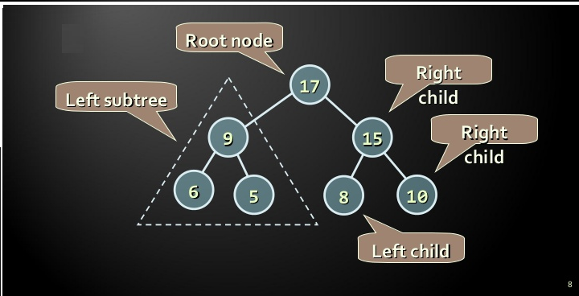

Slide 8
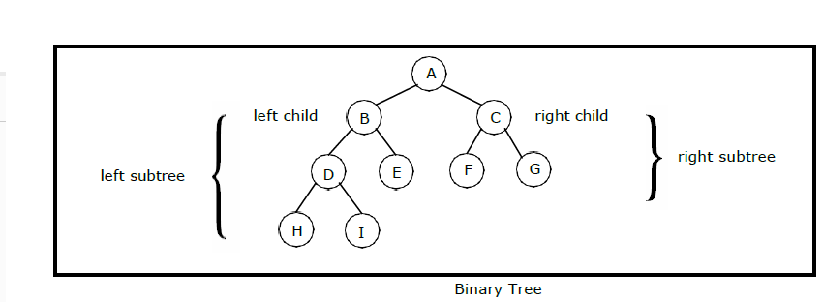

Slide 9
Binary tree Binary tree Binary tree
Not Binary Tree
A
A
A
B
C
B
C
A
B
C
D

Slide 10
Types of binary tree
1 Full Binary Tree
2 Complete Binary Tree
Full Binary Tree: A binary tree is a full binary tree
Where each node contains either zero or two childrens. or Each node contain exactly two children except leaf node

Slide 11
example
Full binary tree not full binary tree

Slide 12
Complete Binary Tree:
A binary tree is said to be complete binary tree if all its levels, except possibly the last level have the maximum no of nodes ,and all the nodes in the last level appear from left to right.

Slide 13
example
Not complete BT Complete BT

Slide 14
Representations of binary tree
1 Array Representation
2 Linked Representation

Slide 15
Binary search Tree
A binary tree T is termed as binary search tree if each node n of T satisfies the following property
→ The value at n is greater than every value in the left sub tree and less than every value in the right sub tree.

Slide 16
Binary Search Tree
65
19
74
15
28
69
88
25
57
81
54

Slide 17
Operations on Binary search tree
1 Searching
2 Traversing
3 Insertion

Slide 18
Searching
1 Searching data in a binary search tree is much faster than searching data in arrays or linked list.
2 suppose in a binary search tree to search an item we start from root node
3 If item is less than root node then search in left sub tree.
4 If item is greater than root node then search in right sub tree.

Slide 19
Algorithm
1 ptr=root, flag=false
2 while(ptr!=NULL) and (flag== false)
3 case: item < ptr->data
ptr=ptr->LC
4 case: item==ptr->data
flag=true
5 case: item > ptr->data
ptr=ptr->RC
6 end while
7 if(flag==true)
8 print “ item found”
9 else
10 print “ item not found”
11 end if
12 stop

Slide 20
Tree Traversal
There are three types of traversals
1 pre order traversal ( Root, Left, Right)
2 in order traversal ( left, Root, Right)
3 post order traversal ( Left, Right, Root)

Slide 21
Pre order traversal ( Root, Left, Right)
Pre order: A,B,D,C,E,G,F,H,I
A
B
C
D
E
F
G
H
I

Slide 22
Algorithm
1 ptr=root
2 if(ptr!=NULL)
3 visit(ptr)
4 pre order(ptr->LC)
5 pre order(ptr->RC)
6 end if
7 stop

Slide 23
In order traversal (Left, Root, Right)
in order: B,D,A,G,E,C,H,F,I
A
B
C
D
E
F
G
H
I

Slide 24
Algorithm
1 ptr=root
2 if(ptr!=NULL)
3 in order(ptr->LC)
4 visit(ptr)
5 in order(ptr->RC)
6 end if
7 stop

Slide 25
POST order traversal (Left, Right, Root)
post order:D,B,G,E,H,I,F,C,A
A
B
C
D
E
F
G
H
I

Slide 26
ALGORITHM
1 ptr=root
2 if(ptr!=NULL)
3 post order(ptr->LC)
4 post order(ptr->RC)
5 vist(ptr)
6 end if
7 stop

Slide 27
Insertion
1 To insert a node with data say item into a tree the tree is required to be searched starting from the root node.
2 If item is found insertion is not possible , otherwise item is inserted .
Before insertion After insertion node 7
6
6
2
8
2
8
1
4
1
4
7

Slide 28
Algorithm
1 ptr=root, flag=false
2 while(ptr!=NULL) and (flag==false)
3 case: item < ptr->data
ptr1=ptr
ptr=ptr->LC
4 case: item > ptr->data
ptr1=ptr
ptr=ptr->RC
5 case: ptr->data==item
flag=true
print “ item exists no insertion”
exit
6 end while

Slide 29
Conti….
7 if(ptr==NULL)
8 new=getnode(NODE)
9 new->data=item
10 new->LC=NULL
11 new->RC=NULL
12 if(ptr1->data < item)
13 ptr1->RC=new
14 else
15 ptr1->LC=new
16 end if
17 end if
18 stop

Slide 30
AVL TREES
1 AVL Stands for Adelson, Velski & Landis
2 AVL trees are height balancing binary search tree.
3 AVL tree checks the height of the left and the right sub-trees and assures that the difference is in between -1,0,1.
4 This difference is called the Balance Factor.
5 Balance Factor = height(left-subtree) − height(right-subtree)

Slide 31
Here we see that the first tree is balanced and the next two trees are not balanced
9
6
5
7
2
7
7
6
9

Slide 32
AVL Rotations
To balance itself, an AVL tree may perform the following four kinds of rotations −
LL: Left rotation (single rotation)
RR: Right rotation (single rotation)
LR: Left-Right rotation (double rotation)
RL: Right-Left rotation (double rotation)

Slide 33
LL: Left rotation (single rotation)
If a tree becomes unbalanced, when a node is inserted into the Left sub tree of the left sub tree, then we perform a single left rotation −
30
20
20
10
30
10

Slide 34
RR: Right rotation (single rotation)
If a tree becomes unbalanced, when a node is inserted into the right subtree of the right subtree, then we perform a single right rotation
20
10
10
30
20
30

Slide 35
LR: Left-Right rotation (double rotation)
30
30
20
10
20
10
30
20
10

Slide 36
RL: Right-Left rotation (double rotation)
10
10
20
30
20
10
30
20
30

Slide 37
example
Keys = 40,20,10,25,30,22,50,45
30
25
45
20
22
40
50
10

Slide 38
THANK YOU

