Slide 1
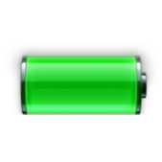




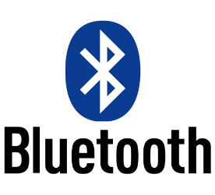

FEATURES
Environment friendly NiMh battery
60 days of continuous use
Piezoelectric powered
iOS 9 compatible
4.0 Low Power
Haptic guidance
Microcontroller coding

