Slide 1

Contextual Security Dashboard
Team 3
Blake Lassiter
Veronica Alban
Joe Kuttickal
Wes Toler

Slide 2
Problem Recap
Interactive Intelligence needs a way to effectively monitor security data on the Purecloud Platform
This means:
Having all the data in the same place
Presenting it in a way that is easily human readable

Slide 3



PureCloud Security Data
Unencrypted S3 Buckets
Overly Permissive Security Groups
Amazon Linux Security Advisories

Slide 4
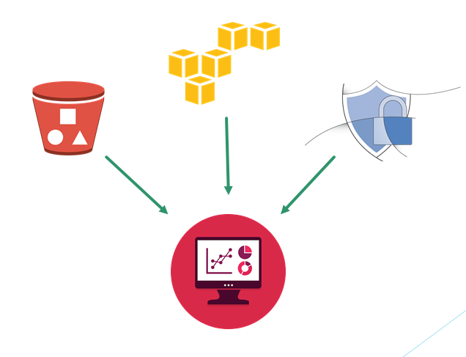
Our Solution
Create a dashboard application to act as:
A central location to store PureCloud’s security data
A framework for viewing data

Slide 5





High-Level Design
Cloud Computing Platform
Database Server
Amazon RDS
Amazon EC2
SQL Database
Back End API
ORM
Post {JSON}
External Data Collector
PostgreSQL
Django
API Calls
Front End UI
AngularJS

Slide 6
Structure of a Report
Metadata
Module – which module the report comes from
Severity – how important the report is
Status – this report’s progress
Title – the title of the report
Date – timestamp of when report was posted to the dashboard
Data
Could be anything

Slide 7
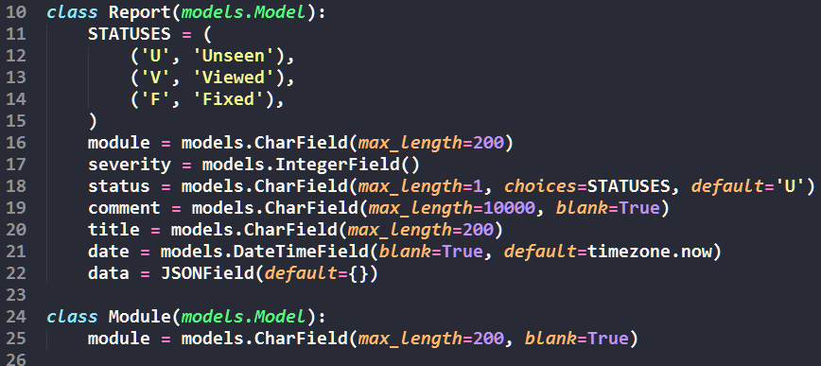
Models.py

Slide 8
API Design
Includes calls to post, get, delete, and patch reports
Allows for filtering results based upon any of the fields they contain
Base URL: localhost:8000/dashboard/api/reports
Same functionality for list of modules added to dashboard (mostly used by front end to populate sidebar

Slide 9
API URL Examples
Get all reports
GET http://localhost:8000/dashboard/api/reports/
Get the report who’s id is ‘5’
GET http://localhost:8000/dashboard/api/reports/5/
Post report(s)
POST http://localhost:8000/dashboard/api/reports/
Get all reports who’s severity is ‘1’
GET http://localhost:8000/dashboard/api/reports?severity=1
Get all reports who’s module is ‘alas’ and status is ‘U’
GET http://localhost:8000/dashboard/api/reports?module=alas&status=U

Slide 10
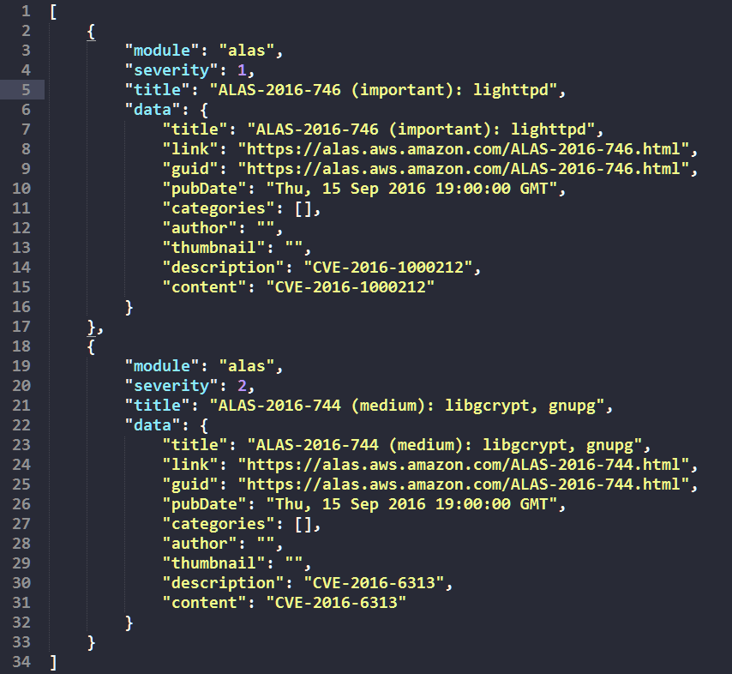
Sample Report Post Body

Slide 11
Front End Layout
Home Page
Lists all the most recent reports in the dashboard
Notices Page
Lists all the most important reports (severity=1) in the dashboard
Module View
Sidebar gives access to view reports from specific modules
Report View
Displays detailed data for a particular report

Slide 12
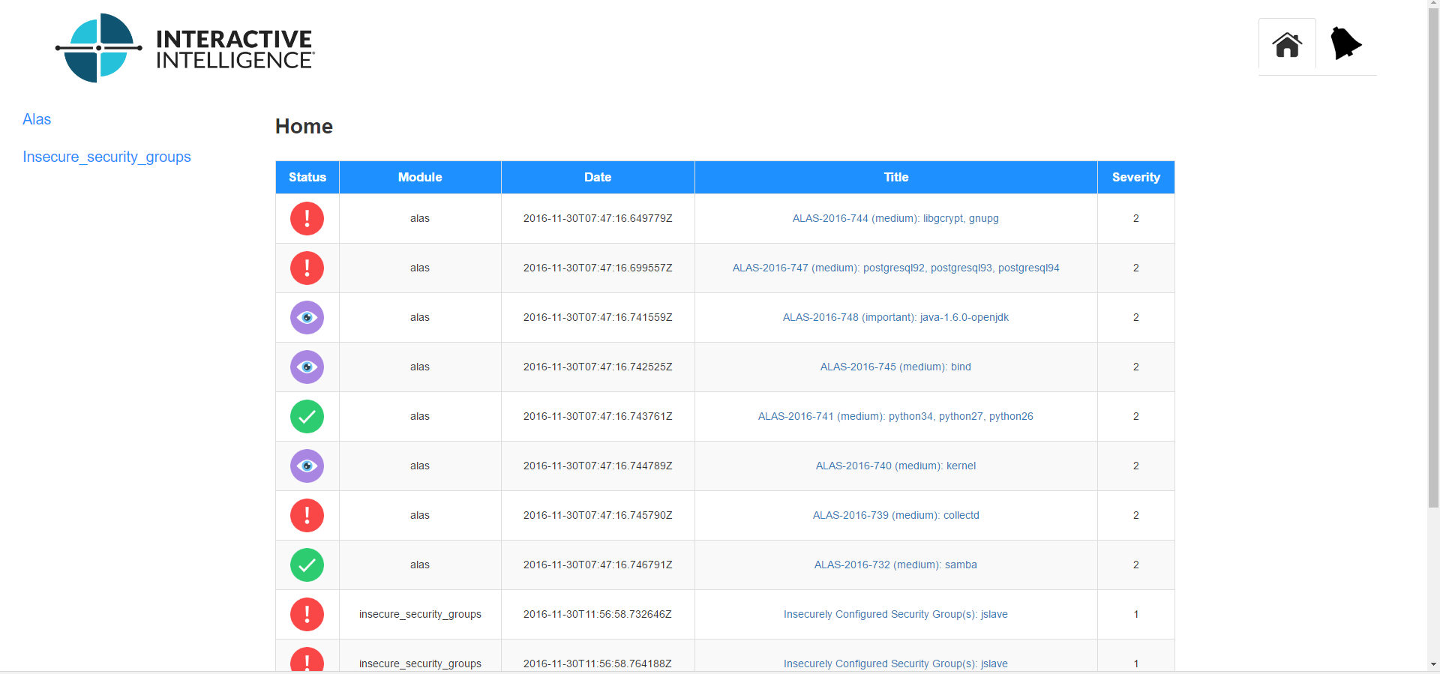
List View

Slide 13
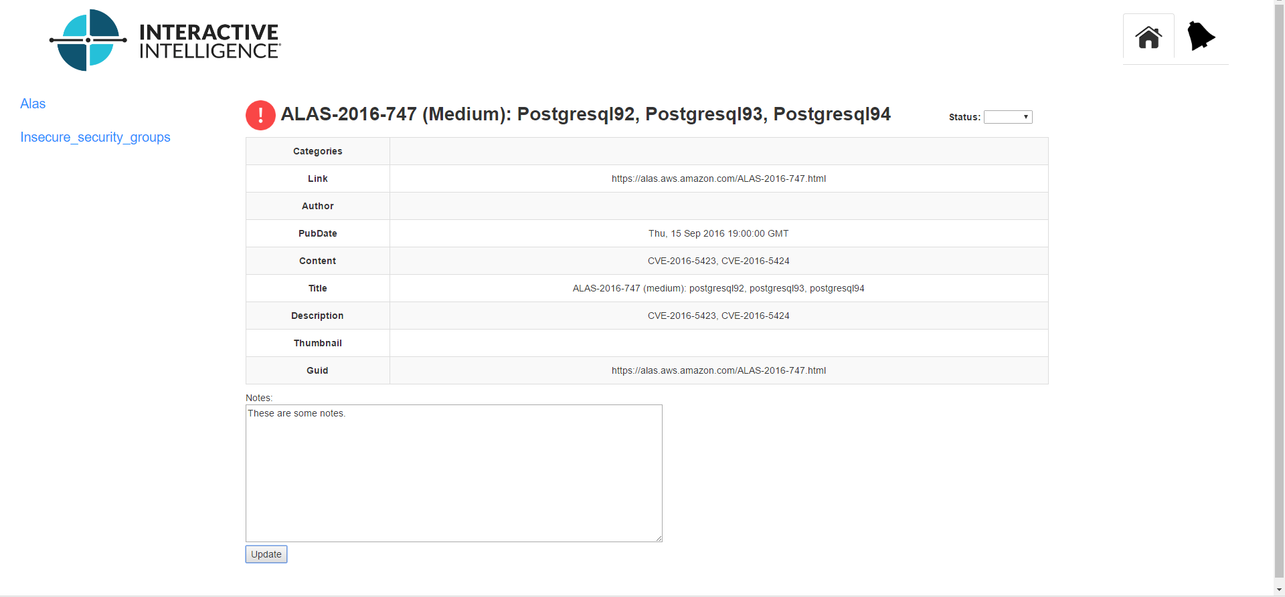
Report View

Slide 14
Testing
Django APITestCase
Run through the test calls using mock data in a virtual database
Statement coverage
Selenium
Selenium standalone IDE was used for testing front end
Covered blackbox testing as well as a few extras

