Slide 1
SOFTWARE PROPOSAL
HealthPlus HMS
🏥
Hospital Management System
HealthPlus
A complete, integrated platform to manage every aspect of your hospital — appointments, clinical records, pharmacy, billing, inventory and more. Built on modern technology, ready for production.
Hospital Management
System
10+
14
100%
Python / Django
PostgreSQL
HTMX
Docker
AWS EC2
Modules
Screens
Custom
Prepared for Client Review • March 2026

Slide 2
What We'll Cover
A structured walkthrough of the HealthPlus HMS proposal
01
Executive Summary
05
Pricing & Packages
What HMS is and the problems it solves
Starter, Professional, Enterprise tiers
02
System Modules Overview
06
Implementation Timeline
All 10 modules at a glance
10-week phased delivery plan
03
Module Walkthroughs
07
Next Steps
Screen-by-screen feature demonstration
How to get started
04
Technology Stack
Backend, frontend, database & infrastructure

Slide 3
01
Executive Summary
HealthPlus HMS is a fully-integrated, web-based hospital management platform built to replace fragmented, paper-based workflows with a single connected digital system.
🏥
🔒
⚡
📊
Complete Platform
Role-Based Access
Modern Tech Stack
Real-Time Insights
Covers every hospital workflow — OPD, IPD, Pharmacy, Billing, Inventory and HR in one system
5 user roles — Admin, Doctors, Staff, Pharmacist, Inventory Manager — each with tailored dashboards
Python/Django 5.2, PostgreSQL, HTMX, Docker, AWS EC2 — production-grade and future-proof
Live dashboards, stock alerts, AMC expiry warnings, attendance logs and revenue reports
10+
36
50+
24/7
Functional Modules
Database Tables
Specialist Doctors Supported
Emergency & OPD Coverage

Slide 4
The Problem → Our Solution
❌ Common Challenges
✅ HealthPlus HMS Solution
✕
Manual paper-based appointment books
→
✓
Digital booking portal + staff dashboard with live queue
✕
Patient records scattered across departments
→
✓
Unified patient registry (HMS-P-XXXX) linked across all modules
✕
No real-time bed availability visibility
→
✓
Live IPD bed map with colour-coded status across all wards
✕
Pharmacy stock in spreadsheets
→
✓
Batch-level inventory with POS, expiry alerts & purchase orders
✕
No digital prescriptions
→
✓
Doctor console with structured Rx + auto-generated PDF
✕
Manual GST billing calculations
→
✓
Auto-invoicing with CGST/SGST split per line item
✕
Equipment with no lifecycle tracking
→
✓
Inventory module: QR codes, AMC alerts, depreciation tracking

Slide 5
02
System Modules Overview
🌐
📅
🩺
🛏️
💊
Public Portal
Appointments
Doctor Console
IPD Admissions
Pharmacy
Landing page, doctor directory, health packages, blog, careers & reviews
Online booking form, token queue, check-in & status management
Clinical notes, diagnosis, digital prescriptions & PDF generation
Ward/bed management, admission, discharge & live bed status map
POS, medicine catalogue, batch stock, purchase orders & returns
💰
📦
👥
📰
⚙️
Billing
Inventory & AMC
Staff Management
Blog & Reviews
Admin & Reports
GST invoicing, CGST/SGST split, multiple payment modes
Equipment, QR codes, AMC alerts, vendor directory & consumables
Employee profiles, digital attendance clock-in/clock-out
Health article publishing and patient testimonial display
Django admin panel, reports dashboard & user management

Slide 6
03
Module Walkthroughs
Screen-by-screen feature demonstration for every module
Public Portal
Appointment System
Doctor Console
IPD Admissions
Pharmacy
Billing
Inventory
Staff Mgmt

Slide 7
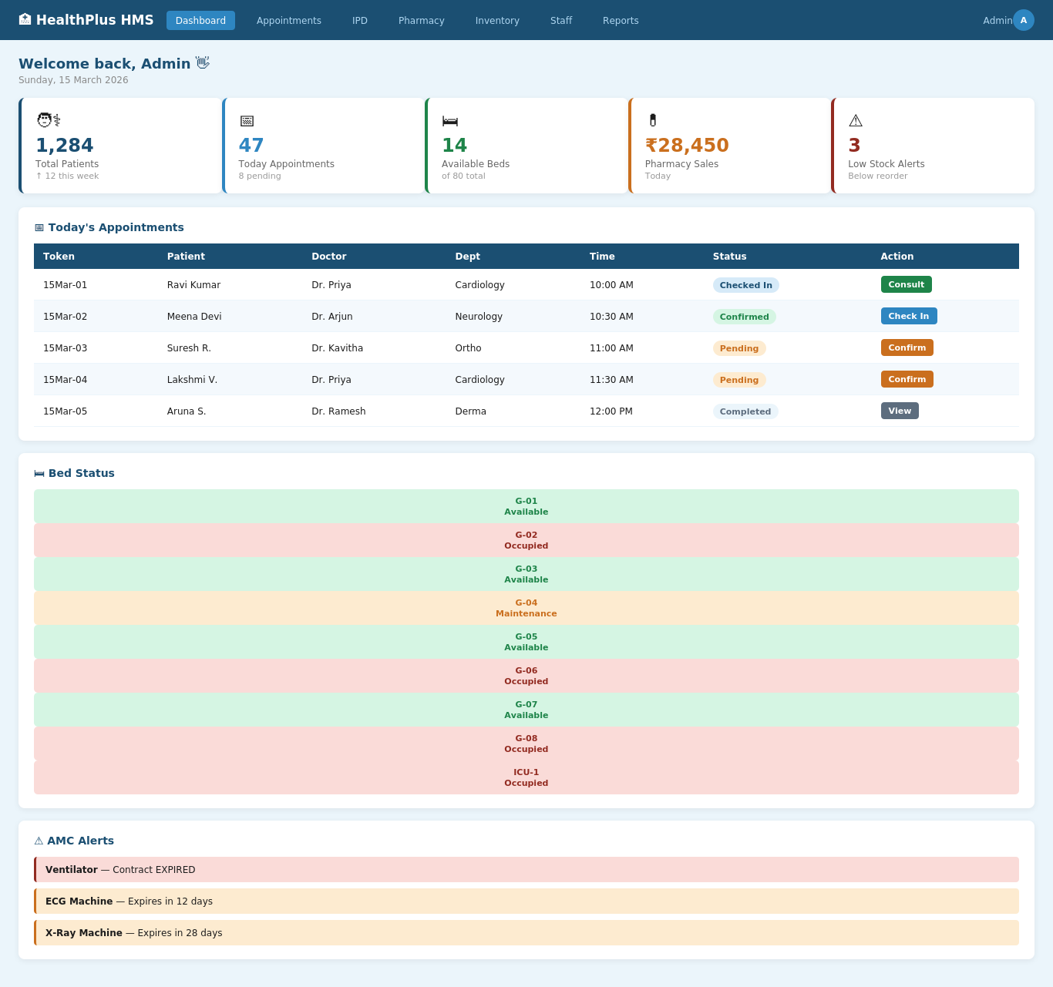
Admin Dashboard
🔒 healthplushms.com/dashboard
Central command centre — real-time hospital overview
✓
Live KPI cards: patients, beds, revenue, alerts
✓
Today's appointment queue with status actions
✓
Colour-coded bed map across all wards
✓
AMC expiry warnings (yellow/red urgency)
✓
Role-based redirect on login
✓
Quick access to all modules

Slide 8
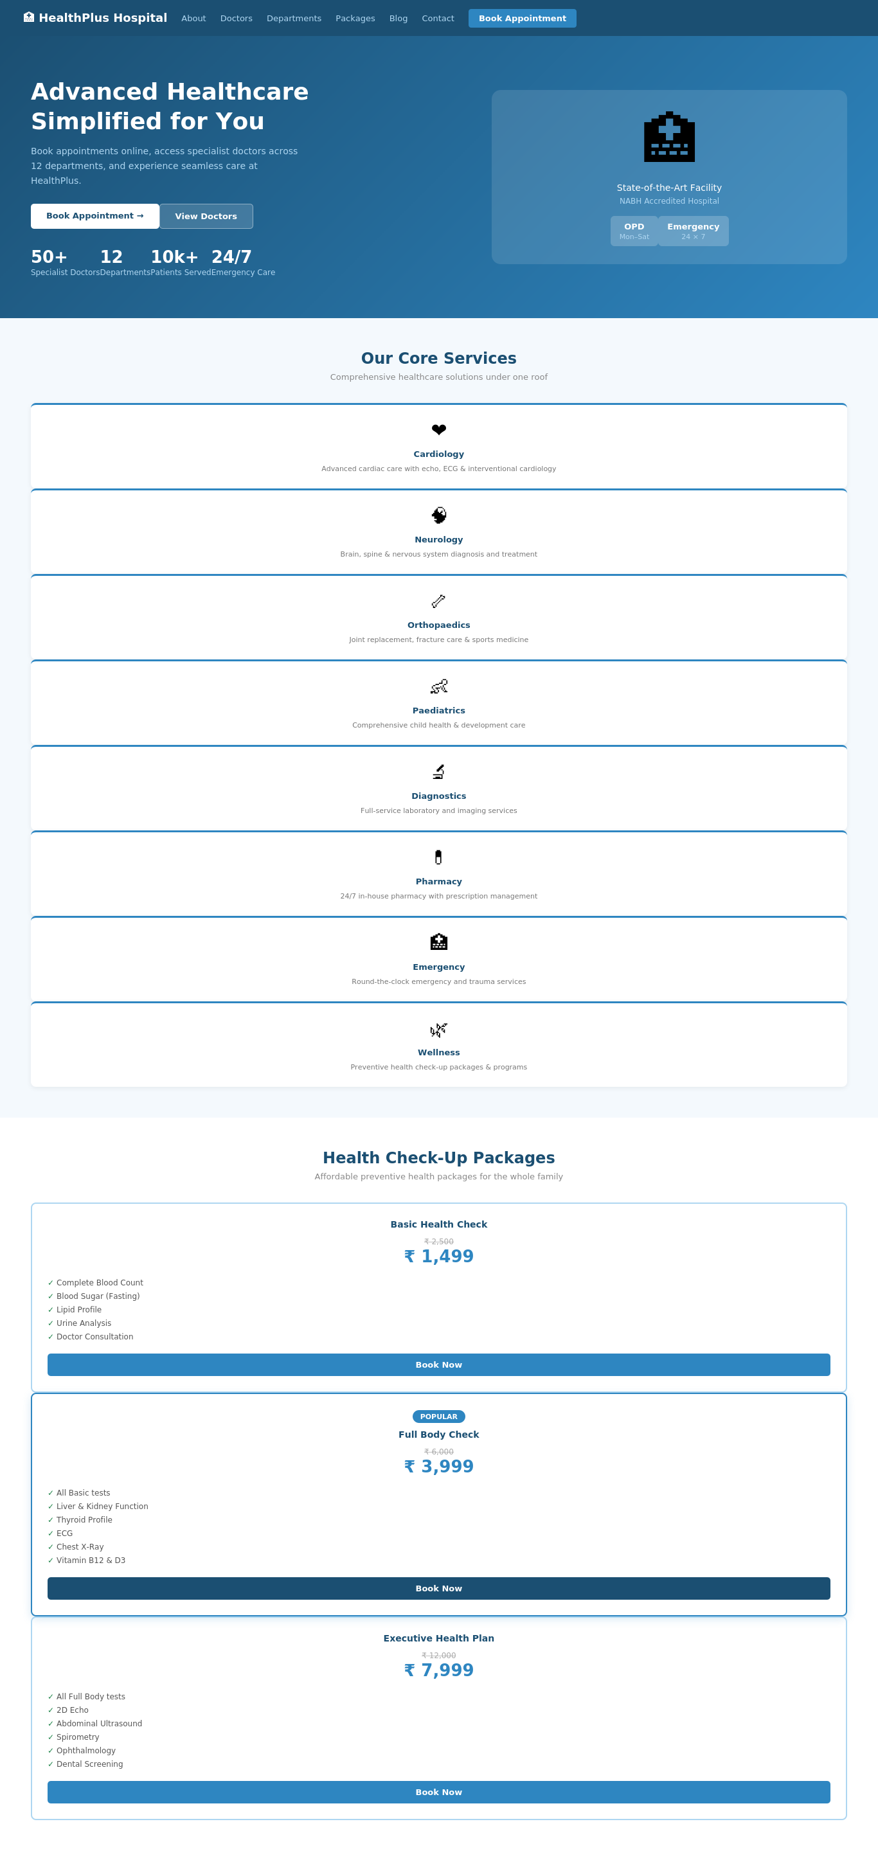
Public Patient Portal
🔒 healthplushms.com/home
Professional public website — patient's digital front door
✓
Modern hero section with CTA buttons
✓
8 department service cards
✓
Health packages with pricing & inclusions
✓
Doctor directory with search & filter
✓
Featured doctor badges
✓
Blog, reviews & career portal

Slide 9
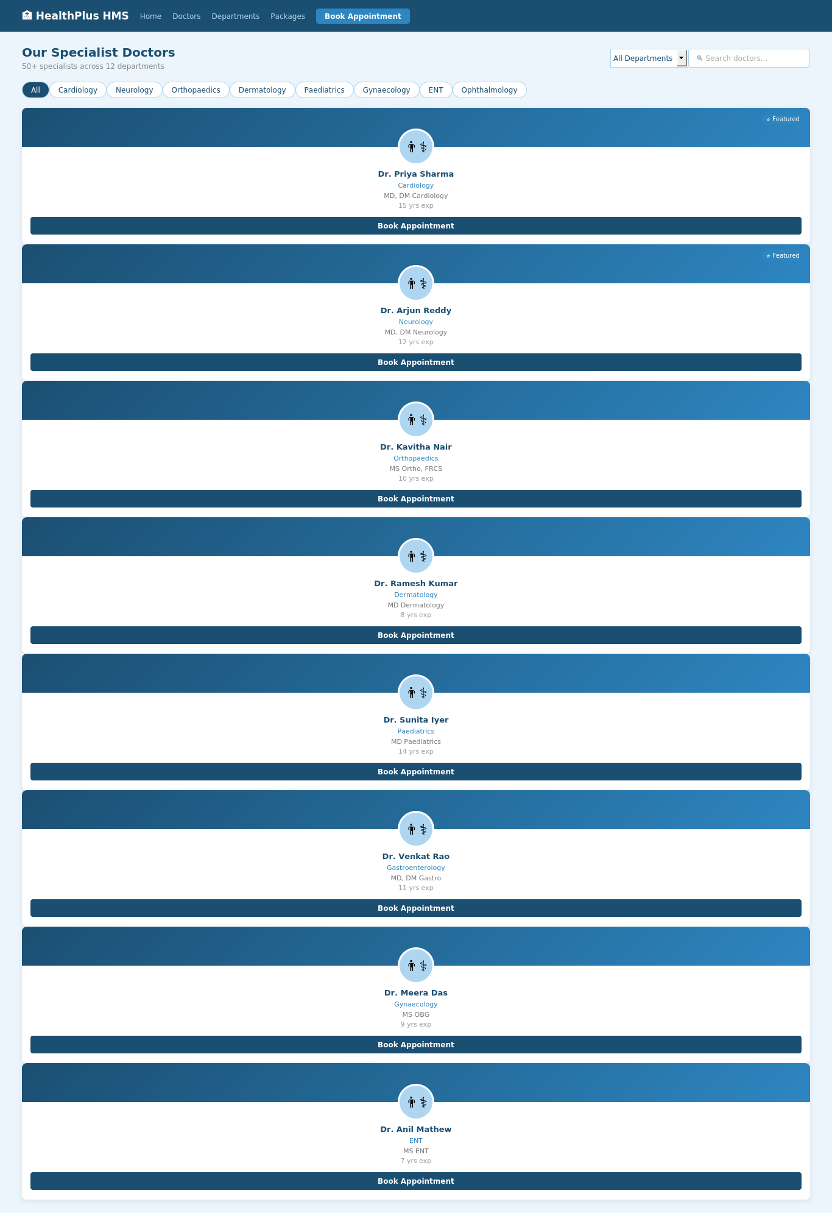
Doctor Directory
🔒 healthplushms.com/doctors
Searchable & filterable specialist doctor listing
✓
Filter by department / speciality
✓
Search by doctor name
✓
Photo, qualifications, experience per card
✓
⭐ Featured badge for highlighted doctors
✓
Direct 'Book Appointment' on every card
✓
SEO-friendly slug-based URLs

Slide 10
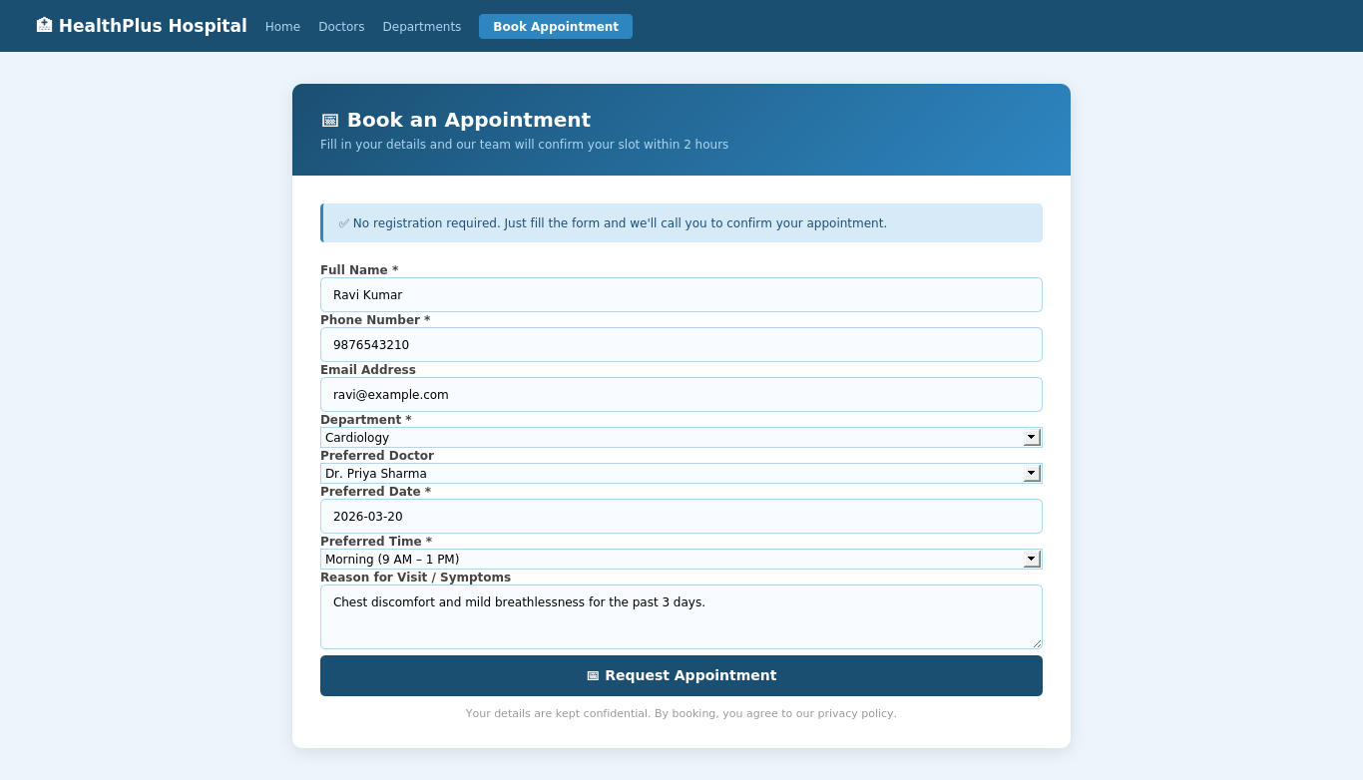
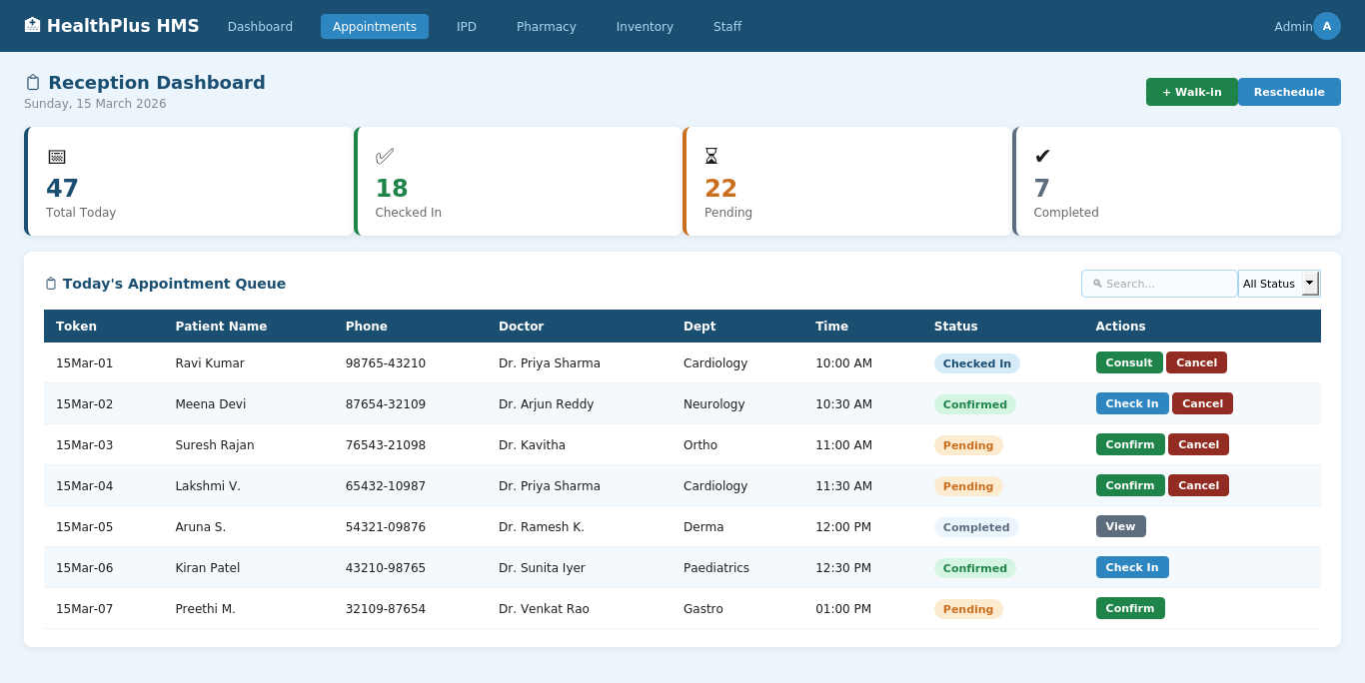
Appointment Booking & Reception
🔒 healthplushms.com/book
🔒 healthplushms.com/reception
Public Booking Form
Staff Reception Dashboard
No registration needed — fills in under 60 seconds
Full queue with confirm, check-in, reschedule & cancel
Token IDs Auto-Generated
Daily Queue View
Status Badges
Walk-in Support
SMS-ready Architecture

Slide 11
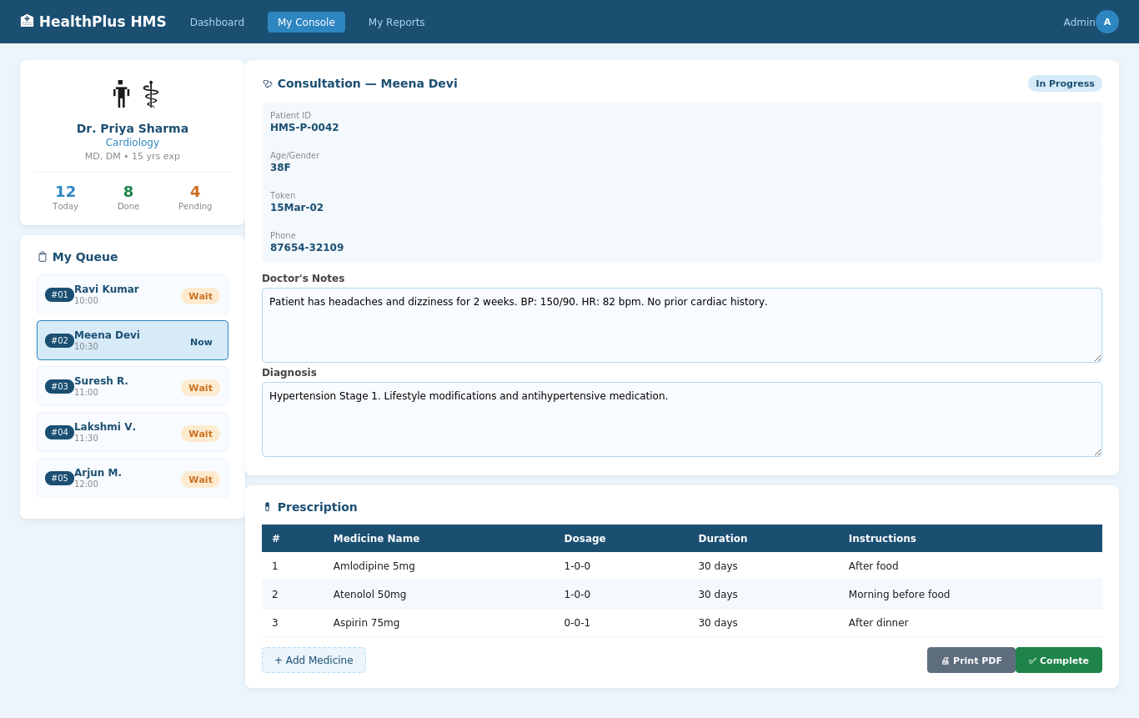
Doctor Console & Digital Consultation
🔒 healthplushms.com/console
Clinical workflow: notes, diagnosis & digital prescription on one screen
✓
Personal queue showing doctor's own schedule
✓
Clinical notes & diagnosis fields
✓
Structured prescription: dose, duration, instructions
✓
One-click PDF prescription generation
✓
Pharmacy status: Pending → Dispensed
✓
Next visit date scheduling

Slide 12
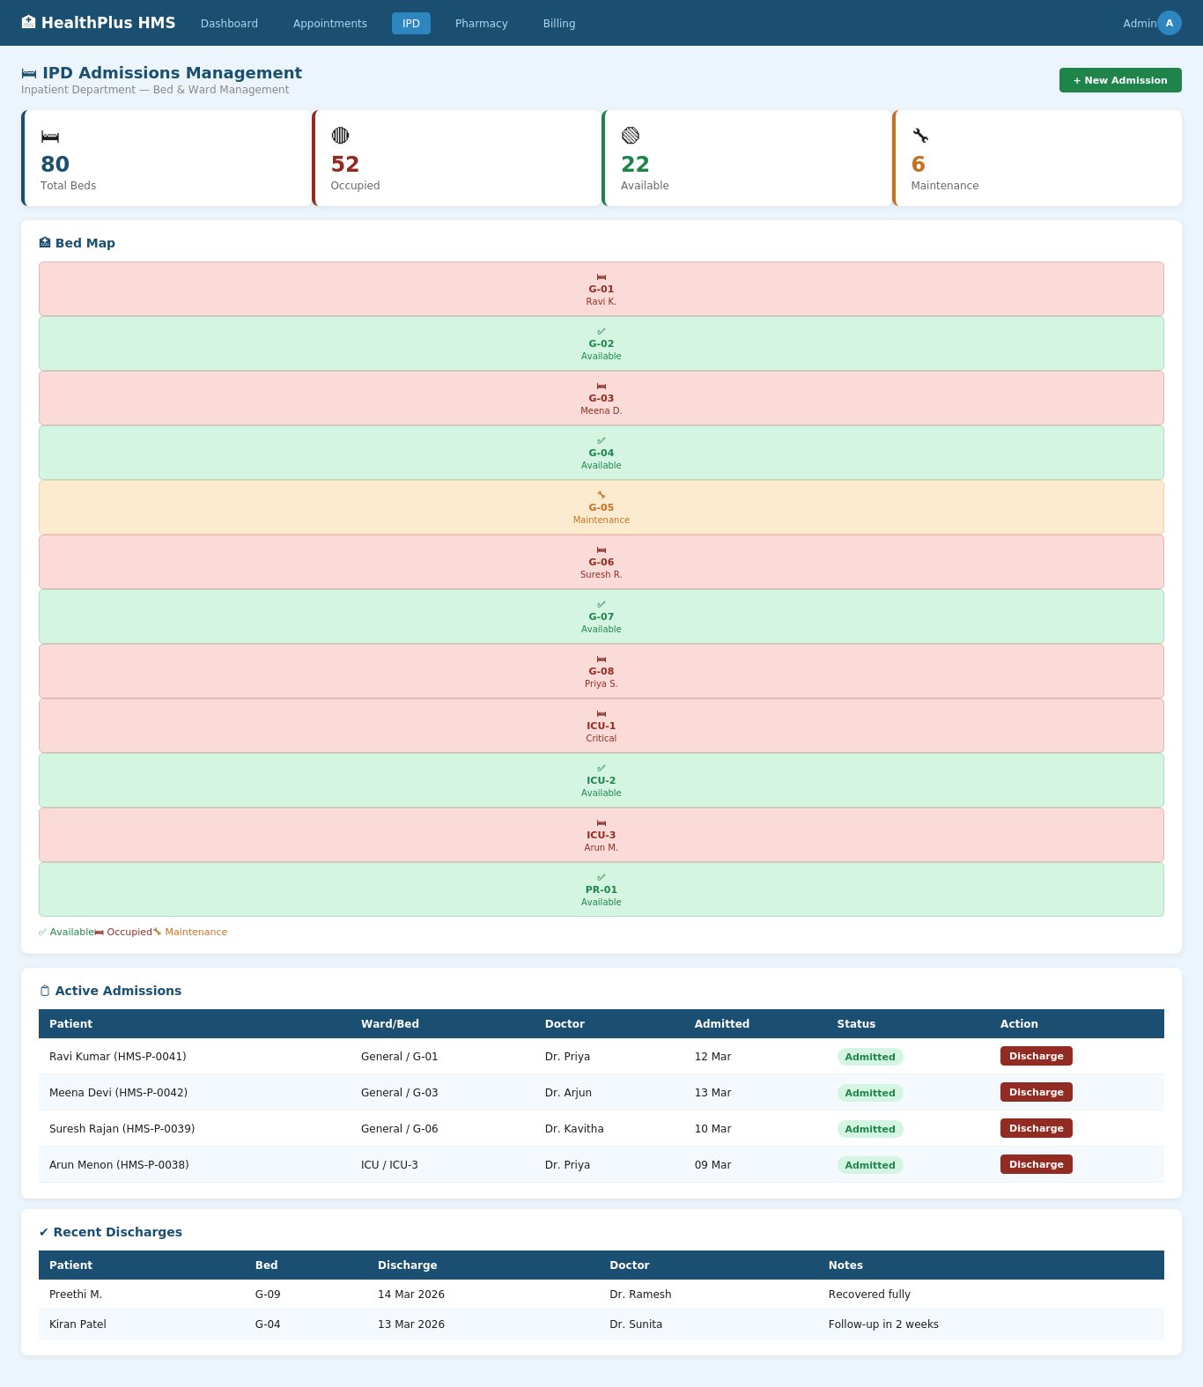
IPD Admissions & Bed Management
🔒 healthplushms.com/ipd
Complete inpatient department management with live bed tracking
✓
Ward types: General, ICU, Private, Emergency
✓
Visual bed map — colour-coded status
✓
Auto bed-status on admit & discharge
✓
Per-bed daily pricing for billing
✓
Discharge notes & timestamp capture
✓
Linked to pharmacy & billing modules

Slide 13
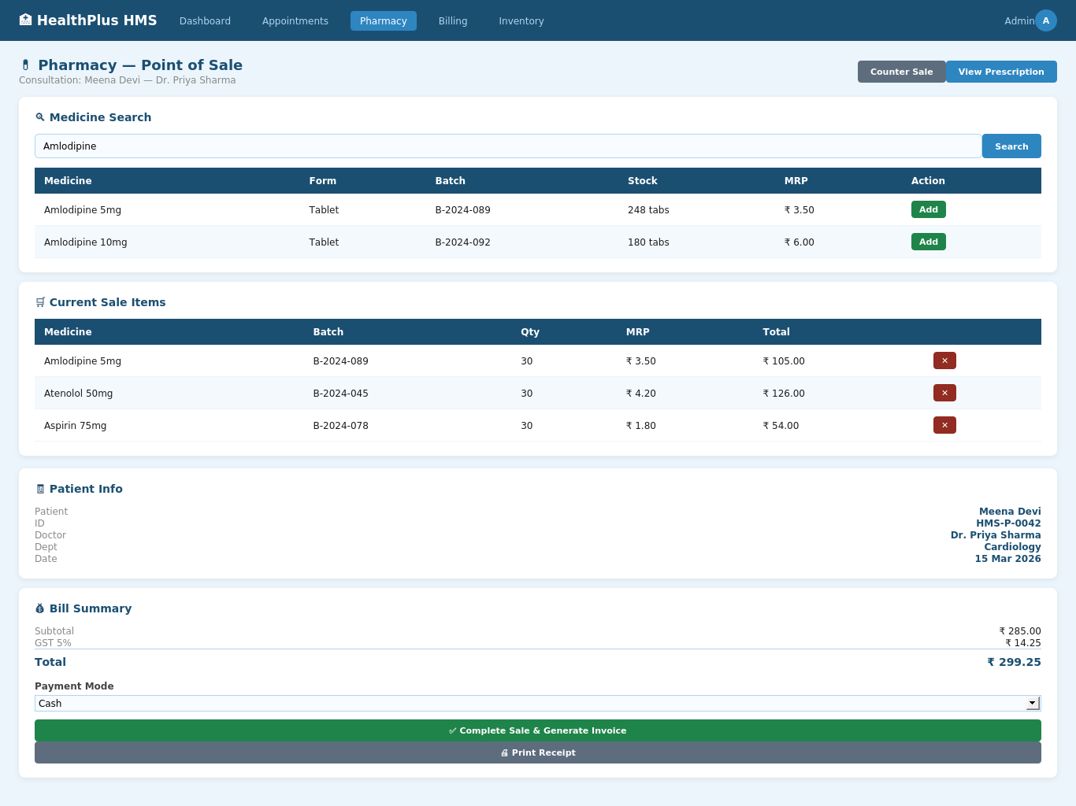
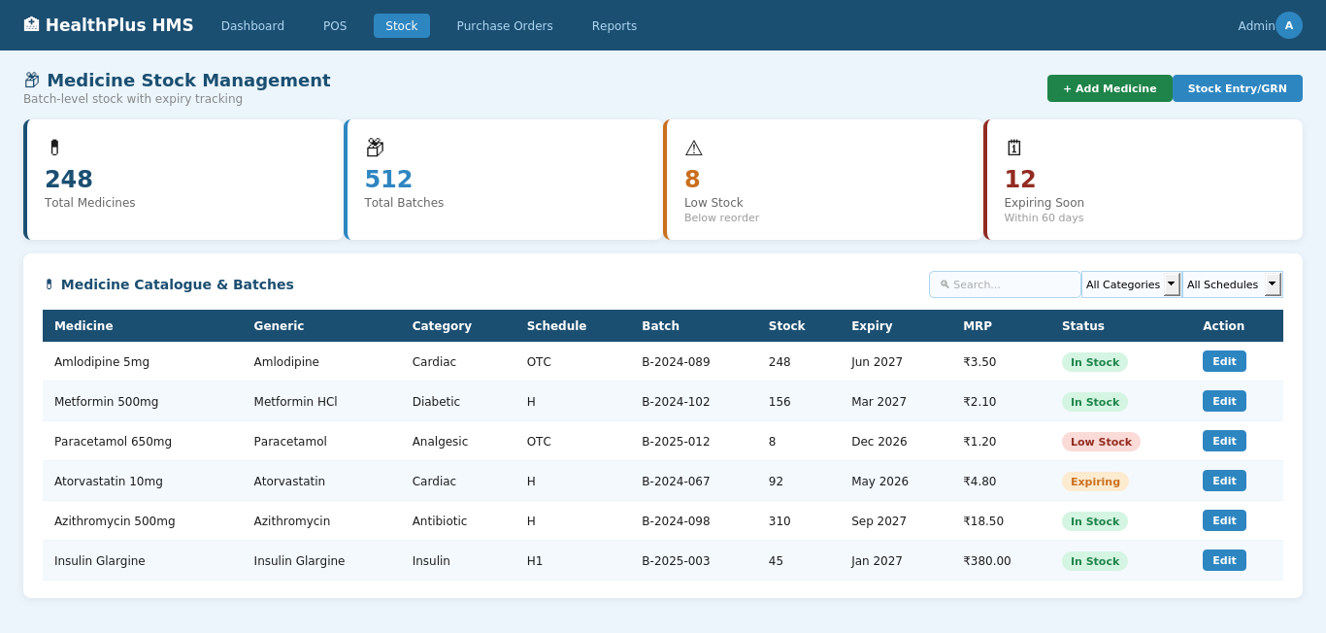
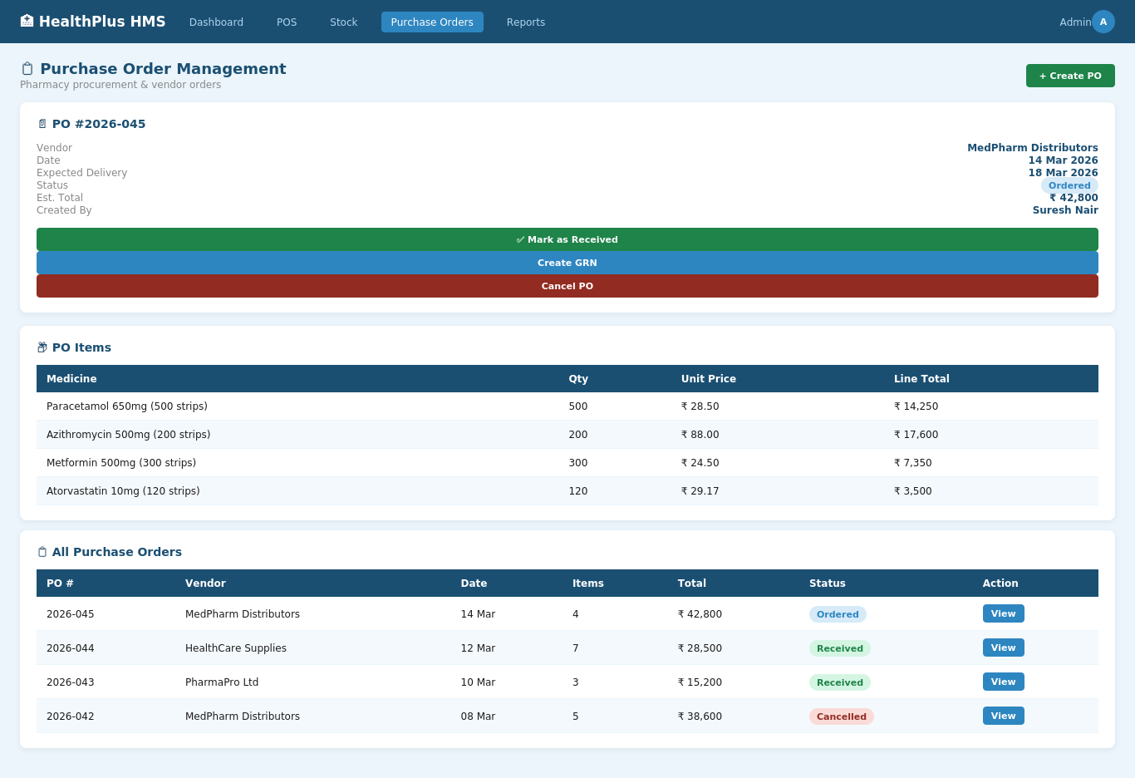
Pharmacy Management
🔒 healthplushms.com/pos-terminal
🔒 healthplushms.com/stock-management
🔒 healthplushms.com/purchase-orders
POS Terminal
Stock Management
Purchase Orders
✓
Batch-level stock tracking
✓
Expiry date alerts
✓
OPD + IPD linked POS
✓
Medicine Returns module
✓
Auto stock deduction on sale
✓
GRN / Stock Entry workflow

Slide 14
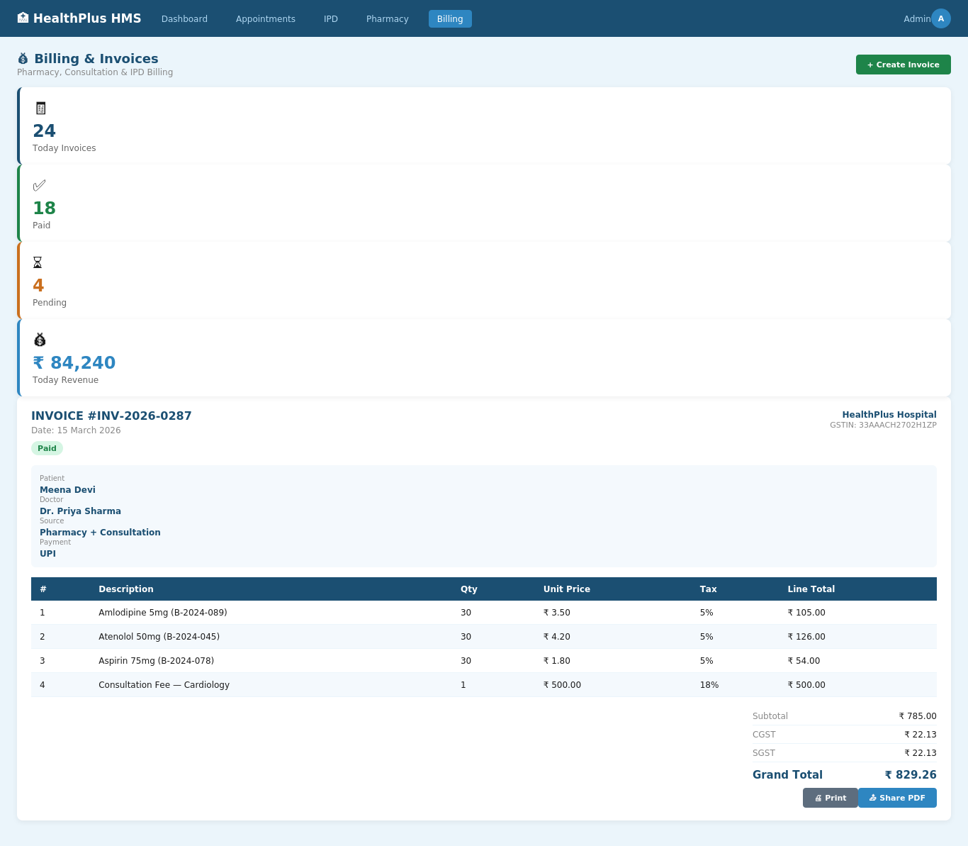
Billing & GST Invoicing
🔒 healthplushms.com/billing
Unified, GST-compliant invoicing for all revenue sources
✓
Invoices for pharmacy, OPD & IPD charges
✓
Auto CGST + SGST split per line item
✓
Payment modes: Cash, Card, UPI, Insurance
✓
Invoice status: Pending → Paid → Cancelled
✓
PDF invoice generation & sharing
✓
Today's revenue & collection dashboard

Slide 15
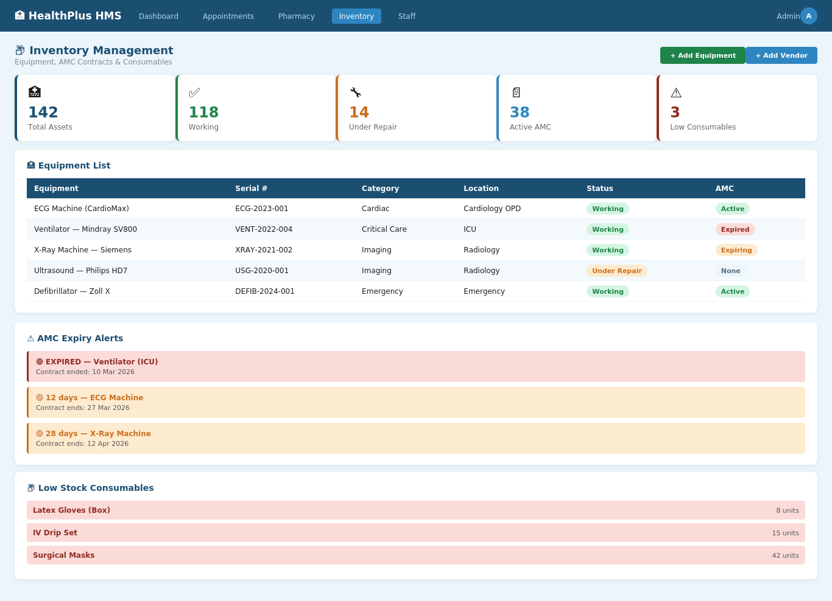
Inventory & Asset Management
🔒 healthplushms.com/inventory
Full equipment lifecycle tracking with AMC alerts & QR codes
✓
Equipment registry with serial, warranty & status
✓
Auto QR code generation on asset save
✓
AMC tracker: 🟡 expiring 🔴 expired
✓
Vendor directory — shared with Pharmacy
✓
Consumables stock with low-stock alerts
✓
Maintenance log & depreciation calculation

Slide 16
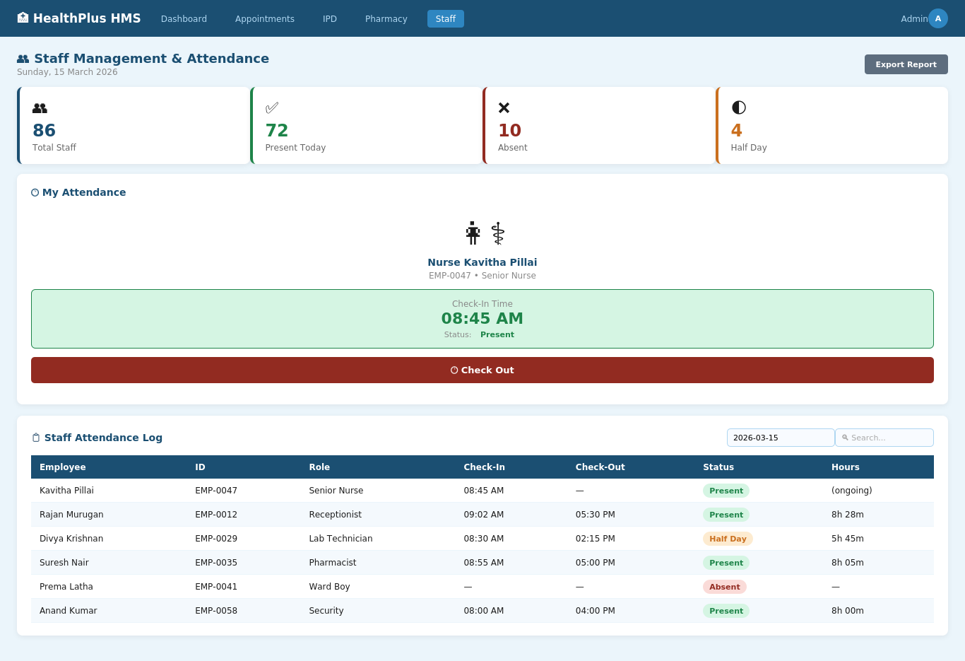
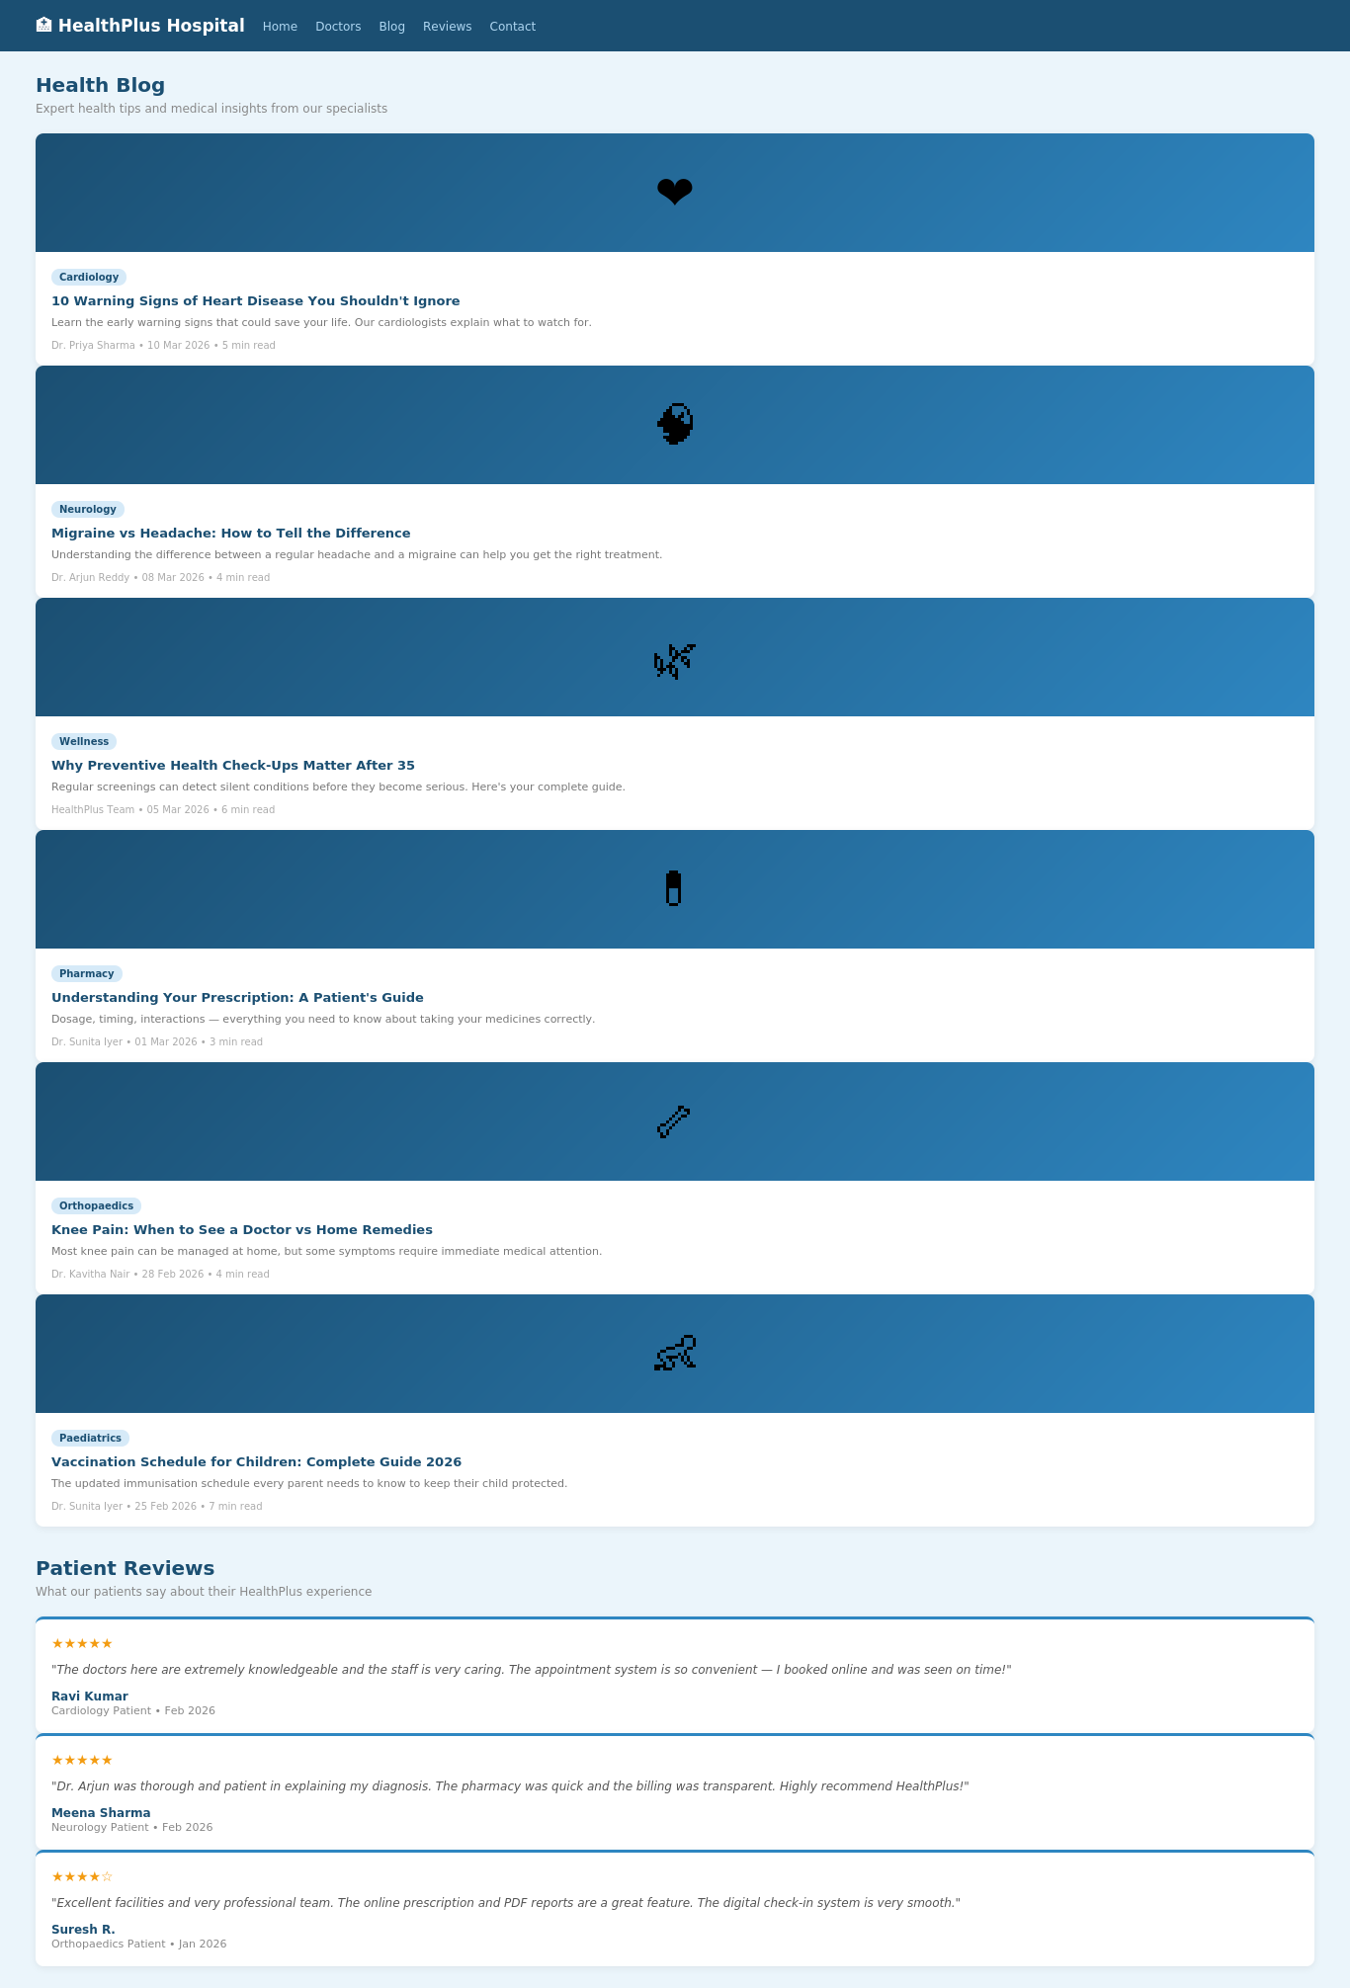
Staff Management, Blog & Reviews
🔒 healthplushms.com/attendance
🔒 healthplushms.com/blog
Staff Attendance
Blog & Patient Reviews
Digital clock-in/out with daily attendance log
Health content publishing & testimonial display
• Employee Profiles
• Daily Attendance Log
• Admin Reports
• Health Articles
• Draft/Published Workflow
• Patient Testimonials

Slide 17
04
Technology Stack
Frontend
Django Templates + HTMX + Custom CSS
Server-rendered HTML with dynamic partial updates — no heavy JS framework. Fast, lightweight, and accessible.
Backend
Python 3 + Django 5.2 + Gunicorn
Industry-standard web framework with built-in ORM, admin, auth, and security. Gunicorn runs multi-worker WSGI in production.
Database
PostgreSQL 15 (Docker)
Enterprise-grade relational database. Runs in Docker for local dev, scales to AWS RDS for production.
PDF / QR
ReportLab + qrcode library
Auto-generates prescription PDFs and equipment QR code images — triggered on model save with no manual steps.
Infrastructure
Docker + Nginx + AWS EC2 + GitHub Actions
Dockerized services, Nginx reverse proxy, EC2 deployment. GitHub Actions CI/CD deploys every push to main branch automatically.

Slide 18
05 Pricing & Packages
One-time software licence fee • All prices in Indian Rupees
MOST POPULAR
Starter
Professional
Enterprise
Up to 50 beds
50 – 200 beds
200+ beds
₹ 8,00,000
₹ 18,00,000
Custom Quote
✓
Core Modules (OPD, Portal, Blog)
✓
Everything in Starter
✓
Everything in Professional
✓
Patient Registry & Records
✓
Pharmacy POS & Stock Mgmt
✓
Advanced Reports & Analytics
✓
Appointment Booking
✓
Billing & GST Invoicing
✓
CI/CD Deployment Pipeline
✓
Staff Attendance
✓
IPD Admissions & Bed Map
✓
Cloud Setup (AWS EC2)
✓
Doctor Console + Prescription PDF
✓
Purchase Orders & GRN
✓
Custom Branding / White-Label
✓
1 Year Free Support
✓
Inventory + AMC Alerts
✓
Lab / PACS Integration (add-on)
✓
2 Training Sessions
✓
QR Code Asset Tracking
✓
Dedicated Account Manager
✓
3 Training Sessions
✓
Priority Support (SLA)

Slide 19
06
Implementation Timeline
Total: 10 weeks from contract signing
Week
1–2
Week
5–6
Week
9
Setup & Core
Finance & Pharmacy
Testing & Training
Server (EC2), Docker, DB, Auth, Public Portal, Doctor Module
Pharmacy POS & Stock, Purchase Orders & GRN, Billing & GST Invoicing
User Acceptance Testing, Bug Fixes, 3 Staff Training Sessions
Week
3–4
Week
7–8
Week
10
Clinical Modules
Operations
Go-Live
Appointments, Doctor Console, Consultation, PDF Prescriptions, IPD Admissions
Inventory, AMC Alerts, QR Codes, Staff Attendance, Blog, Reviews
Production Deployment, CI/CD Pipeline, Handover Documentation

Slide 20
07
Next Steps
01
Schedule a Live Demo
We walk through every module with your team — typically 2 hours. You see the actual system, ask questions, and evaluate fit.
02
Select Your Package
Choose Starter, Professional, or Enterprise based on your bed count and required modules. We can customise any tier.
03
Sign & Advance Payment
Execute the Software Development Agreement and process 30% advance. This locks in your timeline and dedicated developer.
04
Data Migration Planning
Share your existing doctor list, patient records, and medicine catalogue. We plan the migration and kickoff the project.
05
10-Week Delivery & Go-Live
Phased delivery with weekly milestones. Your team is trained and the system goes live at the end of Week 10.
📧 sales@healthplushms.com • 📞 +91 98765 43210 • 🌐 www.healthplushms.com • Proposal valid for 30 days

