Slide 1
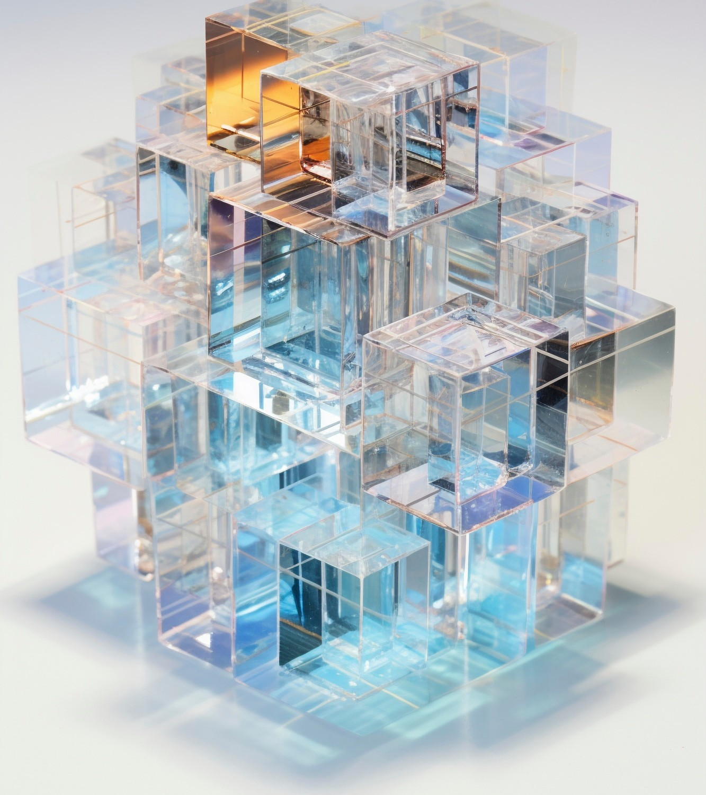

Introduction to Java
Architecture
Java Architecture is a powerful framework that enables developers to build scalable and robust applications. This presentation will explore its core components, principles, and best practices, ensuring a comprehensive understanding of how to design effective solutions using Java. Let's embark on this informative journey.

Slide 2






Core Components of Java
Architecture
The core components of Java architecture include the Java Virtual Machine (JVM), Java Runtime Environment (JRE), and Java Development Kit (JDK). Each component plays a crucial role in executing and developing Java applications, ensuring platform independence and enhanced
performance.

Slide 3



Best Practices for Robust
Solutions
To architect robust solutions, developers should follow best practices such as modular design, error handling, and performance optimization. These practices not only enhance code maintainability but also improve application resilience, ensuring that systems can withstand unexpected
challenges.

Slide 4
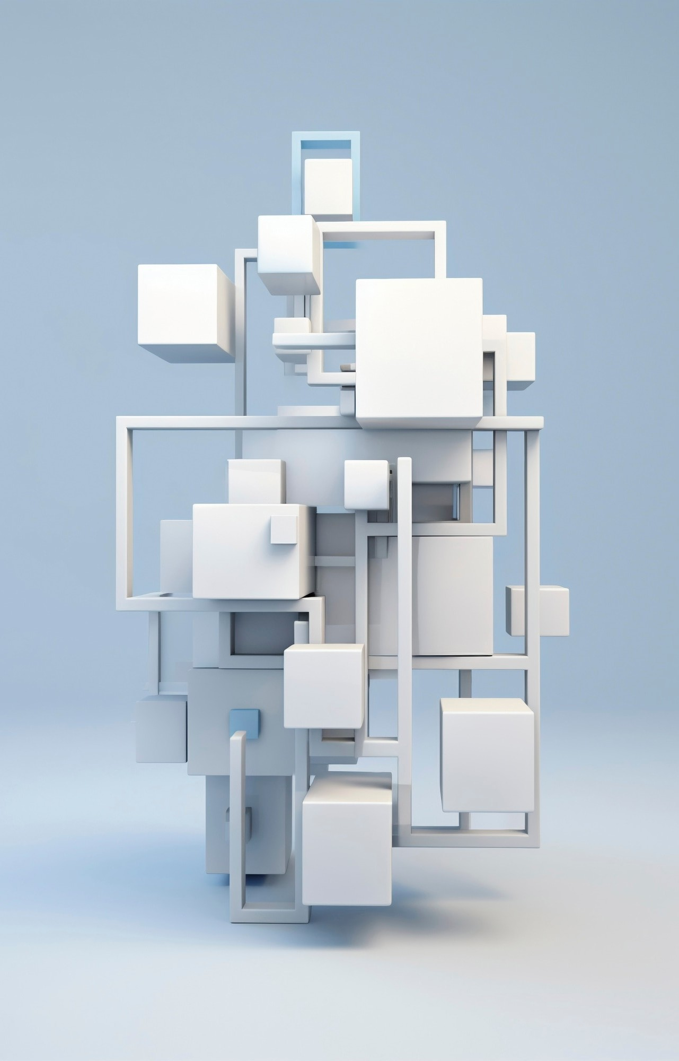
Architecting Robust Solutions: An In-Depth
E ploration of Java Architecture

Slide 5
Conclusion and Key Takeaways
In conclusion, understanding Java architecture is essential for building robust applications. By leveraging its core components and adhering to best practices, developers can create scalable and efﬁcient solutions. Continuous learning and adaptation are key to mastering this powerful framework.

Slide 6
Thanks!
Do you have any questions? youremail@email.com
+91 620 421 838
www.yourwebsite.com @yourusername

