Slide 1
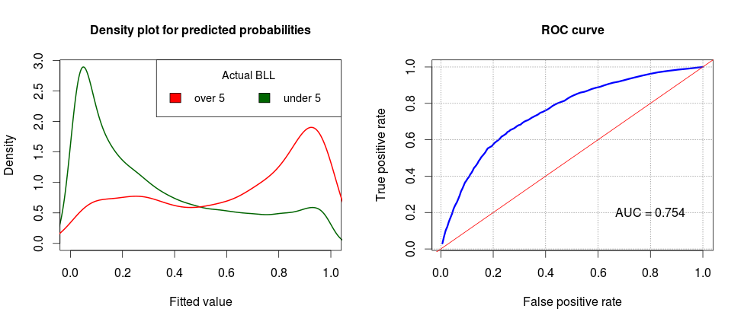
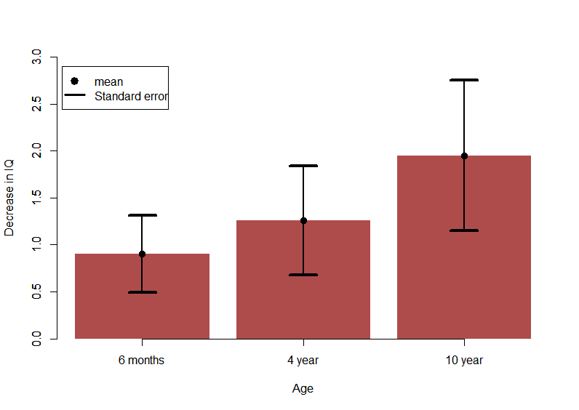
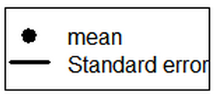

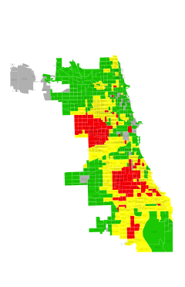

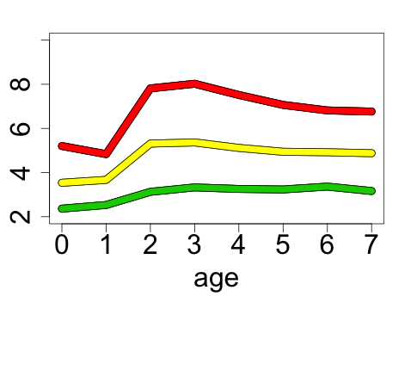
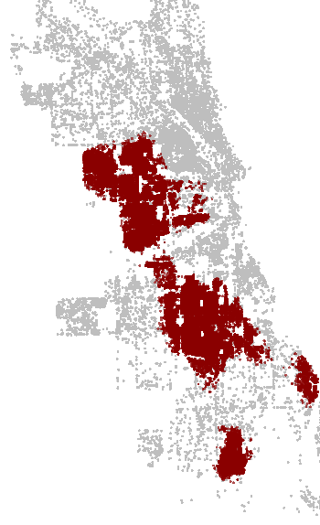
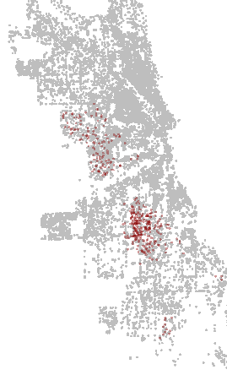

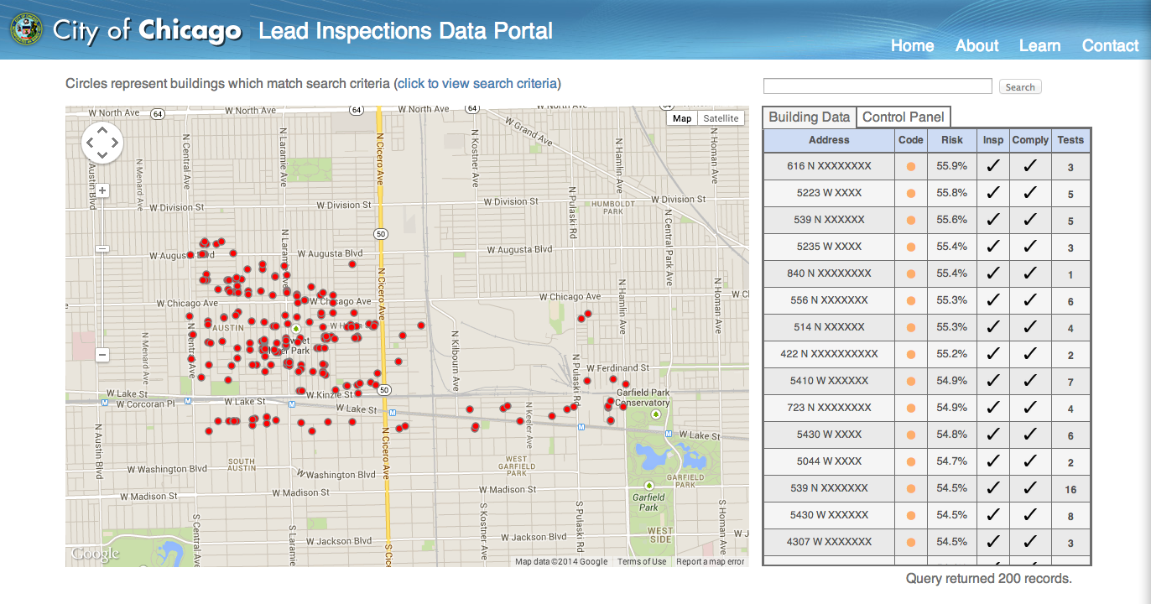

Preventing Lead Poisoning in Chicago
Joe Brew (Univ. of Florida), Alex Loewi (Carnegie Mellon),
Subhabrata Majumdar (Univ. of Minnesota), Andrew Reece (Harvard)
Mentor: Eric Rozier (Univ. of Miami)
The problem
From 1995 to 2013, 298,675 Chicago children (29% of those tested) were poisoned by lead (blood lead level [BLL] >5 micrograms per deciliter). Though the incidence of lead poisoning has declined drastically (fewer than 3% in 2013), the consequences for those sickened are severe and life-long. Lead poisoning is associated with intellectual disability, systemic organ malfunction, aggression, and in severe cases, death.
The Predictive Model
Exposure Prevention:
Estimating Life Trajectories
Current medical practice is to act only once a child exhibits a level of lead in the blood that is considered dangerous. We found canonical trajectories by imputing tract-level trajectories, then using spectral clustering to pick out exemplars. These suggest a trajectory can be predicted very early in life, allowing for preventative interventions.
This work is leading us to consider policy recommendations for child lead testing that differ quite dramatically from the current practice.
Density plot for predicted probabilities
ROC curve
Density plot for predicted probabilities
ROC curve
True positive rate
Density
True positive rate
Density
Predicted probability
False positive rate
Predicted probability
False positive rate
Fig 2: Model outputs: (left) Densities of two sub-populations in test data
(right) ROC curve of predicted probabilities
To narrow things down, we built a suite of models for predicting BLL > 5, using features like age and condition of building, poverty rate of neighborhood, and history of lead exposure at that location. After testing, our best performing model was a downsampled aggregated random forest with the following characteristics:
Downsampling of majority class (i.e. <5 class) to tackle rare occurrence of high BLL
Separate random forests made on 25 rebalanced samples from training data
All predicted probabilities for a test sample averaged to get final probability
Fig. 1: Mean decrease in IQ points for 1 mcg/dL increase in BLL
(source: Mazumdar et al. Environmental Health 2011, 10:24)
The task
The principal pathway of childhood exposure to lead is through the home. Upon notification of a poisoned child, the Chicago Department of Public Health (CDPH) inspects that child’s home for lead hazards. Our team was assigned the task of helping CDPH go from a reactive to a proactive system in which homes predicted to be a potential source of exposure would be inspected before a child falls ill.
Fig. 4: Lead Trajectories (left) Risk by Census Tract
(right) Mean Lead Levels at different Ages
The greatest issue with the imputation of the trajectories is the possibility of systematic bias around child age at testing. We are working with the State of Illinois to get birth record data to resolve this, and other, questions.
Current system
Child tests positive for lead poisoning
CDPH performs a home inspection
If present, lead hazard is remediated
Child’s health improves
The Tool
We have built an interactive, web-based application to assist the CDPH inspections team in prioritizing which buildings to visit, as well as to understand the history of those buildings.
Our goal
Fig. 3: Buildings targetted for inspection using current model (left) and projected model with birth data incorporated (right)
House is predicted to be a source of lead
CDPH performs a home inspection
If present, lead hazard is remediated
Child never gets sick
Improvements
Modeling brings the number of “high-risk” (probability of lead poisoning greater than 0.5) buildings targeted for inspection down from 200,000 to approximately 42,000. But that number still remains too high for feasibility. Our next step is to incorporate birth data so that we can target only homes with a child at the age of greatest risk (approximately 2 years old). Doing so is expected to bring our number of “high-risk” homes down to fewer than 500 (Fig. 3).
The data
We had four principal data sources: 20 years of BLL tests, CDPH inspections data, Cook County assessor data, 2010 census.

