Slide 2
.
Speech Emotion Recognition Using Deep Learning
Enrollment number:106
Team Members:
2103A52029 – P . Tejaswi
2103A52006 – B . Harini Sri
2103A52007 – B . Anvitha
2103A52012 – D . Bala Varshitha
2103A52023 – M . Vyshnavi
Supervised by:
Dr . P. Chandra Shaker Reddy
Professor Dept. of CS&AI
SR University

Slide 3
.
CONTENTS
S.NO TITLE PG.NO
Abstract 04
Motivation 05
Objectives 06
Introduction 07
Literature Survey 08
Limitations 18
Problem statement 20
Architectural Design 21
Process Flow 22
Implementation and results 24
Conclusion and future scope 28

Slide 4
.
ABSTRACT
This research presents a unique and meticulously organized dataset comprising 2800 audio recordings in WAV format, featuring two actresses aged 26 and 64 years. The dataset is structured to investigate the expression of seven distinct emotions (anger, disgust, fear, happiness, pleasant surprise, sadness, and neutral) across 200 target words. The audio files, embedded within their respective emotion and actress folders, provide a rich resource for training and evaluating models in Speech Emotion Recognition (SER). Researchers and practitioners in the fields of artificial intelligence, affective computing, and emotion analysis can leverage this dataset for developing and testing robust SER systems.The utilization of the WAV format ensures high-quality audio data, allowing for precise analysis of subtle acoustic features related to emotional expression.

Slide 5
MOTIVATION
Speech emotion recognition has several applications in modern technology.
Human-Computer Interaction (HCI): Computers can understand not just words, but also emotions behind them, leading to more effective interactions.
Internet of Things (IoT): Voice assistants like Alexa rely on understanding emotions in voice commands for better user experience. Studies predict 12% of all IoT applications will be voice-controlled by 2022.
AI and NLP applications: Recognizing emotions in voice commands is crucial for complex systems like self-driving cars . In emergencies, user emotions can help activate safety features even if commands are unclear.
Call centers: Automated calls can be efficiently routed to human agents based on the caller's emotional state.

Slide 6
OBJECTIVES
In a Speech Emotion Recognition project leveraging deep learning with LSTM models, several objectives are paramount. Firstly, the system should accurately classify the emotional content of spoken utterances into predefined categories such as happiness, sadness, anger, etc. Secondly, it should exhibit robustness across various speakers, languages, and recording conditions to ensure its practical applicability in real-world scenarios.
LSTM models require substantial computational resources for training and inference, which can be a barrier for real-time applications. Additionally, the model should strive for efficiency in both computational resources and inference time, enabling its deployment in resource-constrained environments like mobile devices or embedded systems.
LSTMs, while effective at capturing temporal dependencies in speech, can struggle with complex, nonlinear emotional nuances that are embedded in the prosodic features like tone, pitch, and rhythm. This results in challenges with generalizing across different speakers, accents, and languages due to variations in speech patterns and also scarcity and imbalance of labeled emotion datasets.

Slide 7
INTRODUCTION
Speech Emotion Recognition with Deep Learning: Key Points
Human Voice Reveals Emotions: We convey emotions not just through words, but also through variations in tone, pitch, and rhythm .
Speech Emotion Recognition (SER): This technology aims to decode these hidden emotional messages in spoken language.
Deep Learning Revolutionizes SER: Deep learning excels at analyzing vast amounts of data, enabling it to capture complex emotional patterns in speech .
Beyond Traditional Methods: Deep learning goes beyond limitations of traditional methods, focusing on intricate nuances of human expression.
Wide-ranging Applications: Speech emotion recognition with deep learning has potential applications in various fields; Healthcare & Education: Personalized responses based on emotional state (calming voice for stress, enthusiastic tone for excitement) and Customer Service: Bots that empathize with customer frustrations and offer solutions.

Slide 8
.
LITERATURE SURVEY
1.Comparison of Multiple Classifiers for Audio-Visual Speaker Recognition System.
This paper was published by Prachi Shrivastava in the year 2023. In this paper, the focus is on Audio-Visual Automatic Speaker Recognition (AV-ASR), an emerging field aimed at enhancing person authentication by integrating both audio and visual modalities. Recognizing the susceptibility of solely relying on audio or video features to interference, the study introduces a novel set of hybrid visual features, comprising texture-based, appearance-based, and shape-based features. Appearance-based features utilize Discrete Cosine Transform (DCT), while shape-based features employ Active Appearance Model (AAM). Through experimental classification approaches, the proposed AV-ASR model achieves an impressive recognition accuracy of 80.0%, surpassing results obtained by various classifiers. This highlights the effectiveness of integrating hybrid visual features in AV-ASR systems for improved accuracy in person authentication tasks.

Slide 9
.
2. Speech Emotion Recognition through Hybrid Features and Convolutional Neural Network
This paper was published by Alluhaidan in the year 2023.This paper focuses on enhancing Speech Emotion Recognition (SER) systems by combining Mel frequency cepstral coefficients (MFCCs) with time-domain features (MFCCT) and leveraging convolutional neural networks (CNNs). Traditional SER approaches often rely solely on MFCCs, but this study proposes that incorporating time-domain features alongside MFCCs can improve emotion representation accuracy. By feeding the hybrid MFCCT features into a CNN model, the researchers achieved remarkable results, outperforming both MFCCs and time-domain features on multiple datasets, including Emo-DB, SAVEE, and RAVDESS, with accuracies of 97%, 93%, and 92% respectively. Moreover, the CNN model exhibited superior performance compared to conventional machine learning classifiers commonly used in SER. The findings suggest that the proposed hybrid features, combined with CNN architecture, hold significant promise for enhancing emotion recognition accuracy across diverse SER datasets, showcasing their potential for widespread adoption in various applications across psychology, medicine, education, and entertainment.

Slide 10
.
3. Automatic Speech Emotion Recognition Using Machine Learning.
This paper was published by Leila Kerkeni, in the year 2019. This paper presents a comprehensive investigation into Speech Emotion Recognition (SER) systems, focusing on theoretical definitions, affective state categorization, and emotion expression modalities. The study develops an SER system utilizing various classifiers and feature extraction methods, particularly Mel-frequency cepstrum coefficients (MFCC) and modulation spectral (MS) features. Feature selection techniques are employed to identify the most relevant feature subset, and several machine learning paradigms, including recurrent neural networks (RNN), multivariate linear regression (MLR), and support vector machines (SVM), are utilized for emotion classification. Evaluations conducted on Berlin and Spanish databases reveal significant insights, with all classifiers achieving an 83% accuracy for the Berlin dataset when speaker normalization and feature selection are applied. Notably, the RNN classifier achieves the highest accuracy of 94% for the Spanish dataset without speaker normalization and with feature selection. These findings underscore the effectiveness of different classifiers and feature extraction methods in SER, offering valuable insights into optimizing emotion recognition systems for diverse linguistic contexts and datasets.

Slide 11
.
4. Automatic speech emotion detection using hybrid of gray wolf optimizer and naïve Bayes.
This paper was published by Gomathi in the year 2023.The paper provides the past decade, automatic speech emotion detection has presented a significant challenge in the realm of human-computer interaction. This study addresses this challenge by focusing on detecting seven primary emotions – neutrality, happiness, sadness, fear, surprise, disgust, and anger – through speech signals. Unlike previous approaches that utilized separate databases, this study merges the SAVEE and TESS datasets to create a comprehensive database for emotion identification. The main objective is to characterize emotions using this robust dataset. To achieve this, the study proposes a novel machine learning algorithm combining Mel-frequency cepstral coefficients for feature extraction with a hybrid of gray wolf optimizer and naïve Bayes for classification. The results demonstrate that the proposed classification algorithm outperforms existing machine learning methods, showcasing its potential for enhancing speech emotion recognition accuracy.

Slide 12
.
5. A Comprehensive Survey of Convolutions in Deep Learning: Applications, Challenges, and Future Trends
This was published by Mohsen Ansari in the year 2024. The paper focuses ,in today's digital landscape, Convolutional Neural Networks (CNNs) stand at the forefront of Deep Learning (DL), serving as invaluable tools for a wide array of computer vision tasks. This survey paper delves into the diverse spectrum of CNN architectures, ranging from 1D to 3D CNNs, as well as specialized variants like dilated, grouped, and attention-based convolutions. By providing a comparative analysis of these CNN types, the paper elucidates their unique structures, strengths, weaknesses, and practical applications across different domains. Furthermore, it explores emerging research fields such as 6D vision, generative models, and meta-learning, shedding light on the evolving landscape of CNN research and development. Ultimately, this comprehensive examination aims to offer insights into the performance, limitations, and future trends of CNN architectures, guiding researchers and practitioners towards novel advancements in the field of computer vision.

Slide 13
.
6. Design of Efficient Speech Emotion Recognition Based on Multi Task Learning
This paper was published by Z.Kexin in the year 2023. This paper addresses the challenges of reduced efficiency in speech emotion recognition (SER) caused by noise interference and gender differences. To tackle this issue, the authors propose two multi-task learning models based on adversarial multi-task learning (ASP-MTL). The first model treats emotion recognition as the main task and noise recognition as the auxiliary task, removing identified noise to enhance recognition accuracy. Subsequently, the second model focuses on emotion recognition as the main task and gender classification as the auxiliary task. By leveraging shared information and identifying specific tasks, these models improve recognition performance. The study utilizes the Audio/Visual Emotion Challenge (AVEC) database and AFEW6.0 database recorded in real-world settings, addressing data imbalance through preprocessing. Results demonstrate a significant increase of approximately 10% in accuracy and F1 score compared to recent works, showcasing notable progress in SER achieved by this approach.

Slide 14
.
7. Speech emotion recognition: Emotional models, databases, features, preprocessing methods, supporting modalities, and classifiers.
This paper was published by Mehmet Berkehan in the year 2020.This paper underscores the significance of speech emotion recognition (SER) systems in extending human-like communication to computer applications. Despite its longstanding history spanning over two decades, SER has experienced a resurgence of interest due to recent advancements in computing and technology. The authors highlight the necessity for an updated understanding of SER methodologies and techniques, given the evolving landscape of research in this field. Through a detailed survey of current literature, the paper delineates distinct areas of SER, offering insights into ongoing research endeavors and listing current challenges. By synthesizing a comprehensive overview, the paper serves as a valuable resource for researchers and practitioners seeking to navigate the complexities of SER and contribute to its continued advancement.

Slide 15
.
8. Speech Emotion Recognition and Deep Learning: An Extensive Validation Using Convolutional Neural Networks.
The paper was published by Francesco Ardan Dal Rí in the year 2023. This paper delves into the realm of Speech Emotion Recognition (SER) leveraging the advancements of deep learning, particularly focusing on Convolutional Neural Network (CNN) models enhanced with Convolutional Attention Blocks. Addressing the challenges within SER, such as the lack of standardized practices and high-quality datasets, the study implements and evaluates the proposed model across four prominent English datasets: RAVDESS, TESS, CREMA-D, and IEMOCAP. Through rigorous experimentation, the pipeline achieves notable accuracies across individual datasets, with means ranging from 63% to 100%. Furthermore, extensive cross-validation elucidates the generalization capabilities of the extracted features across emotional classes, shedding light on the potential applicability of the model in real-world scenarios.

Slide 16
.
9. An Engineering View on Emotions and Speech: From Analysis and Predictive Models to Responsible Human-Centered Applications.
The paper was published by Chi-Chun Lee, in the year 2023. This paper highlights the burgeoning interest in Speech Emotion Recognition (SER) technologies driven by the proliferation of Internet-of-Things (IoT) and smartphone devices. However, it underscores the myriad challenges hindering widespread adoption, spanning conceptual, technical, and societal domains. These challenges are particularly pronounced in "in-the-wild" scenarios due to the complex nature of human emotion, labeling difficulties, and contextual variability. Moreover, societal and ethical concerns regarding privacy, fairness, and explainability pose additional barriers to acceptance. The article provides a historical perspective on affective speech processing, surveys current state-of-the-art SER approaches, and advocates for algorithmic solutions that prioritize accessibility, maximized benefits, and responsible human-centered computing applications.

Slide 17
.
10. An Adversarial Training Based Speech Emotion Classifier With Isolated Gaussian Regularization
This paper was proposed by Changzeng Fu in the year 2023. This paper addresses the challenge of speaker individual bias in Speech Emotion Recognition (SER), which can lead to irregular clusters of emotion-related features and overfitting of in-domain datasets. To mitigate this issue, the authors propose an adversarial training-based classifier that regularizes the distribution of latent representations, smoothing boundaries among different emotion categories. This regularization involves mapping representations into Gaussian distributions in an unsupervised manner, with a novel adoption of a mixture of isolated Gaussian distributions. Additionally, the use of multi-instance learning aids in capturing the most salient parts of emotion presentation by segmenting speech into bags of segments. The model's performance is evaluated on the IEMOCAP and MELD datasets with in-corpus speaker-independent settings, and cross-corpus settings to simulate speaker-independent and channel-variant scenarios. Experimental results demonstrate the competitiveness of the proposed model against baseline models, both within-corpus and across-corpus validations.

Slide 18
.
LIMITATIONS
Limited comparison of feature extraction techniques: While the study compares Mel-Frequency Cepstral Coefficients (MFCC) and Linear Predictive Coding (LPC) for feature selection, it may overlook other potentially effective feature extraction methods. Exploring a wider range of techniques could provide a more comprehensive understanding of their efficacy in speech emotion recognition.
Lack of diversity in datasets: The study primarily focuses on datasets recorded in noiseless environments by professional actors. This limited scope may not fully capture the variability present in real-world scenarios, where speech samples can exhibit diverse acoustic characteristics due to factors like environmental noise, speaker variability, and emotional intensity.
Potential overfitting: The study may be susceptible to overfitting, particularly if the model is trained and evaluated on the same dataset without sufficient cross-validation or testing on independent datasets. Overfitting could lead to inflated performance metrics and limited generalizability of the results to unseen data.

Slide 19
.
Lack of real-world application validation: While the study proposes implementing the system in a voice mail application to manage calls based on emotions, it does not provide empirical validation or user feedback from real-world deployments. Validation in practical settings is essential to assess the system's usability, effectiveness, and user acceptance.
Computational Complexity: The proposed methods, such as Hidden Markov Models (HMM) and Support Vector Machines (SVM), may involve significant computational overhead, particularly when dealing with large datasets or real-time applications. Scalability and efficiency considerations are essential for deploying the system in resource-constrained environments.
Feature Generalization: The paper employs an extensive set of 39 candidate instantaneous features for emotion recognition. While this approach may yield high accuracy on the DES database, the generalizability of these features to other datasets or real-world applications remains uncertain. Additional research is needed to validate the effectiveness of the feature set across different contexts

Slide 20
.
PROBLEM STATEMENT
Speech emotion recognition (SER) deciphers emotional cues in spoken language, revolutionizing human-computer
interaction. Deep learning, adept at extracting intricate patterns, empowers SER by capturing nuances in tone and
pitch from raw audio data. This advancement transcends traditional methods, offering diverse applications in
healthcare, education, customer service, and entertainment.

Slide 21
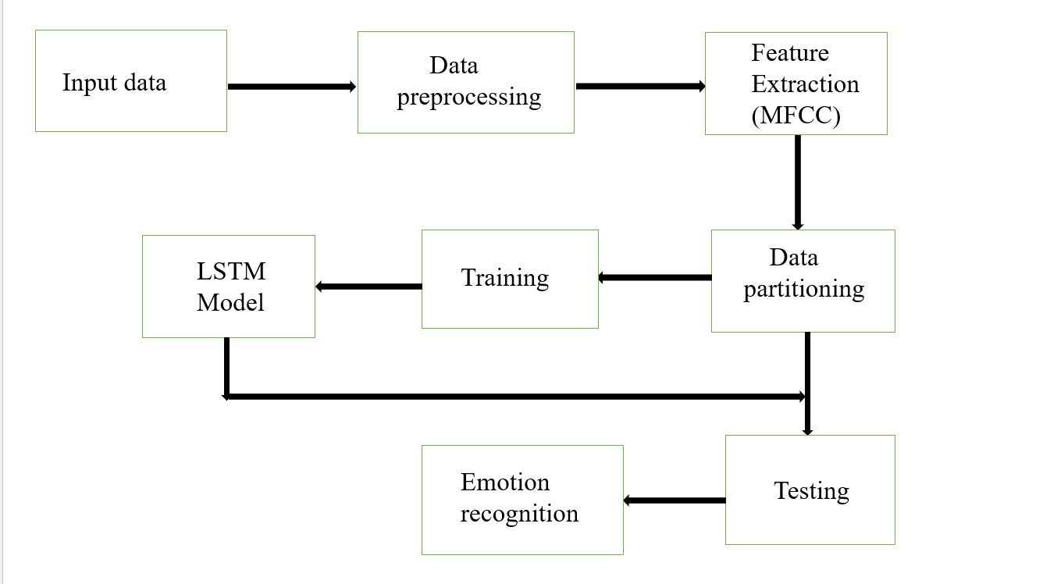
ARCHITECTURAL DESIGN
.

Slide 22
PROCESS FLOW
Input data: The input speech refers to the audio data received by the system for processing. This could be any spoken words, phrases, or sentences captured by a microphone or any audio input device.
Data preprocessing : Data preprocessing involves cleaning, transforming, and organizing raw data to prepare it for analysis or modeling. This includes handling missing values, scaling numerical features, encoding categorical variables, and detecting outliers. Effective preprocessing can improve model performance and accuracy by ensuring that the data is suitable for the chosen machine learning algorithm.
Feature Extraction : Feature extraction involves identifying and extracting relevant attributes or characteristics from the input speech data. Common features include spectral features like MFCCs (Mel-Frequency Cepstral Coefficients), and other acoustic properties that are essential for speech recognition and analysis.
Data partitioning : Data partitioning involves dividing a dataset into subsets for training, validation, and testing purposes. Typically, the majority of the data is used for training the model, a smaller portion for validation to tune hyperparameters, and a separate portion for testing to evaluate model performance on unseen data. Proper data partitioning helps assess model generalization and prevents overfitting.

Slide 23
.
Training : Training the data involves feeding it into a machine learning algorithm to learn patterns and relationships within the dataset. During training, the algorithm adjusts its internal parameters iteratively to minimize a defined loss function, optimizing its ability to make accurate predictions.
Testing : Testing the data involves evaluating the performance of a trained machine learning model on unseen data to assess its generalization ability. Testing data is typically kept separate from the training data and is used to measure various performance metrics such as accuracy, precision, recall, and F1-score.
LSTM Model : Long Short-Term Memory (LSTM) is a type of recurrent neural network (RNN) architecture capable of learning long-term dependencies in sequential data. It includes specialized memory cells that can retain information over long sequences, making it effective for tasks such as time series prediction, natural language processing, and speech recognition.
Emotion Recognized : Emotion recognition involves identifying the emotional state conveyed through the input speech. This could include emotions such as happiness, sadness, anger, or neutral sentiments. Emotion recognition algorithms analyze various acoustic features, intonation patterns, and linguistic cues to infer the underlying emotional state accurately.

Slide 24
IMPLEMENTATION
Implementing Speech Emotion Recognition (SER) using deep learning involves several key steps, from data preprocessing to model training and evaluation. Firstly, the audio data needs to be loaded and preprocessed, typically involving feature extraction and normalization. Common features include Mel-frequency cepstral coefficients (MFCCs), which capture the spectral characteristics of the speech signal, and pitch or intensity features. These features are then fed into a deep learning model, often based on architectures like RNNs, or specifically, LSTM networks, known for their ability to model sequential data effectively .
The model is constructed by defining the architecture, including the number of layers, hidden units, and activation functions. For LSTM-based models, the architecture typically comprises LSTM layers followed by fully connected layers for classification.
During training, the model is compiled with appropriate loss functions and optimizers and trained on labeled data, iteratively adjusting its parameters to minimize the loss function. Training involves splitting the dataset into training, validation, and testing sets to assess the model's performance. Once trained, the model is evaluated on the test set to assess its performance in classifying emotions from unseen data.

Slide 25
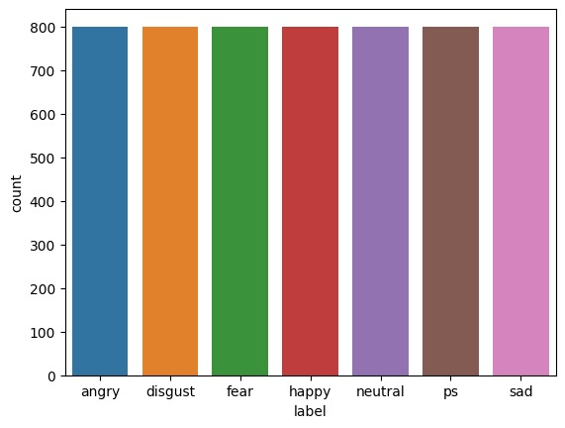
RESULTS

Slide 26
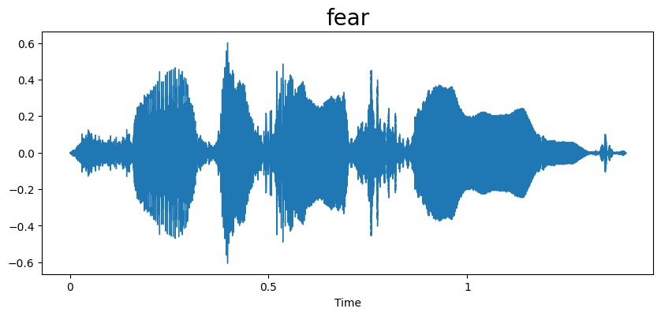
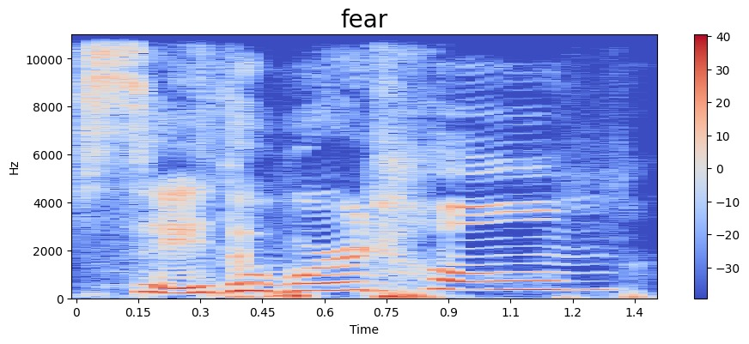
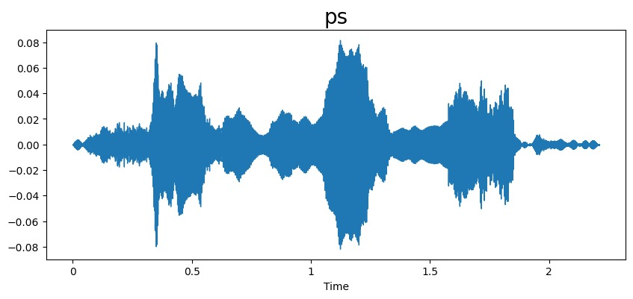
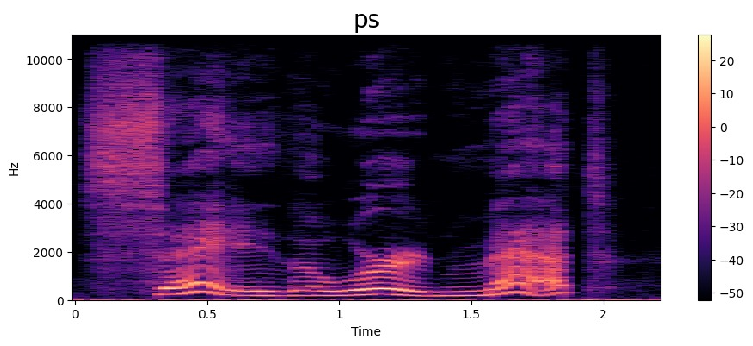
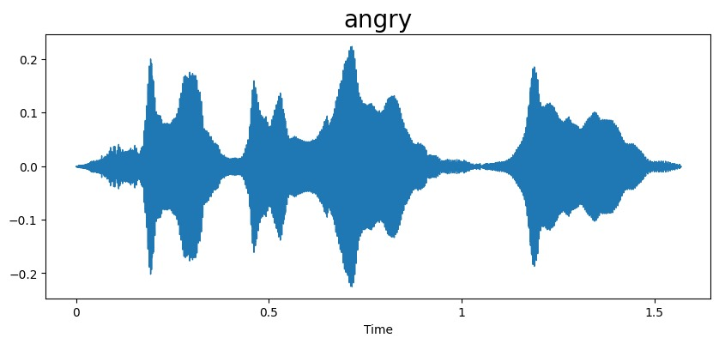
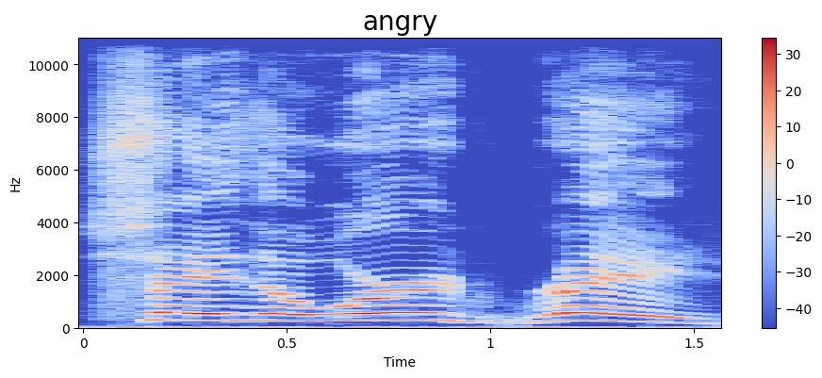
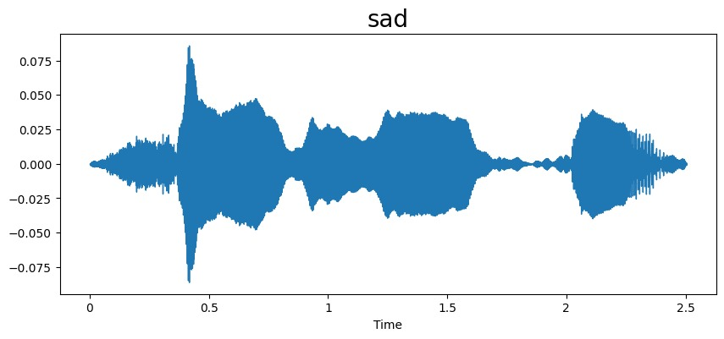
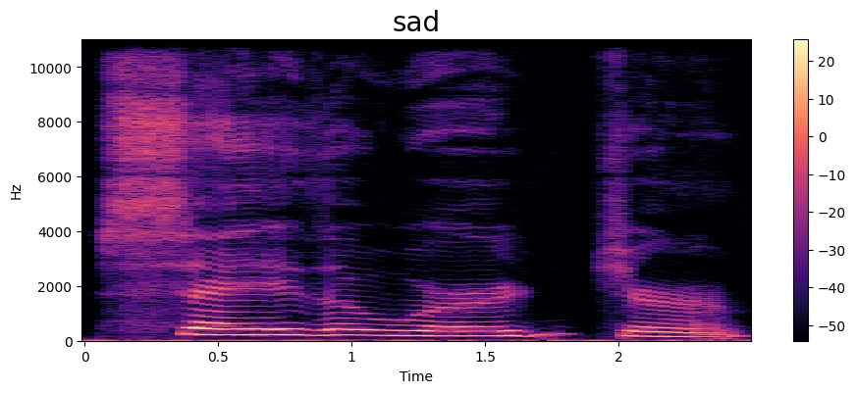
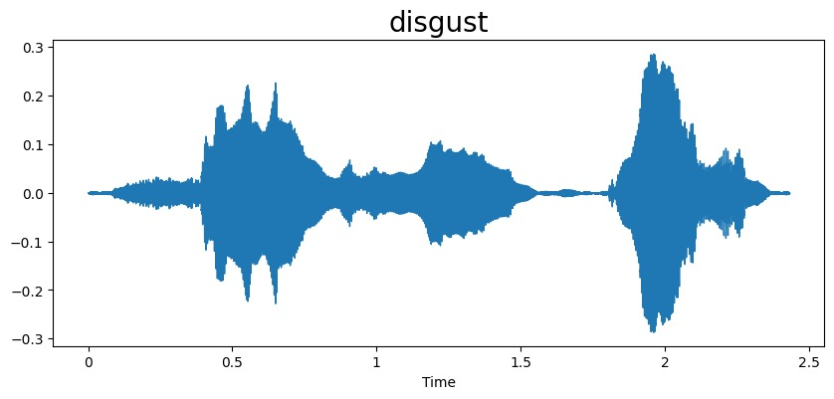
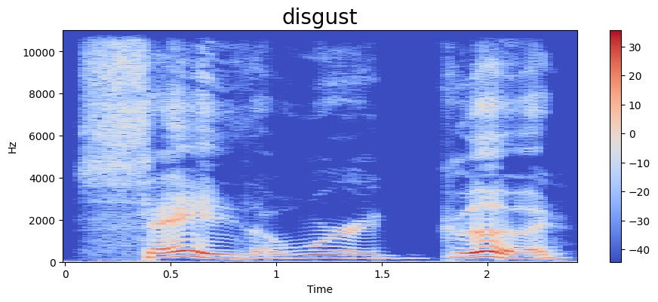
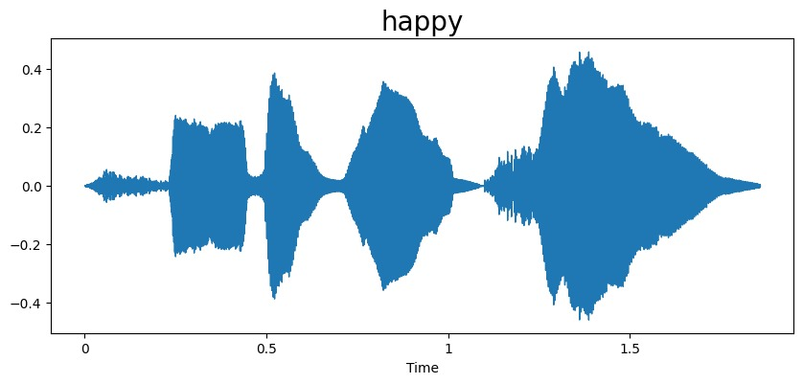
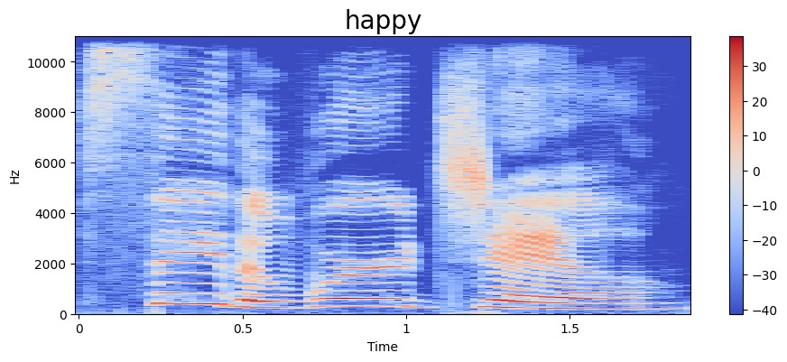
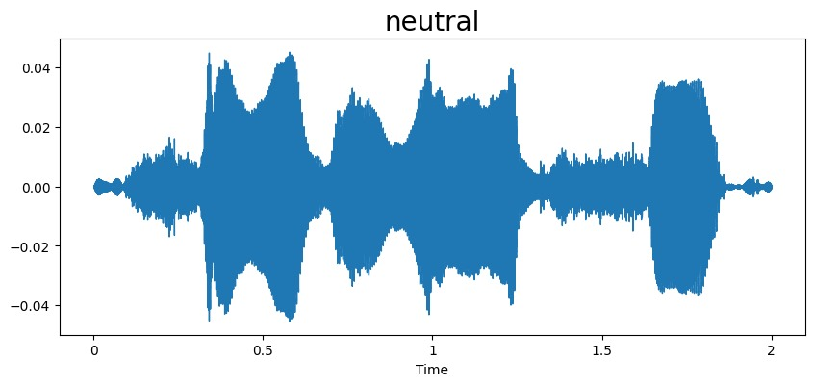
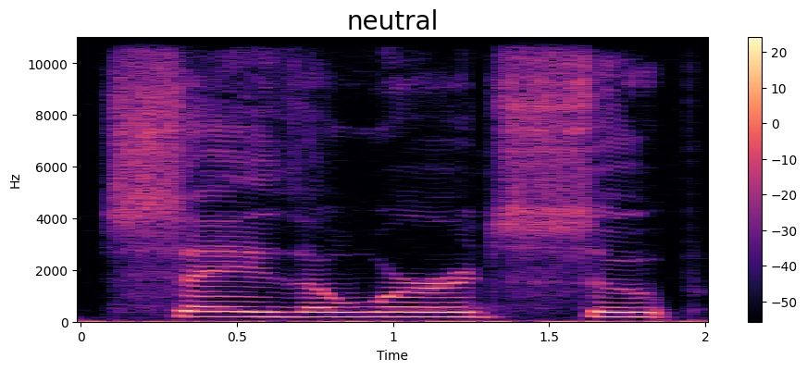

Slide 27
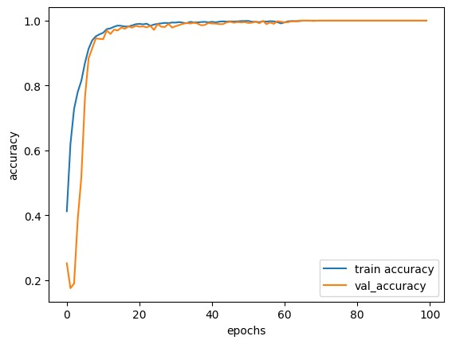
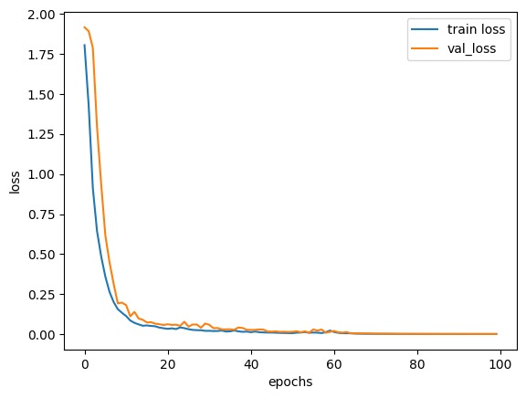
.

Slide 28
CONCLUSION
In conclusion, speech emotion recognition represents a significant advancement in human-computer interaction and emotional intelligence applications. Through the extraction of acoustic features and the utilization of sophisticated machine learning or deep learning models, we can effectively classify and understand the emotional content conveyed in speech signals. As technology continues to evolve, the integration of speech emotion recognition systems into various domains, including virtual assistants, healthcare, and entertainment, holds immense potential to enhance user experiences and enable more empathetic interactions. However, ongoing research and development are necessary to improve the accuracy, robustness, and real-time capabilities of these systems, ultimately bringing us closer to a future where machines can comprehend and respond to human emotions with nuance and sensitivity.

Slide 29
FUTURE SCOPE
The future scope for speech emotion recognition, considering its current limitations, offers several avenues for improvement and innovation. Addressing the challenge of cross-cultural and multilingual adaptation will be crucial to developing more inclusive and globally applicable emotion recognition systems. Additionally, advancements in real-time processing capabilities and the integration of contextual understanding can enhance the responsiveness and accuracy of these systems, enabling more natural and nuanced interactions. Moreover, research efforts focused on mitigating bias and ensuring fairness in emotion recognition algorithms will be essential to building trustworthy and ethically sound systems. By overcoming these limitations, the future of speech emotion recognition holds the potential to revolutionize human-computer interaction, ushering in an era of more empathetic and personalized technology experiences.

Slide 30
Thank You

