Slide 1

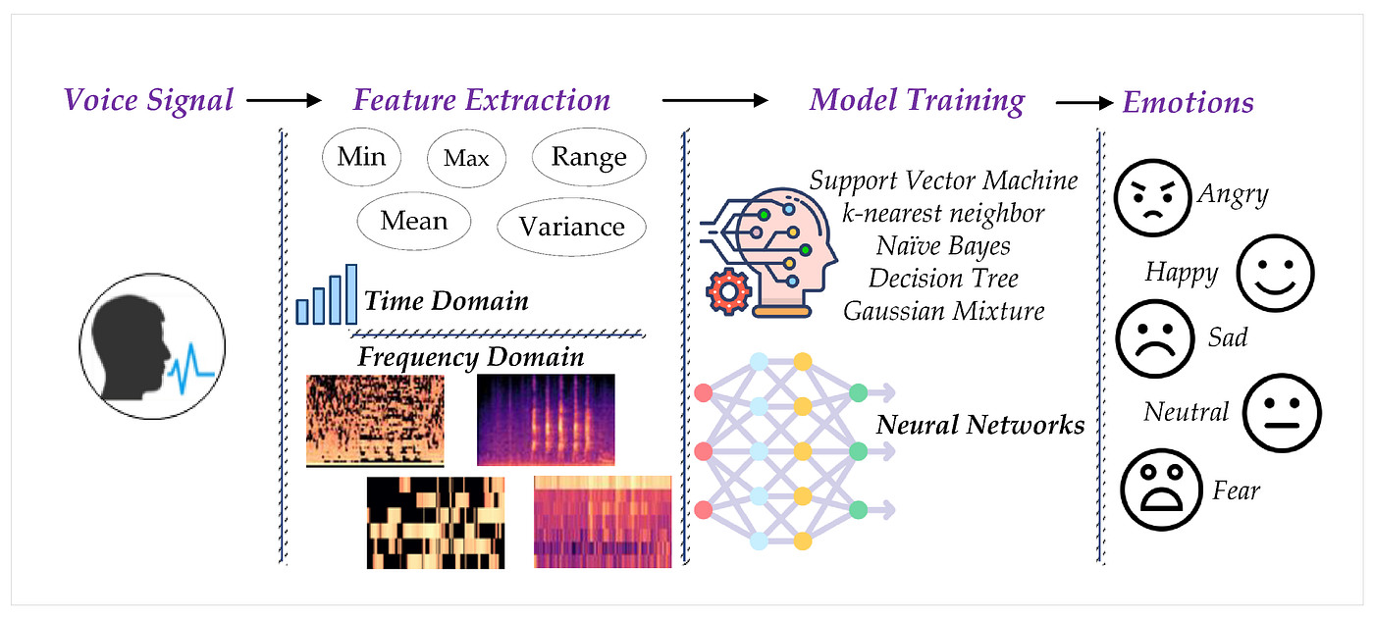
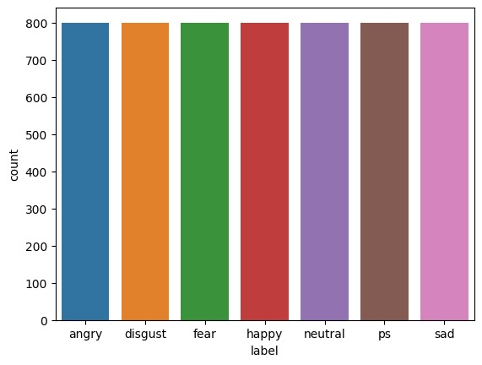
SPEECH EMOTION RECOGNITION
Enrollment no:106
P.Tejaswi - 2103A52029 D.Bala Varshitha - 2103A52012
B.Harini sri - 2103A52006 B.Anvitha - 2103A52007
M.Vyshnavi - 2103A52023
INTRODUCTION
LIMITATIONS
Human voices carry far more than words; they whisper secrets of our inner world through subtle variations in tone, pitch, and rhythm. SER aims to decode these hidden messages, automatically identifying the emotions conveyed in spoken language.
OVERVIEW
The dataset comprising 2800 audio recordings in WAV format, featuring two actresses aged 26 and 64 years. The dataset is structured to investigate the expression of seven distinct emotions (anger, disgust, fear, happiness, pleasant surprise, sadness, and neutral) across 200 target words.
LSTMs, results in challenges with generalizing across different speakers, accents, and languages due to variations in speech patterns and also scarcity and imbalance of labeled emotion datasets.
LSTM models require substantial computational resources for training and inference, which can be a barrier for real-time applications.
PROBLEM STATEMENT
Speech emotion recognition (SER) deciphers emotional cues in spoken language, revolutionizing human-computer
interaction. Deep learning, adept at extracting intricate patterns, empowers SER by capturing nuances in tone and
pitch from raw audio data. This advancement transcends traditional methods, offering diverse applications in
healthcare, education, customer service, and entertainment.
OBJECTIVES
The primary objectives for a speech emotion recognition involve developing a robust system capable of accurately identifying and classifying various emotional states from speech inputs.
MODELS USED
We are employing a deep learning approach using the Long Short-Term Memory (LSTM) model, which is a type of recurrent neural network (RNN) particularly adept at processing sequences of data, such as speech.
PROPOSED METHODOLOGY
LSTM networks, a type of recurrent neural network (RNN) particularly well-suited for sequence prediction problems. Our approach involves several key steps to enhance the model's ability to accurately recognize and classify emotional states from audio inputs.
REFERENCES
https://ieeexplore.ieee.org/abstract/document/9453028
https://link.springer.com/article/10.1007/s10772-022-09985-
https://www.sciencedirect.com/science/article/abs/pii/S1566253519302532
ACKNOWLEDGEMENT
Dr.M.Sheshikala, HOD, CSAI Dept.
PROJECT GUIDE - Dr.P.Chandrashaker Reddy , Prof.,
CSAI Dept
CO-ORDINATOR – P.Praveen ,Prof.,CSAI Dept

