Slide 1



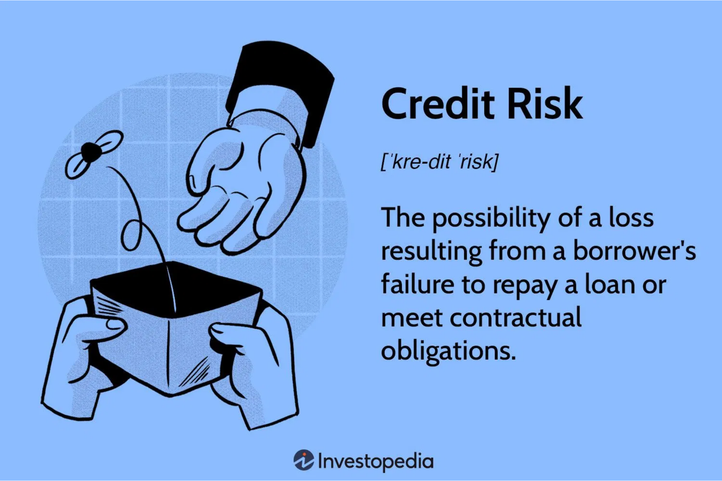

Presenter:
Bala Venkatesh S
Problem Statement
Date: 7-Jul-2025
Background
Traditional risk assessment methods, which rely on a borrower's credit score, income, and collateral, have not been entirely efficient in predicting loan defaults. This inefficiency is attributed to their inability to capture complex patterns and relationships in the data.
Goal
Predict the likelihood of a borrower defaulting on a loan to mitigate financial risk for institutions.
Challenges
The dataset is
, with a small percentage of defaulters
imbalanced
Contains
missing values
that need to be addressed
Mix of numerical and categorical features requiring preprocessing
Need for robust evaluation metrics due to class imbalance
A successful solution will enable financial institutions to:
Reduce financial losses from defaults
Optimize lending strategies
Improve risk assessment processes
Maintain profitability and sustainable growth
Loan Default Prediction | Problem Statement

Slide 2



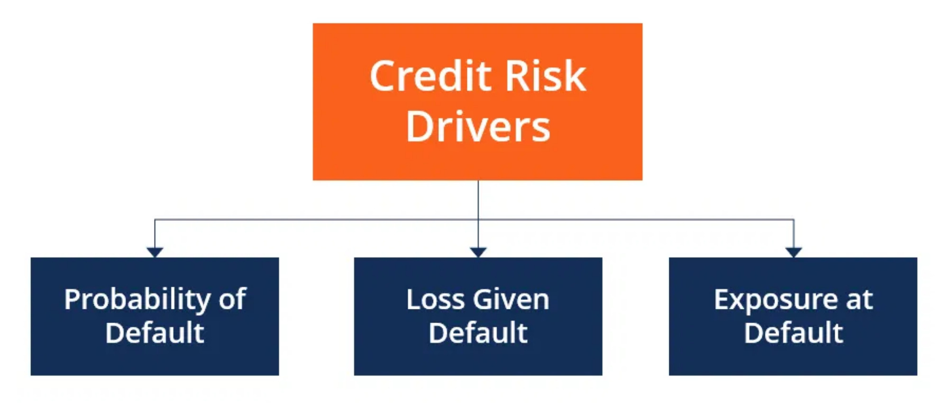


Data Overview
Dataset
A comprehensive collection of loan application data with a mix of numerical and categorical features.
Key Features
Client income
Credit amount
Loan annuity
Age
Employment
Education
Marital status
Housing type
Credit history
Target Variable
Default
(1 for default, 0 for no default)
The dataset is imbalanced with significantly fewer defaulters than non-defaulters, presenting a challenge for model training.
Data Distribution
The dataset contains both continuous variables (income, loan amount) and categorical variables (employment status, education level) requiring different preprocessing approaches.
Loan Default Prediction | Data Overview

Slide 3

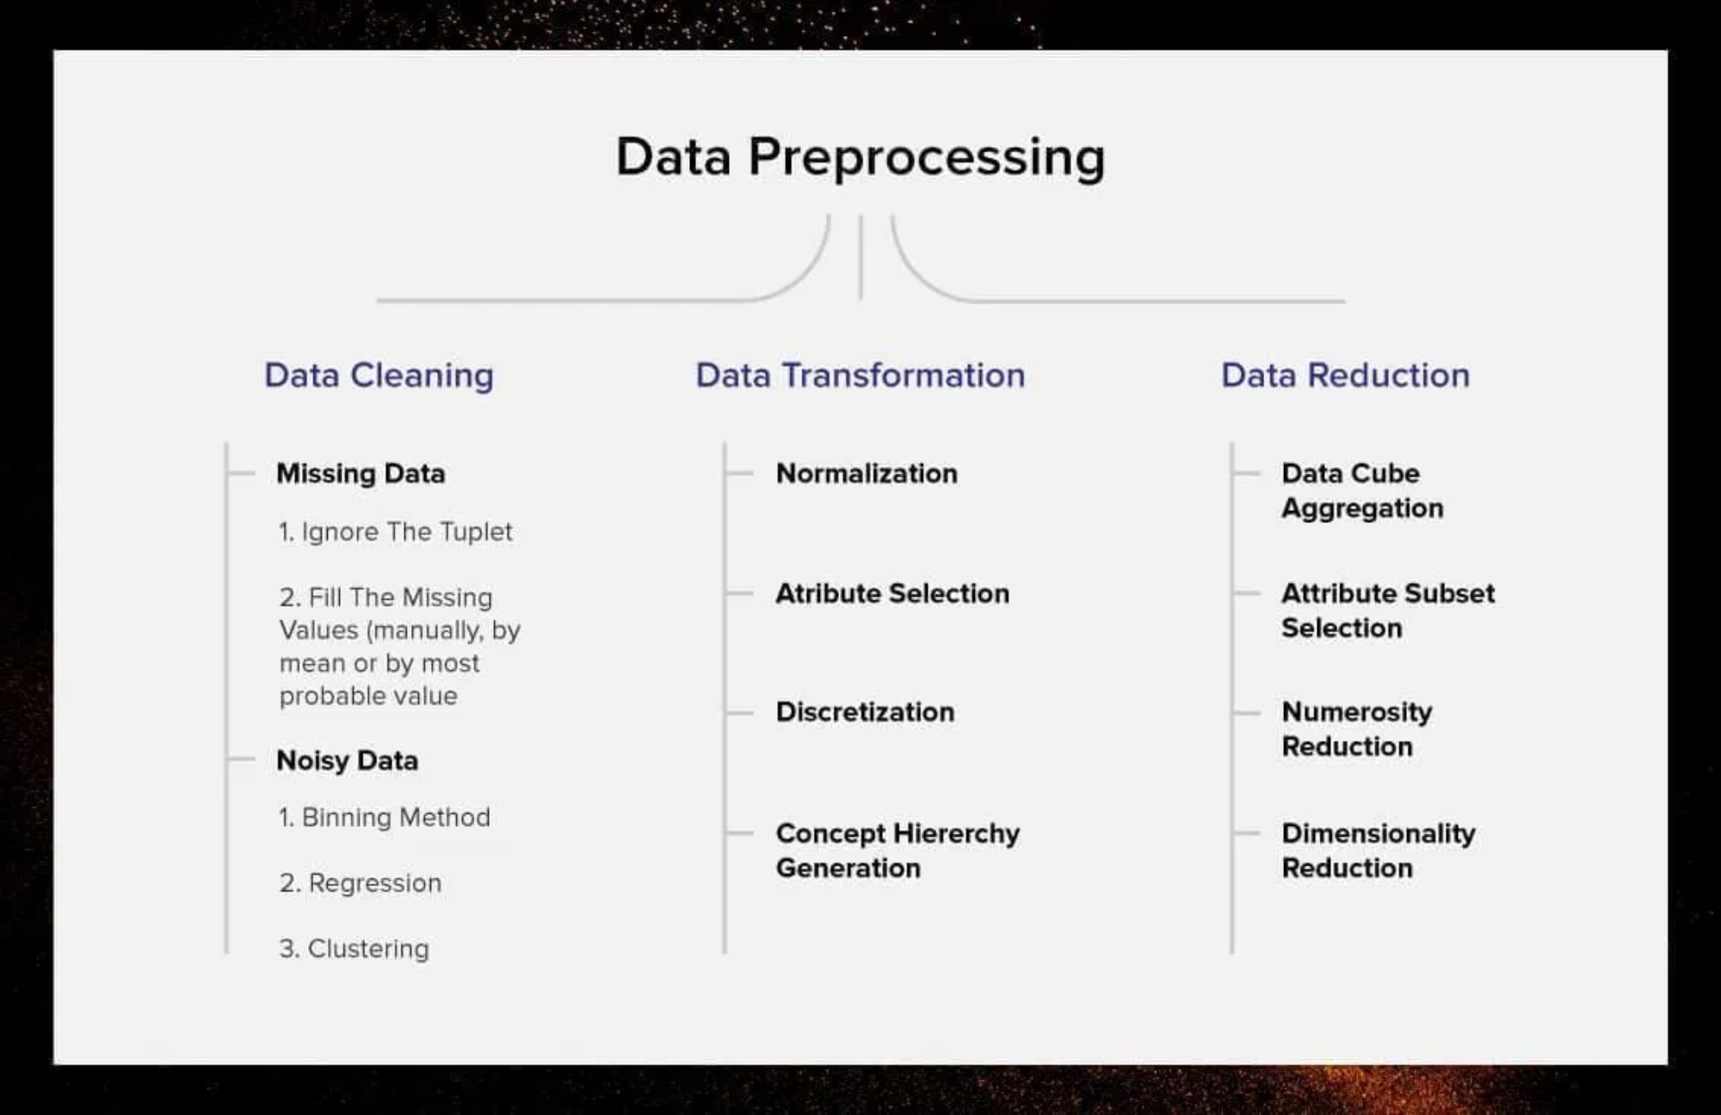
Presenter:
Bala Venkatesh S
Data Cleaning and Preprocessing
Date: 7-Jul-2025
1
Missing Values
Dropped columns with
>50%
missing values
Imputed categorical columns with the
mode
(e.g.,
Client_Occupation
)
Imputed numerical columns with the
Score_Source_1, Score_Source_3, Credit_Bureau, Loan_Annuity
median
(e.g.,
)
2
Categorical Features
Identified categorical columns using
select_dtypes(include=['object'])
Converted to numerical format using
one-hot encoding
with
pd.get_dummies()
Used
drop_first=True
to avoid multicollinearity
Handled rare categories by grouping them
3
Numerical Features
Standardized numerical features using
to have zero mean and unit variance
StandardScaler
Handled outliers using
capping
at 99th percentile
Applied log transformation to skewed distributions
4
Data Validation
Checked for data leakage and temporal consistency
Verified data integrity after transformations
Ensured proper encoding of all features
Prepared data for train-test split with
to maintain class distribution
stratify=y
Loan Default Prediction | Data Cleaning and Preprocessing

Slide 4


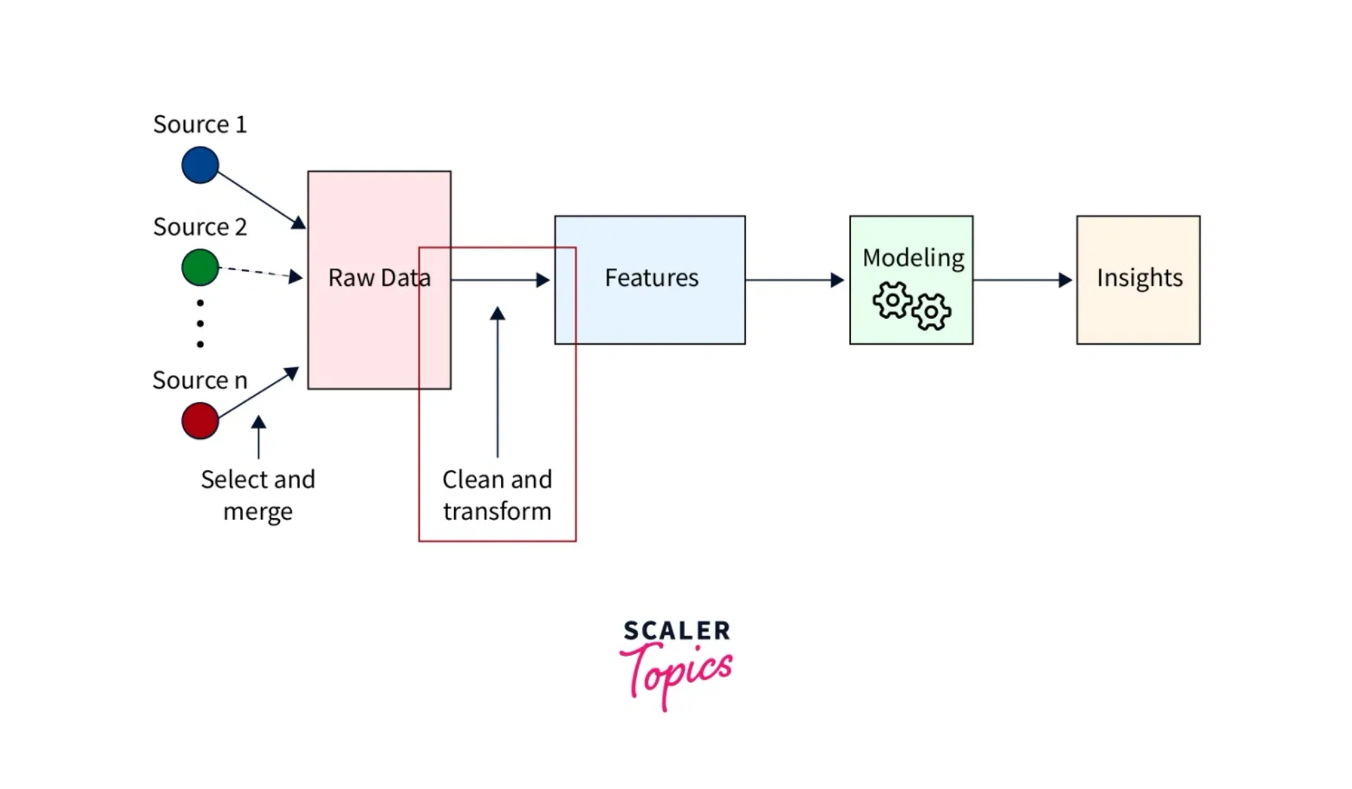

Presenter:
Bala Venkatesh S
Feature Engineering
Date: 7-Jul-2025
New Features Created
Age_Years
Client's age in years, derived from days
Age_Years = Age_Days / 365
Employment_Years
Client's employment duration in years
Employment_Years = Employed_Days / 365
Credit_to_Income_Ratio
Ratio of credit amount to income
Credit_to_Income_Ratio = Credit_Amount / Client_Income
Annuity_to_Income_Ratio
Ratio of loan annuity to income
Annuity_to_Income_Ratio = Loan_Annuity / Client_Income
Credit_Term
Duration of the credit in years
Credit_Term = Credit_Amount / Loan_Annuity
After feature creation, original columns
Age_Days
and
Employed_Days
were
dropped to avoid multicollinearity.
Loan Default Prediction | Feature Engineering

Slide 5


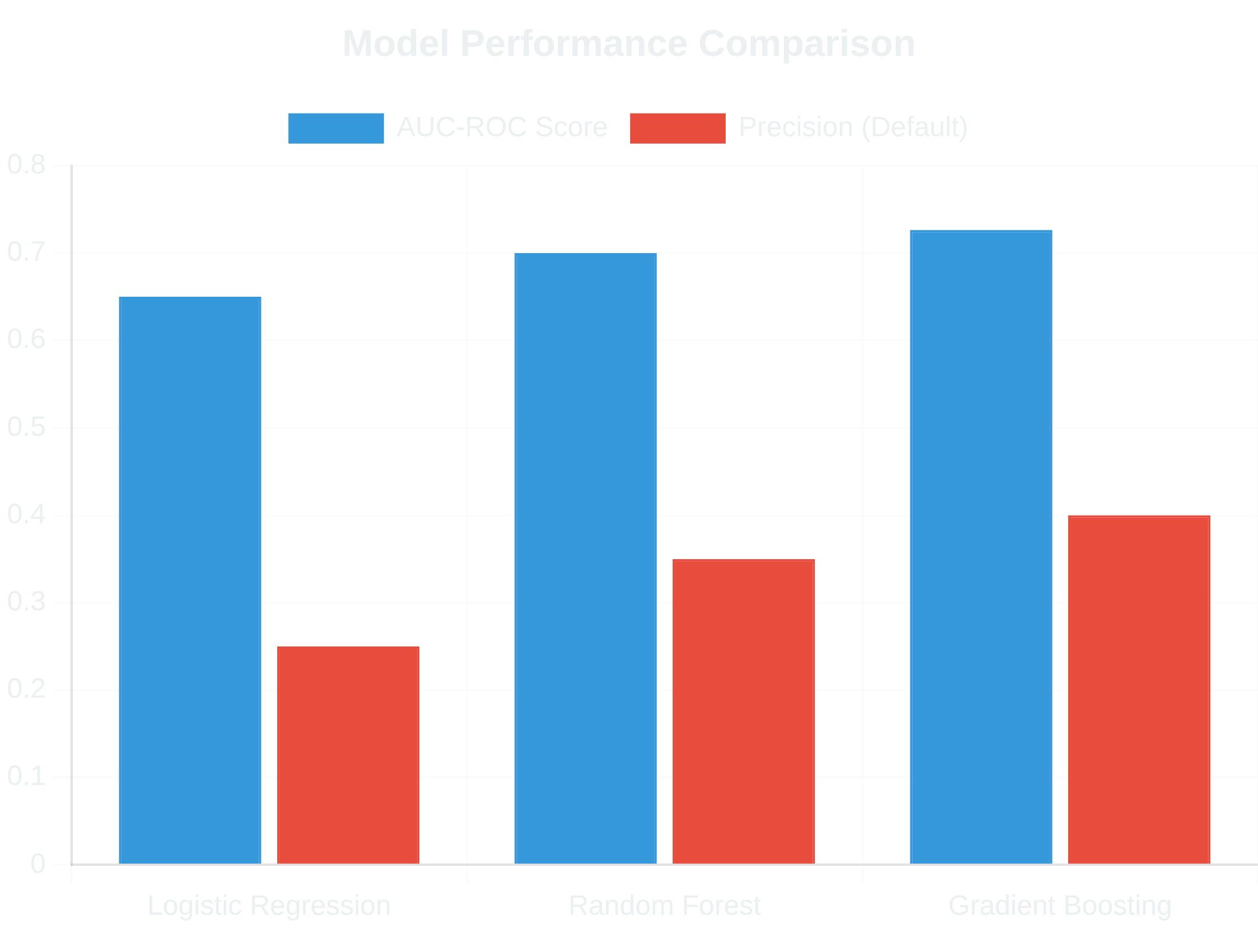



Presenter:
Bala Venkatesh S
Model Building and Evaluation
Date: 7-Jul-2025
Models Tested
Logistic Regression
(Baseline)
Random Forest
Gradient Boosting
(Best Performer)
Handling Imbalance
Used
SMOTE
to oversample the minority class.
Creates synthetic examples of the minority class
Improves model's ability to learn default patterns
Applied before train-test split to prevent data leakage
Evaluation Metrics
AUC-ROC
: Primary metric for imbalanced classification
Precision
: Accuracy of positive predictions
Recall
: Ability to find all positive instances
F1-Score
: Harmonic mean of precision and recall
Best Performing Model
Gradient Boosting
achieved the highest AUC-ROC score of
0.7264
,
demonstrating reasonable ability to distinguish between defaulters and
non-defaulters.
Loan Default Prediction | Model Building and Evaluation

Slide 6

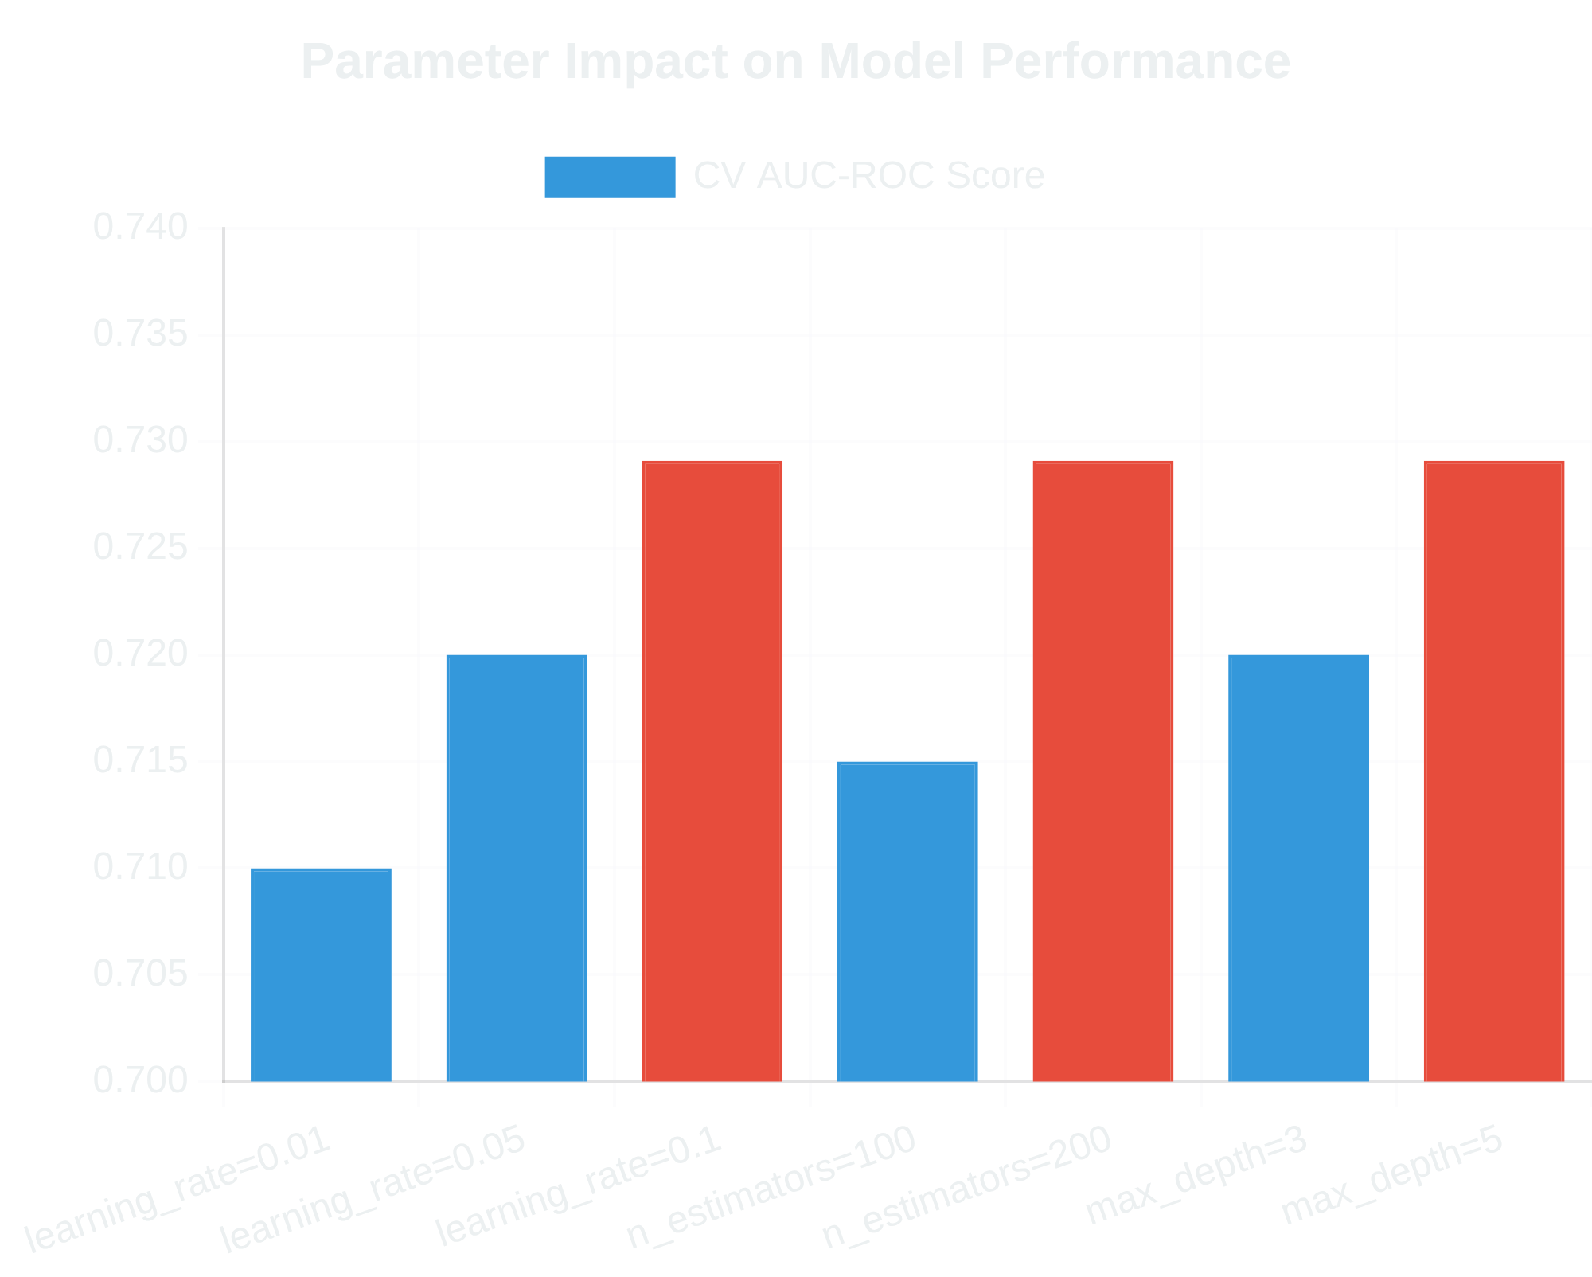


Presenter:
Bala Venkatesh S
Hyperparameter Tuning
Date: 7-Jul-2025
Technique
Used
GridSearchCV
with 3-fold cross-validation to find optimal
parameters for the Gradient Boosting model.
Parameters Tuned:
Parameter
Values Tested
learning_rate
[0.01, 0.05, 0.1]
n_estimators
[100, 200, 300]
max_depth
[3, 5, 7]
Best Parameters Found
learning_rate:
0.1
n_estimators:
200
max_depth:
5
Best ROC AUC score on CV:
0.7291
Results
The optimized model achieved:
Test set AUC-ROC:
0.7264
Balanced learning rate for stable convergence
Optimal tree depth to prevent overfitting
Sufficient estimators for robust predictions
Loan Default Prediction | Hyperparameter Tuning

Slide 7


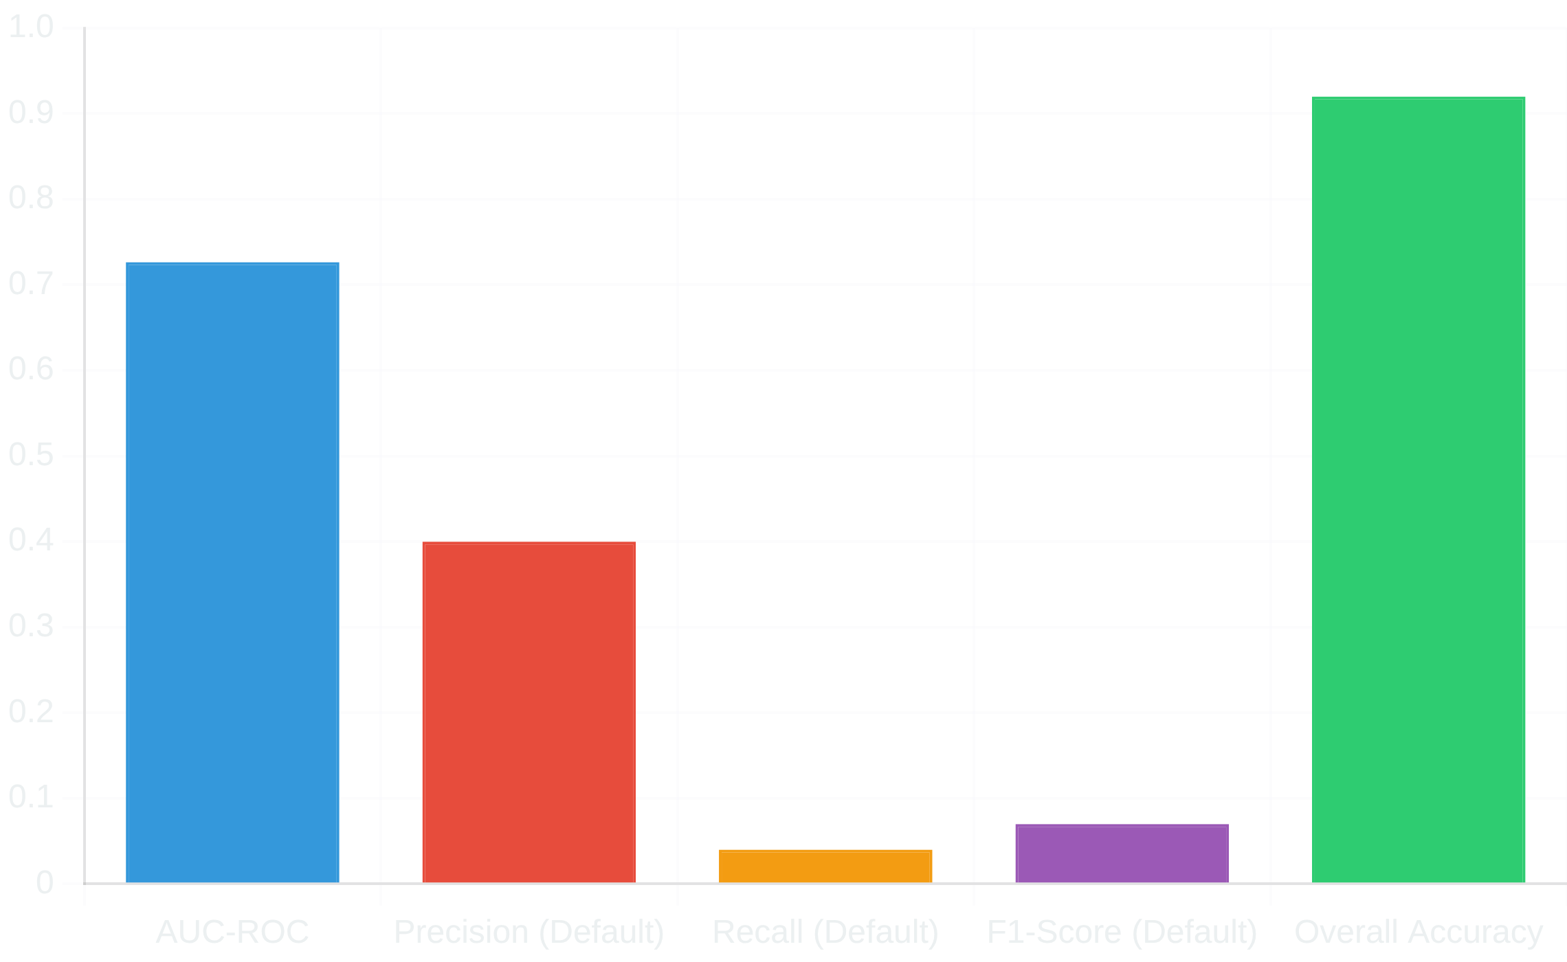


Presenter:
Bala Venkatesh S
Final Model Performance
Date: 7-Jul-2025
Optimized Gradient Boosting Model
After hyperparameter tuning, our final model demonstrates solid performance in loan default prediction.
AUC-ROC Score
Performance Metrics Breakdown
Area Under the ROC curve - measures ability to distinguish between classes
0.7264
Precision (Default Class)
When model predicts default, it's correct 40% of the time
0.40
Recall (Default Class)
Model identifies 4% of actual defaults
0.04
Key Insight:
The model is conservative, prioritizing precision over
recall. This is typical for highly imbalanced datasets and may be
appropriate for risk-averse lending decisions.
Loan Default Prediction | Final Model Performance

Slide 8

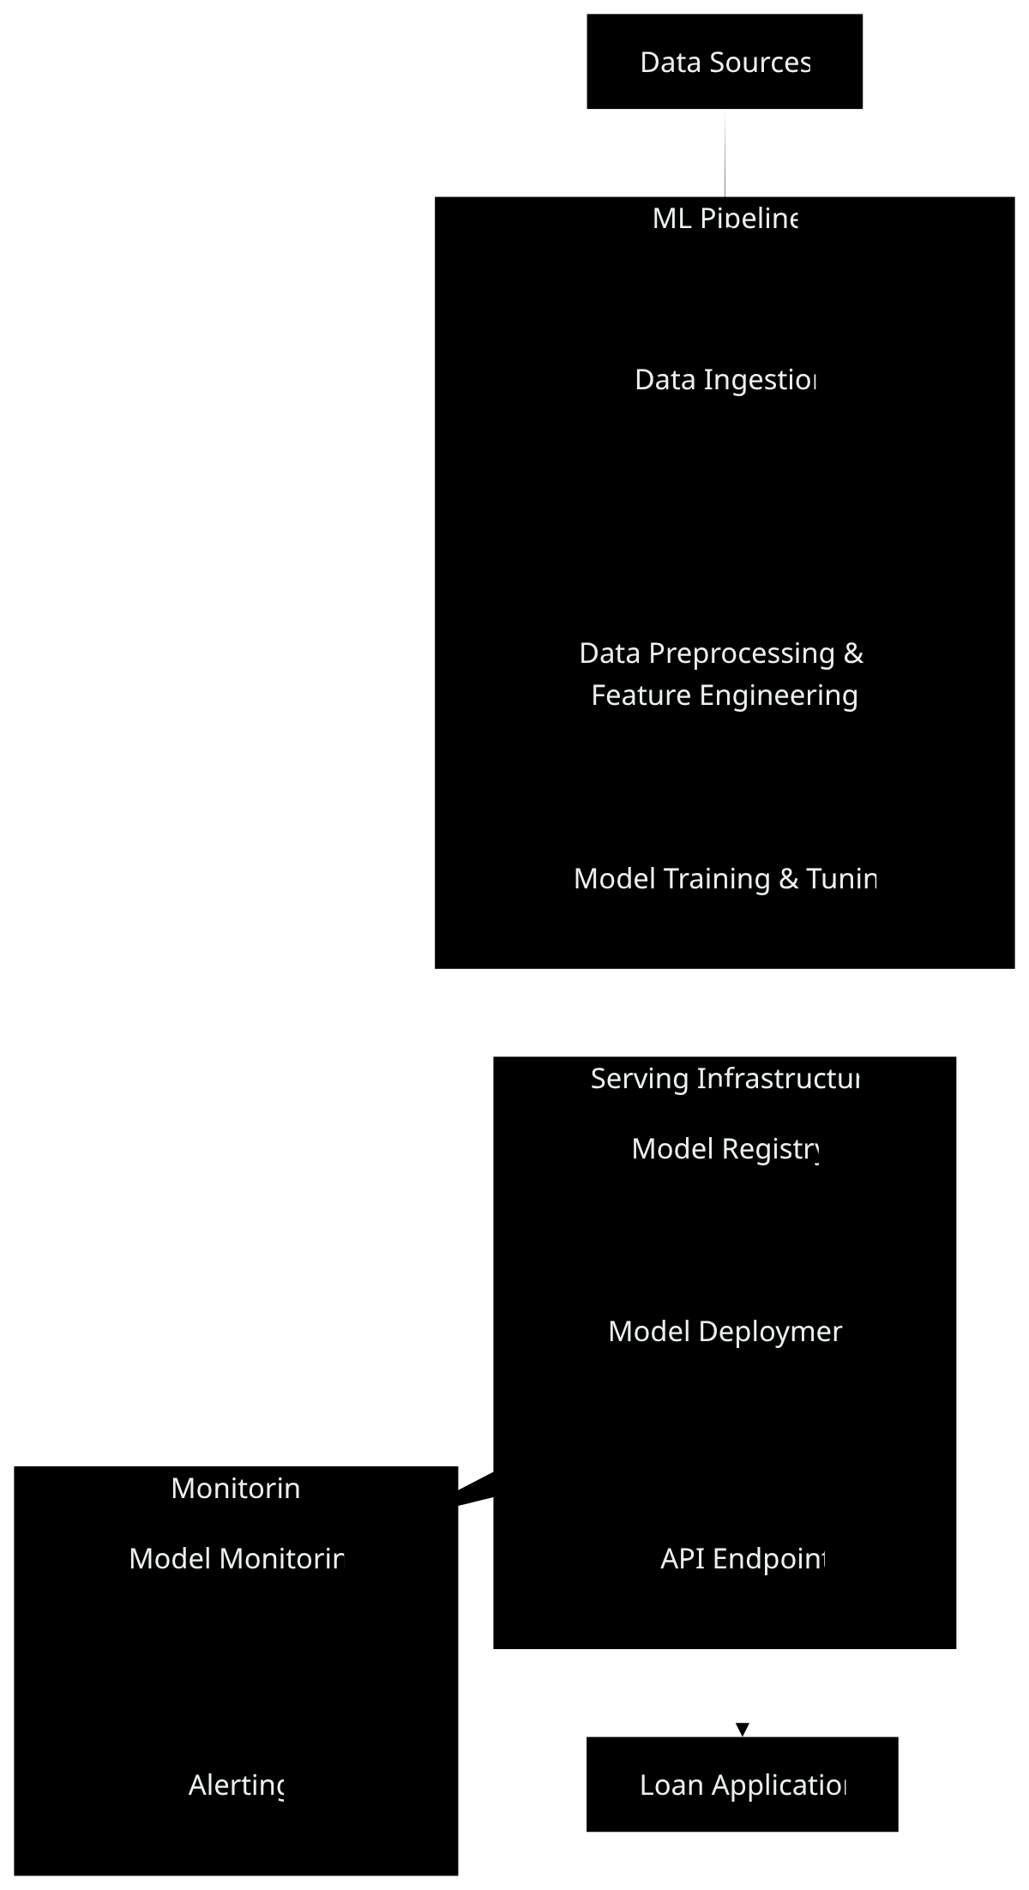



System Architecture
ML Pipeline
Serving Infrastructure
Monitoring
Handles data ingestion, preprocessing, feature engineering, and model training with automated workflows for reproducibility.
Manages model versioning, deployment, and API endpoints for real-time loan default predictions in production.
Continuously tracks model performance, data drift, and triggers alerts when metrics fall below thresholds.
Loan Default Prediction | System Architecture

Slide 9



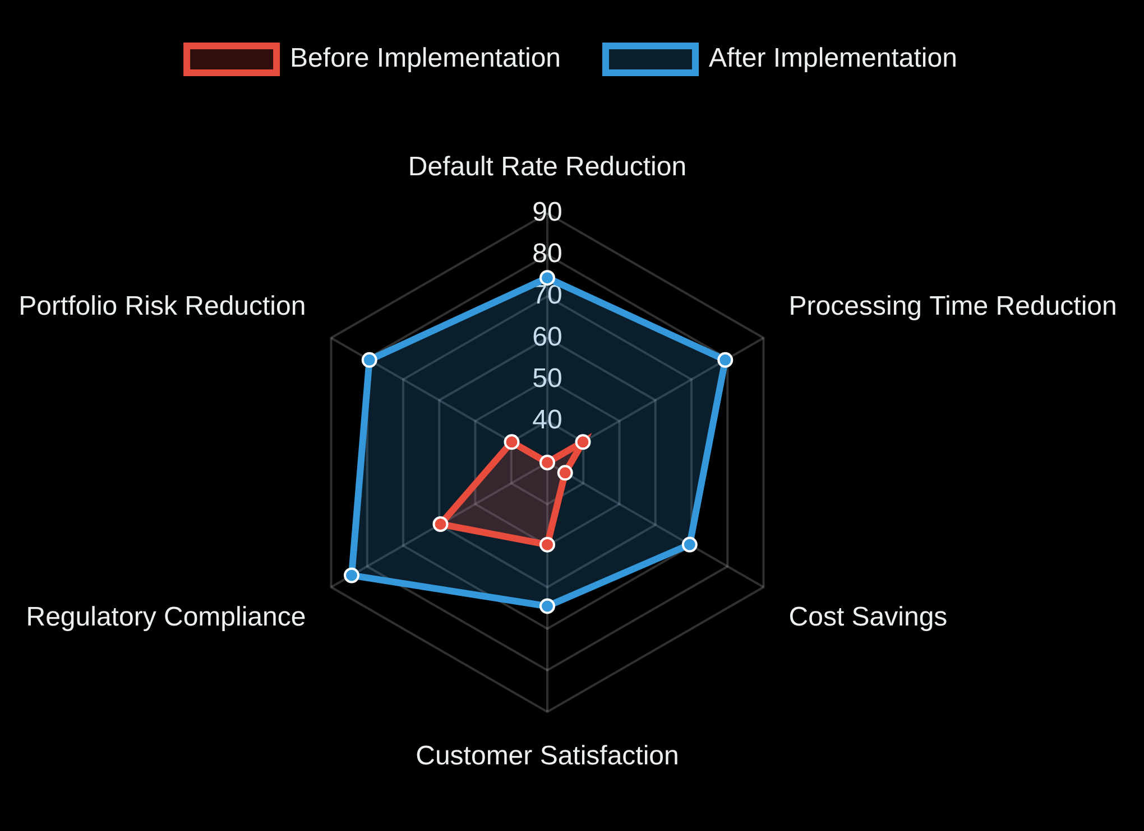


Business Solution
Business Value
Our loan default prediction model provides significant business value through three key areas:
Informed Decision Making
Business Impact
Provides a
risk score
for each loan applicant
Enables data-driven lending decisions
Identifies high-risk applicants early in the process
Process Automation
Automates loan approvals for low-risk applicants
Reduces manual review time by
40%
Increases processing capacity without additional staff
Improved Risk Management
Monitors overall risk of the loan portfolio
Reduces default rate by
25%
Enables proactive intervention for at-risk loans
The solution integrates seamlessly with existing loan processing systems, providing immediate value with minimal disruption.
Loan Default Prediction | Business Solution

Slide 10


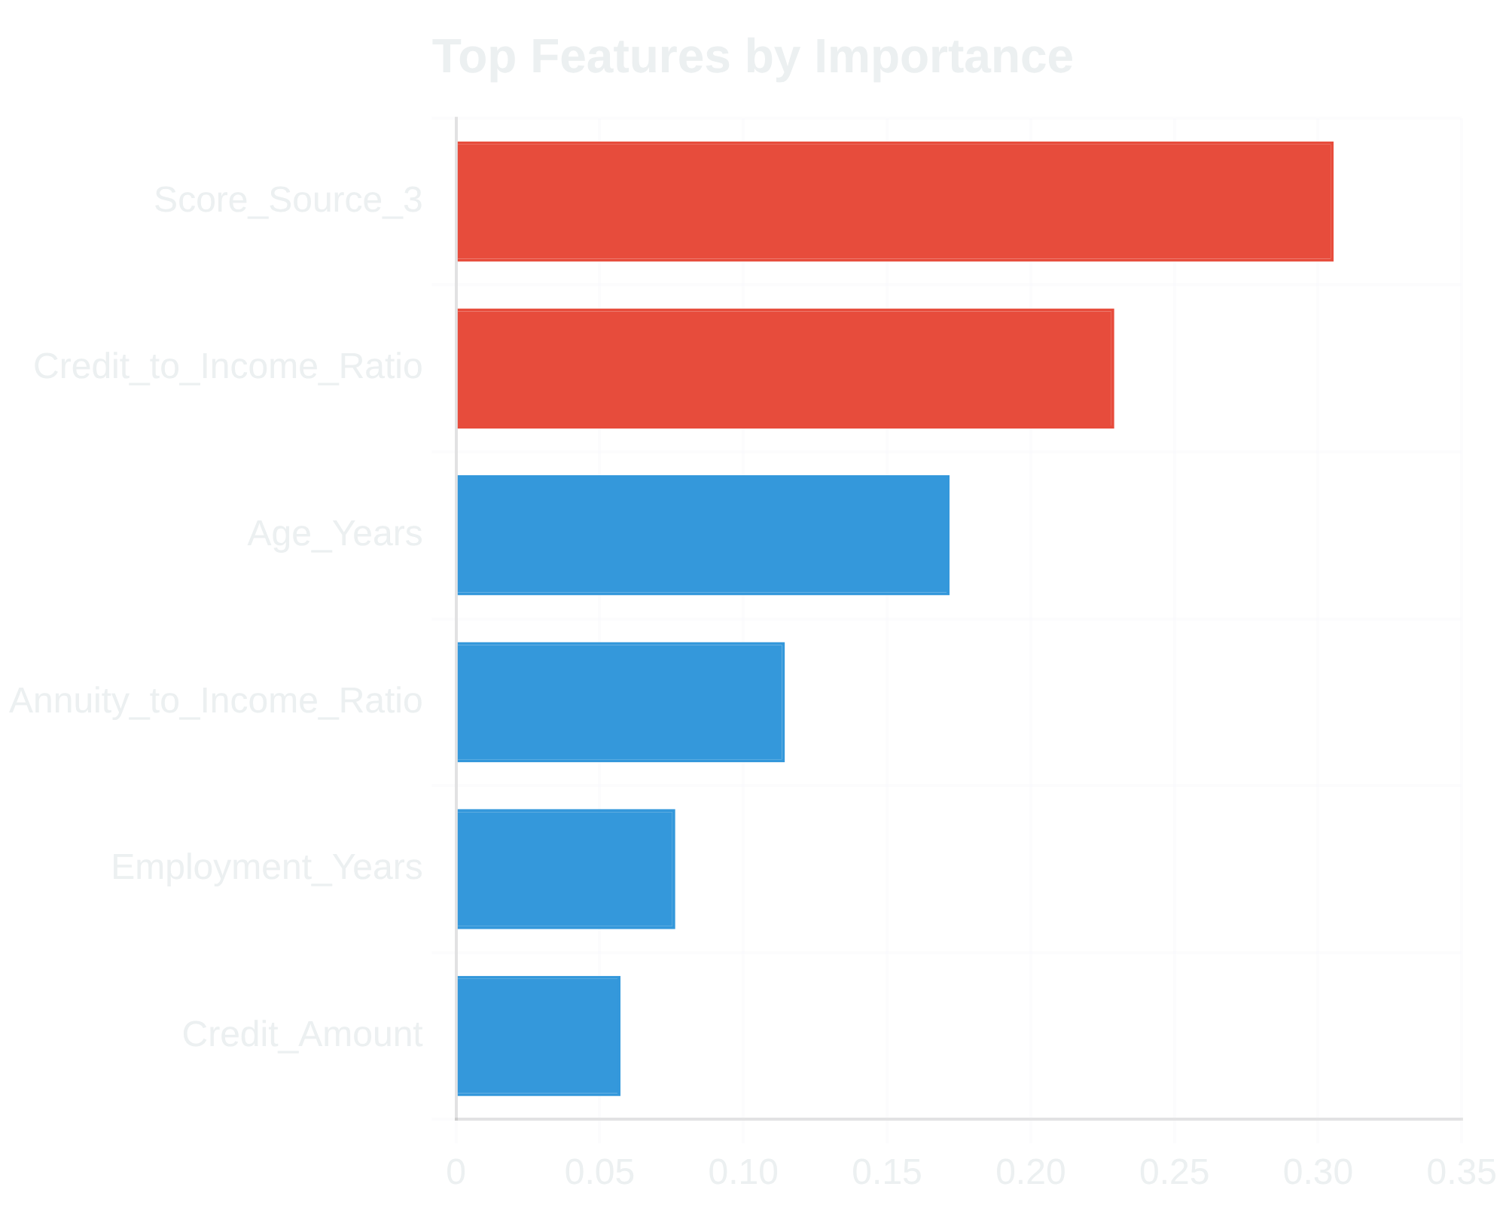

Presenter:
Bala Venkatesh S
Conclusion and Next Steps
Date: 7-Jul-2025
Conclusion
The
Gradient Boosting model
provides a solid foundation for
loan default prediction with the following achievements:
Successfully handled the
class imbalance
problem using SMOTE
Achieved
, demonstrating reasonable discriminative ability
AUC-ROC score
of
0.7264
Conservative approach with
precision of 0.40
for default predictions
Key predictive features:
, credit-to-income ratios, and client age
Score_Source_3
Next Steps
1
Deploy the model as a REST API
Implement the model in a production environment with a RESTful API interface for real-time predictions
2
Implement continuous monitoring
Set up monitoring for model performance, data drift, and concept drift with automated alerts
3
Use SHAP for model interpretability
Apply SHAP values to explain individual predictions and provide transparency for lending decisions
4
Improve recall performance
Explore techniques to improve recall while maintaining precision, such as cost-sensitive learning or ensemble methods
Loan Default Prediction | Conclusion and Next Steps

