Slide 1
Layered Architecture
Balavignesh.P

Slide 2
Unity is Strength

Slide 3
Layered Architecture
Layered architecture is one of the architectural pattern based on call – and – return style.
Like it is mostly understandable design in java
Here we can easily find out the mistakes which is created by the developer.
4 layers to be followed,
Presentation
Service/Business
Data Access Object
Data Transfer Objects

Slide 4
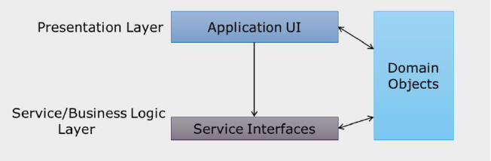
Presentation Layer
The presentation layer contains the components that implement and display user interface and manage user interaction. This layer includes controls for user input and display.
Exception handling is also an important responsibility of this layer.

Slide 5
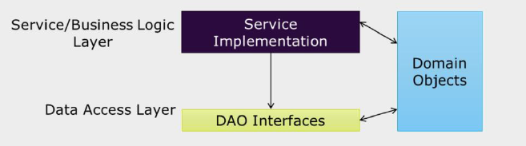
Business Layer
Business logic layer is concerned with the retrieval, processing, transformation and management of application data.
Mainly this layer is responsible to implement business rules and policies. It also ensures data consistency and validity.
Presentation layer passes data collected from UI to business layer and interact with business logic through abstract interfaces.

Slide 6
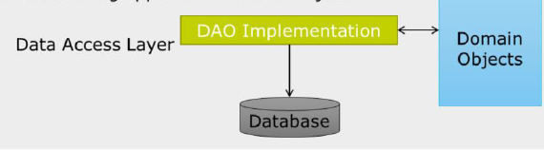
Data Access Object(DAO) Layer
This layer abstract the logic required to access the underlying data sources.
This layer is responsible for managing connections, generating queries, and mapping application domain objects to data source structures.
The data access layer should hide the details of data source access.

Slide 7
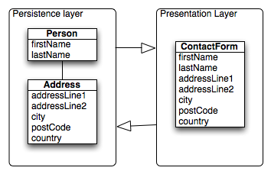
Data Transfer Objects(DTO) Layer
Since each call to any "Data Layer" is expensive, response to each call should bring as much data as possible. So, if multiple requests are required to bring data for a particular task, data to be brought can be combined in a DTO so that only one request can bring all the required data.
In simple applications, the domain objects can often be directly reused as DTOs and passed through directly to the display layer, so that there is only one unified data model.

Slide 8
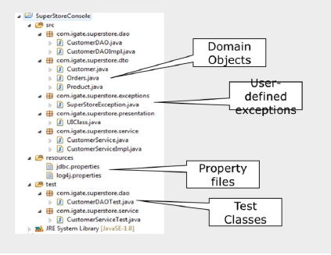
Sample Layered Application Structure

Slide 9
Summary…

Slide 10


