Slide 1
HEALTHCARE & DATA ANALYTICS
Predicting and understanding 30‑day hospital readmission in diabetes
A reproducible, fairness-audited analytics platform with a safety-checked AI assistant
[Your name] · [Course] · October 2026
Notes:
Introduce the question: can we predict 30-day readmission for diabetic patients, and, just as important, can we show honestly how well and for whom? Everything in this talk comes from saved results in the project repository, not hand-entered numbers.

Slide 2
Why 30-day readmission matters
A quality measure: hospitals are compared on how many patients return within 30 days
A hard problem: administrative data carry limited signal, so modest accuracy is expected
Our goal: evaluate honestly, explain the drivers, and audit fairness
11.2%
of encounters are readmitted within 30 days
101,766
encounters from 71,518 patients
1999–2008
UCI Diabetes 130-US Hospitals (public, de-identified)
Notes:
Readmission within 30 days is a standard quality indicator and a hard prediction problem; published models usually reach only modest discrimination. The aim here is a trustworthy evaluation, not a record-breaking score. The dataset is public and de-identified.

Slide 3
The data, and what is missing
96.9%
weight missing: column excluded
83.3%
HbA1c never measured
16,773
patients with repeat encounters: split by patient
* test not performed (not a missing value)
Notes:
Profiling the data first changed the design. Weight is almost entirely missing, so it was excluded. HbA1c was not performed for most encounters, which limits any analysis of it. Many patients have several encounters, which is why the split is by patient. The file also has no dates.

Slide 4
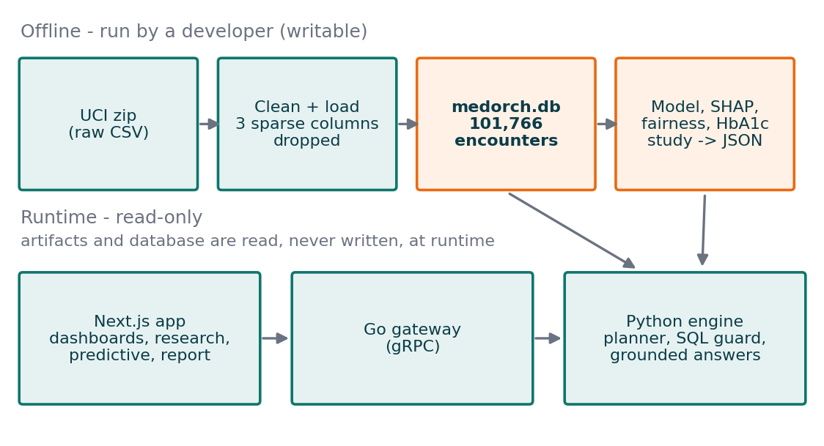
How the platform is built
1
Exclude 2,423 death and hospice discharges
they cannot be readmitted
2
Split 60/20/20 by patient
no patient in two sets
3
Calibrated probabilities
thresholds chosen on validation data
4
Test set scored once
bootstrap 95% intervals
Notes:
Work that writes (cleaning, training, explanations, audits) is done offline by scripts that produce saved artifacts. At runtime the web app and engine only read. Every page shows saved results or says they are missing, so there are no placeholder numbers. On the right are the four design choices that make the evaluation trustworthy.

Slide 5
The cutoff matters more than the model
0.669
ROC-AUC, 95% CI 0.657–0.681
0.232
PR-AUC vs 0.112 for chance (2.1×)
0.5 cutoff: 0.6% of readmissions caught.
Validation-chosen cutoff: 43.8%.
Notes:
The held-out ROC-AUC is 0.669, modest but typical. The striking result is the threshold: the textbook 0.5 cutoff catches under 1% of readmissions because only about 11% of encounters are readmitted. Choosing the cutoff on validation data catches 43.8% at the cost of precision. Which point is right depends on the cost of a missed readmission versus an unnecessary follow-up.

Slide 6
What drives the predictions
More prior admissions, longer stays and more diagnoses all raise risk
Discharge to rehabilitation raises risk the most; discharge home lowers it
Associations, not causes
Notes:
SHAP values show how much each feature moves the model score. Prior inpatient visits and the discharge destination dominate; more prior visits, longer stays, more diagnoses and more medications all raise predicted risk, which is clinically plausible. These are associations the model learned, not causes.

Slide 7
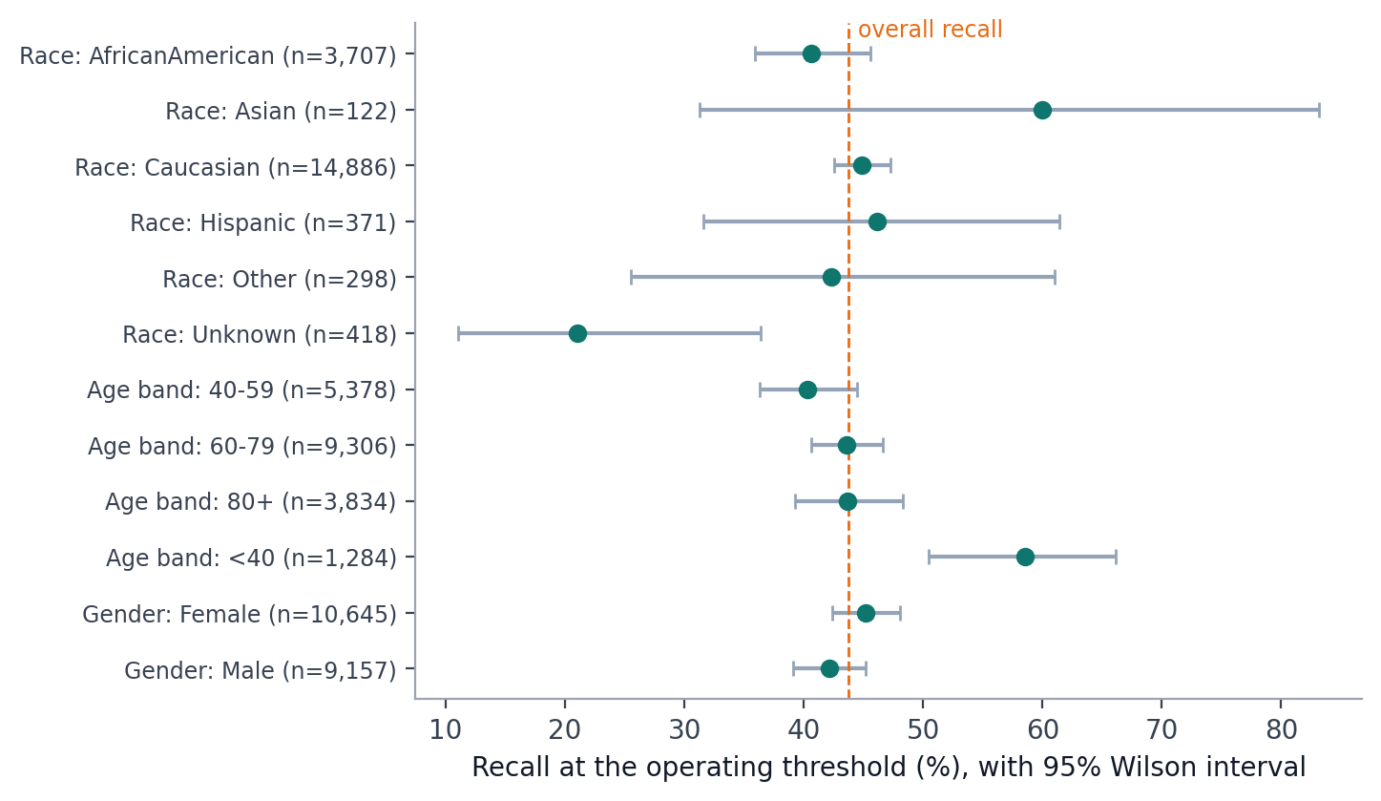
Fairness: which gaps to trust
Race recall gap 0.39: driven by 122 Asian encounters (10 readmissions); intervals overlap
Age: recall 0.58 under 40 vs 0.40 at 40–59; intervals do not overlap
Gender gap 0.03: within the 0.10 review threshold
Notes:
We checked recall, false-positive rate and AUC across race, gender and age at the operating threshold, with Wilson intervals. The large race gap comes from a group of 122 encounters with only 10 readmissions, and its interval overlaps the others, so it is more plausibly noise. The age differences are better supported. Gender is within the review threshold. This is a visibility tool, not a fairness certification.

Slide 8
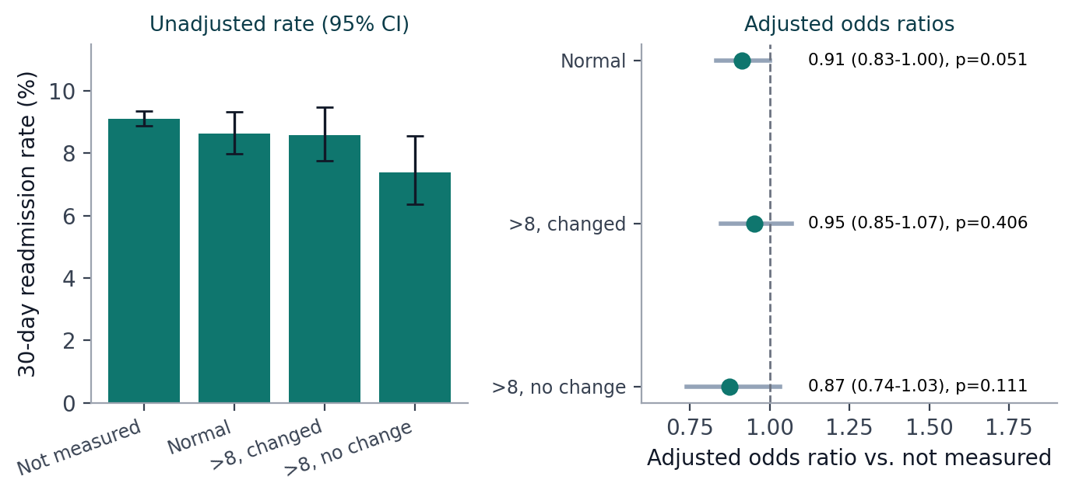
HbA1c testing and readmission
9.1% → 7.4%
unadjusted rate, not measured vs high without change
None significant
adjusted ORs 0.87–0.95, all p > 0.05
p = 0.007
n = 69,987 patients, one encounter each; adjusted for age, race, gender, admission source, discharge, stay and diagnosis.
effect depends on primary diagnosis
Notes:
This is a replication-style analysis of the question in the paper that introduced this dataset. Unadjusted rates fall from not measured to measured with no medication change, and all three adjusted odds ratios are below one, matching the direction of the paper, but none is individually significant. The association does depend on primary diagnosis. HbA1c testing is clinically selected, so there is no causal claim, and this is not an exact reproduction of the published cohort.

Slide 9
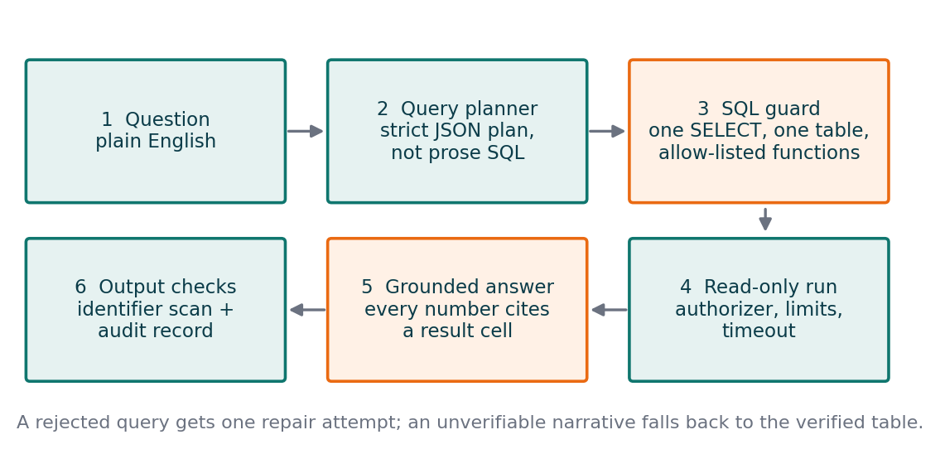
An assistant that cannot invent numbers
12 / 12
curated questions correct, live (local Qwen 2.5 14B)
Found by live testing, now fixed:
Unsupported SQL: one repair attempt
Over-strict rounding check
A prompt change that returned one row
One SELECT, one table, allow-listed functions, read-only, time-limited
Every number in an explanation must cite a result cell
Notes:
Users ask in plain English. The model only proposes a structured plan; the SQL guard and a database authorizer independently enforce one read-only query; any explanation must cite real result cells or the exact table is shown instead. On 12 curated questions run live on a local 14-billion-parameter model, all 12 were correct. Live testing found three defects that unit tests missed, and each is now fixed and tested.

Slide 10
Live demo
1
Data Quality what is missing, definitions, lineage
2
Research HbA1c study and cohort comparison
3
Predictive model card, threshold explorer, fairness
4
Assistant suggested question, chart, validated SQL
5
Report one-click printable PDF
Notes:
Live demo, about five minutes. Open the tabs in this order. If the assistant is slow, use a suggested question; if anything fails, play the recorded video and open the saved PDF. See docs/DEMO_CHECKLIST.md.

Slide 11
Limitations and responsible use
Limitations
Responsible use
Data from 1999–2008, no dates: no temporal or external validation
Modest signal: ROC-AUC about 0.67
Small subgroups limit fairness conclusions
Observational: associations, not causes
De-identified data; identifiers never exposed by the assistant
Both readmission definitions labelled everywhere
Model card and “not for clinical use” notices
Real deployment needs clinical validation, governance and real authentication
Notes:
Be upfront about the limits. The data are old and undated, there is no external validation, calibration used cross-validation inside the training split, and stored scores include training rows. For responsible use: de-identified data, identifiers never exposed by the assistant, prompts stored only as hashes, labelled definitions, demonstration-only screens hidden by default, and a not-for-clinical-use notice on every prediction page.

Slide 12
Conclusions
1
A leakage-safe, calibrated model (ROC-AUC 0.669)
catches 43.8% of readmissions at a validation-chosen cutoff, with its limits stated
2
Fairness and statistics reported with uncertainty
supported gaps separated from likely noise; HbA1c results stated honestly
3
An assistant whose answers are validated and evidence-checked
12 of 12 curated questions correct live
Questions?
Notes:
Close on the methodological lesson: with modest predictive signal, the care taken over the split, the threshold and the reporting determines whether results can be trusted. Then invite questions.

