Slide 1
REVIEW III · PANEL EVALUATION
NEXUS
Physical Intelligence Platform — Implementation, Technical Accuracy & Results Obtained So Far
Simulated cyber-physical validation · Backend + Frontend + Rule Engine + Digital Twin + AI Explanation

Slide 2
AGENDA
What this review covers
01
Implementation
5 marks
Modules completed, executable and attributable to the team
02
Technical Accuracy
5 marks
Methods, algorithms, parameters and implementation practices
03
Results Obtained So Far
5 marks
Metrics, tables, graphs, and technically sound interpretation
04
Presentation & Clarity
5 marks
Logical explanation, justified decisions, Q&A readiness
NEXUS — Physical Intelligence Platform · Review III
2 / 15

Slide 3
SYSTEM OVERVIEW
TECHNICAL ACCURACY
The implemented pipeline
Telemetry
→
Digital Twin
→
Event
→
Rule Match
→
Action
→
Command
→
ACK
→
Persistence
• MQTT contract: real ESP32-equivalent topics (nexus/devices/{id}/telemetry|status|commands|commands/ack), QoS 1, LWT for online/offline status.
• Device model: each ESP32 = one Device; sensors/actuators = DeviceCapability rows (READ/WRITE) — never one device per sensor.
• Correlation: one correlationId minted per ingested telemetry message, threaded through twin update, event detection, rule matching and action dispatch — reconstructable end-to-end via pipeline_traces.
• Simulation ≠ physical claim: all 3 devices run in DeviceMode.SIMULATED; the same contract is designed so a real ESP32 can be substituted with zero backend changes.
NEXUS — Physical Intelligence Platform · Review III
3 / 15

Slide 4
IMPLEMENTATION
IMPLEMENTATION
Modules completed — executable, attributable to the team
Backend (Spring Boot / Java)
Frontend, Simulator & Tooling
• Device & capability model (READ/WRITE, multi-channel RELAY)
• MQTT ingestion + command dispatch (Eclipse Paho)
• Digital Twin registry (per-capability, DB-backed)
• Event detector (TWIN_CREATED / UPDATED / VALUE_CHANGED)
• Rule engine incl. device-aware multi-capability conditions
• Command validator per capability type
• Pipeline trace + correlation ID system
• Evidence-grounded AI explanation endpoint
• React/TypeScript operations UI (Telemetry, Twins, Rules, Events, AI, Analytics)
• Python capability-driven ESP32 simulator package
• grand_simulation.py — 3-device, 9-scenario validation harness
• Idempotent device + rule provisioning
• start_nexus.py / stop_script.py dev orchestration
• 709 backend + 2269 frontend automated tests
NEXUS — Physical Intelligence Platform · Review III
4 / 15

Slide 5
TECHNICAL ACCURACY
TECHNICAL ACCURACY
Device & capability model
• CapabilityType enum: TEMPERATURE, HUMIDITY, PRESSURE, GAS, MOTION, BUTTON, LED, FAN, BUZZER, SERVO, RELAY.
• Direction: READ / WRITE, enforced per DeviceCapability row.
• Uniqueness constraint: UNIQUE(device_id, capability_type, direction) — RELAY is always exactly one row, never four.
• Multi-channel actuators: RELAY channels expressed as metadata.channels (e.g. [1,2,3,4]) on a single capability, not four separate capabilities.
• Command validation is capability-aware: LED/FAN/BUZZER require boolean; SERVO requires integer 0–180; RELAY requires {channel, state} with channel checked against provisioned metadata.
3 simulated ESP32 devices, 11 capabilities
Device | Capabilities | Direction
ESP32-ENV-01 | TEMPERATURE, HUMIDITY, PRESSURE | READ
ESP32-SAFETY-01 | GAS, MOTION, BUTTON | READ
ESP32-ACTUATOR-01 | LED, BUZZER, SERVO, FAN, RELAY×4 | WRITE
Device identity is stable across runs (serialNumber-based idempotent provisioning) — repeated executions never create duplicate devices or capabilities.
NEXUS — Physical Intelligence Platform · Review III
5 / 15

Slide 6
TECHNICAL ACCURACY
TECHNICAL ACCURACY
Rule engine & multi-capability evaluation
• Condition model: field (DEVICE_ID / VALUE) × operator (EQ, NE, GT, LT, GTE, LTE) × expectedValue, with an optional capabilityType discriminator.
• Device scoping: enforced purely via a DEVICE_ID = EQ condition — no implicit device binding exists.
• Multi-capability semantics: a capability-typed condition reads its value from the live per-device Digital Twin registry, independent of which telemetry message triggered evaluation — so GAS and MOTION can be read at different timestamps and still jointly match.
• Cooldown: per-rule cooldownSeconds gate prevents re-firing on every tick while a condition remains true.
Verified example — measured, not illustrative
Rule “Gas+Motion Safety Event”: DEVICE_ID = SAFETY-01 AND GAS GT 500 AND MOTION EQ true
Measured evaluation: GAS = 700.9 ppm (twin state at 20:10:05.912Z) MOTION = true (twin state at 20:10:00.908Z)
→ 5.0 seconds apart, from two independently-updated capabilities on the same device → rule matched → BUZZER + FAN + RELAY CH1 commanded.
NEXUS — Physical Intelligence Platform · Review III
6 / 15

Slide 7
TECHNICAL ACCURACY
TECHNICAL ACCURACY
Command dispatch, ACK & MQTT contract
• Command topic: nexus/devices/{deviceId}/commands, QoS 1.
• Payload: {commandId, capability, command:"SET_STATE", value, timestamp}.
• Preconditions checked in order: device exists → mode ≠ REAL → WRITE capability exists → value validates → device connectivity ONLINE → broker connected.
• ACK topic: nexus/devices/{deviceId}/commands/ack, QoS 1.
• Correlation: commandId == ActionHistory.requestId — the ACK handler looks up the exact pending record and applies the acknowledgement idempotently (safe under QoS1 redelivery).
Measured command outcomes (this run)
Capability | Value type | Count | ACK
LED | boolean | 8 | ACCEPTED
FAN | boolean | 121 | ACCEPTED
BUZZER | boolean | 6 | ACCEPTED
RELAY | {channel,state} | 4 | ACCEPTED
SERVO | int 0–180 | 3 | ACCEPTED
SIMULATED DEVICE ACK ≠ PHYSICAL ACTUATOR OUTCOME. Every ACCEPTED above means the simulated ESP32 validated and applied the command to its own internal state — not a physical-world claim.
NEXUS — Physical Intelligence Platform · Review III
7 / 15

Slide 8
VALIDATION METHODOLOGY
RESULTS OBTAINED SO FAR
The Grand Simulation run
• What it is: grand_simulation.py — 3 simulated ESP32 devices exercising the full real pipeline over real MQTT for 230 continuous seconds.
• Why it's valid evidence: no shortcuts — telemetry travels over the same MQTT contract a physical ESP32 will use; rules, twin, events and commands are the real backend code paths, not mocks.
Normal
High
Temperature
Motion
Detected
Gas
Alert
Gas+Motion
(multi-cap)
Relay
Control
Servo
Control
Button
Press
Recovery
All 9 scenarios completed in one continuous run — confirmed from the simulation's own timestamped console log.
NEXUS — Physical Intelligence Platform · Review III
8 / 15

Slide 9
RESULTS OBTAINED SO FAR
RESULTS OBTAINED SO FAR
Key metrics
709 / 709
2265 / 2269
9 / 9
Backend tests passed
Frontend tests passed
Validation scenarios completed
mvnw.cmd test
npm run test -- run (4 pre-existing failures)
grand_simulation.py console log
+132
+142
+694
Rule matches generated
Commands executed, 100% ACCEPTED
Pipeline traces generated
rule_matches table, before/after
action_history table, before/after
pipeline_traces table, before/after
NEXUS — Physical Intelligence Platform · Review III
9 / 15

Slide 10
RESULTS OBTAINED SO FAR
RESULTS OBTAINED SO FAR
Expected vs. observed
Scenario | Expected | Observed | Result
High Temperature | TEMPERATURE > 35 → FAN ON | Rule matched vs. live twin; FAN ACCEPTED | PASS
Gas Alert | GAS > 400 → BUZZER ON | Matched with real GAS > 400ppm reading | PASS
Gas + Motion | GAS>500 & MOTION=true → Buzzer+Fan(+Relay) | GAS=700.9, MOTION=true → all 3 commands ACCEPTED | PASS
Relay / Servo Control | Manual commands accepted via REST | 6 manual commands, all SUCCESS | PASS
Button Press | BUTTON=true → LED ON | Matched with real BUTTON=true telemetry | PASS
Recovery | TEMPERATURE<26 → FAN OFF (auto) | Recovery rule fired repeatedly as expected | PASS
Multi-Device Isolation | Device B rule must not fire from Device A | 43→43 (other device); 43→44 (correct device) | PASS
Restart Persistence | State must survive backend restart | All DB counts + twin state identical before/after | PASS
NEXUS — Physical Intelligence Platform · Review III
10 / 15

Slide 11
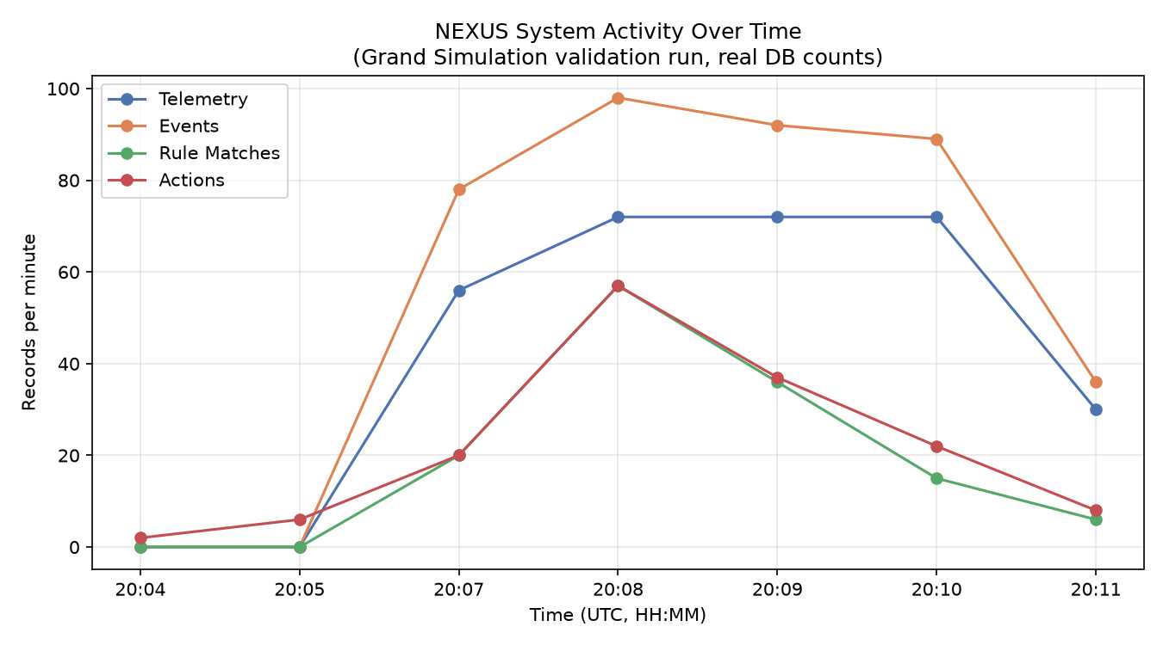
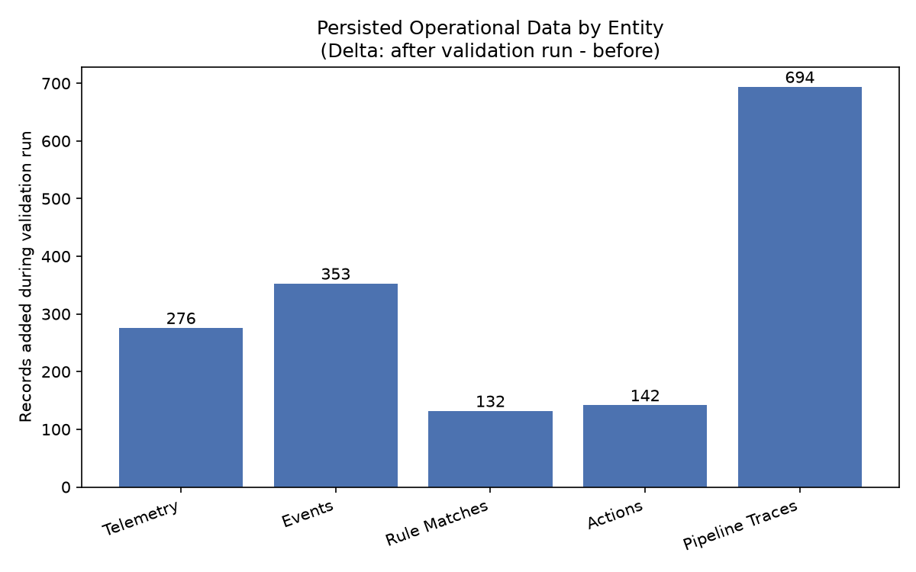
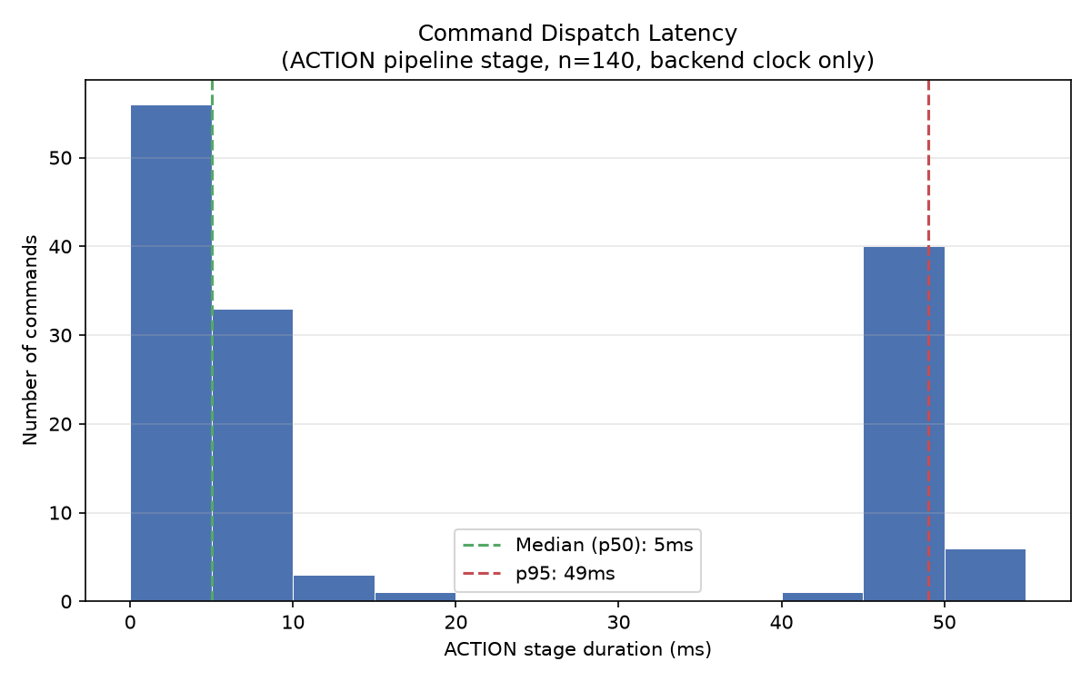
RESULTS OBTAINED SO FAR
RESULTS OBTAINED SO FAR
System activity — measured, not illustrative
Telemetry, events, rule matches and actions per minute — the four pipeline stages rise and fall together as the Gas+Motion event peaks, showing they are causally linked.
Records added per entity during the run — every pipeline stage produced durable, persisted output, not just telemetry ingestion.
ACTION stage duration, backend clock only (n=140, median 5ms). Deliberately narrower than a full ACK round-trip — see limitations.
NEXUS — Physical Intelligence Platform · Review III
11 / 15

Slide 12
RESULTS OBTAINED SO FAR
RESULTS OBTAINED SO FAR
Multi-capability reasoning & device isolation
Multi-capability: GAS + MOTION
Multi-device isolation (controlled test)
• GAS = 700.9 ppm (evaluated 20:10:05.912Z)
• MOTION = true (evaluated 20:10:00.908Z)
• 5 seconds apart → read from independently-updated twin state, not one lucky event
• Result: RELAY CH1, BUZZER, FAN all commanded — all ACCEPTED
• Negative control: MOTION=true published to a DIFFERENT device → rule match count unchanged: 43 → 43
• Positive control: same signal published to the CORRECT device → count incremented exactly once: 43 → 44
• Conclusion: device-scoped rules cannot be triggered by another device's state — proven, not assumed.
NEXUS — Physical Intelligence Platform · Review III
12 / 15

Slide 13
RESULTS OBTAINED SO FAR
RESULTS OBTAINED SO FAR
Persistence & evidence-grounded AI
Component | Before restart | After restart | Result
Rules | 9 | 9 | PASS
Rule Matches | 826 | 826 | PASS
Action History | 893 | 893 | PASS
Pipeline Traces | 30,531 | 30,531 | PASS
Digital Twin state | identical | identical, 0 new telemetry | PASS
AI explanation — evidence-grounded, not free-form
• GAS observed 700.9, required > 500 — condition met [FACT]
• MOTION observed true, required = true — condition met [FACT]
• 2 SEND_COMMAND actions recorded, status SUCCESS [FACT]
• Whether this reflects a genuine physical hazard cannot be determined from available evidence [UNKNOWN]
Every FACT traces to a persisted DB record; the system explicitly flags what it cannot know rather than guessing. No accuracy claim is made.
NEXUS — Physical Intelligence Platform · Review III
13 / 15

Slide 14
TECHNICAL INTERPRETATION
What these results prove — and what they don't
1. The pipeline executes end-to-end from simulated telemetry to acknowledged action — shown by a 694-record pipeline-trace delta with real timestamps, not asserted.
2. Multi-capability rules correctly reason over independently-updated twin state, not a single triggering event.
3. Device-scoped rules are provably isolated — demonstrated with a negative and positive control, not assumed.
4. Command validation is capability-aware and every dispatched command in this run passed validation and was acknowledged.
5. Operational state is PostgreSQL-backed and survives a backend restart with zero measured loss.
Disclosed honestly, unprompted
All results are from SIMULATED devices (DeviceMode.SIMULATED), never claimed as physical. On real hardware: PIR, Push Button, LED, Buzzer are TESTED; BME280 is NOT VERIFIED; MQ-2 is PARKED; Servo, Fan, Relay are NOT TESTED. A transient MQTT session issue was observed and self-cleared during this session — disclosed rather than hidden. The command→ACK latency field (action_history.ack_received_at) uses a whole-second-truncated device timestamp and cannot reliably measure round-trip time; the latency graph instead uses the ACTION pipeline stage's backend-clock duration — a real but narrower metric, reported rather than a misleading number.
NEXUS — Physical Intelligence Platform · Review III
14 / 15

Slide 15
SUMMARY
The system runs. We measured it.
→ 709 backend + 2265 frontend tests passing, freshly re-verified
→ 9/9 scenarios executed live across 3 simulated ESP32 devices, real MQTT contract
→ 132 rule matches, 142 acknowledged commands, 694 pipeline traces — all measured before/after
→ Multi-capability reasoning and multi-device isolation independently proven with controlled tests
→ Zero data loss across a backend restart; limitations disclosed transparently
Thank you — questions welcome.

