Slide 1

Quantile - Based Estimation and Forecasting

Slide 2
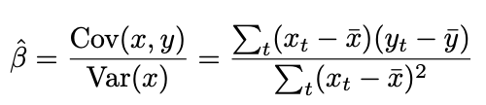

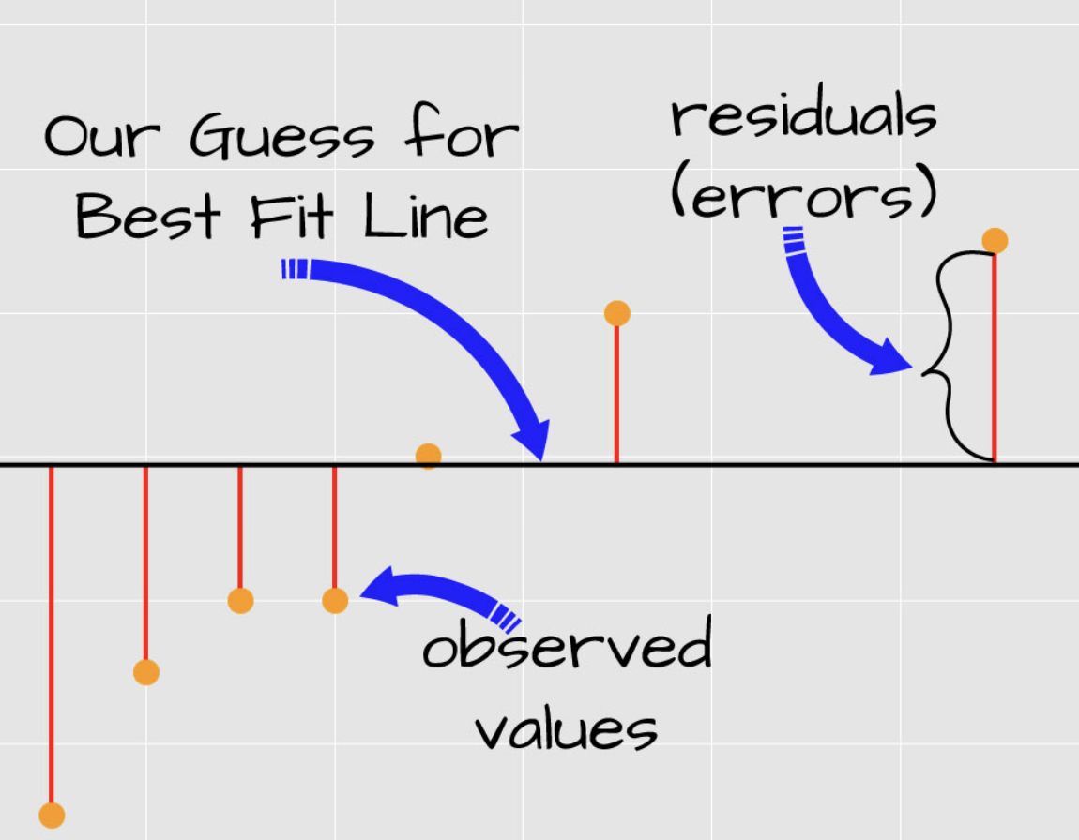
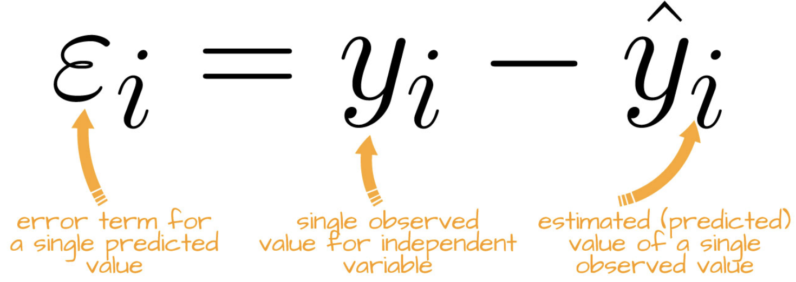
Simple Linear Regression Model
Key Characteristics
Math Formulations
BLUE
Homoskedastic
OLS-Ordinary Least Square
1
2
3

Slide 3
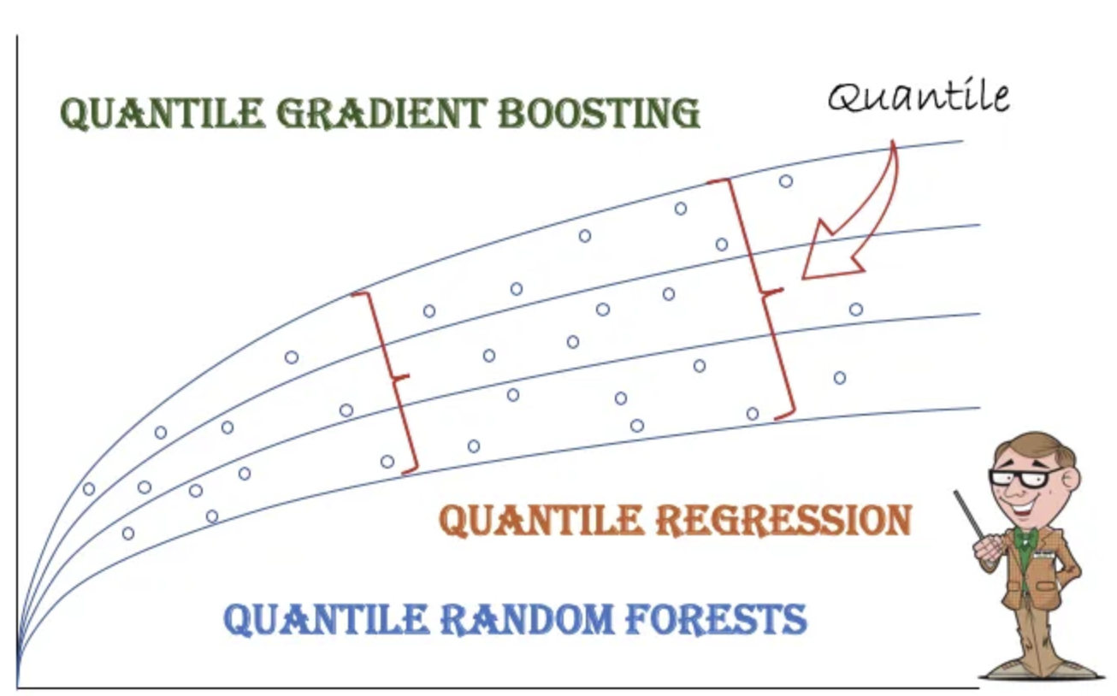
Quantile Regression Model
Koenker and Basset (1978)
An Introduction :
Quantile regression extends classical linear regression by estimating conditional quantiles of the response variable, rather than just the conditional mean. This provides a more complete view of relationships between variables, particularly useful when:
Data contains heteroskedasticity
Error distributions are non-normal
Outliers are present

Slide 4
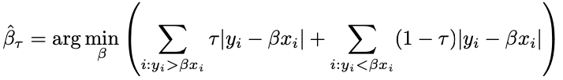

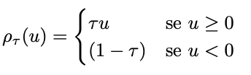
Detailed QR
Basic Definition
Compact Form
Penalties

Slide 5
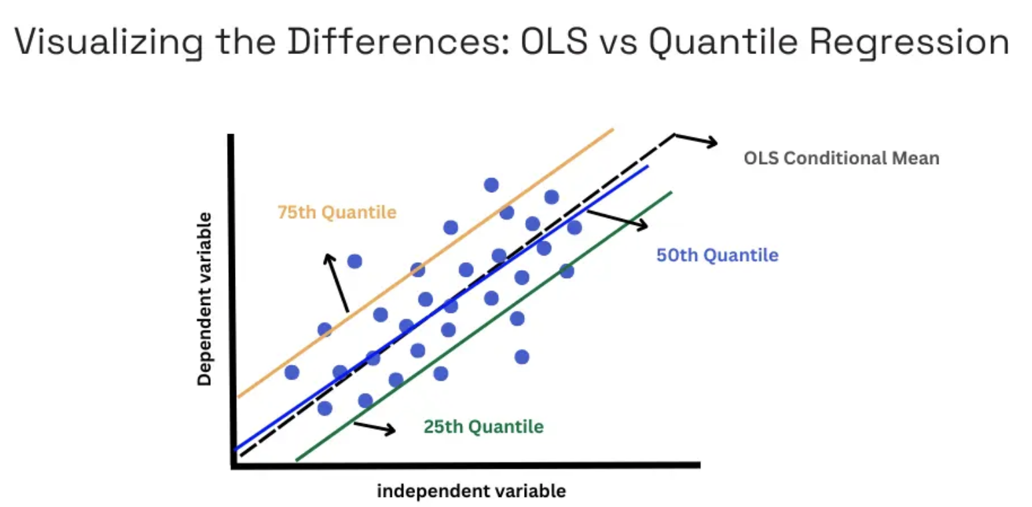
SLM :
Estimates conditional mean
Minimize squared residuals
Sensitive to outliers
Assumes :
normality,
homoscedasticity,
and indipendence
Beast for average trends
OLS VS QR
QR:
Estimates conditional quantiles
Uses asymmetric absolute loss function
Robust to outliers and heteroschedasticity
Reveals impact at different points of distribution

Slide 6

Set Up for the Analysis
Length(observations_of_CO2) = 625
k | 𝝉 (tau level)
1 | 0.25
2 | 0.5 (MEDIAN)
3 | 0.75
Next Step consists into applying :
Criterion 1 : w_k ∝ 1- | 2𝝉_k -1|
Criterion 2 : w_k ∝ ϕ(Φ^1(𝝉_k)) / sqrt( 𝝉_k(1-𝝉_k))
CQR ( Composite Quantile Regression) : “crq.fit()”
Package : quantreg (the most Important) and
cqrReg
Pivotal Function : “rq()”
Useful for :
Objective : To estimate β in different zones of the Y distribution

Slide 7
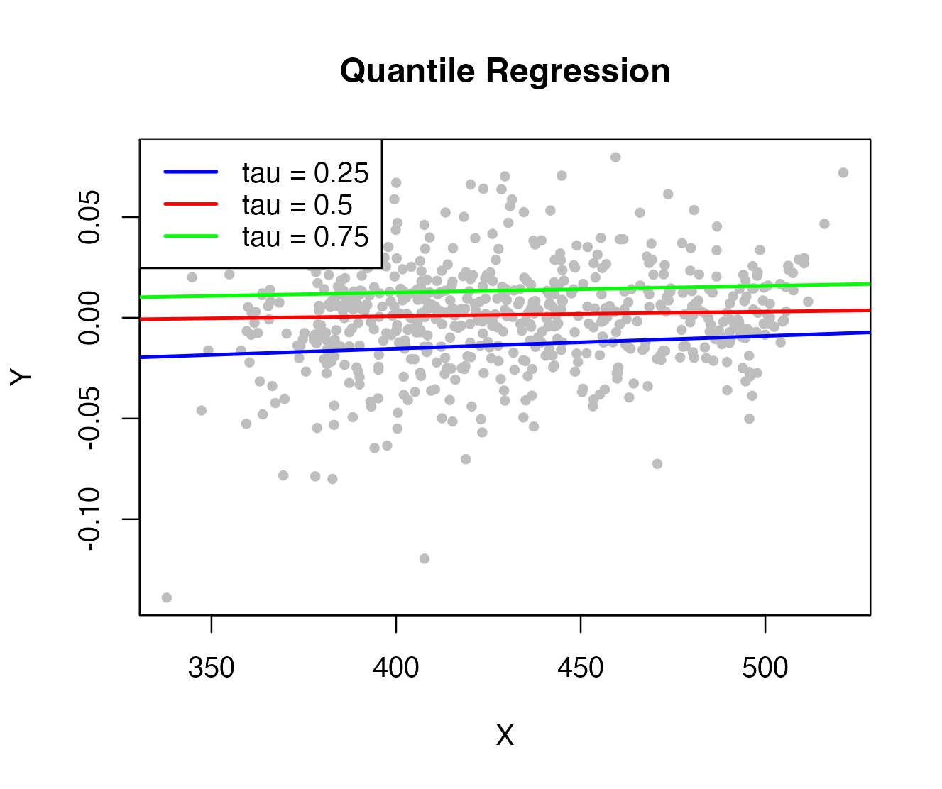
Quantile Regression Visulazation
Since we work with 625 obs. the QR results:
More ROBUST
And of course it is a HETEROSKEDASTIC model
R Function : quantiles <- rq(Dependent_variable_Y ~ Independent_variable_X, data = my_data, tau = taus)
OBSERVATIONS :
The three lines have slightly positive gradients, suggesting a weak but growing relationship between X and Y.
The different quantiles help to visualize how the distribution of Y as a function of X varies beyond the average, making the model more robust in the presence of outliers or asymmetric distributions.

Slide 8
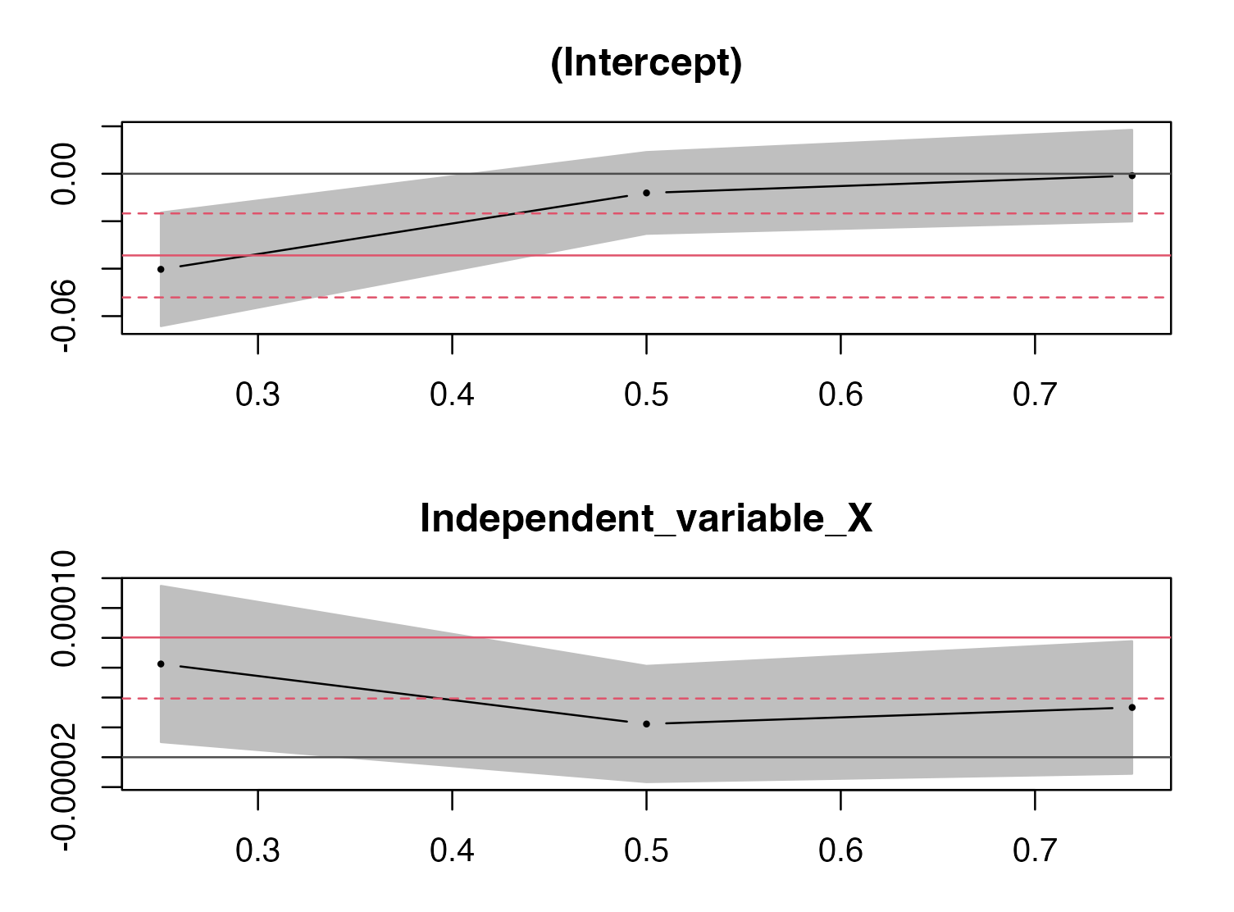
The Intercept increases as the quantile increases
The Coefficients are not constant among the quantiles
01
02
The effect of X on Y changes along the conditional distribution of Y, and is not Uniform
Values of Y increase in the highest quantiles equal to X
Summary ( quantiles, se = “nid”)
Significance Level
0.3025 (30.25%)
P-Value
0.05 (5%)
ANOVA
There are no statistically significant differences between the slopes.

Slide 9
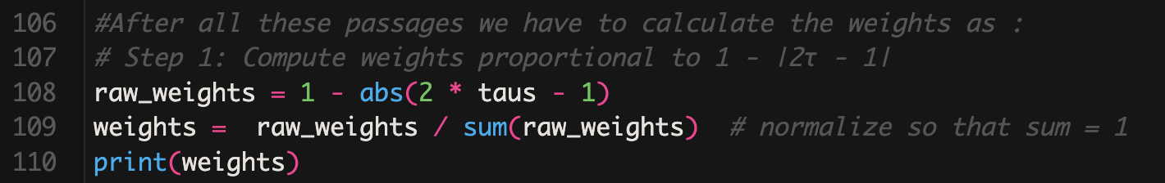
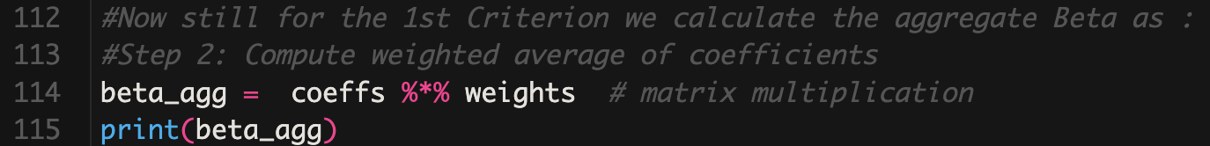
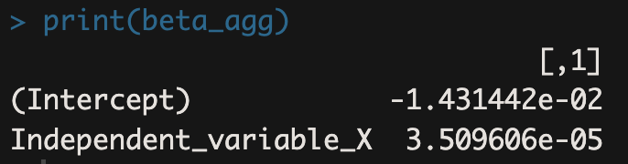
CRITERION 1
Not Normalized weights (v_k)
k | v_k
1 | 0.5
2 | 1
3 | 0.5
Sum of No-normalized Weights | = 2
Normalized weights (w_k)
k | w_k
1 | 0.5/2 = 0.25
2 | 1/2 = 0.5
3 | 0.5/2 = 0.25
Sum of Normalized Weights | = 1 (weights assumption respected)

Slide 10
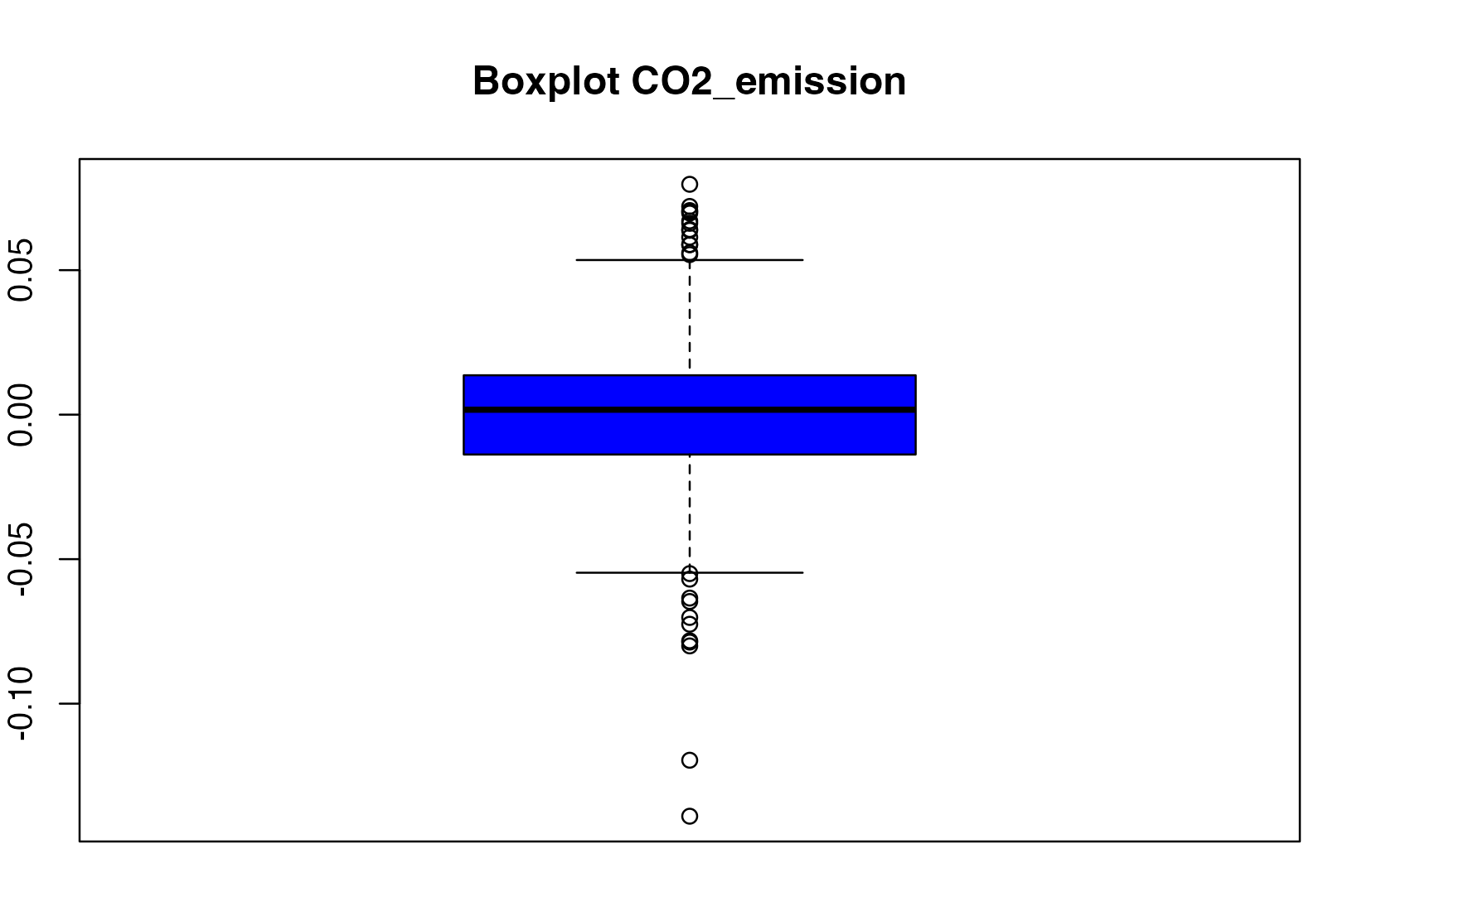
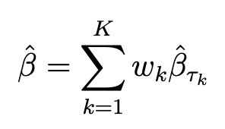
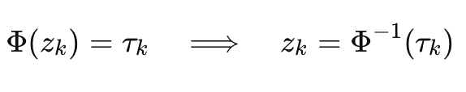

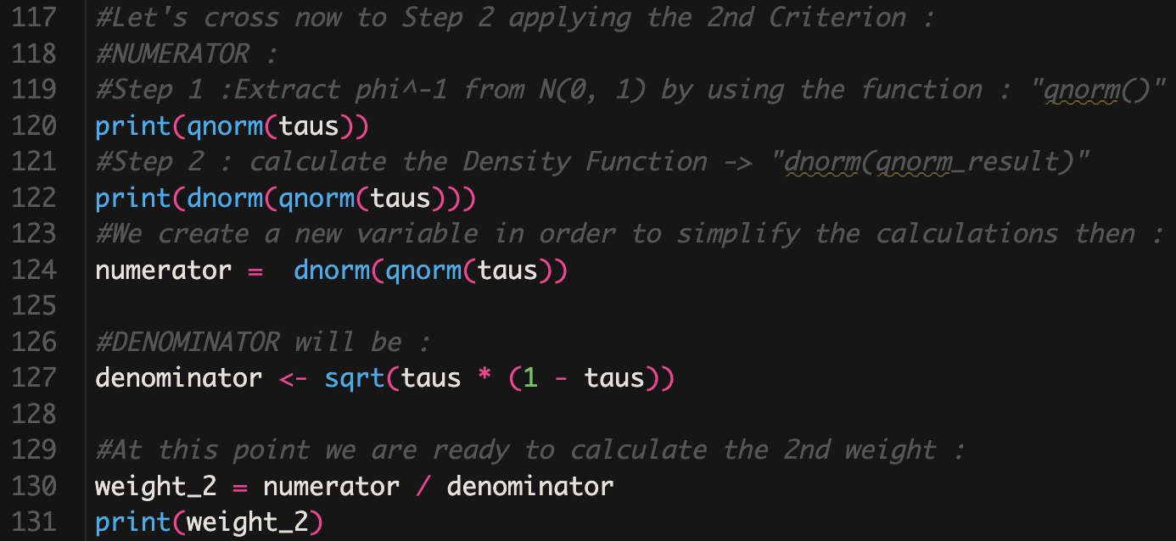

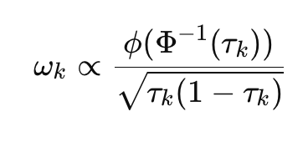
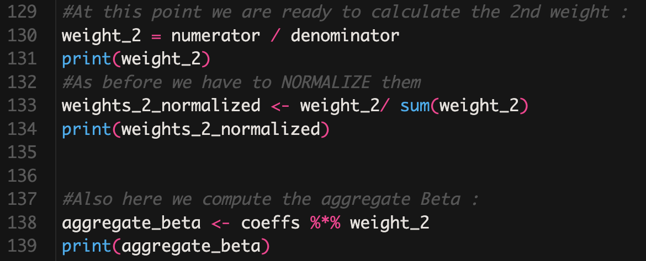
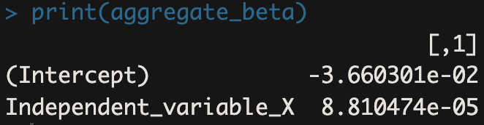
CRITERION 2
OBJECTIVE
Quantile Value | Density Value
-0.6744898 | 0.3177766
0 | 0.3989423
0.6744898 | 0.3177766

Slide 11
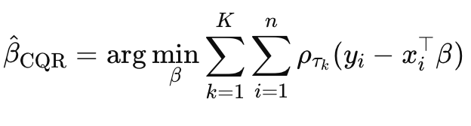
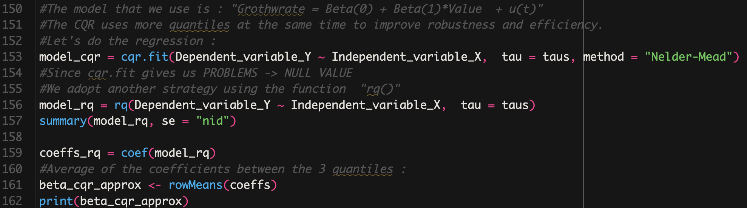
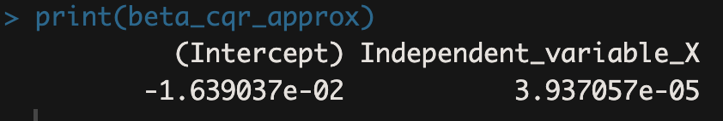
Objective : determine a single vector of coefficients
CQR(mean)
AN ALTERNATIVE STRATEGY

Slide 12
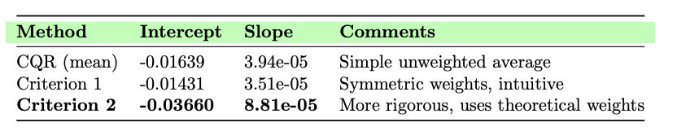
SHORT COMPARISON

Slide 13

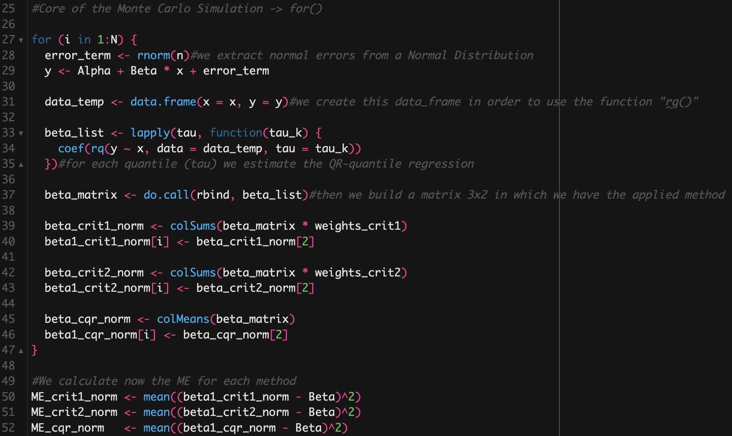
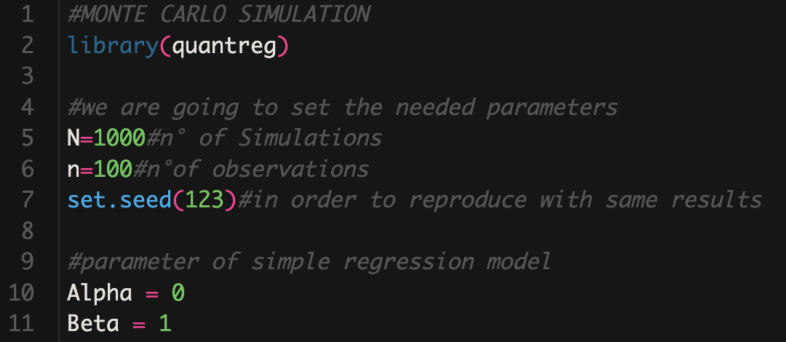
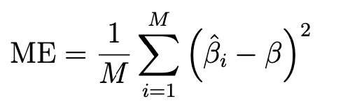
MSE CALCULATION
Core
Setting part

Slide 14
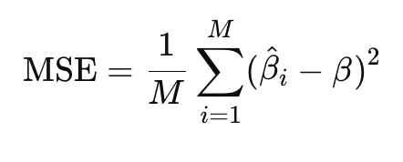
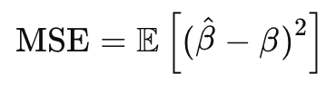


Decomposition
Initial Formula
TOT Errors
Stability or Instability ?

Slide 15
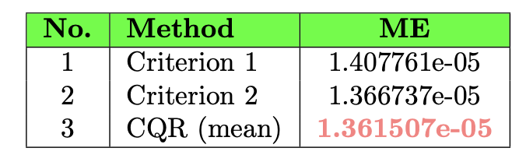

Normal Distribution Results: MSE Comparison
MSE-Marginal Squared Error
Conclusions
The weights are equal for all the quantile
MSE=$\frac{1}{M}\sum_{i=1}^{M}{(\hat{βi}}$-$β)^2$
Beta =1 -> the true value
M=1000 the number of simulation
MSE measures accuracy and consistency of each estimator
All 3 methods produce robust and accurate estimates of beta
Composite quantile regression performs better in terms of MSE
From the table we can see that CQR is the best

Slide 16
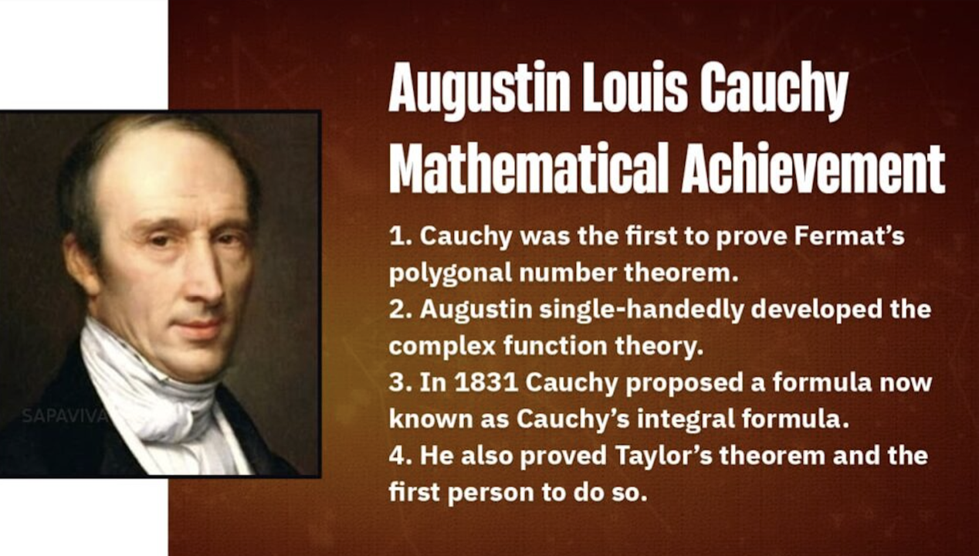
Cauchy Distribution : Testing Robustness
Expected value and variance and undefined.
Help to evaluate the ROBUSTNESS of the estimator respect to the presence of extreme value
Ols performs poorly
QR is more suitable

Slide 17
Set Up
Objective
Evaluate the robustness of the quantile regression estimators under heavy-tailed.
Compare the results with the previous normal error
Simulation Parameters
For the Cauchy distribution analysis, we maintain consistent methodology while changing only the error distribution:
Error term follows a Cauchy distribution with location parameter = 0
Scale parameter = 1 (determines the width of the distribution)
True slope coefficient β remains unchanged from the normal case
Same number of simulation iterations to ensure comparability
Estimation Criteria
We apply identical estimation methods as in the normal case:
Criterion 1: Symmetric weights τ = (0.25, 0.5, 0.25)
Criterion Criterion 2: Efficiency-based weights τ = (0.3240, 0.3533, 0.3239)
CQR using simple averaging of three quantile estimates

Slide 18
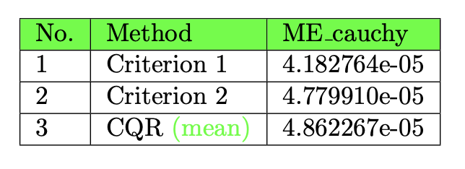
A lower MSE means a better accuracy !
Criterion1 perform better, is the most robust
Criterion 2 and CQR still perform well, but with some error

Slide 19
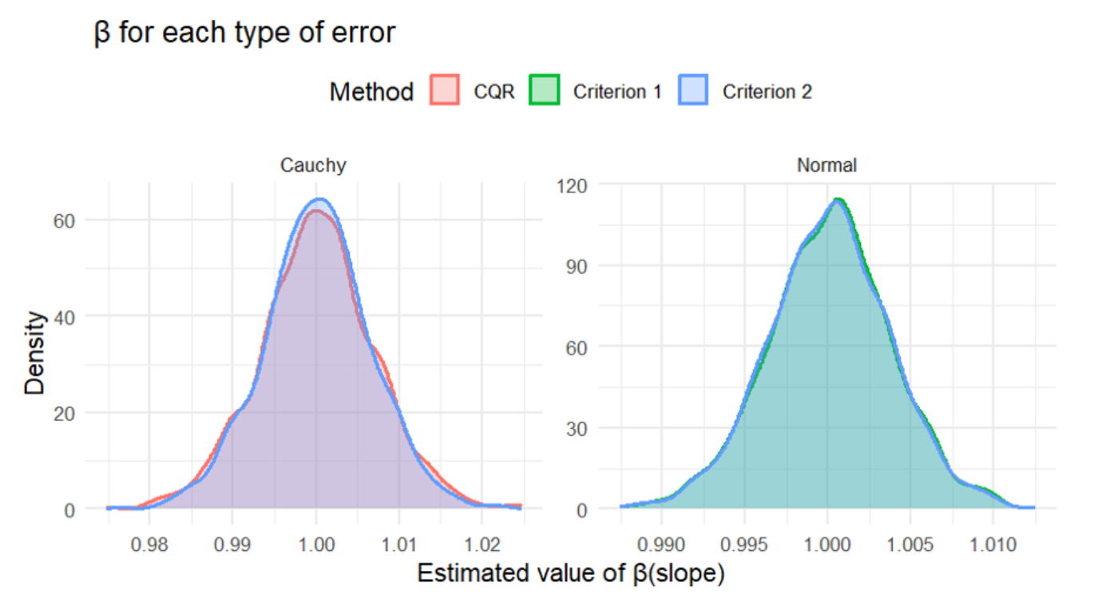
Comparison
Density plot show slope estimates distributions under both error types.
Under normal errors, all methods are accurate and consistent.
Under Cauchy errors:
OLS would fail
QR-based estimators still provide stable and concentrated estimates.

Slide 20
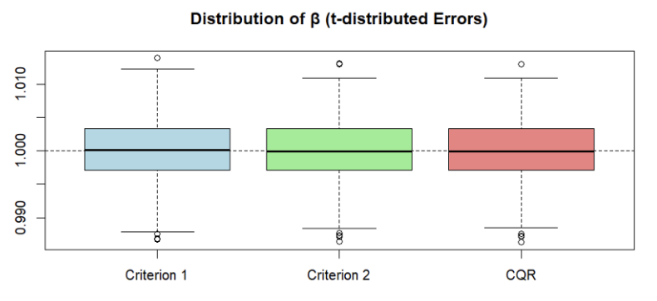
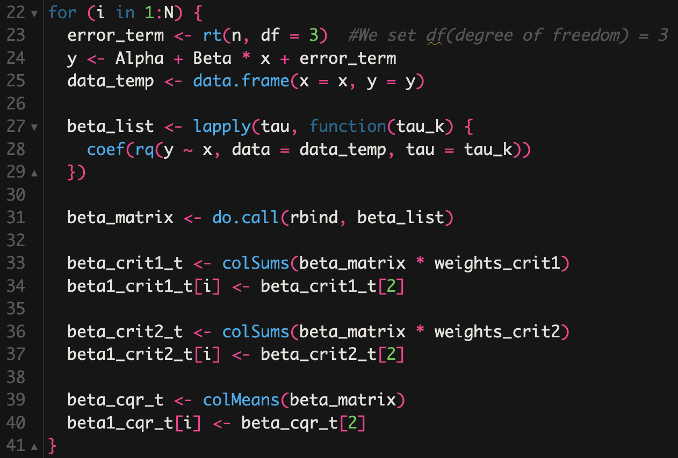
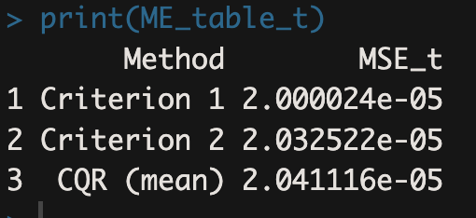
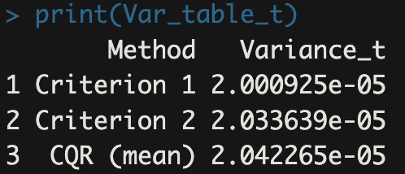
t-Student Distribution

Slide 21

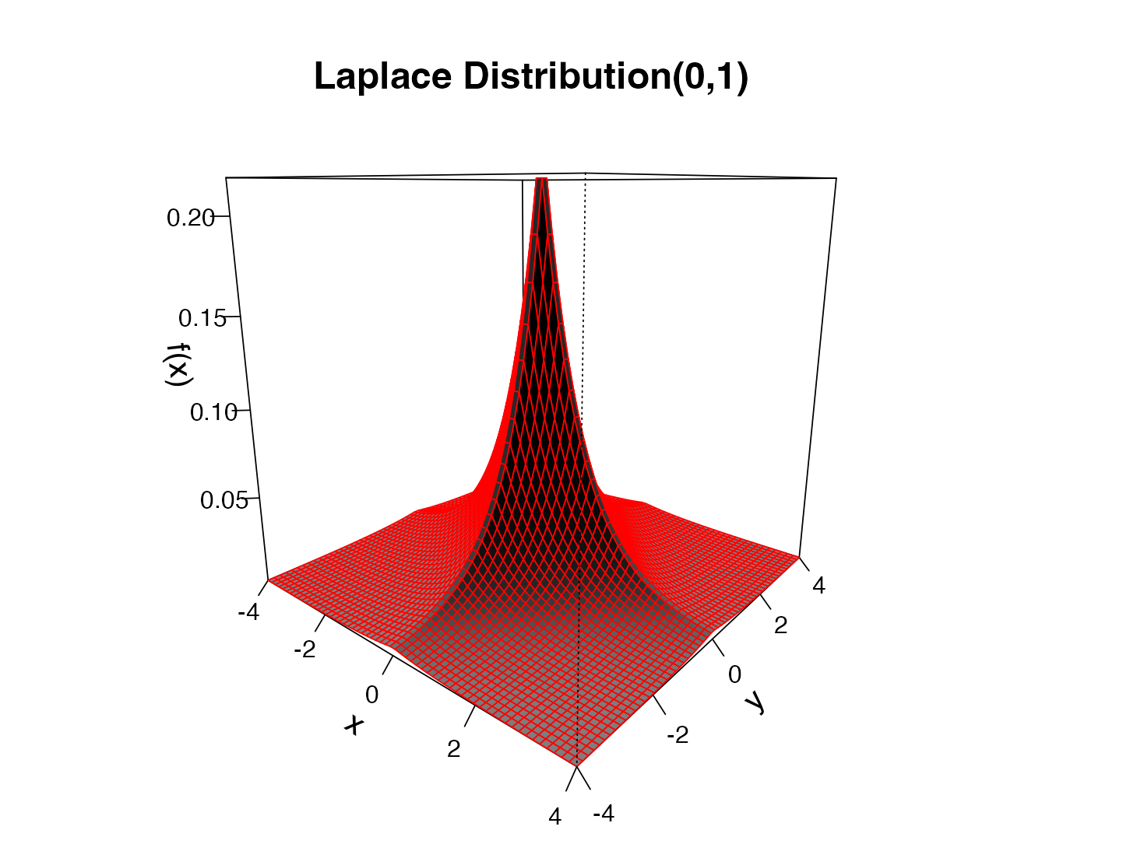

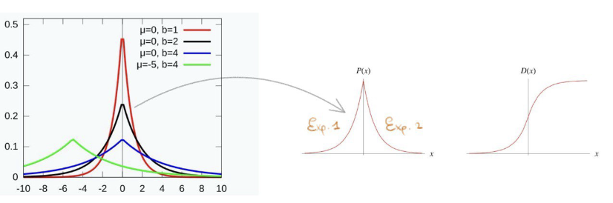

Slide 22
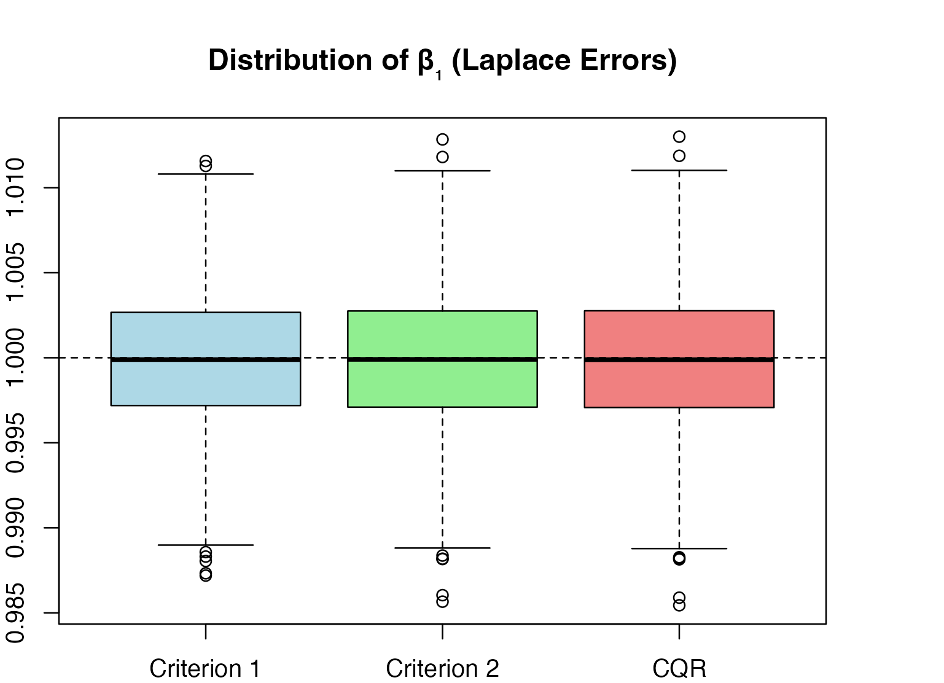
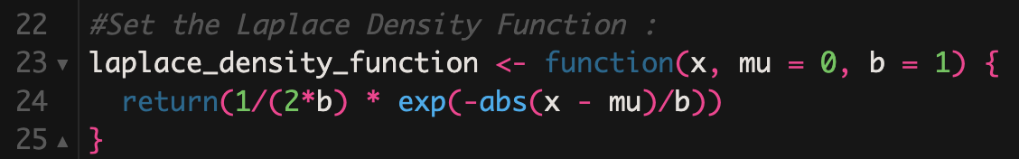
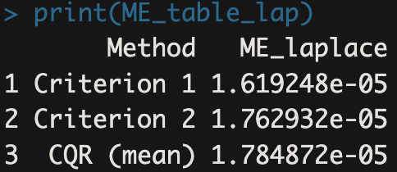
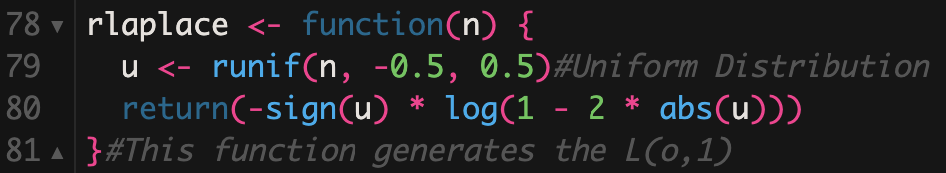
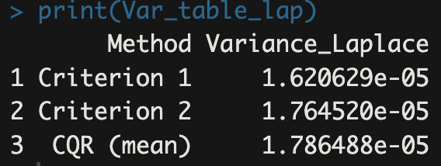
1
2
3

Slide 23
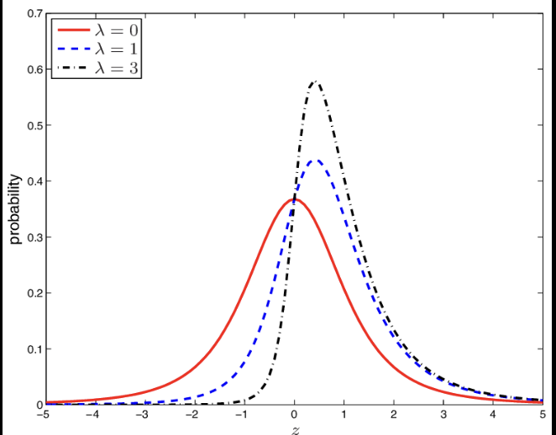
Skew-t Distribution function
It reflects realistic data scenarios in economics and finance.
Why Skew-t?
Combines asymmetry (skewness) and heavy tails
Capture non-normality in real world data
It is deal for testing estimator consistency and variance under complex error structure
The error term come from a Skew-t distribution with:
Location=0
Scale01
Skewness=5
Degree of freedom=5

Slide 24
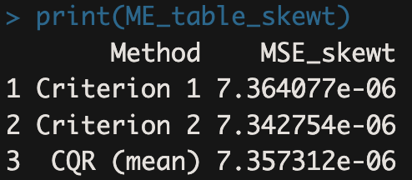
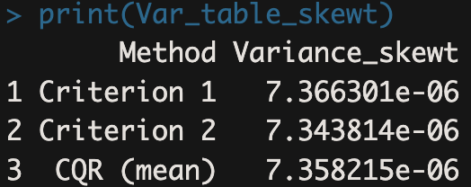
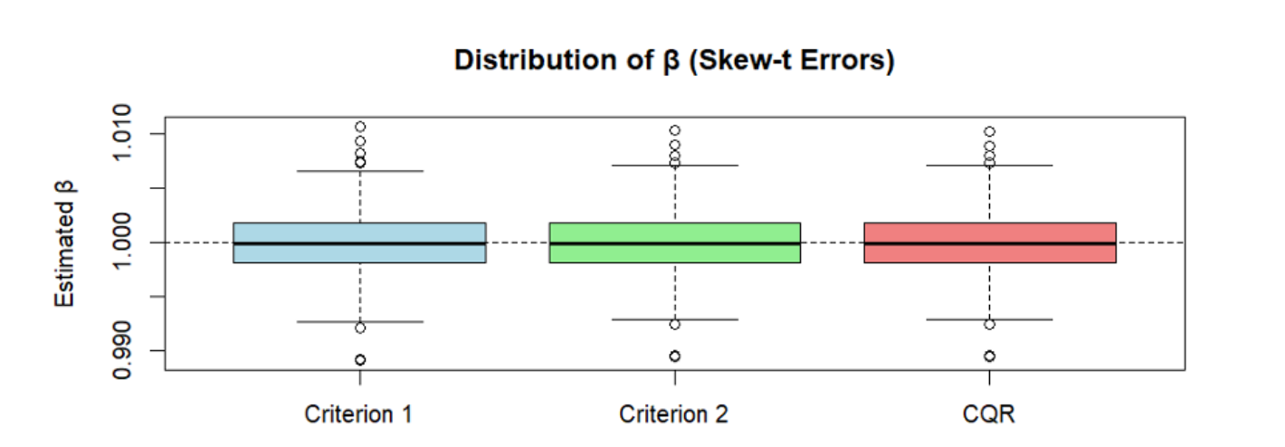
All 3 methods are robust under skewed and heavy-tailed error conditions. Differences in performance are minimal, but: Criterion 2 is slightly more efficient and consistent. CQR and Criterion 1 still deliver strong, unbiased estimates. Quantile regression remains a powerful tool for non-standard error settings.

Slide 25
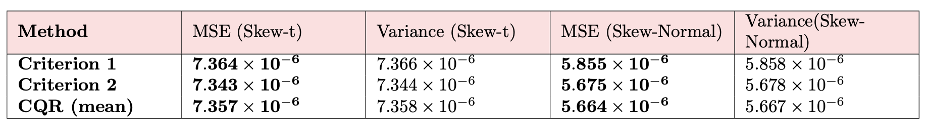
If we make the comparison:
While the skewness is the same, the tail behaviour strongly influences the performance.
With the light tails (SKEW-NORMAL ERROR), estimators are more stable and precise
With heavy tails (SKEW-T ERROR), we observe slightly higher variability
Skew-normal distribution function
The set up is the same:
Alpha=0
Beta=1
Xi is a deterministic sequence from 1 to 100
The error term come from a skew-normal distribution with:
Location=0
Scale=1
Skewness parameter alpha=5
N=1000
n=100
Is ideal for modelling dataset with mild skewness and limited extreme values

Slide 26
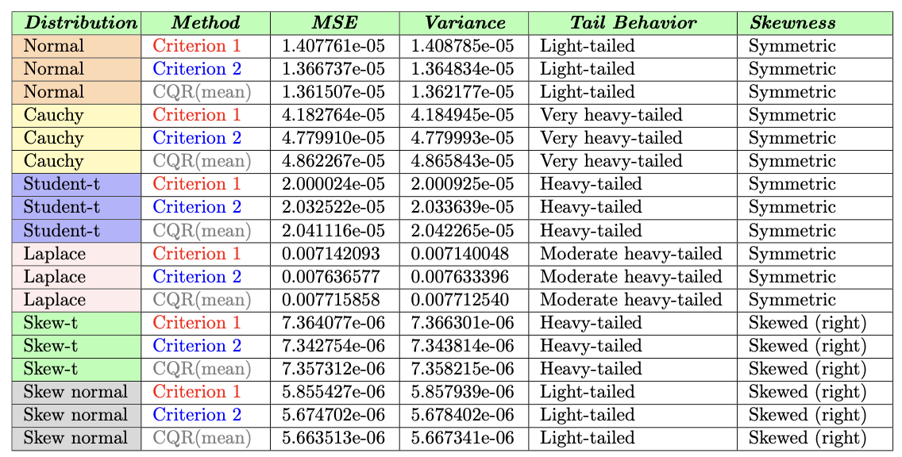
Performance across error distributions
PERFORMANCE VARIES BY TAIL BEHAVIOR AND SKEWNESS.
QR METHODS SHOW ROBUSTNESS

Slide 27


Analysis of CO2 growth rate
Objective
Investigate the short-term dynamics of CO2 emissions growth, using macroeconomic variable to explain and forecast fluctuations in emissions.
The GOAL is to explore both average and distributional effects using regression-based techniques

Slide 28

The macroeconomic indicators come from FRED (Federal Reserve Economic Data) and include:
Industrial Production Index (INDPRO)
Unemployment Rate (UNRATE)
Federal Funds Rate (FEDFUNDS)
Nonfarm Payrolls (PAYEMS)
Two regression models are used to study the relationship between CO₂ growth and the macro factors:
Ordinary Least Squares (OLS) – captures the average (mean) effect
Quantile Regression (QR) – estimates conditional quantiles

Slide 29

Environment setup and data cleaning
The analysis begins with:
Setting the working directory
Import the file CO2_SA.csv
Removing missing value (Nas) using na-omit() to ensure a complete dataset

Slide 30





Extract and Clean Data
Core Function
Proportion of Variances

Slide 31


Useful for DECISIONS

Slide 32




Slide 33

PC2 is strongly dominated by SP500

Slide 34


4 CLUSTERS
COVID-19

Slide 35

Rolling windows forecasting
To evaluate how well our models perform in real-world, out-of-sample prediction, we apply a rolling window forecasting procedure.
This method simulates a scenario where, at each forecast point, we only use past information, avoiding any look-ahead bias.
We use 623 monthly observations of CO2 growth:
The first 415 observation (2\3) are used for training
The remaining 208 (1\3) observations from the test set for rolling forecast

Slide 36


OLS forecasting
QR forecasting
For each point from t=416 to t=623:
We re-estimate an OLS model using an expanding window
A one-step-ahead forecast is generated
This create a sequences of 208 predictions
We evaluate performance using the Root Mean Squared Error (RMSE)
OLS RMSE is 0.11136, is the lowest error among all models
We repeat the process using quantile regression models:
Initially with tau=0.5 (the median)
Then extended to tau =0.25,0.5 and 0.75
RMSE:
$\sqrt{\frac{1}{H}\sum_{h=1}^{H}{(\hat{yt+h−}yt+h)^2}}$

Slide 37




The value of the QR are much higher than OLS, as expected.
Because QR is not optimized for minimizing squared errors.

Slide 38

Diebold-Mariano-test
The DM test is a widely used statistical tool to compare the predictive accuracy of two competing forecasting models.
In our case, we use DM test to assess whether the forecast errors from the OLS model differ significantly from those of the QR models at 3 quantiles:
τ = 0.25
τ = 0.5 (the median)
τ = 0.75

Slide 39

CASE 1: OLS vs QR at tau=0.5
DM statistic :-0.19703
p-value: 0.844
this high p-value means we cannot reject the null hypothesis. OLS and Q(at the median) perform equally well in terms of predictive accuracy
CASE 2: OLS vs QR at tau=0.75
DM statistic: –3.663
p-value: 0.0003166
This result is highly significant at the 5% level (α = 0.05). QR at τ = 0.75 performs significantly better than OLS, especially for upper-tail outcomes

Slide 40

Linear and Quantile regression - CO2 analysis

Slide 41


QR across multiple quantiles – CO2 analysis

Slide 42

𝝉 = 0.1 low income
𝝉 = 0.5 median
𝝉 = 0.9 high income
Relationship between :
age
jobclass
wage outcom
QR – FRED-MD analysis

Slide 43


Slide 44
Conclusion Fred-MD analysis
• QR provides deeper insight than OLS for wage determinants
• Age and experience prove more influential for high earners than low earners
• OLS misses these crucial nuances across the wage distribution
• QR is valuable for understanding :
inequality ,
wage dynamics,
and labor market structure

