Slide 1
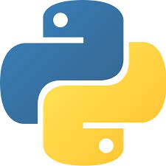
Python
Python [1]

Slide 2
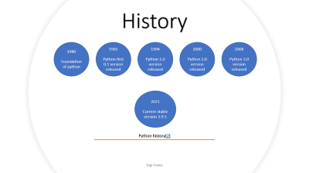
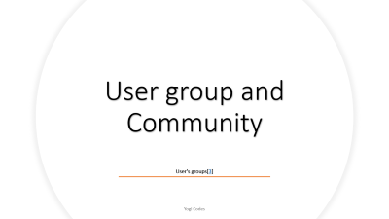
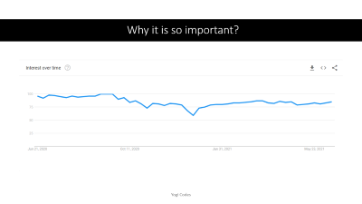

Slide 3
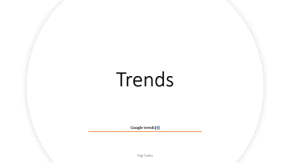
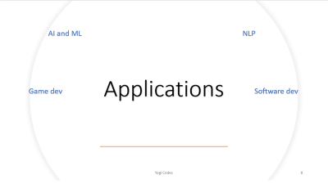


Slide 4
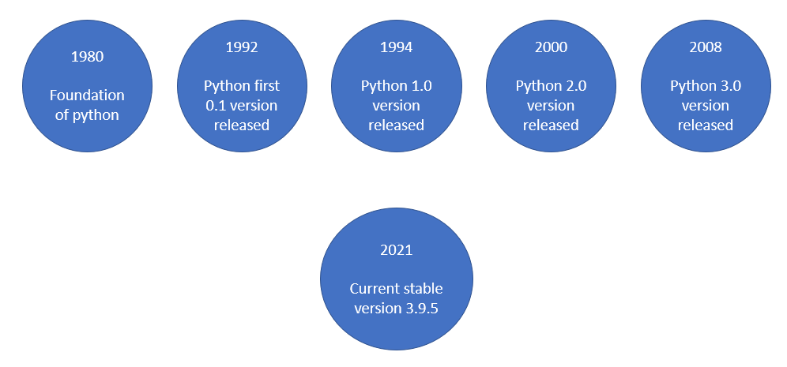
History
Python history[2]

Slide 5
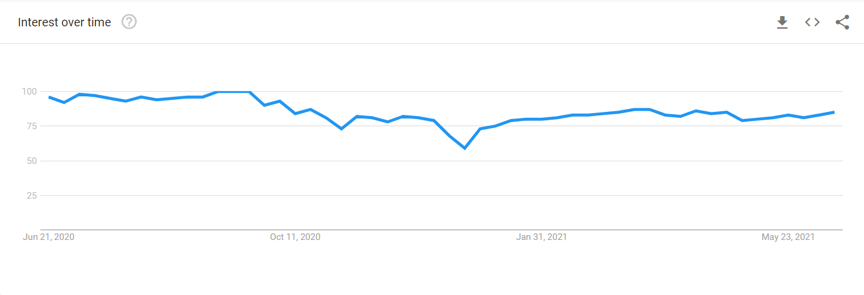
Why it is so important?

Slide 6
User group and Community
User's groups[3]

Slide 7
Trends
Google trends[4]

Slide 8
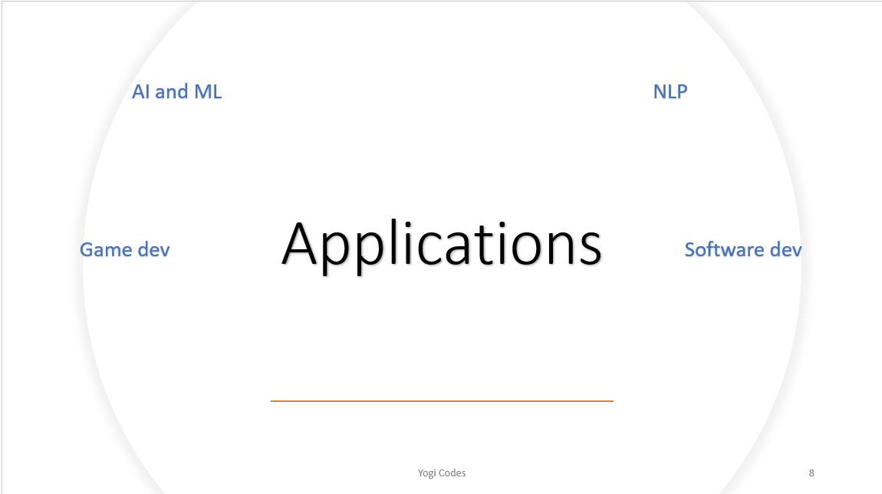

Slide 14
Features

Slide 15
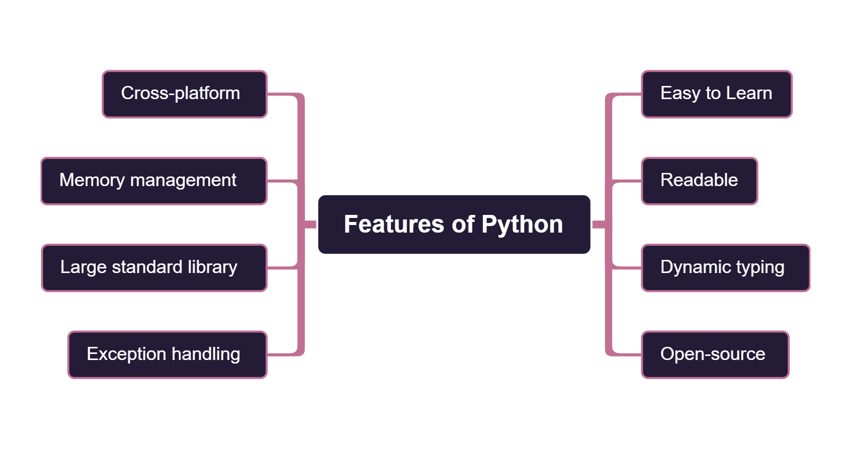

Slide 19

References

Slide 20
https://www.python.org/
https://pythoninstitute.org/what-is-python/
https://www.python.org/events/python-user-group/
https://trends.google.com/trends/explore?q=python
https://www.python.org/about/apps/

Slide 21
Anaconda
VS code
Py-Dev
IDEs
PyCharm
Jupyter notebooks

