Slide 1
StromManager
An SDSS for responding to storm events
GEO1005–2015/16
Balázs Dukai, Yuxuan Kang

Slide 2
Concept
quick overview of the current situation
info about the events
info about the wind conditions
dispatch field units if needed

Slide 3
1. Overview
screenshot of the map with symbols
explain symbol levels

Slide 4
2. Event Info
screenshot of the event reporting tab in operation
explain why did we implement the quick reporting functionality and how it works

Slide 5
3. Wind conditions
screenshot of the wind charts
explain why did we implement the wind charts and how it works

Slide 6
4. Dispatch units
screenshot(s) of the shortest route and "Assign" functions in operation
explain why did we implement the shortest route — what is essentially a nearest firestation/hospital functionality — and how it works
explain why did we implement the assign unit function, how it works
explain change event status function

Slide 7
Demo
Live or recorded? I recommend recorded

Slide 9
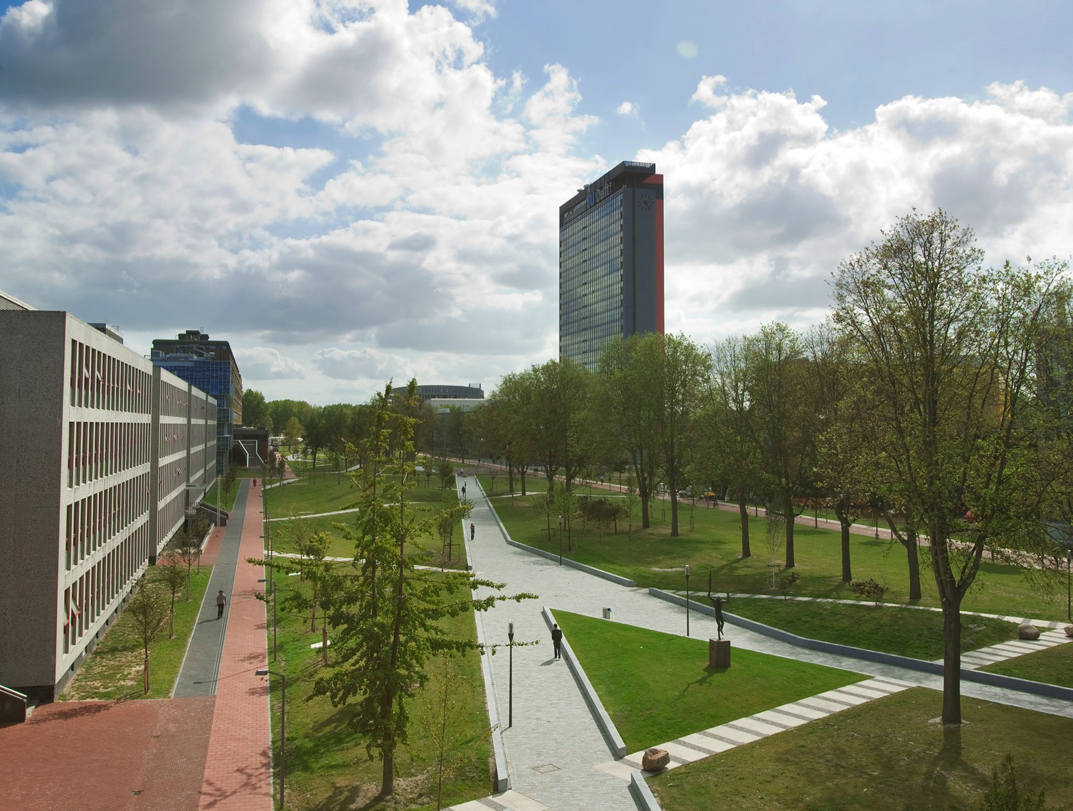
Insert a picture

Slide 10
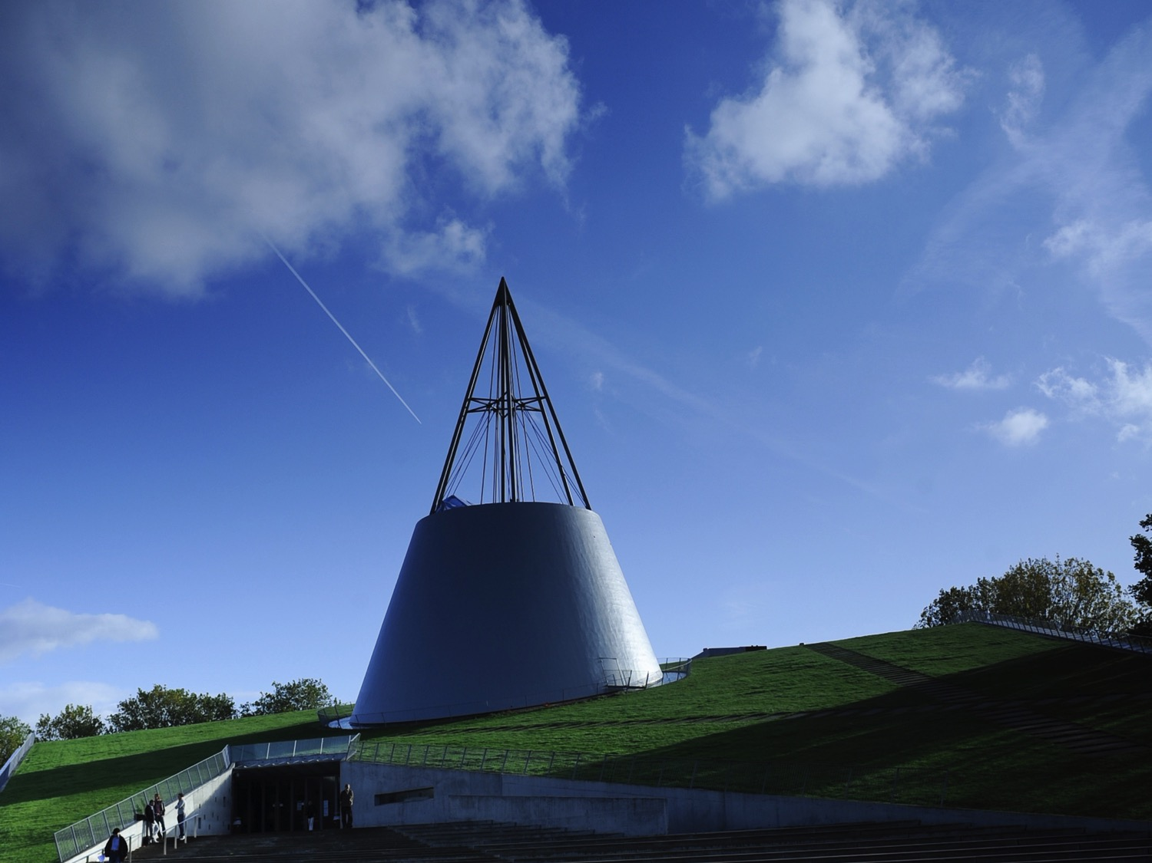
Insert a picture

