Slide 1
Markov chains
Balázs Horváth
2018

Slide 2
Overview
History
Markov chains
Examples
Dam overflow prediction
Estimating advertisement effictiveness

Slide 3
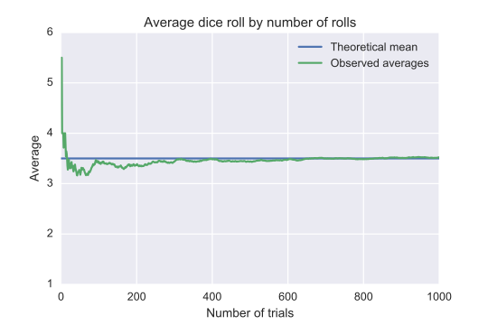
History - Bernoulli
Law of large numbers - Jacob Bernoulli (1689)
Cup with black and white balls
We can get the exact ratio
Ability to calculate probabilities

Slide 4
History – Nekrasov
„If observations of all events be continued for the entire infinity, it will be noticed, that everything in the world is govenred by precise ratios and a constant law of change”
Seems to be very true
Convergence
Distribution (binomial)
Pavel Nekrasov – russian teologian, mathematician
The law of large numbers doesn’t apply to the real world
Independence is a necessity for this law

Slide 5
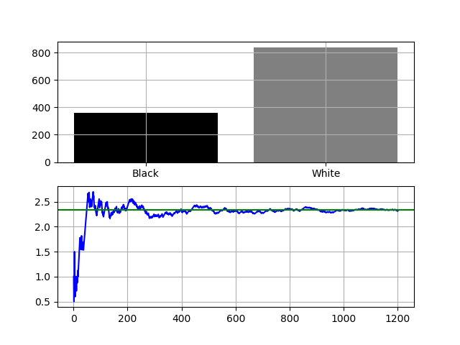
History - Markov
Andrey Markov – russian mathematician
Extends Bernoulli’s results
Two cups
Different ratios
An event decides which cup to use
These results also converge
W
0
1
B
W
B

Slide 6
Let’s check markov_cups.py

Slide 7
Markov chains
Markov property: An event is only dependent on the current state
Markov process: Stochatic process, that satisfies the Markov property
Transition matrix: Probalilities of going from one state to another
Stationary matrix: Final, stable state
Fancy visual chains
Notes:
Homogén markov lánc

Slide 8
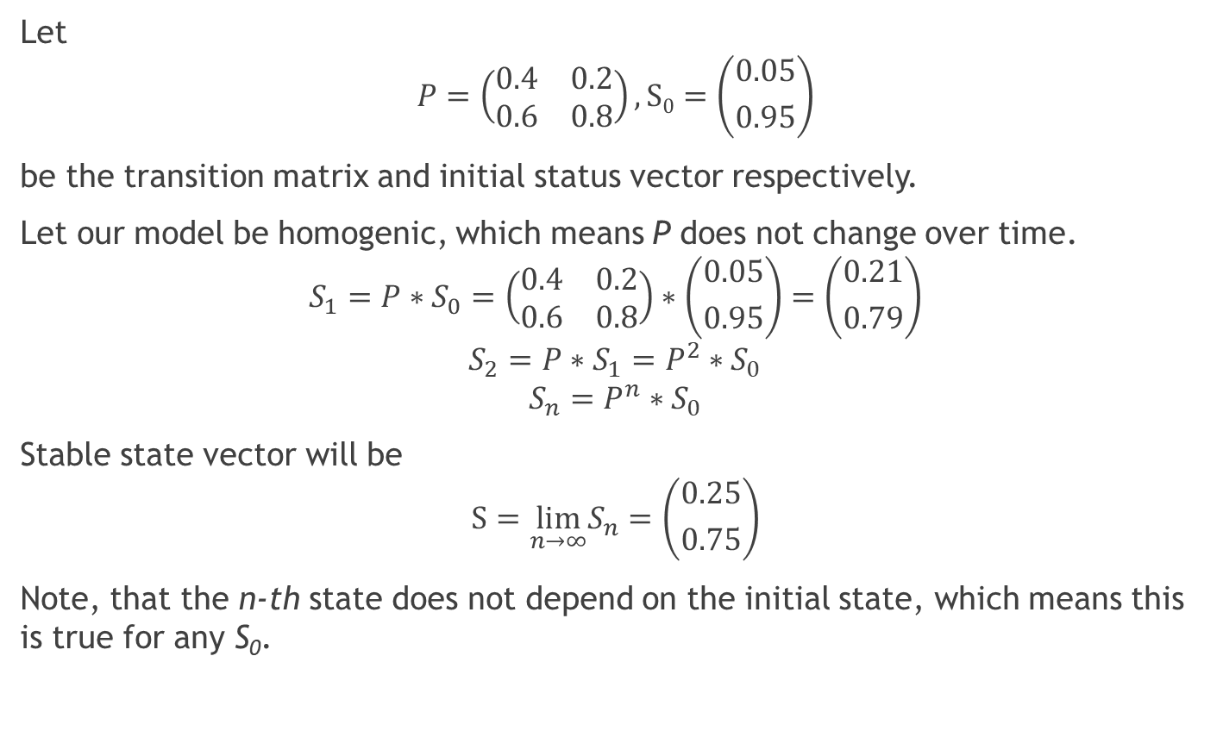
Markov chains - Calculations
Let
$$P=\left(\begin{matrix}0.4 & 0.2 \\ 0.6 & 0.8\end{matrix}\right), S0=\left({0.05 \atop 0.95}\right)$$
be the transition matrix and initial status vector respectively.
Let our model be homogenic, which means P does not change over time.
$$S_{1}=P∗S_{0}=\left(\begin{matrix}0.4 & 0.2 \\ 0.6 & 0.8\end{matrix}\right)∗\left({0.05 \atop 0.95}\right)=\left({0.21 \atop 0.79}\right)$$
$$S_{2}=P∗S_{1}=P^{2}∗S_{0}$$
$$S_{n}=P^{n}∗S_{0}$$
Stable state vector will be
$$S=\lim_{n→∞}S_{n}=\left({0.25 \atop 0.75}\right)$$
Note, that the n-th state does not depend on the initial state, which means this is true for any S₀.

Slide 9
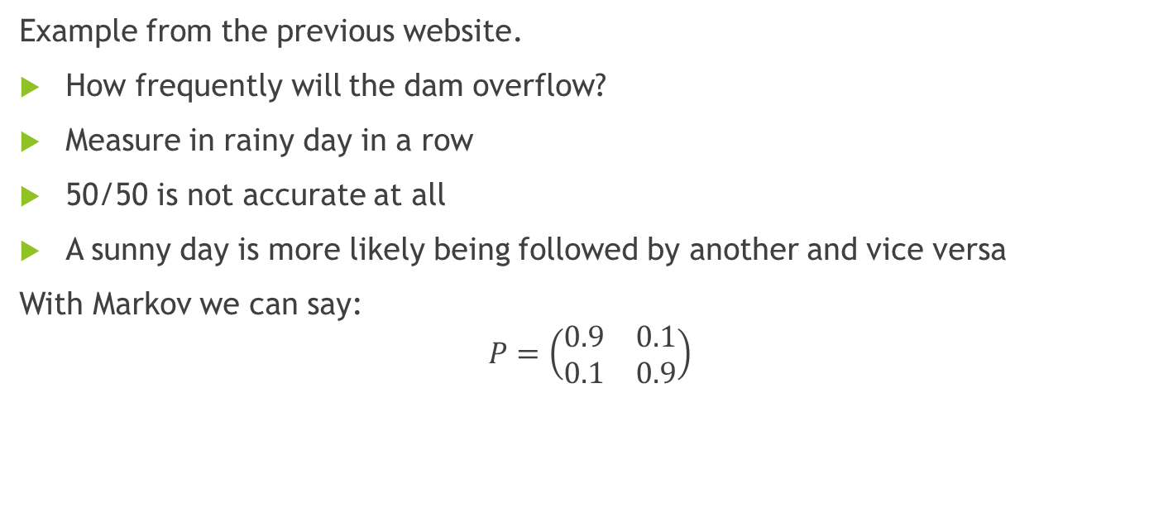
Examples - Dam
Example from the previous website.
How frequently will the dam overflow?
Measure in rainy day in a row
50/50 is not accurate at all
A sunny day is more likely being followed by another and vice versa
With Markov we can say:
$$P=\left(\begin{matrix}0.9 & 0.1 \\ 0.1 & 0.9\end{matrix}\right)$$

Slide 10
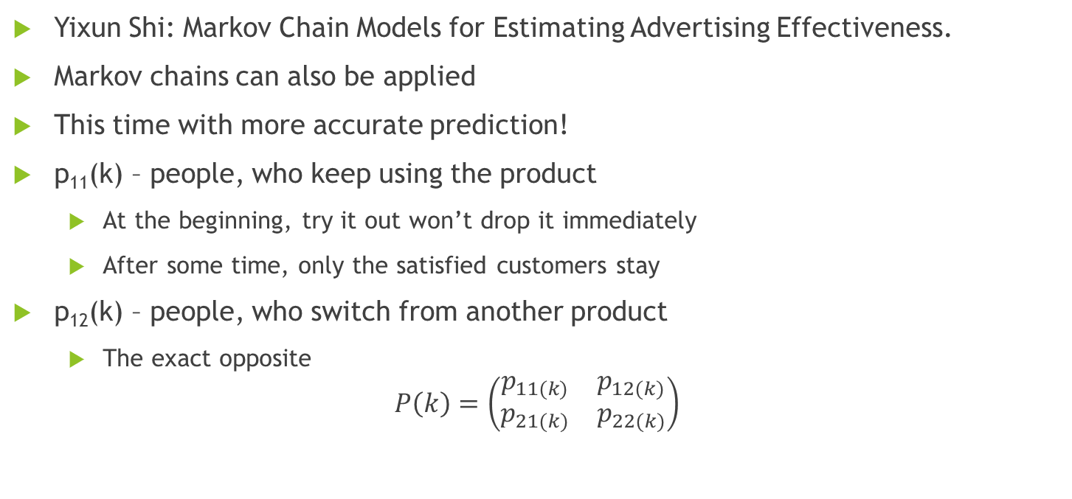
Examples - Advertising
Yixun Shi: Markov Chain Models for Estimating Advertising Effectiveness.
Markov chains can also be applied
This time with more accurate prediction!
p₁₁(k) – people, who keep using the product
At the beginning, try it out won’t drop it immediately
After some time, only the satisfied customers stay
p₁₂(k) – people, who switch from another product
The exact opposite
$$P\left(k\right)=\left(\begin{matrix}p_{11(k)} & p_{12(k)} \\ p_{21(k)} & p_{22(k)}\end{matrix}\right)$$

Slide 11
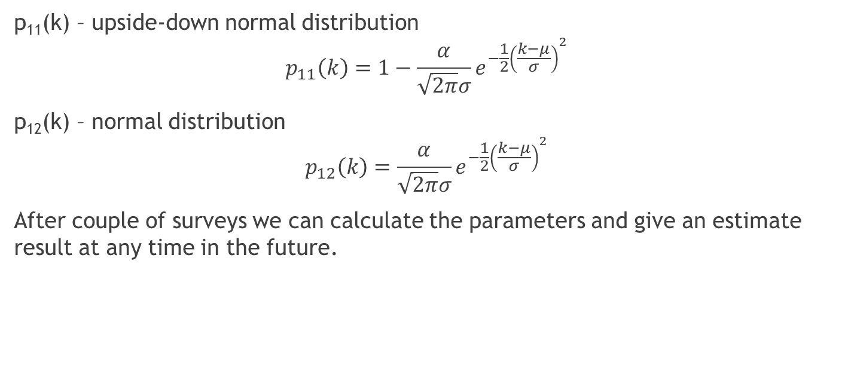
Examples - Advertising
p₁₁(k) – upside-down normal distribution
$$p_{11}\left(k\right)=1−\frac{α}{\sqrt{2π}σ}ⅇ^{−\frac{1}{2}{\left(\frac{k−μ}{σ}\right)}^{2}}$$
p₁₂(k) – normal distribution
$$p_{12}\left(k\right)=\frac{α}{\sqrt{2π}σ}ⅇ^{−\frac{1}{2}{\left(\frac{k−μ}{σ}\right)}^{2}}$$
After couple of surveys we can calculate the parameters and give an estimate result at any time in the future.

Slide 12
Let’s do this also in Python!

Slide 13
Thank you! Source code and this file is available here.

