Slide 1
Front-end
Back-end
Elemzés
Leképzés
Kódgészítés
Lexikai
Szintak- tikai
Szeman-tikai
Transz- formáció
Optima- lizálás
Kódge- nerálás
Linkelés
Forrás nyelv
Token-sorozat
AST
Modell
Kódgráf
Célnyelv

Slide 2
Token sorozat
Szintaxisfa
Programkód
int x=5;
print(x);
lexer
int
x
=
5
;
parser
statements
print
(
x
)
;
stmt
stmt
vardecl
;
funccall
;
type
name
=
expr
name
(
expr
)
int
x
5
print
x
szemantikai elemző

Slide 3
Language
Service
Find all
references
Edit and
continue
Colorizer
Outlining
Navigate to
Object Browser
Formatter
Completion list
Signature help
Extract method
Rename
Go to definition
Quick info
Compiler
API
Syntax Tree
API
Symbol API
Binding and Flow Analysis
APIs
Emit
API
Compiler
pipeline
Parser
Symbols
Binder
IL
Emitter
Metadata import

Slide 4
Workspaces
API
Code formatting
Find all references
Expand/Reduce
...
Workspaces (Solutions, Projects, Documents)
Diagnostic API
Code analysis
Code fixes
...
Scripting API
Compile script
Run script
Compiler
API
Syntax Tree
API
Symbol API
Binding and Flow Analysis
APIs
Emit
API

Slide 5
Host Environment
Environmental events (key strokes)
Tool
Event
Workspace
Apply
Tool
Solution¹
Edit
Solution²
Edit
Solution³
Project A
Project B
Document X
Document Y
Text
Syntax
Symbols

Slide 6
main
‘hello’
ID: ‘world’

Slide 7
Root
Scope
SymbolDef
SymbolDef
SymbolUse
SymbolDef
SymbolUse
Name
Property
Scope
Identifier
Value
SymbolDef
SymbolDef
Name
Name
Name
Property
Scope
Identifier
Qualifier
Property
Property
Property
Property
Property
SymbolUse
SymbolUse
Value
EnumValue
SymbolDef
SymbolUse
Identifier
Qualifier

Slide 8
Roslyn
csc
vbc
Microsoft.CodeAnalysis.CSharp
Microsoft.CodeAnalysis.VisualBasic
Microsoft.CodeAnalysis

Slide 9
Microsoft.CodeAnalysis
Compilation
Emit
ReferenceManager
SemanticModel
DataFlowAnalysis
MetadataReader
ControlFlowAnalysis
Symbols
MetadataReference
SymbolDisplay
Operations
DiagnosticAnalyzer
Syntax
Diagnostic
Serialization
Text

Slide 10
Microsoft.CodeAnalysis.CSharp
Compilation
Emit
ReferenceManager
SemanticModel
DataFlowAnalysis
MetadataReader
ControlFlowAnalysis
Symbols
MetadataReference
Binding
SymbolDisplay
Operations
DiagnosticAnalyzer
BoundTree
Declarations
Diagnostic
Syntax
Parser
Serialization
Text

Slide 11
MetaDslx
MetaDslx.VisualStudio
MetaDslx.BuildTasks
MetaDslx.CodeAnalysis
MetaDslx.Languages.Meta
MetaDslx.CodeAnalysis.Antlr4
MetaDslx.Core
MetaDslx.CodeAnalysis.CSharp
MetaDslx.CodeAnalysis.Common

Slide 12
MetaDslx.CodeAnalysis.Core
Compilation
Model
Backend
ReferenceManager
SemanticModel
DataFlowAnalysis
CSharp.Symbols
ControlFlowAnalysis
Symbols
MetadataReference
Binding
SymbolDisplay
Operations
DiagnosticAnalyzer
BoundTree
Declarations
Diagnostic
Syntax
Parser
Serialization
Text

Slide 13
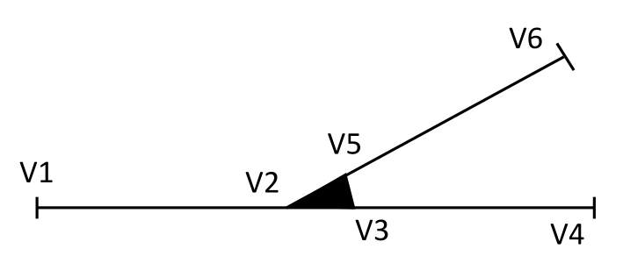
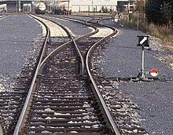
Property
Operation
MOF
Class
Association
UML szabvány,
DSL-ek
Property
Point
Class
State
Segment
Dependency
Általunk
készített
modellek
Person
turn off
Engine on
Engine off
Dog
turn on
Világ

Slide 14
Szöveges DSL nyelvi leírás [.ag4]
(annotált ANTLR4)
DSL metamodell leírása [.mm]
(Meta-Model nyelv)
Szöveges DSL kód
DSL fordító
DSL metamodell C#-ban
DSL modell
DSL generátor
Kódgenerátor leírása [.mgen]
(Meta-Generator nyelv)
Generált kód

