Slide 1
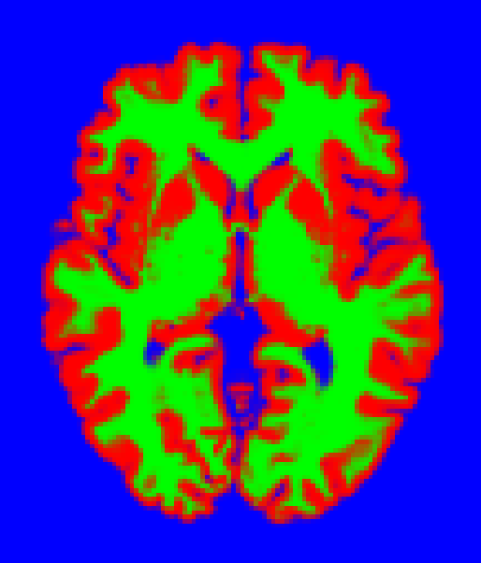
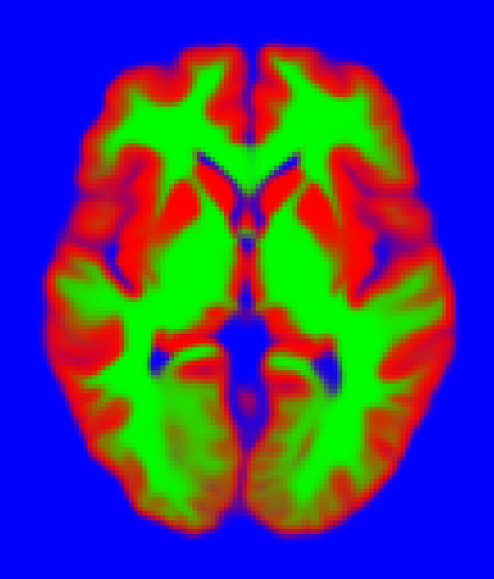

Slide 2
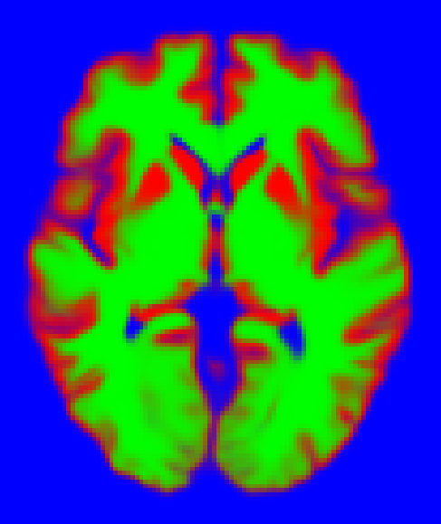

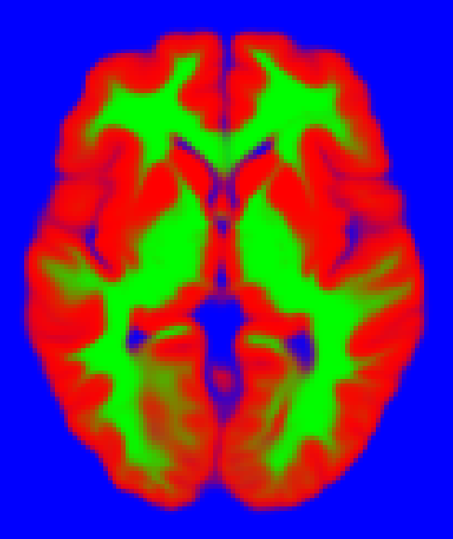

Slide 3


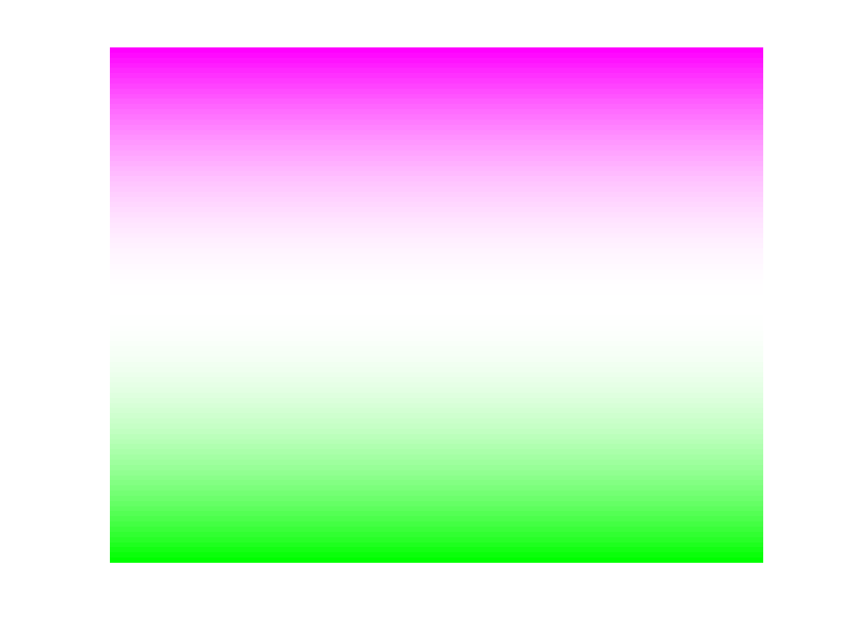
-x
+x
-y
+y
-z
+z

Slide 4
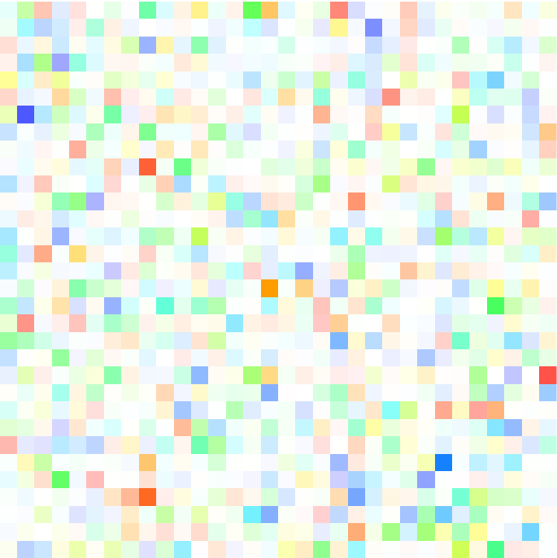
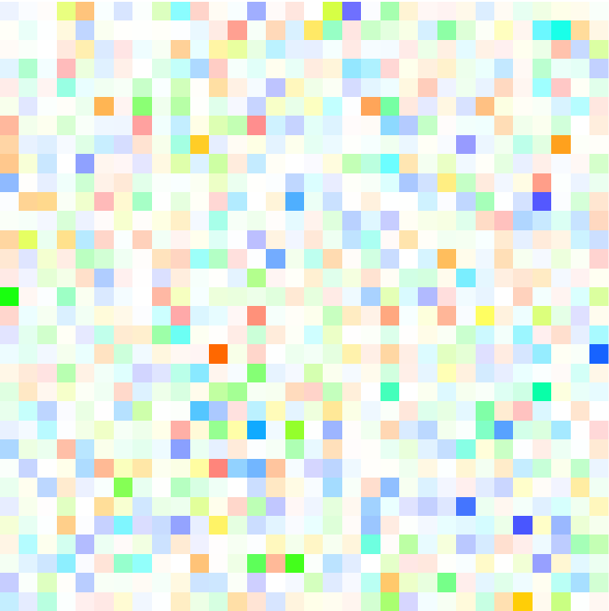
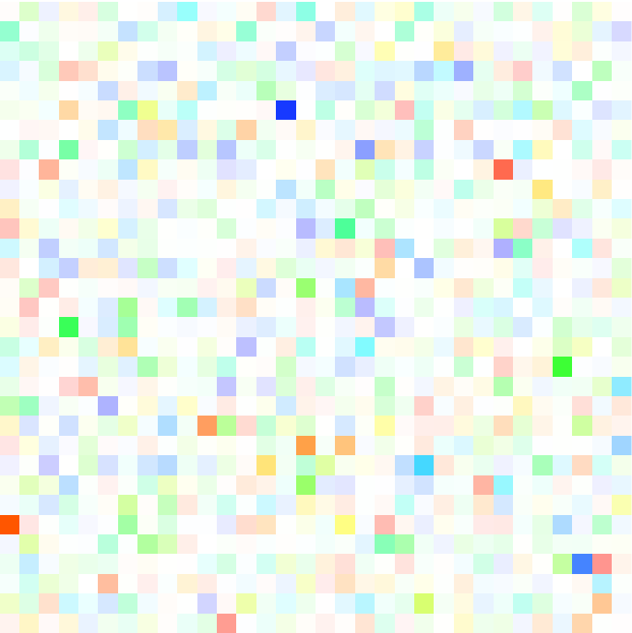
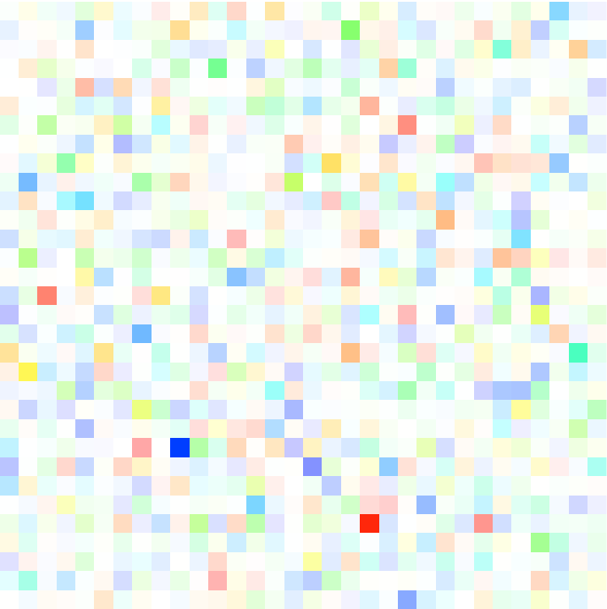
absolute
1
10⁻¹
10⁻²
10⁻³
10
10²
10³
10⁴

Slide 5
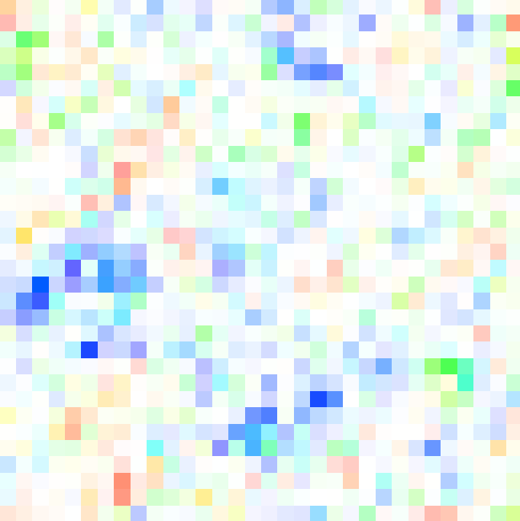
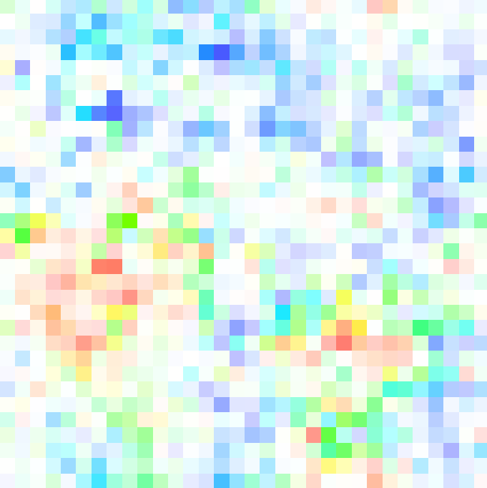
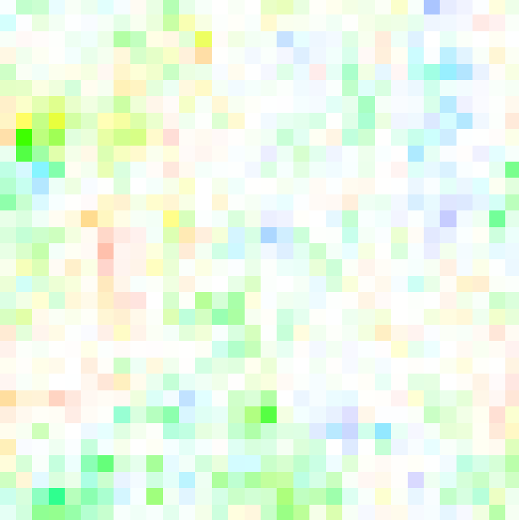
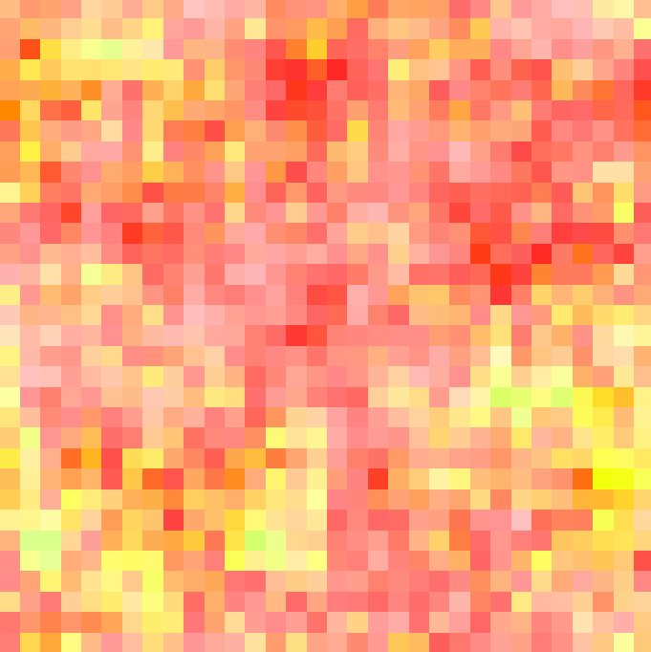
membrane
5x10⁻¹
7x10⁻²
9x10⁻²
7x10⁻³
10
10²
10³
10⁴

Slide 6
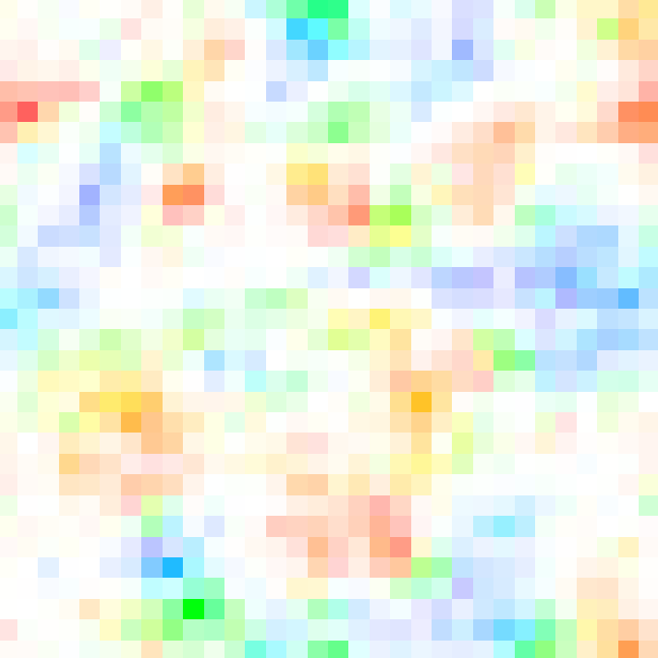
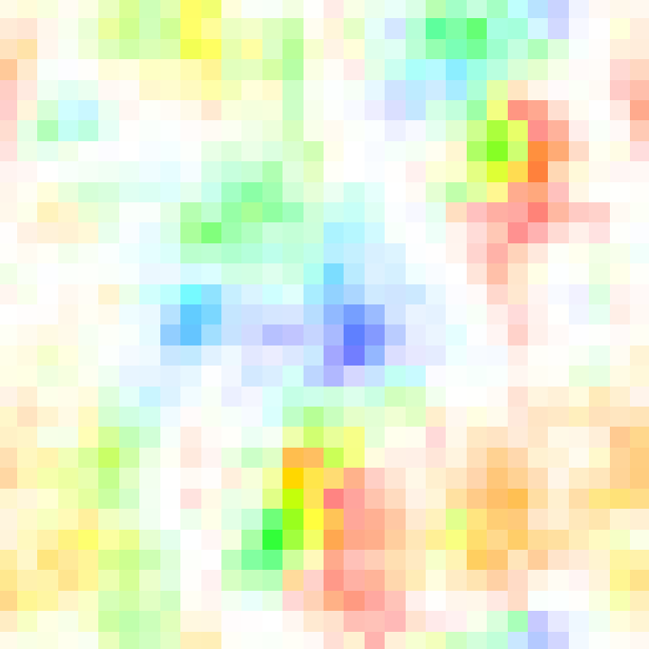
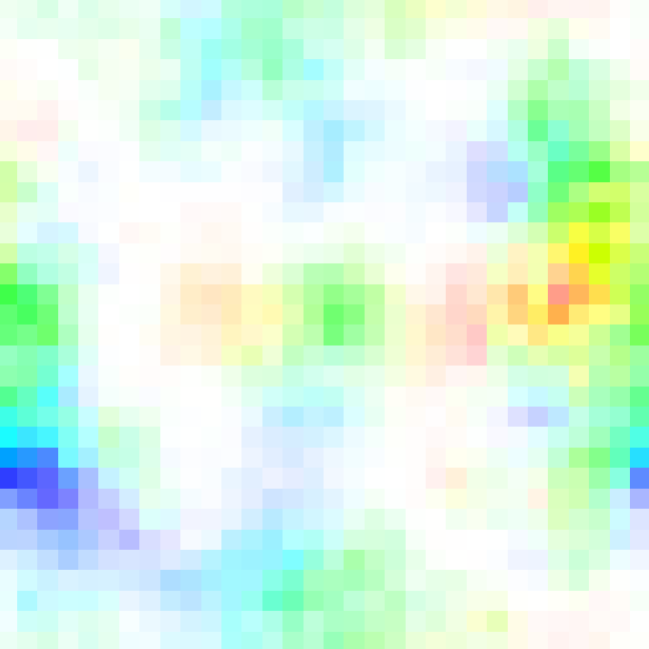
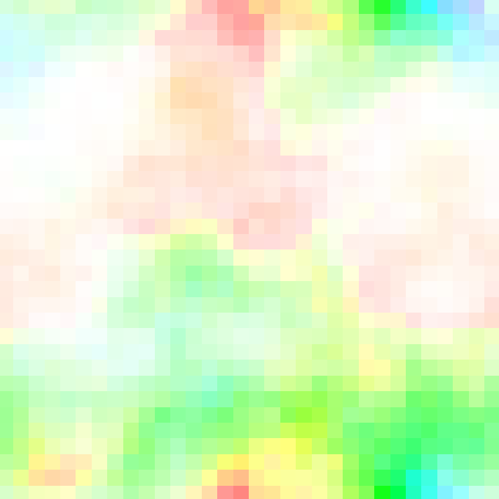
bending
5x10⁻¹
1x10⁻¹
3x10⁻²
5x10⁻³
10
10²
10³
10⁴

Slide 7
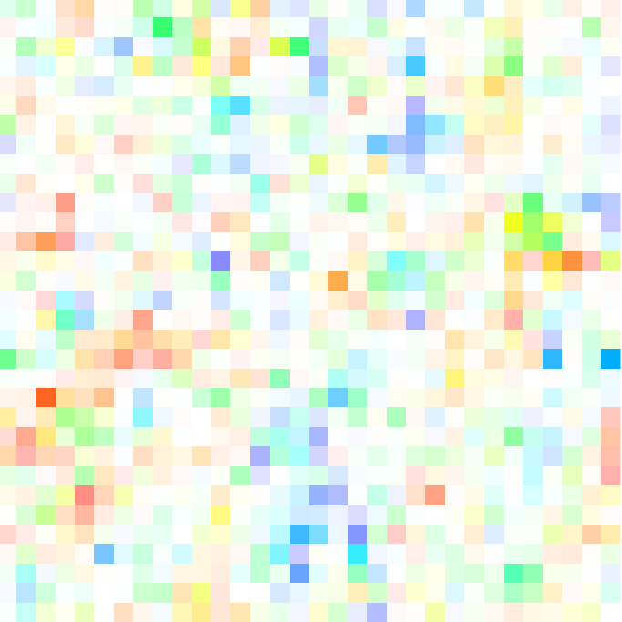
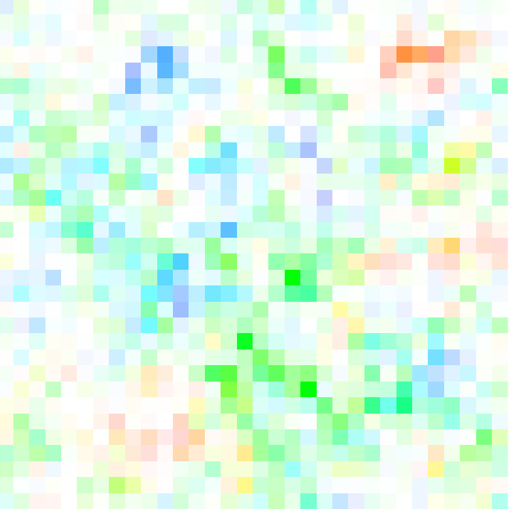
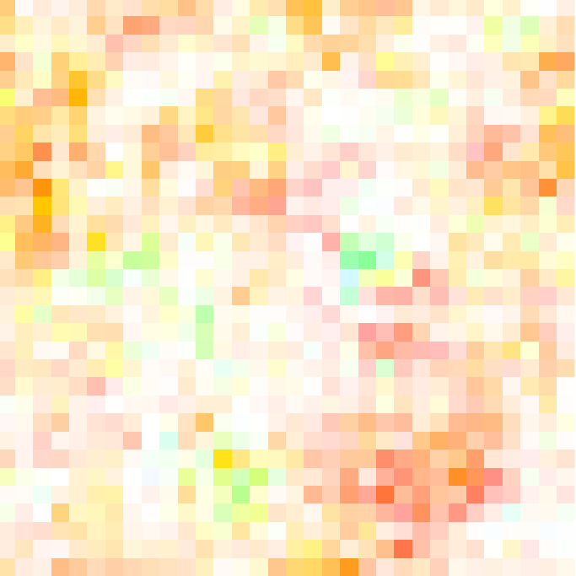
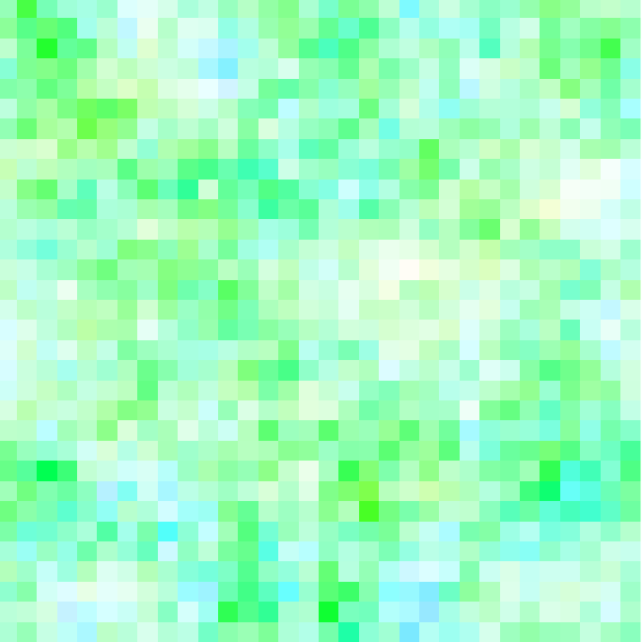
Linear-Elastic Sym
3x10⁻¹
5x10⁻²
3x10⁻²
2x10⁻³
10
10²
10³
10⁴

Slide 8
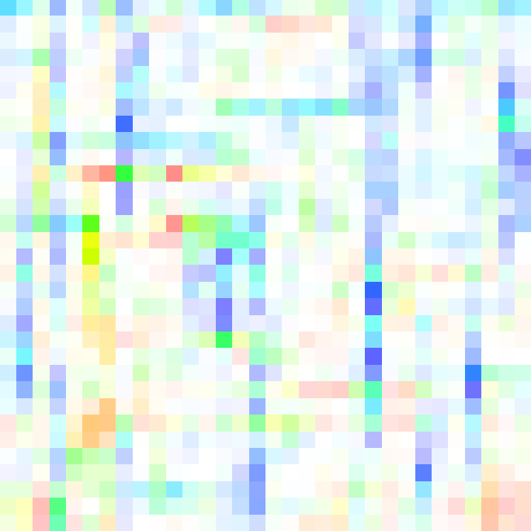
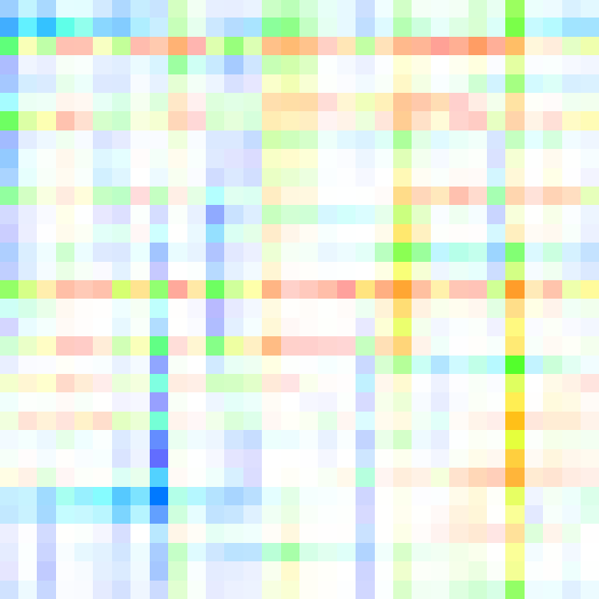

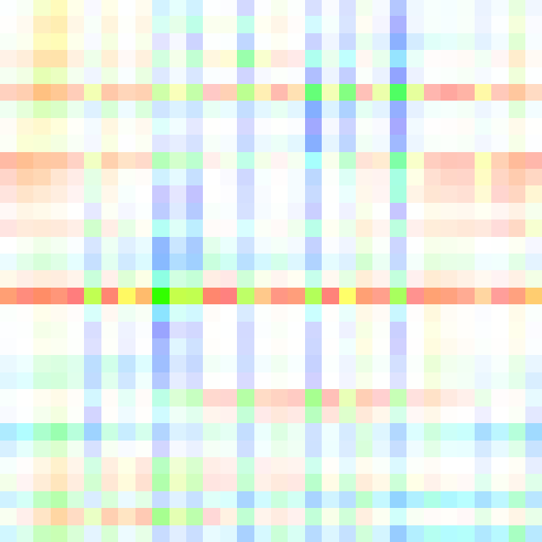
Linear-Elastic Div
2
9x10⁻¹
4x10⁻¹
2x10⁻¹
10
10²
10³
10⁴

Slide 9
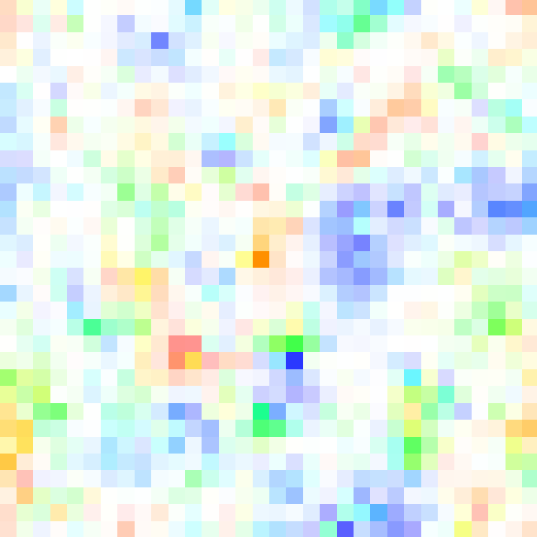
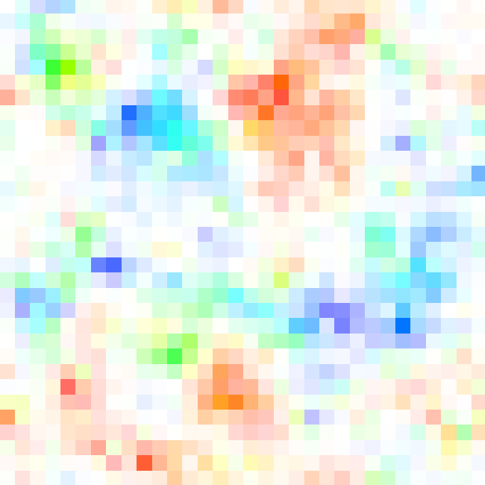
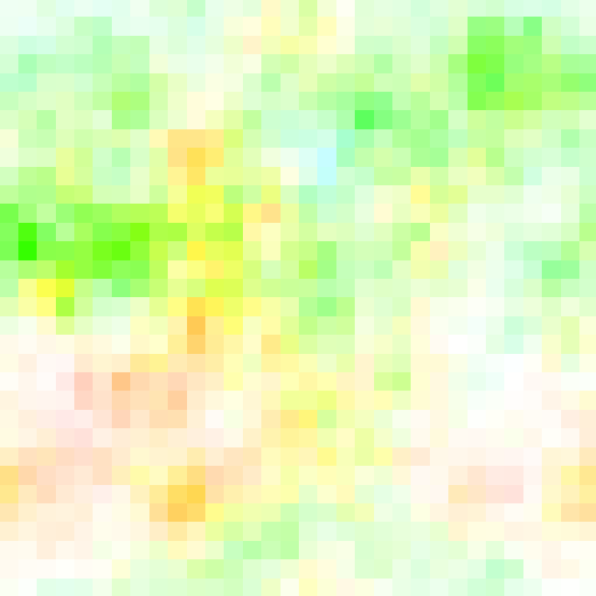
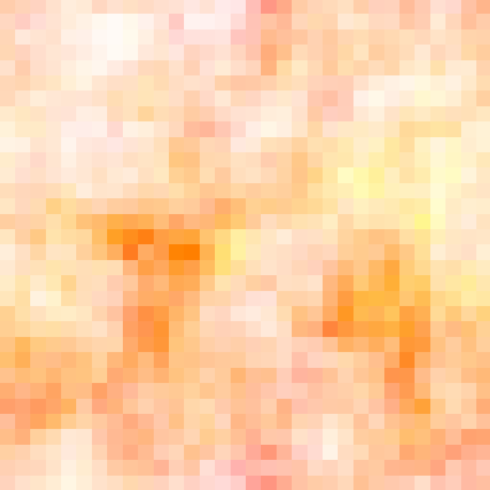
Membrane + Bending
2x10⁻¹
4x10⁻²
1x10⁻²
1x10⁻³
10
10²
10³
10⁴

Slide 10
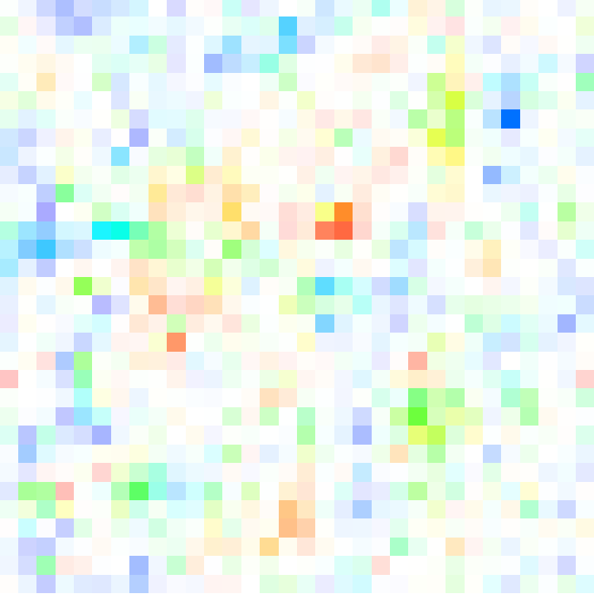
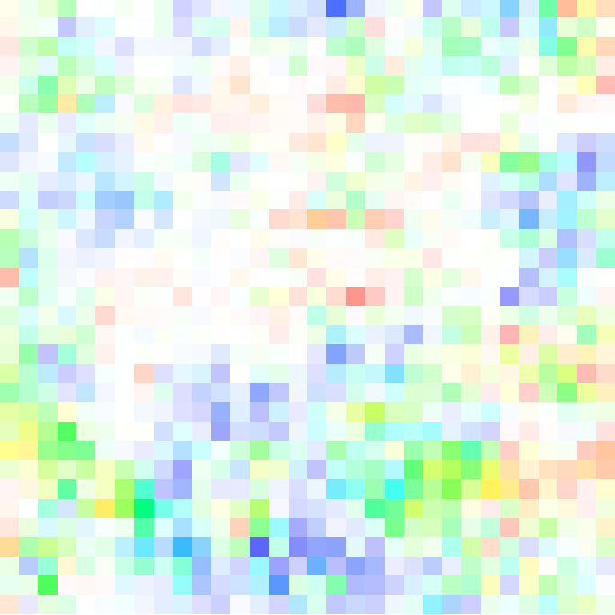
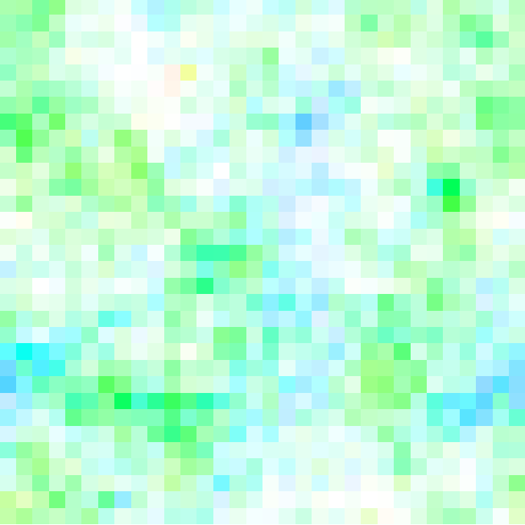
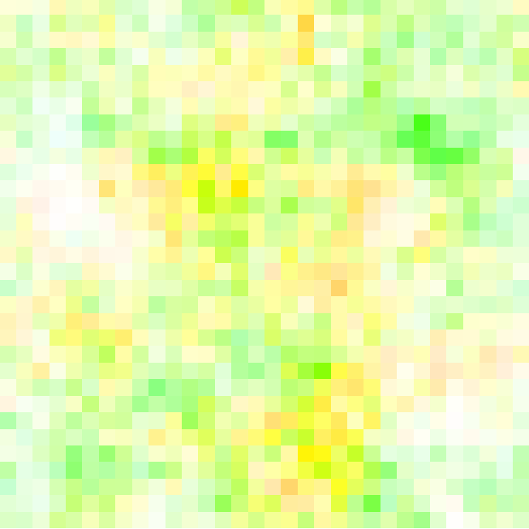
Linear Elastic
4x10⁻¹
6x10⁻²
1x10⁻²
2x10⁻³
10
10²
10³
10⁴

Slide 11
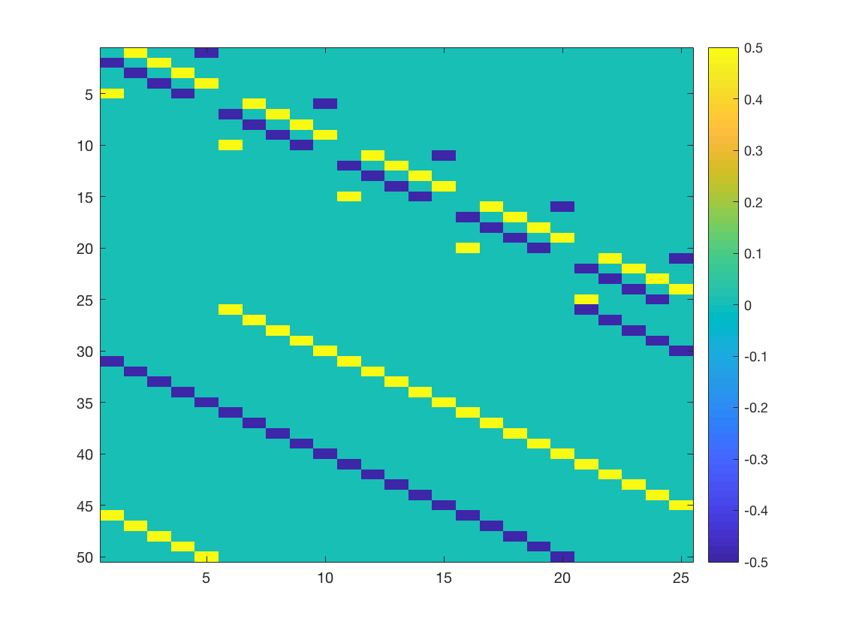
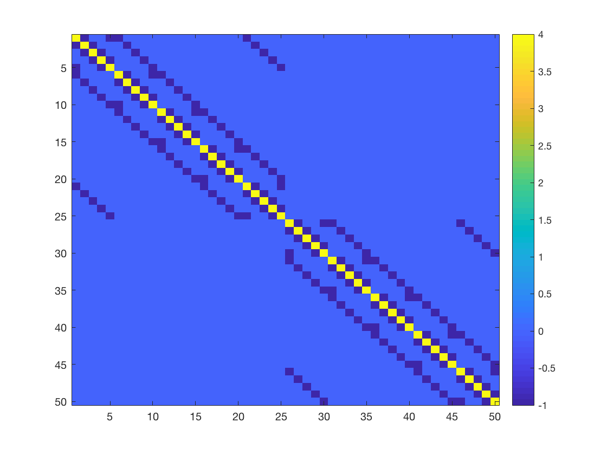
membrane
(a) J
(b) L

Slide 12
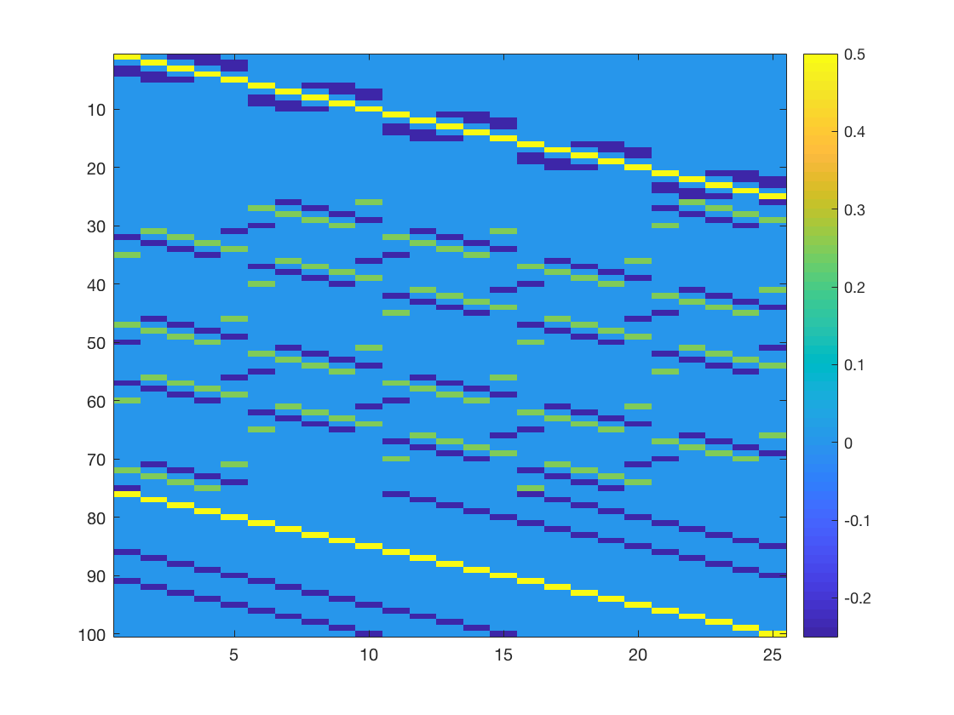
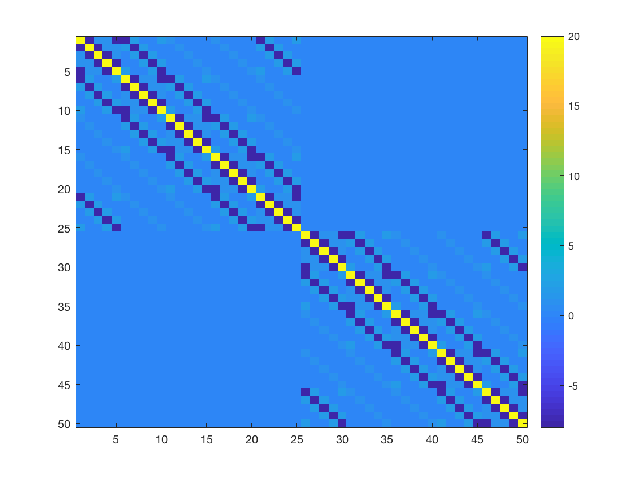
bending
(a) H
(b) L

Slide 13
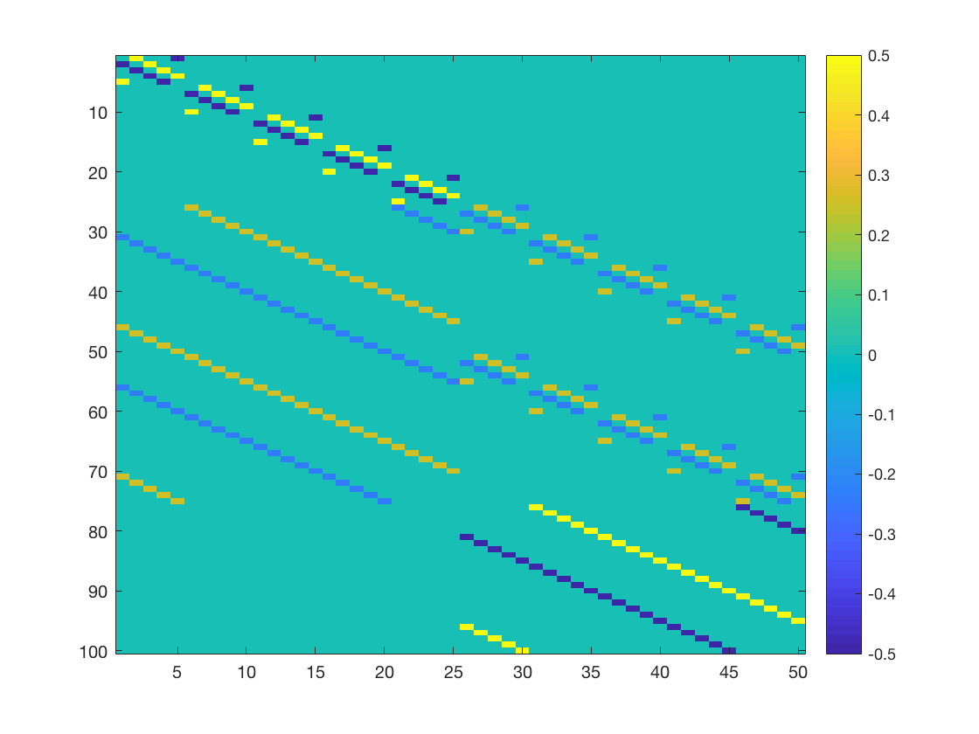
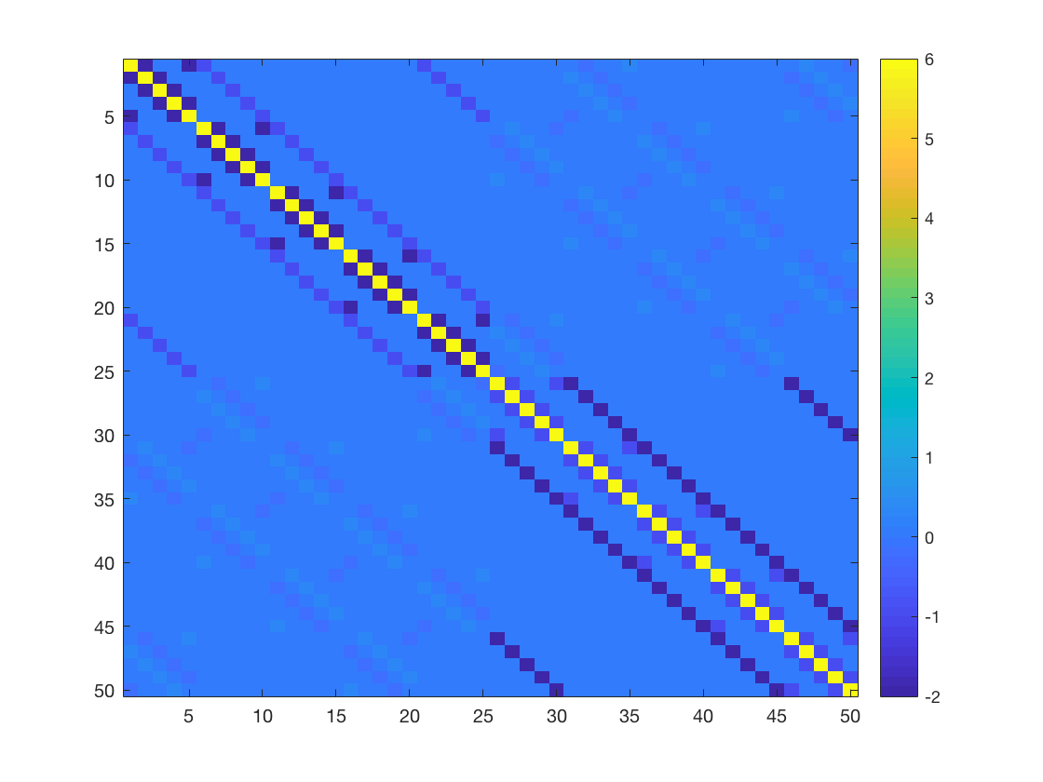
shears
(a) S
(b) L

Slide 14
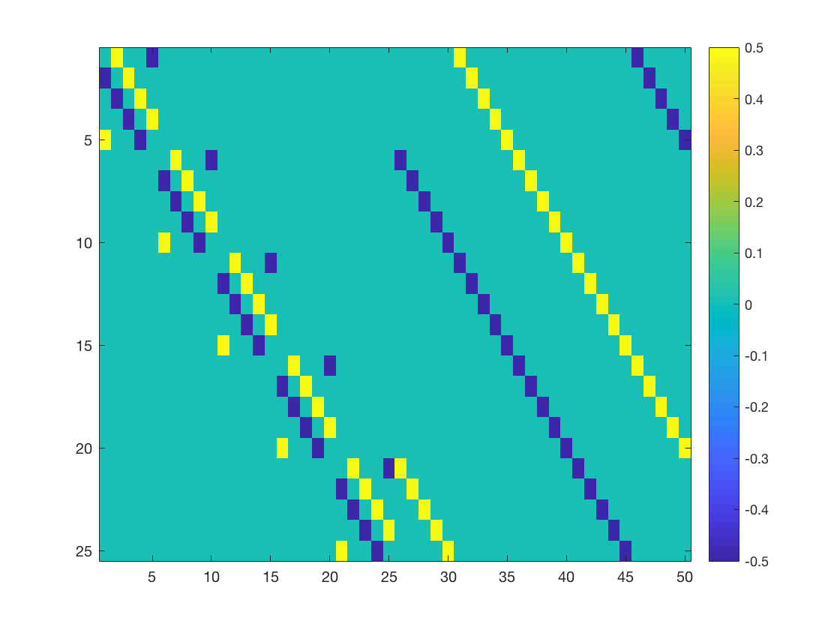
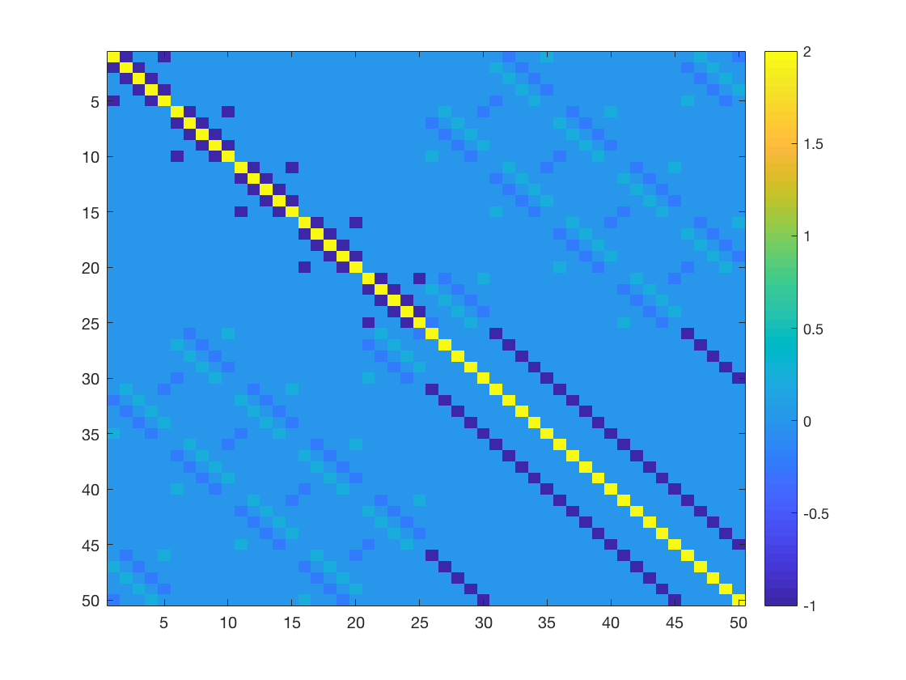
zooms
(a) D
(b) L

Slide 15
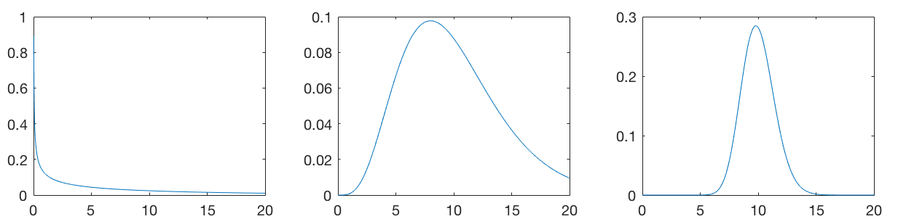
Gamma distribution – normal precision conjugate (𝜆₀ = 10)
n₀ = 1
n₀ = 10
n₀ = 100

Slide 16
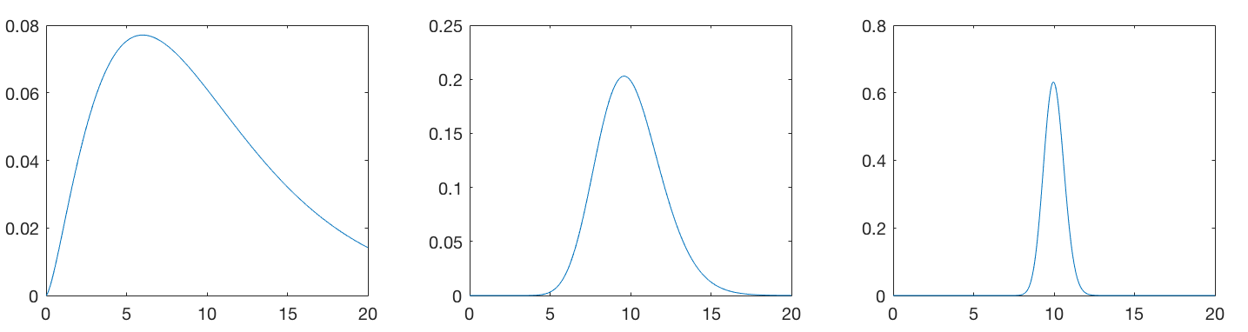
Gamma distribution – multivariate normal precision conjugate (K = 5, 𝜆₀ = 10)
n₀ = 1
n₀ = 10
n₀ = 100

Slide 17
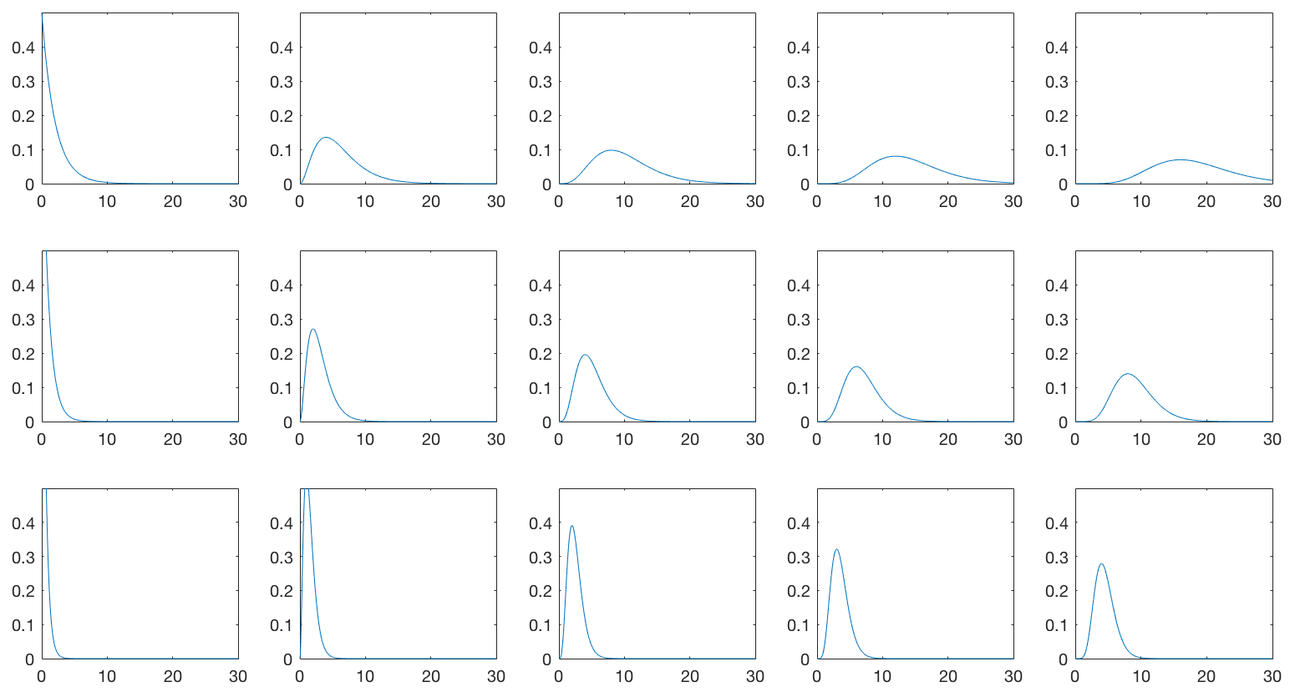
Gamma distribution
𝛼 = 1
𝛼 = 3
𝛼 = 5
𝛼 = 7
𝛼 = 9
𝛽 = 0.5
𝛽 = 1
𝛽 = 2

