Slide 1

IN311 · UNIT 10
Predictive Analytics for NYC 311 Telephone Demand
Forecasting daily DEP phone requests
Trevor Cudmore
Purdue University Global
Dr. Todd Wolfe · November 3, 2026
Notes:
This presentation summarizes my IN311 project and explains how I would turn the work into a professional portfolio item. The project focuses on forecasting daily NYC 311 telephone demand assigned to the Department of Environmental Protection.

Slide 2
ANALYTICAL THESIS
The goal is to estimate demand before the day begins
The problem
Historical 311 phone-request patterns can provide a useful forecast of daily DEP demand and give managers a better starting point for planning workload.
• Demand changes by weekday, season, and unexpected events.
• Managers have to plan before the actual volume is known.
• A forecast can reduce guesswork, even when it is not perfect.
Important limit
This project forecasts contact demand. It does not measure staffing effectiveness because the public dataset does not include staffing, handle time, wait time, service level, or abandonment data.
Project scope based on NYC OpenData fields and instructor feedback.
02
Notes:
The original idea connected forecasting to workforce planning. Dr. Wolfe's feedback helped narrow the claim. With this public dataset, I can forecast phone-request demand, but I cannot prove whether staffing decisions were effective. That would require internal workforce-management data.

Slide 3
DATA AND SCOPE
A focused slice of official 311 data kept the project manageable
78,211
365
214
1,462
DEP phone requests
daily observations
average requests per day
highest daily volume
How the file was narrowed
• Source: NYC 311 Service Requests from 2020 to Present
• Calendar year: 2025
• Agency: Department of Environmental Protection (DEP)
• Channel: PHONE
• Final structure: one row per date with the daily request count
Why this dataset worked
It is credible, large enough to show repeated patterns, and includes exact creation dates and channel information. Those fields directly support a daily demand forecast.
Source: NYC OpenData, 311 Service Requests from 2020 to Present.
03
Notes:
I downloaded the official NYC OpenData file, filtered it to 2025, DEP, and PHONE, then grouped the requests into one daily count. This turned a very large transaction-level file into 365 observations that were easier to model and explain.

Slide 4
STEPS TAKEN
The analysis followed a simple, repeatable workflow
1
2
3
4
5
Filter
Prepare
Engineer
Model
Evaluate
Keep 2025 DEP phone requests
Clean dates and total requests by day
Create weekday, weekend, and seasonal fields
Fit regression and k-means models
Compare test errors, residuals, and clusters
Development environment
ASUS VivoBook · Windows 11 · R 4.5.1 in RGui · tidyverse 2.0.0 · lubridate 1.9.5 · ggplot2 4.0.3
04
Notes:
I kept the workflow straightforward so another person could reproduce it. The regression used a chronological split: January 1 through October 19 for training and October 20 through December 31 for testing. K-means used standardized daily volume and a weekend indicator.

Slide 5
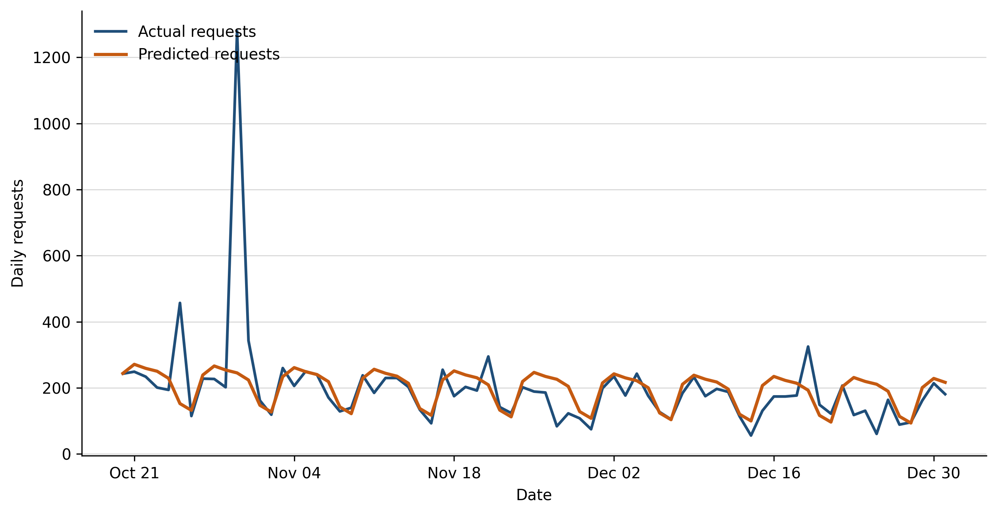
MODEL RESULTS
Regression beat the basic baseline, but unusual days still mattered
Test-period performance
MAE
53.73
Baseline 73.98
RMSE
135.44
Baseline 145.46
R²
0.114
Modest explanatory power
Bottom line
The model improved MAE by 27.4%, but it missed the October 30 spike.
05
Notes:
The regression did better than a simple training-mean baseline. Its mean absolute error was 53.73 requests compared with 73.98 for the baseline. However, the low R-squared and the large October 30 miss show that it is still a basic model. It gives a starting point, not an exact answer.

Slide 6
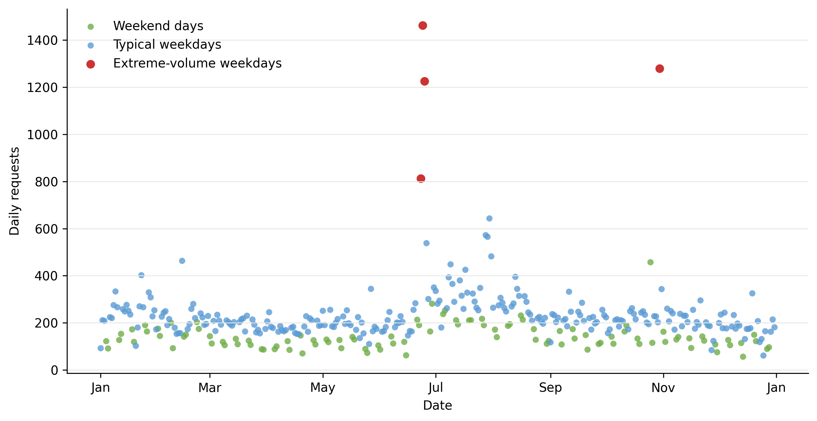
MODEL RESULTS
K-means found three distinct types of demand days
The four extreme weekdays were June 23–25 and October 30.
06
Notes:
K-means was useful for describing types of days rather than forecasting a future count. It found weekend days, typical weekdays, and four extreme-volume weekdays. That helped explain why average-error metrics alone do not tell the whole story.

Slide 7
CONCLUSION AND RECOMMENDATION
Use regression as a starting forecast, then improve it
Recommendation
Conclusion
• Use the regression forecast as an initial workload estimate, not an exact staffing number.
• Add multiple years, holidays, complaint categories, and weather variables.
• Compare regression with time-series models such as exponential smoothing or ARIMA.
• Add internal staffing and service data before making workforce-performance claims.
Linear regression is the better primary model because it produces a daily forecast and beat the baseline. K-means is still useful because it shows the difference between routine and extreme demand days.
Forecasting guidance: Hyndman & Athanasopoulos (2021); workforce-planning context: Koole & Li (2023).
07
Notes:
The results support the thesis in a limited but useful way. Historical patterns can improve a starting forecast. The next version should add more history and outside factors, especially weather. If internal call-center measures become available, the work could then connect demand to staffing decisions more directly.

Slide 8
PROFESSIONAL PORTFOLIO
The project can become a clear, easy-to-review portfolio piece
GitHub repository
nyc-311-demand-forecast/
I would use GitHub to store the code, project files, and revision history. A short README would explain the problem, the data, how to run the analysis, and what the results mean.
README.md project overview and instructions
code/ R script used for the analysis
visuals/ approved charts and model results
docs/ final report and presentation
data-source.md official source link and filters
A LinkedIn profile or simple personal site could link to the repository and highlight the finished project.
GitHub Docs recommends a README to help visitors understand and navigate a repository.
08
Notes:
I would make the project easy for someone else to review. The repository would include the cleaned R script, charts, report, and presentation. I would not upload a huge raw dataset. Instead, I would document the official source and the exact filters used so another analyst could reproduce the extract.

Slide 9
PUBLIC PORTFOLIO PLAN
Share the work without exposing private information
Share publicly
Keep private
• Clean R script with comments
• README with the question, steps, and results
• Final charts, report, and presentation
• NYC OpenData source link and filter details
• Passwords, tokens, or account details
• Internal company or customer information
• Personal contact details I do not want public
• Unfinished drafts that could confuse the final story
Other portfolio items
Résumé · short biography · call-center and workforce-planning experience · Data Analytics micro-credential · future analytics projects
09
Notes:
The public version should demonstrate the analysis without exposing private information. Along with this project, I would add my résumé, a short bio, my professional experience, and future analytics work. That gives employers both technical evidence and the business context behind it.

Slide 10
SOURCES
References
GitHub, Inc. (n.d.). About the repository README file. GitHub Docs. https://docs.github.com/en/repositories/managing-your-repositorys-settings-and-features/customizing-your-repository/about-readmes
Hyndman, R. J., & Athanasopoulos, G. (2021). Forecasting: Principles and practice (3rd ed.). OTexts. https://otexts.com/fpp3/
Koole, G. M., & Li, S. (2023). A practice-oriented overview of call center workforce planning. Stochastic Systems, 13(4), 479–495. https://doi.org/10.1287/stsy.2021.0008
NYC OpenData. (n.d.). 311 service requests from 2020 to present [Data set]. Retrieved October 23, 2026, from https://data.cityofnewyork.us/d/erm2-nwe9
R Core Team. (2025). R: A language and environment for statistical computing (Version 4.5.1) [Computer software]. R Foundation for Statistical Computing. https://www.R-project.org/
10
Notes:
These sources support the dataset, forecasting approach, workforce-planning context, R environment, and portfolio organization described in the presentation.

