Slide 1
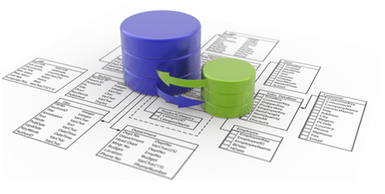





Rest-API (Barramento)
Persistência
Rest-API
App-Admin
Rest-API
Rest-API
Rest-API
Rest-API
App-Estatistica
App-Login
Front-end - Mobile
Rest-API

