Slide 1


PRN292 Project
Auto Marking
System
SE1435
Group 4
01/05
Next

Slide 2
PRN292 Project
Bùi Tiến Đạt - HE141351
Group
Members
Ngô Quang Trung - HE141139
Hà Đức Hạnh - HE141144
Tạ Quang Đạt - HE140939
Back
02/05
Next

Slide 3
Ngô Quang Trung
Hà Đức Hạnh
Tạ Quang Đạt
Bùi Tiến Đạt
Marking file solution of student
Create form, check file .c and .exe and create document
Create Database, Import data to Database
Export database file to excel, create document
01
02
03
04
RESPONSIBILITIES OF MEMBERS
Back
03/05
Next

Slide 4
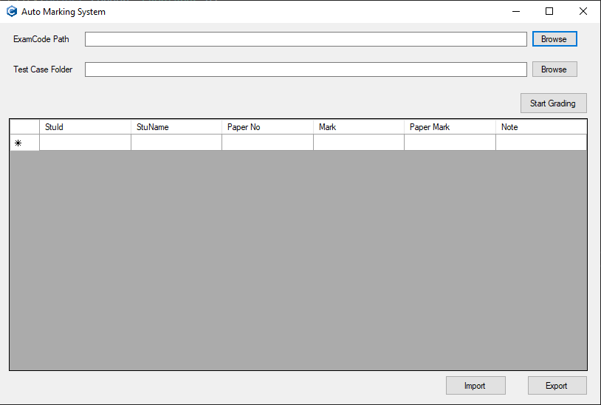

Project
Goals
Auto Marking System
Auto Marking System tool is developed in C# language, can support teacher grade PRF192 easily and conveniently. Built-in functions to import and export data to Excel file for convenient lookup and data retrieval.
Back
04/05
Next

Slide 5




PRN292 Project
GROUP WORK
PROCESS
Facebook
Discord
Time
Connect members and division of work
Upload source code, database, direct communication to solve outstanding problems
2-3h/days
Back
05/05

