Slide 1
Master’s degree in Artificial Intelligence and Data Engineering Data Mining and Machine Learning Stock Sentiment
Edoardo Ruffoli, Tommaso Baldi

Slide 2
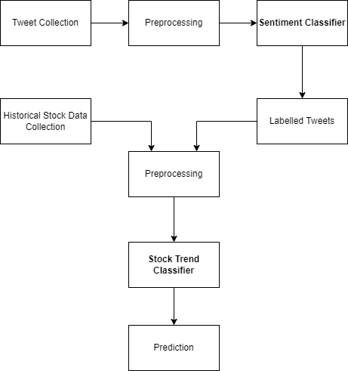
Introduction
StockSentiment is a web financial tool, which helps users with financial investments providing analysis on the opinions expressed by people on stock companies.
More specifically, it provides a prediction on the next close price trend of a stock based on the previous days trend and on the polarity of the recent tweets related to the stock.
Two classification models were realized:
a Tweet Sentiment Classifier, used to classify the tweets related to the various stocks that then will be used to compute the daily sentiment polarity.
a Stock Trend Predictor, used to give to the user the prediction of the next close price of the selected stock.

Slide 3
Dataset
To train the tweet sentiment classifier, we used a labelled dataset of stock market related tweets that contains over 27k financial related tweets.
We also used a manually labelled tweet dataset to better evaluate the model. This dataset contains almost 800 tweets, that were scraped using the data collecting functions of the application.
As regards to the stock trend prediction model, we generate the training dataset with the following procedure:
We scraped stocks historical data between 2021-01-01 and 2022-01-14 for each of the selected stocks.
We computed the correspondent average polarity of tweets related to each stock, for each day of which we have downloaded the data. The tweets were classified with the Tweet Sentiment Classifier.
We merged the data obtained in the previous steps joining on the ‘Date’ field.

Slide 4
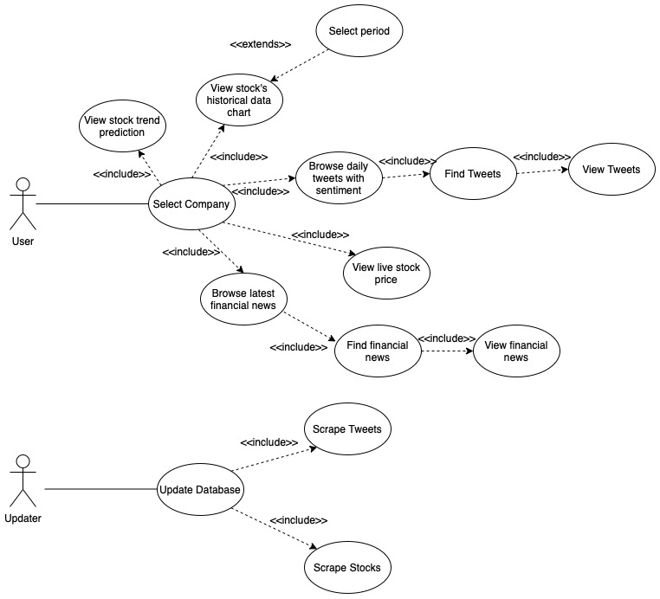
Analysis

Slide 5
Data Collection
Tweet Sentiment Classifier
The raw tweets were scraped with the Python library snscrape. Using the functions offered by this library, we were able to scrape all the tweets that contains certain keywords, published in a specific period. For each stock, we used as keywords the company name and the ticker name.
We decided not to include fields such as the number of likes, retweets, or comments because we are downloading the tweets in real time, so all the previous mentioned fields would have small or zero values.
Stock Trend Predictor
Regarding the stock trend predictor, we scraped financial historical data with Yahoo Finance Python API.

Slide 6
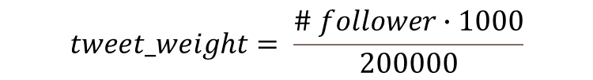
Data Pre-processing
Tweets were pre-processed according to the following steps:
Put the text of the tweets in lower case.
Remove not English tweets and the tweets that do not contains keywords (ex. Remove all tweets published by accounts that contains the keyword in the username).
Removing hashtags, mentions, link, images, and emoji.
Remove all the punctuation.
Remove the extra-spaces.
To compute the daily sentiment of the tweets related to a stock, we have given them a different weight based on the number of followers of the user who has written it.
$$tweet_weight= \frac{\# follower∙1000}{200000}$$

Slide 7
Twitter Sentiment Classifier (I)
The following results were obtained with a 10-fold cross validation (0.8 – 0.2) using the Kaggle dataset.
Algorithm | Class | Precision | Recall | F Score | Accuracy
RandomForestClassifier | Negative | 0.96 | 0.82 | 0.88 | 0.96
 | Neutral | 0.96 | 0.98 | 0.97
 | Positive | 0.96 | 0.95 | 0.96
XGBClassifier | Negative | 0.92 | 0.77 | 0.84 | 0.94
 | Neutral | 0.93 | 0.98 | 0.96
 | Positive | 0.97 | 0.92 | 0.94
AdaBoostClassifier | Negative | 0.90 | 0.61 | 0.73 | 0.89
 | Neutral | 0.86 | 0.98 | 0.92
 | Positive | 0.95 | 0.79 | 0.86
KNeighborsClassifier | Negative | 0.71 | 0.30 | 0.42 | 0.73
 | Neutral | 0.71 | 0.95 | 0.81
 | Positive | 0.85 | 0.41 | 0.55
LogisticRegression | Negative | 0.92 | 0.64 | 0.76 | 0.92
 | Neutral | 0.90 | 0.98 | 0.94
 | Positive | 0.95 | 0.88 | 0.91
MultinomialNB | Negative | 0.96 | 0.20 | 0.33 | 0.80
 | Neutral | 0.78 | 0.96 | 0.86
 | Positive | 0.85 | 0.66 | 0.74
BernoulliNB | Negative | 0.73 | 0.40 | 0.52 | 0.83
 | Neutral | 0.86 | 0.89 | 0.88
 | Positive | 0.80 | 0.84 | 0.82

Slide 8
Twitter Sentiment Classifier (II)
The following results were obtained using the manually labelled tweets dataset that contains 566 neutral, 143 positive and 50 negative labelled tuples
Algorithm | Class | Precision | Recall | F Score | Accuracy
RandomForestClassifier | Negative | 0.76 | 0.60 | 0.68 | 0.77
 | Neutral | 0.84 | 0.83 | 0.83
 | Positive | 0.69 | 0.82 | 0.75
XGBClassifier | Negative | 0.81 | 0.88 | 0.84 | 0.85
 | Neutral | 0.84 | 0.89 | 0.86
 | Positive | 0.91 | 0.76 | 0.83
AdaBoostClassifier | Negative | 1.00 | 0.51 | 0.68 | 0.76
 | Neutral | 0.72 | 0.91 | 0.81
 | Positive | 0.72 | 0.75 | 0.73
KNeighborsClassifier | Negative | 0.00 | 0.00 | 0.00 | 0.43
 | Neutral | 0.43 | 1.00 | 0.60
 | Positive | 0.00 | 0.00 | 0.00
LogisticRegression | Negative | 0.86 | 0.44 | 0.58 | 0.65
 | Neutral | 0.62 | 0.91 | 0.74
 | Positive | 0.62 | 0.47 | 0.53
MultinomialNB | Negative | 0.00 | 0.00 | 0.00 | 0.48
 | Neutral | 0.54 | 0.57 | 0.56
 | Positive | 0.44 | 0.76 | 0.56
BernoulliNB | Negative | 0.71 | 0.63 | 0.67 | 0.60
 | Neutral | 0.76 | 0.40 | 0.52
 | Positive | 0.49 | 0.86 | 0.63

Slide 9

Stock Trend Predictor (I)
We are dealing with a time series, so we exploited a traditional method used to perform time series prediction: the exponential moving average, or EMA.
We used the ewm() function that Pandas library provides and that computes EMA in the following way:
We included 6 different EMAs:
3 computed on the difference between open price and close price of a stock, respectively with span values of 3, 5 and 10.
3 computed on the daily polarity value, respectively with span values of 3, 5 and 10.

Slide 10
Stock Trend Predictor (II)
We cannot perform a ‘standard’ cross validation due the fact that we have a time series, so we trained the data with the first 70% of the data and we used the last 30% for the test set, then with an 80% - 20% split and finally with a 90% - 10% split. The following results are the average values of the 3 tests.
Algorithm | Attribute Selection | Class | Precision | Recall | F Score | Accuracy
RandomForestClassifier | StandardScaler | Down | 0.52 | 0.39 | 0.44 | 0.54
 |  | Up | 0.55 | 0.67 | 0.60
XGBClassifier | StandardScaler PCA | Down | 0.54 | 0.36 | 0.43 | 0.55
 |  | Up | 0.55 | 0.71 | 0.62
AdaBoostClassifier | StandardScaler PCA | Down | 0.57 | 0.42 | 0.49 | 0.57
 |  | Up | 0.57 | 0.71 | 0.64
KNeighborsClassifier | StandardScaler PCA | Down | 0.48 | 0.40 | 0.44 | 0.50
 |  | Up | 0.52 | 0.59 | 0.55
LogisticRegression | StandardScaler | Down | 0.33 | 0.01 | 0.01 | 0.52
 |  | Up | 0.52 | 0.99 | 0.68
GaussianNB | StandardScaler SelectKBest(5) | Down | 0.60 | 0.05 | 0.10 | 0.53
 |  | Up | 0.53 | 0.97 | 0.68

Slide 11
Possible Improvements
To conclude, the random nature of the problem makes it almost impossible to obtain a highly precise classifier model but there are still some improvements that can be done:
We might obtain a more accurate stock trend predictor by reducing the sentiment classifier error and so the error on the daily polarity. It might be done using deep learning techniques.
by triggering a re-train whenever a concept drift is detected.

Slide 12
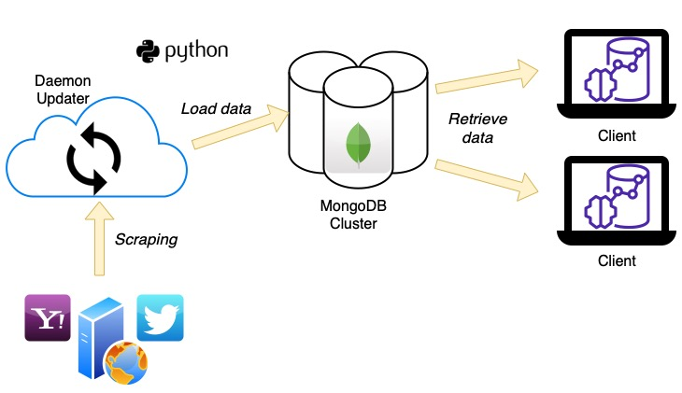
Implementation
The client-side of the application is developed using the Dash library, which permits to develop modern reactive dashboard for the data analysis application.
We decide to use MongoDB Atlas, a document database which gives the possibility to use a cluster of three servers in the cloud to store our data.

