Slide 1
TIME SERIES ANALYSIS
By
Kapil Thakkar & Reshma Kumari
Under Guidance of
Dr. Aaditeshwar Seth

Slide 2
Introduction
Time series is a collection of values which characterizes behaviour of some object
Analysis of time series can reveal various types of events/incidents which may be useful like when it behaves anomalous to the normal behaviour
Such anomalies might be helpful to user for detection of suspicious activities in the system

Slide 3
Motivation
Supply demand imbalance, natural calamities etc. may not always be the reason behind the rise in the price of a commodity.
It may be a consequence of artificial supply deficit planned intelligently by traders’ Nexus for profiteering through manipulation of supply of commodity and hence indirectly controlling their prices.
Our attempt is to locate such hikes in prices which seem suspicious (we call them anomalies).
To detect and analyze the characteristics of anomalies in the prices of commodities, currently only onion test case is taken

Slide 4
Objective
To develop a library which detect anomalies in multiple time series of a system
Consider trend and seasonality in the timeseries
Verify reported anomalies
Onion supply system is taken for analysis
Verification of anomalies with news articles

Slide 5
Hypothesis for Onion Time Series(1)
H1: In the absence of market abuse phenomena, there is a negative correlation between arrival and wholesale prices. i.e. If there is increase in arrival pattern, there should be decrease in the wholesale price and if there is decrease in arrival pattern, there should be increase in the wholesale price considering a lag factor of 15 days.
Assumption: farmers do not hoard which we can support as per our literature review
Test Criterion:
Cross correlation between arrival and wholesale price considering lag factor
Use of sliding window for calculating correlation with different window size
Slope based method
Linear Regression

Slide 6
Hypothesis for Onion Time Series(2)
H2: In the absence of market abuse phenomena, there is positive correlation between wholesale price and retail price. i.e. If there is increase in the wholesale price of onion, then there will be corresponding increase in the retail price and vice-versa
Assuming, demand remains constant and there is no supply shock created because of excessive export of onion
Test Criterion:
Cross correlation between wholesale and retail price considering lag factor
Use of sliding window for calculating correlation with different window size
Slope based method
Linear regression

Slide 7
Hypothesis for Onion Time Series(3)
H3: The deviation between arrival - wholesale and wholesale- retail should not vary much compared to values for same time in past years.(Considering Seasonality within data)
This states that even if it is following H1 and H2, the variation should not be very large as compared to past years
Test Criterion:
Graph based Anomaly Detection Technique
Multivariate Anomaly Detection Technique
Results of H1 and H2 are intersected with results of H3 in order to consider trend and seasonality

Slide 8
Hypothesis for Onion Time Series(4)
H4: Mandis in the same region should follow the same relationship between arrival and wholesale price, as that of, taken whole region combinely.
OR
Retail prices across various centres should follow same relationship among themselves taken effect of them combinely.
Test Criterion:
First generate combined time series from all Mandis/Centers
Average of Prices at all centres
Then compare each Centre's time series with average one, using methods stated in H2

Slide 9
Anomaly Scenarios
Retail\Wholesale | ↑ | ↔ | ↓
↑ | - | A | A
↔ | - | - | A
↓ | - | - | -
Wholesale\Arrival | ↑ | ↔ | ↓
↑ | A | A | -
↔ | A | - | -
↓ | - | - | -
Retail\Arrival | ↑ | ↔ | ↓
↑ | A | A | -
↔ | A | - | -
↓ | - | - | -
Retail\Average-Retail | ↑ | ↔ | ↓
↑ | - | A | A
↔ | - | - | A
↓ | - | - | -

Slide 10
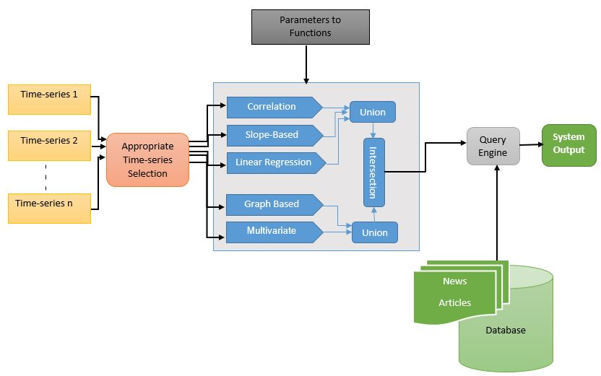
System Design

Slide 11
Onion Data
Daily wholesale price of onion for 1514 mandis
Daily arrival of onion information for 1514 mandis
Daily retail price of onion for 76 centres
Longitude and latitude of mandis and centres
Crawlers were written to collect the data from these date-wise for the period of approximately 9.5 years, starting from 1st January 2006 to 6th July 2015.
Dates and location for hoarding reports from news articles
Total 453 news articles were collected, 267 articles were relevant after studying manually

Slide 12
Detailed Results for Mumbai
Anomalies Reported | Slope Based (1) | Window Correlation (2) | Linear Regression (3) | Graph Based (4) | Multi- Variate (5) | Hypothesis 1 {1 U 2 U 3} (6) | Hypothesis 3 {4 U 5} (7) | Final Result {6 ∩ 7}
Retail Vs Arrival | 266 | 375 | 353 | 500 | 167 | 835 | 573 | 323
Wholesale Vs Arrival | 329 | 360 | 282 | 500 | 186 | 858 | 586 | 332
Anomalies Matched With News | Slope Based (1) | Window Correlation (2) | Linear Regression (3) | Graph Based (4) | Multi- Variate (5) | Hypothesis 1 {1 U 2 U 3} (6) | Hypothesis 3 {4 U 5} (7) | Final Result {6 ∩ 7}
Retail Vs Arrival | 42 | 74 | 167 | 121 | 119 | 220 | 159 | 153
Wholesale Vs Arrival | 64 | 64 | 174 | 122 | 139 | 219 | 174 | 168

Slide 13
Detailed Results for Mumbai
 | Analysis | Slope Based (1) | Window Correlation (2) | Linear Regression (3) | Graph Based (4) | Multi- Variate (5) | Hypothesis 4 {1 U 2 U 3} (6) | Hypothesis 3 {4 U 5} (7) | Final Result {6 ∩ 7}
Anomalies Reported | Retail Vs Average Retail | 471 | 180 | 258 | 300 | 177 | 806 | 362 | 125
Anomalies Matched | Retail Vs Average Retail | 67 | 47 | 50 | 122 | 122 | 142 | 162 | 64
 | Analysis | Slope Based (1) | Window Correlation (2) | Linear Regression (3) | Graph Based (4) | Multi- Variate (5) | Hypothesis 2 {1 U 2 U 3} (6) | Hypothesis 3 {4 U 5} (7) | Final Result {6 ∩ 7}
Anomalies Reported | Retail Vs Wholesale | 322 | 300 | 310 | 300 | 167 | 799 | 367 | 160
Anomalies Matched | Retail Vs Wholesale | 30 | 55 | 40 | 117 | 119 | 107 | 150 | 52

Slide 14
Detailed Results for Mumbai
 | Anomalies Reported | Anomalies Matched | Anomalies Not Matched With Any Article | Articles Not Matched | Articles not matched which stated traders’ nexus as reason
Retail vs Average Retail | 125 | 64 | 61 | 49 | 12 (24.49%)
Retail vs Arrival | 323 | 153 | 170 | 33 | 9 (27.27%)
Retail vs Wholesale | 160 | 52 | 108 | 52 | 14 (26.92%)
Wholesale vs Arrival | 332 | 168 | 164 | 29 | 7 (24.13%)

Slide 15
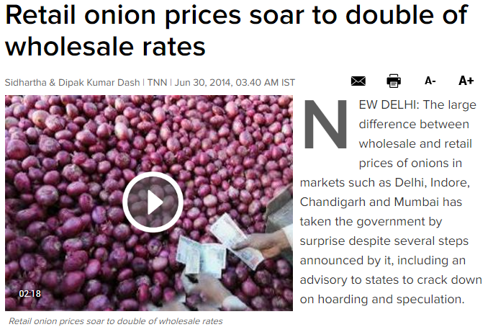
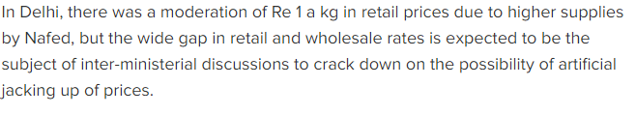
Findings – Matched Anomaly
Delhi- 29-Jun-2014 to 06-July-2014
Retail Price vs Arrival Result by System

Slide 16
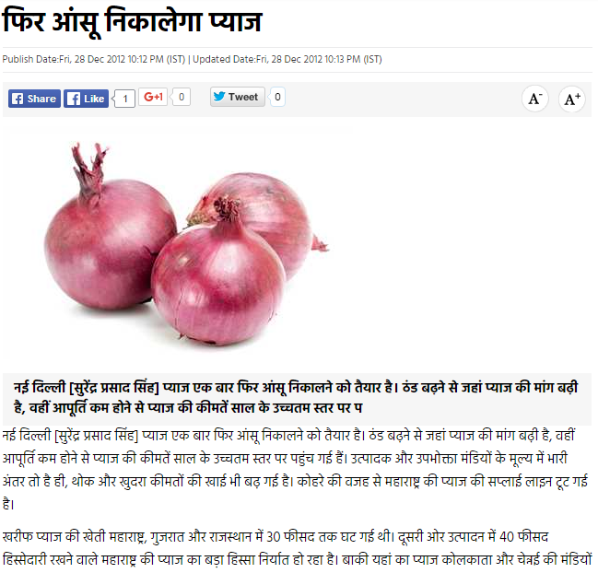
Findings – Local Anomaly
Delhi- 07-Jan-2013 to 08-Jan-2013
Retail Price vs Arrival Result by System

Slide 17
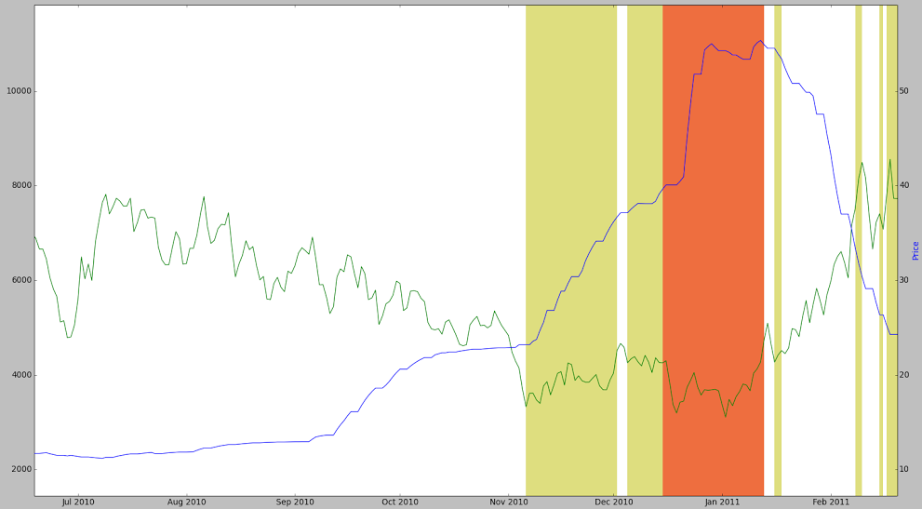
Findings – Reported but Not Matched
Mumbai – 07-Nov-2010 to 01-Dec-2010
Retail Price vs Arrival Result by System

Slide 18
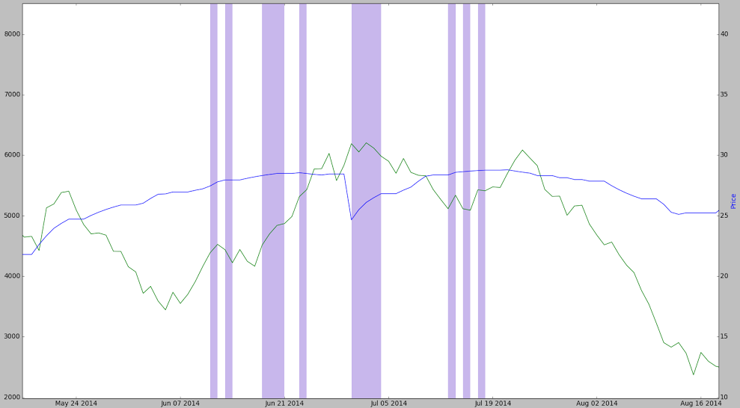
Findings – Articles Missed
Mumbai –11-Jun-2014 to 17-July-2014
Retail Price vs Arrival Result by System

Slide 19
Reasons Stated by News Articles

Slide 20
Mapping Categories to Our Analysis

Slide 21
Limitations
Few articles with traders’ nexus are still not reported by system
Result dependent on configuration of library functions
Window Size
Threshold Value
Number of anomalies to be reported
Manual analysis of news articles is required

Slide 22
Conclusion
Time series analysis can bring more insights to data
In the case of onion, abnormal behaviour can help to detect important events or incidents like hoarding
Most of the results were justified using news articles
Library developed is generic, so can be applied to any time-series which have some sort of dependency on each other

Slide 23
Future Work
New methods can be added to refine results like Spike Detection
New techniques to define default threshold values can be used
Local anomalies to centre can be justified by local news sources
Can be extended further to locate anomalies in Supply Chain

Slide 24
THANK YOU!!! ANY QUESTIONS?

