Slide 1

Victor Baldwin
https://github.com/vbaldwin/embsys105

Slide 2
Features
Required: Play/Stop
Additional:
Pause
Restart/Rewind
Skip/Fast Forward
Song Progress
Volume Control
Track Name Displayed

Slide 3
Task Priorities
InitializationTask: 5
TouchPollingTask: 6
CommandHandlerTask: 7
LcdHandlerTask: 8
StreamingTask: 9

Slide 4
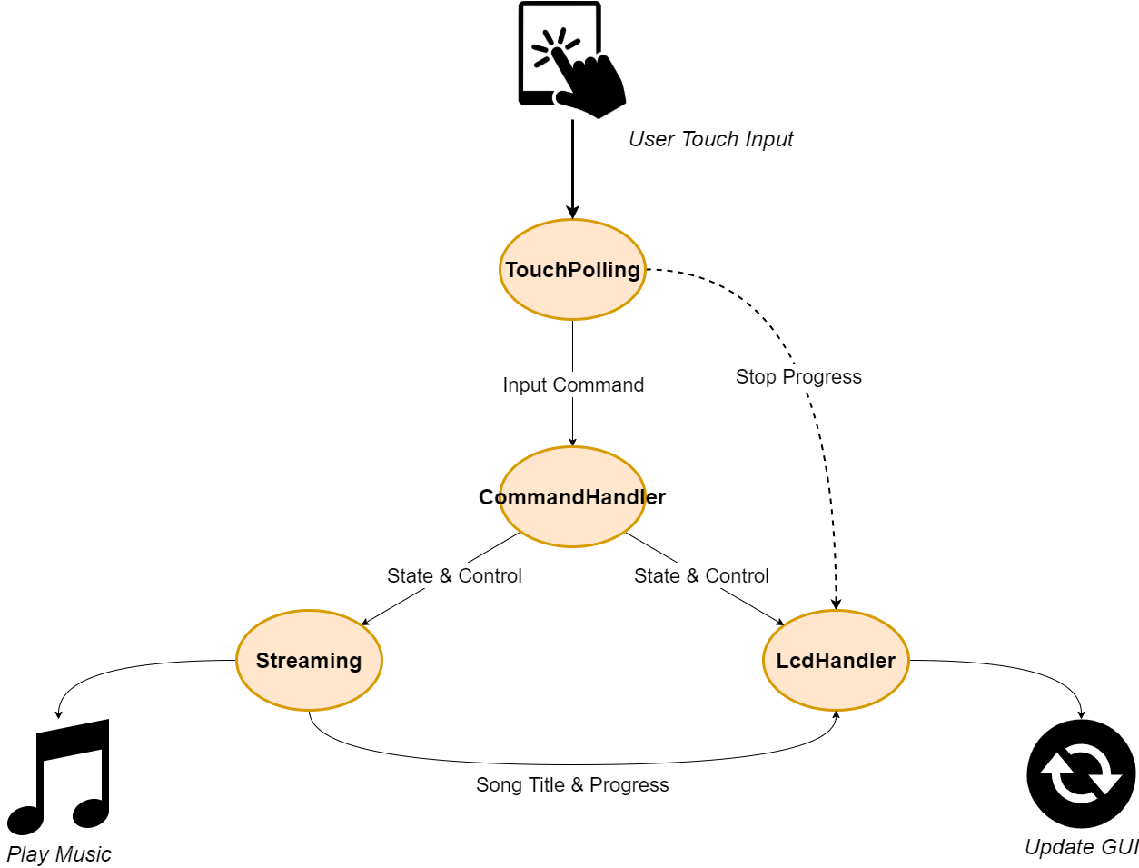
Task Communication

Slide 5
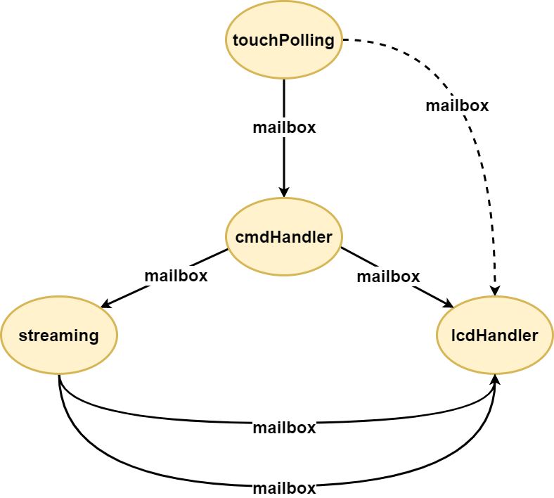
Task Communication

Slide 6
Details
InitializationTask() synchronizes on tasks being initialized; prevents TouchPollingTask() and LcdHandlerTask() from starting if a task encounters an error before fully initializing.
TouchPollingTask() sends only a single message when a button is pressed; 3 exceptions: holding play/skip/restart buttons have additional functionality.
CommandHandlerTask() pends on the message received from TouchPollingTask() and then sends messages to StreamingTask() and LcdHandlerTask().
StreamingTask() polls for the play/skip/restart commands; Mp3StreamSDFile() within the task polls for play/stop/pause/skip/restart/fast forward/rewind/volume up/volume down commands. Sends track name and song progress to LcdHandlerTask().
LcdHandlerTask() polls for 4 different messages for updating the GUI: 1 from TouchPollingTask(), 1 from CommandHandlerTask(), and 2 from StreamingTask().

Slide 7
InitializationTask

Slide 8
TouchPollingTask

Slide 9
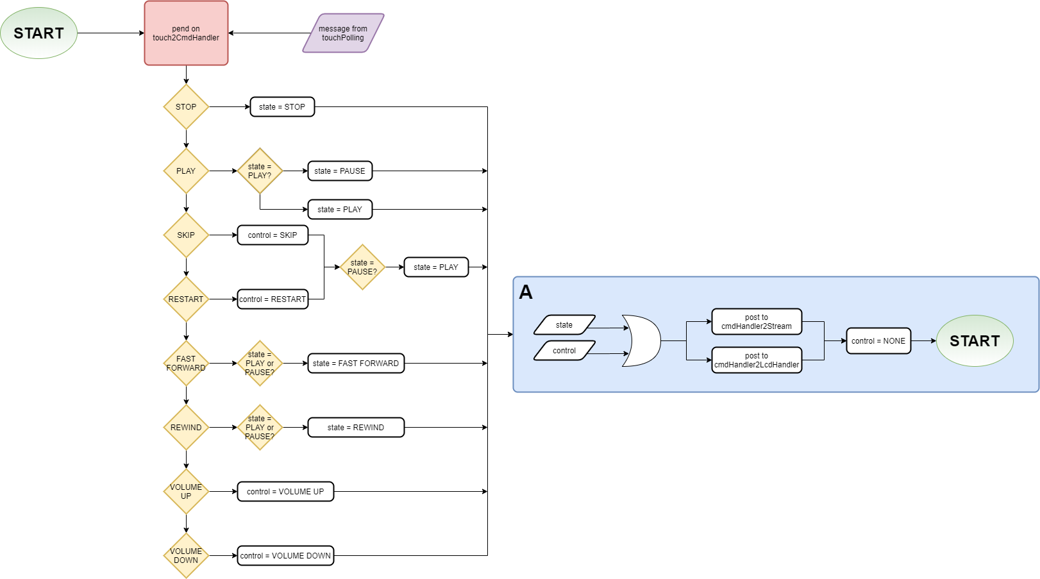
CommandHandlerTask

Slide 10
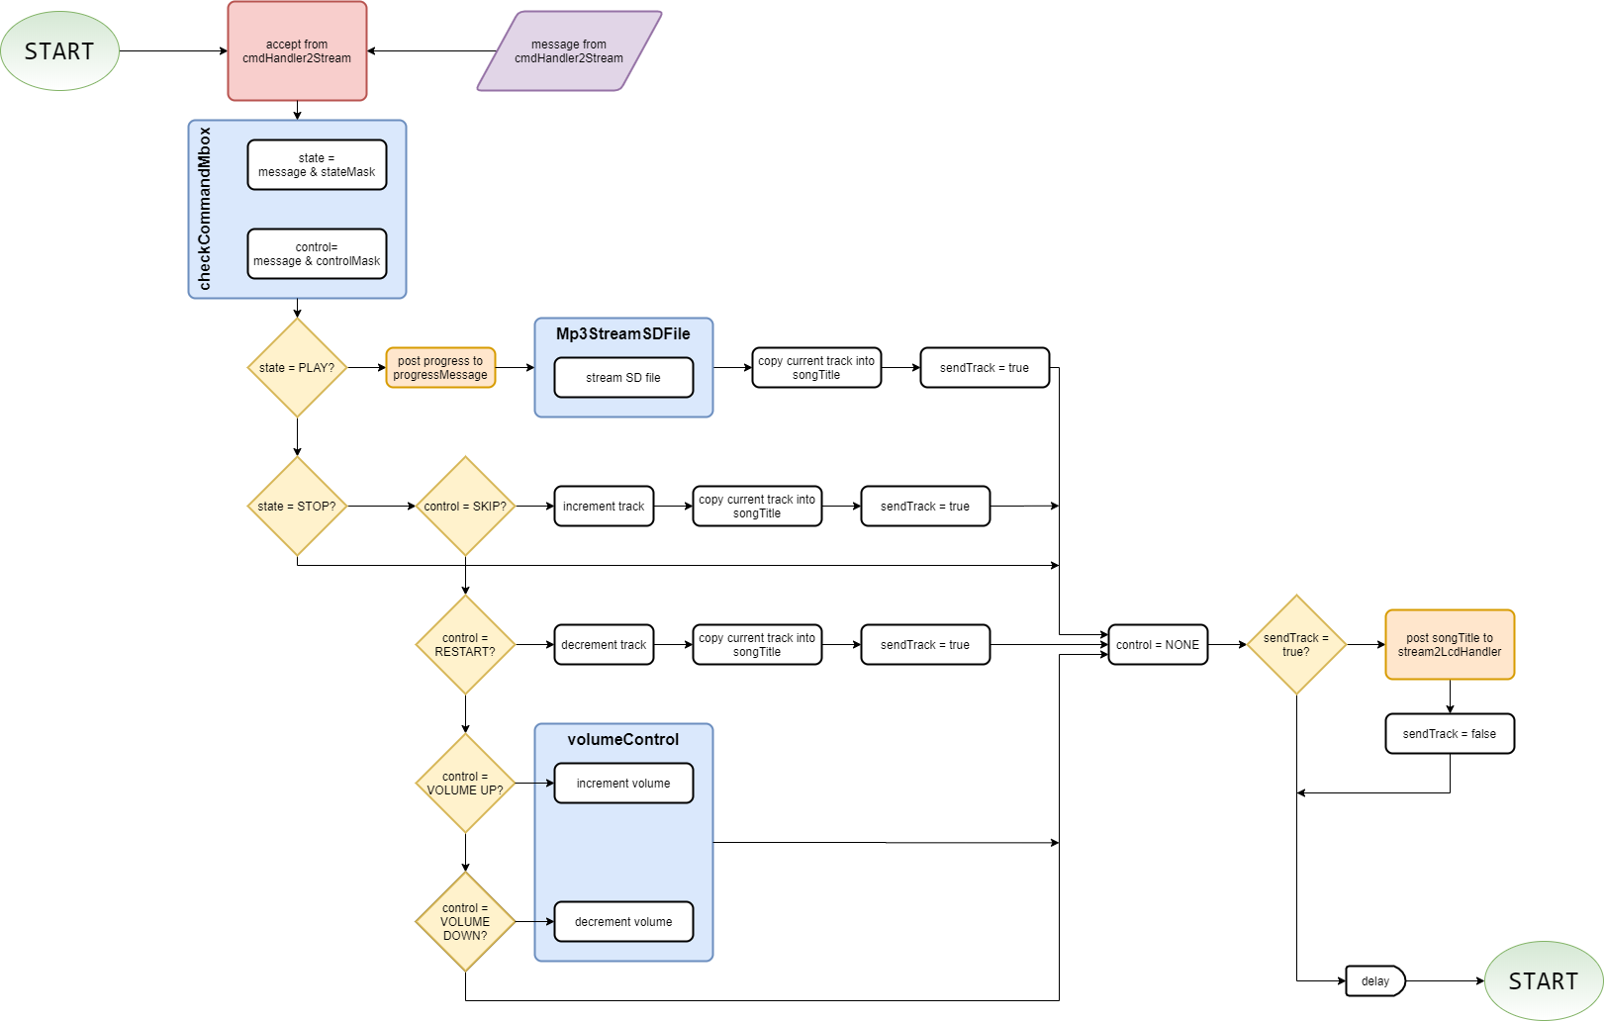
StreamingTask

Slide 11
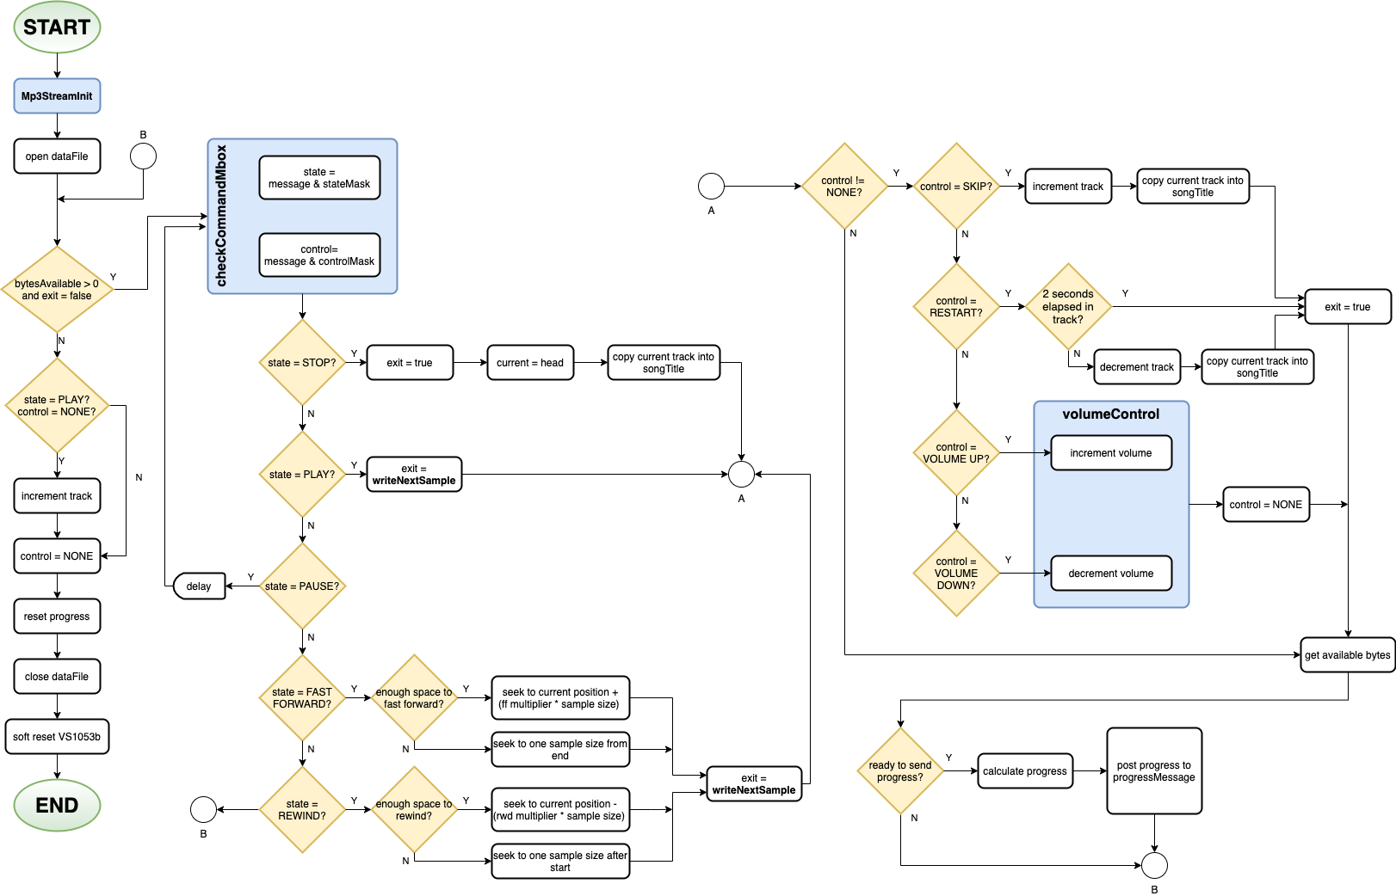
Mp3StreamSDFile

Slide 12
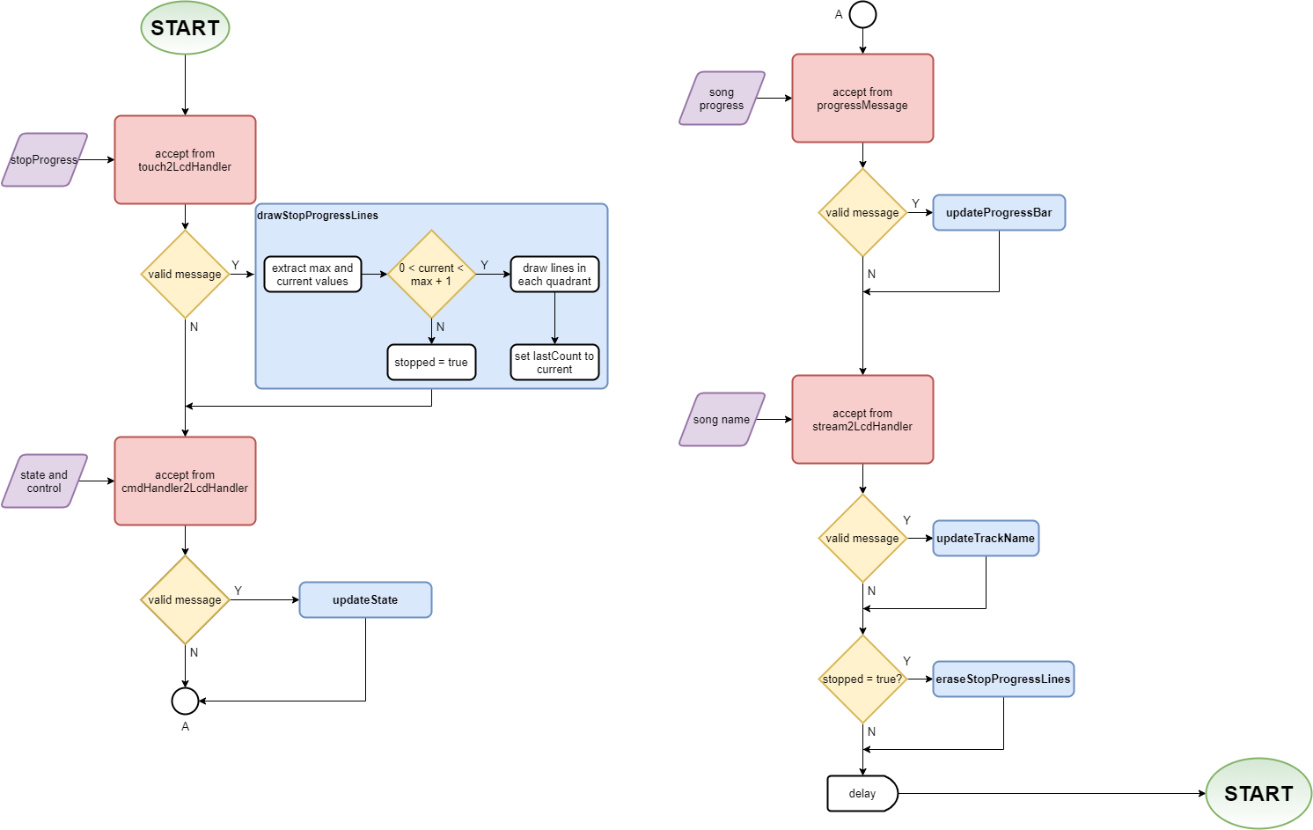
LcdHandlerTask

Slide 13
Running the System
Generate the song list
Controls Layout

Slide 14
Generate Song List
Create a folder in the user’s Music directory called to_SD.
Copy desired .mp3/.m4a files into to_SD.
In the embsys105/Project directory, run the generateSongList.py python script.
Renames files so they can be read within the MP3 Player application.
Creates a file, songs.txt, that is read by the MP3 Player application to populate a list of track information nodes.
Line format within songs.txt (for .mp3 files):
“track<file number>.mp3, <song name>.mp3”
Ex: track004.mp3, Involuntary Doppelganger.mp3
Copy the contents of the to_SD directory into the root directory of the SD card.

Slide 15
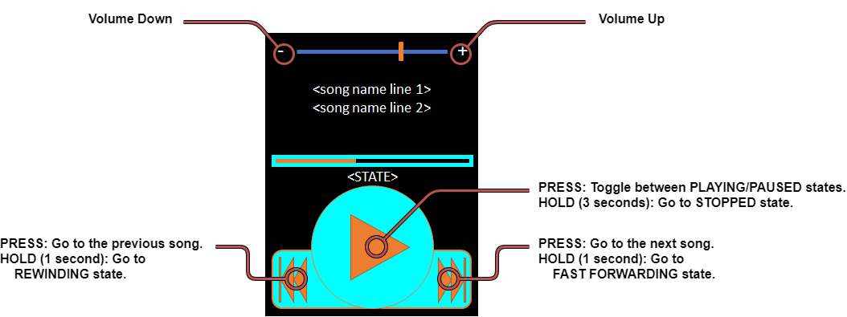
Controls Layout

