Slide 1

Victor Baldwin
https://github.com/vbaldwin/embsys105

Slide 2
Features
Required: Play/Stop
Additional:
Pause
Restart/Rewind
Skip/Fast Forward
Song Progress
Volume Control
Track Name Displayed

Slide 3
Task Priorities
InitializationTask: 5
TouchPollingTask: 6
CommandHandlerTask: 7
LcdHandlerTask: 8
StreamingTask: 9

Slide 4
Running the System
Generate the song list
Controls Layout

Slide 5
Generate Song List
Create a folder in the user’s Music directory called to_SD.
Copy desired .mp3/.m4a files into to_SD.
In the embsys105/Project directory, run the generateSongList.py python script.
Renames files so they can be read within the MP3 Player application.
Creates a file, songs.txt, that is read by the MP3 Player application to populate a list of track information nodes.
Output format for .mp3 files is “track<file number>.mp3, <song name>.mp3”
Copy the contents of the to_SD directory into the root directory of the SD card.

Slide 6
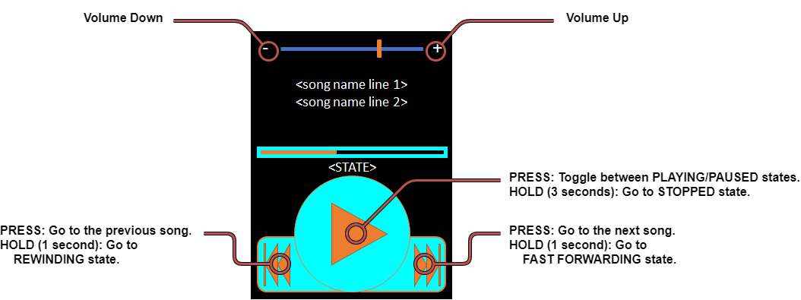
Controls Layout

Slide 7
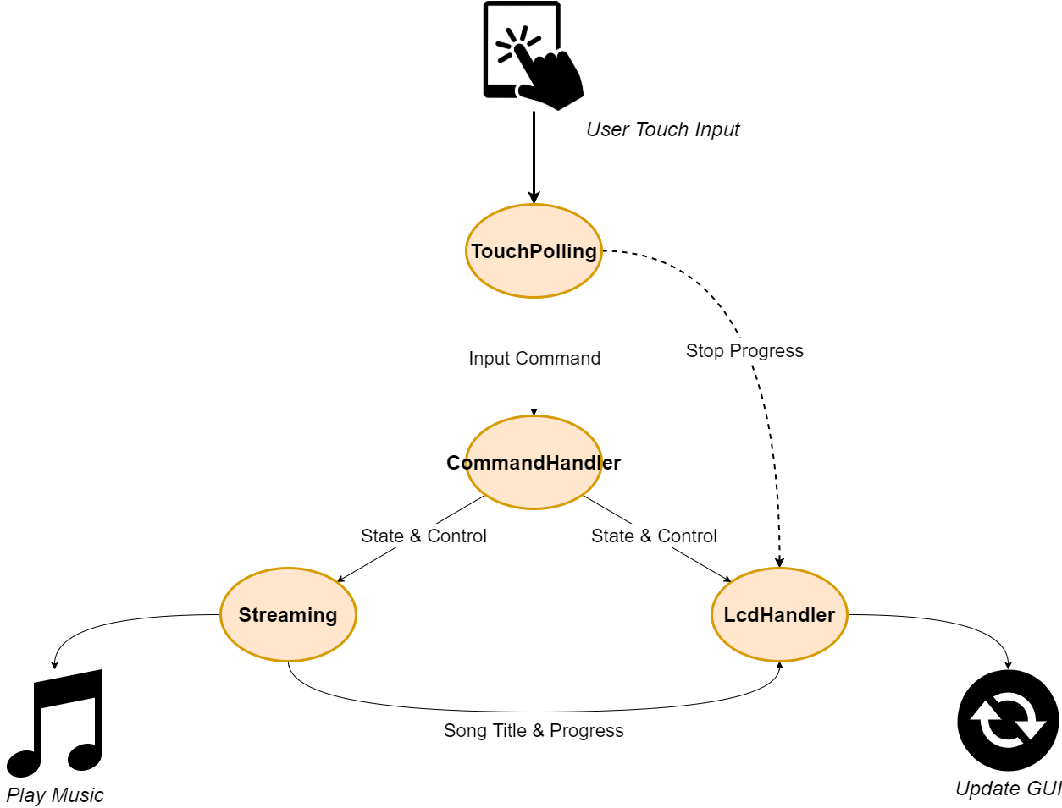
Data Sent via Message Mailboxes

Slide 8
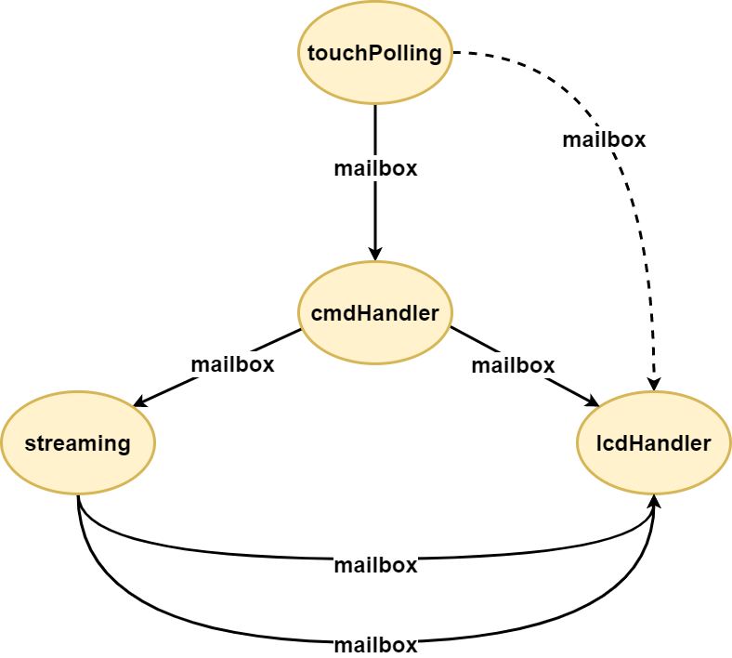
Task Communication

Slide 9
InitializationTask

Slide 10
TouchPollingTask

Slide 11
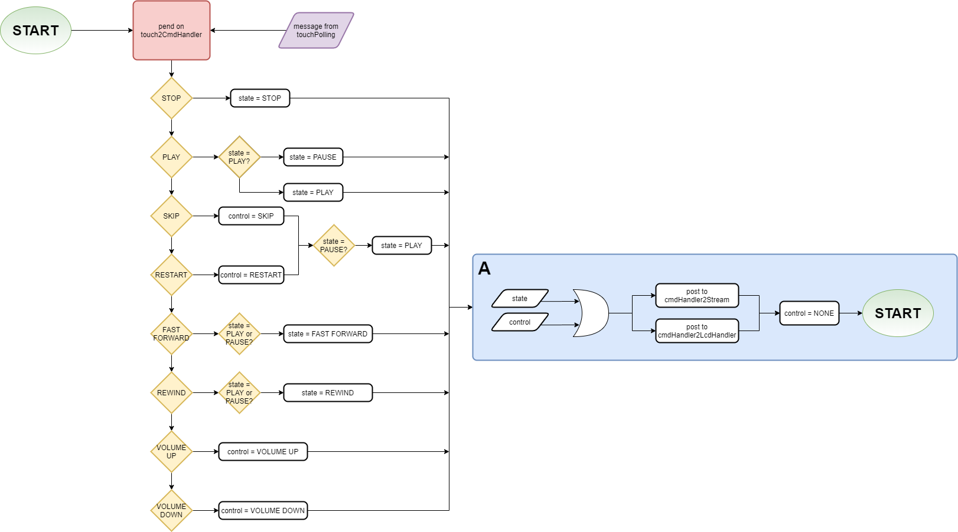
CommandHandlerTask

Slide 12
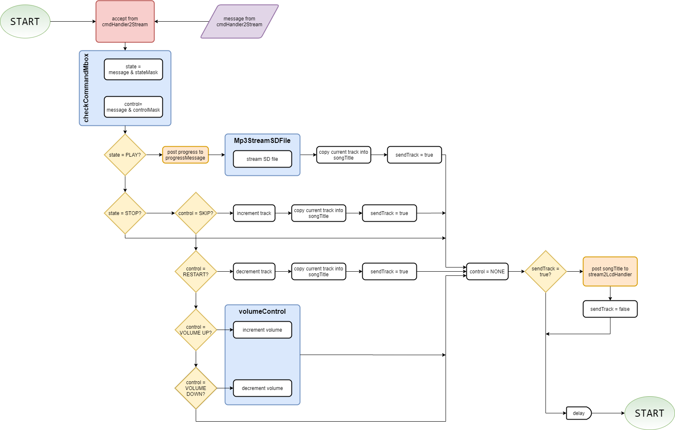
StreamingTask

Slide 13
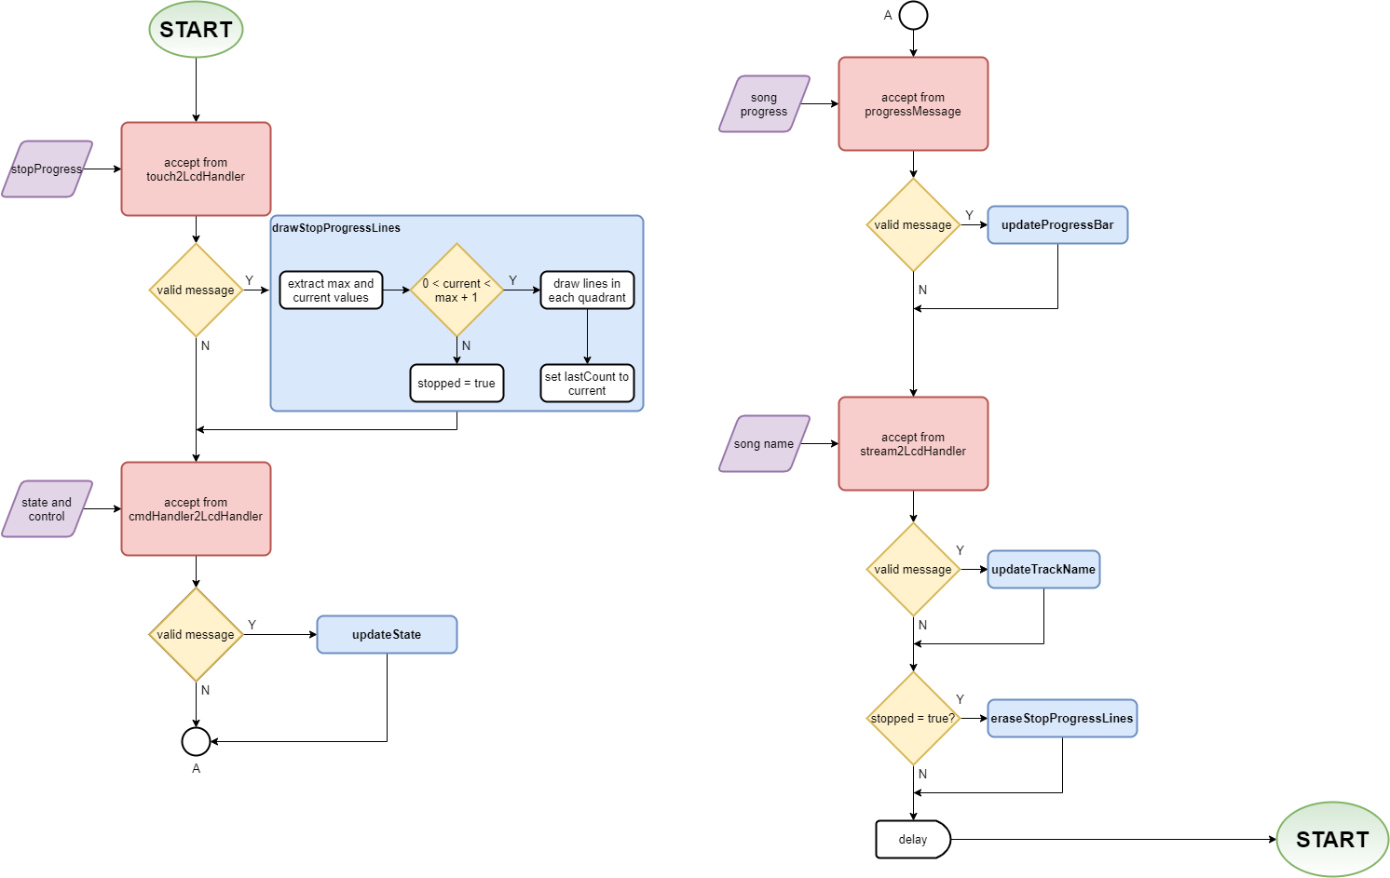
LcdHandlerTask

