Slide 1

Victor Baldwin
https://github.com/vbaldwin/embsys105

Slide 2
Features
Required: Play/Stop
Additional:
Pause
Restart/Rewind
Skip/Fast Forward
Song Progress
Volume Control
Track Name Displayed

Slide 3
Task Priorities
InitializationTask: 5
TouchPollingTask: 6
CommandHandlerTask: 7
LcdHandlerTask: 8
StreamingTask: 9

Slide 4
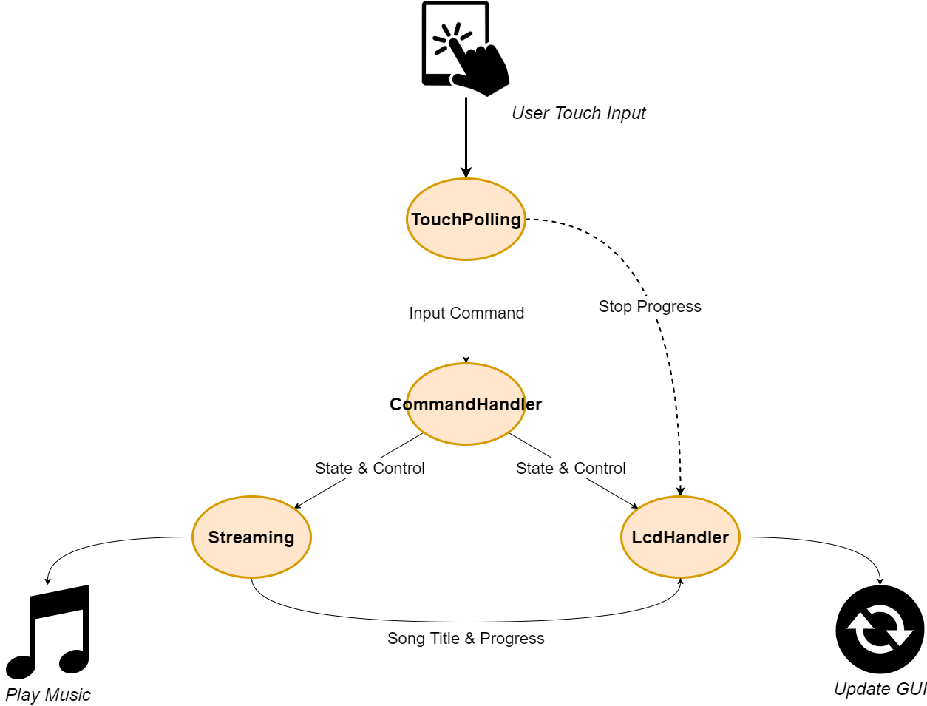
Task Communication

Slide 5
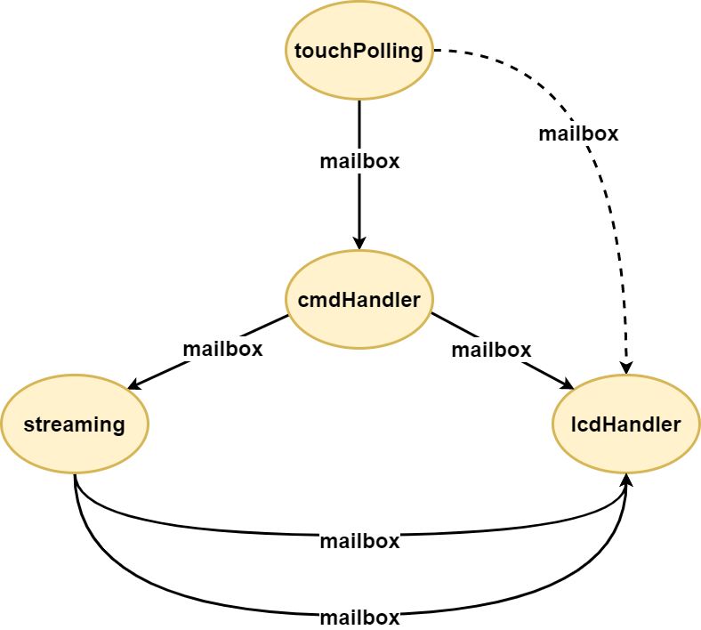
Task Communication

Slide 6
Running the System
Generate the song list
Controls Layout

Slide 7
Generate Song List
Create a folder in the user’s Music directory called to_SD.
Copy desired .mp3/.m4a files into to_SD.
In the embsys105/Project directory, run the generateSongList.py python script.
Renames files so they can be read within the MP3 Player application.
Creates a file, songs.txt, that is read by the MP3 Player application to populate a linked list of track information.
Line format within songs.txt (for .mp3 files):
“track<file number>.mp3, <song name>.mp3”
Ex: track004.mp3, Involuntary Doppelganger.mp3
Copy the contents of the to_SD directory into the root directory of the SD card.

Slide 8
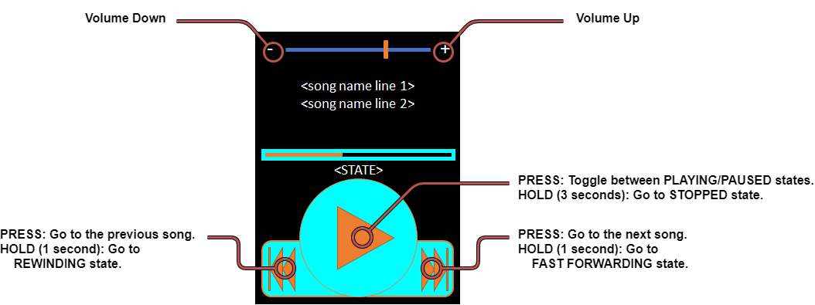
Controls Layout

Slide 9
Stats
Tools Used
30,369 bytes of readonly code memory
3,960 bytes of readonly data memory
34,198 bytes of readwrite data memory
Running with optimization of –O2
Python 3.7 (generating song list)
Draw.io (now diagrams.net) for flow charts

Slide 10
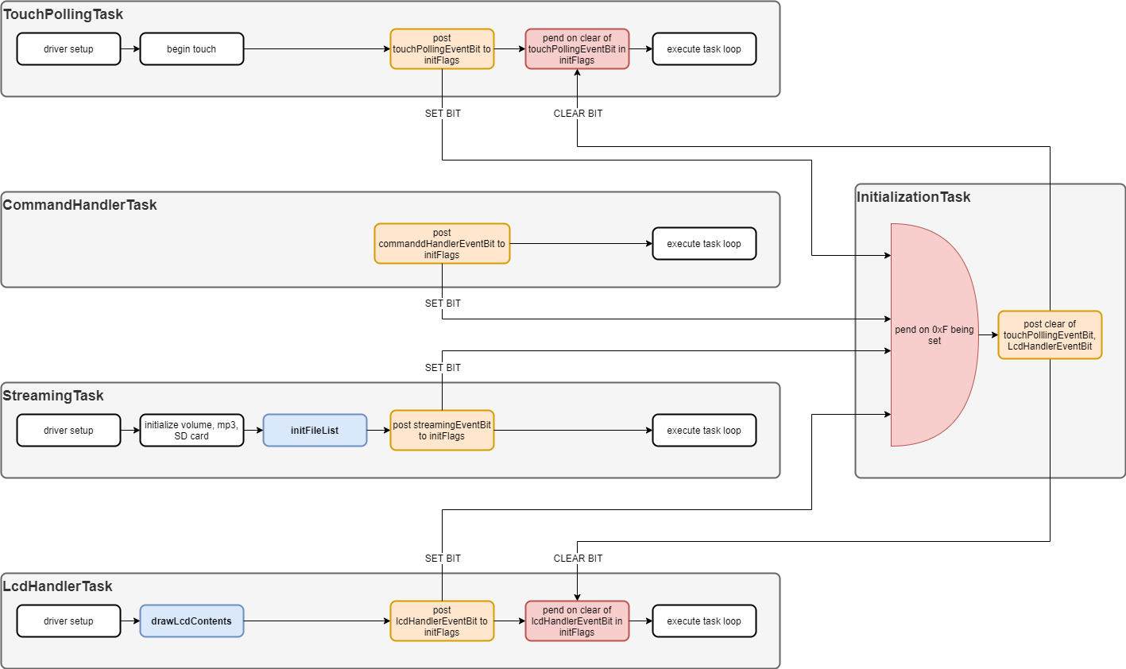
InitializationTask

Slide 11
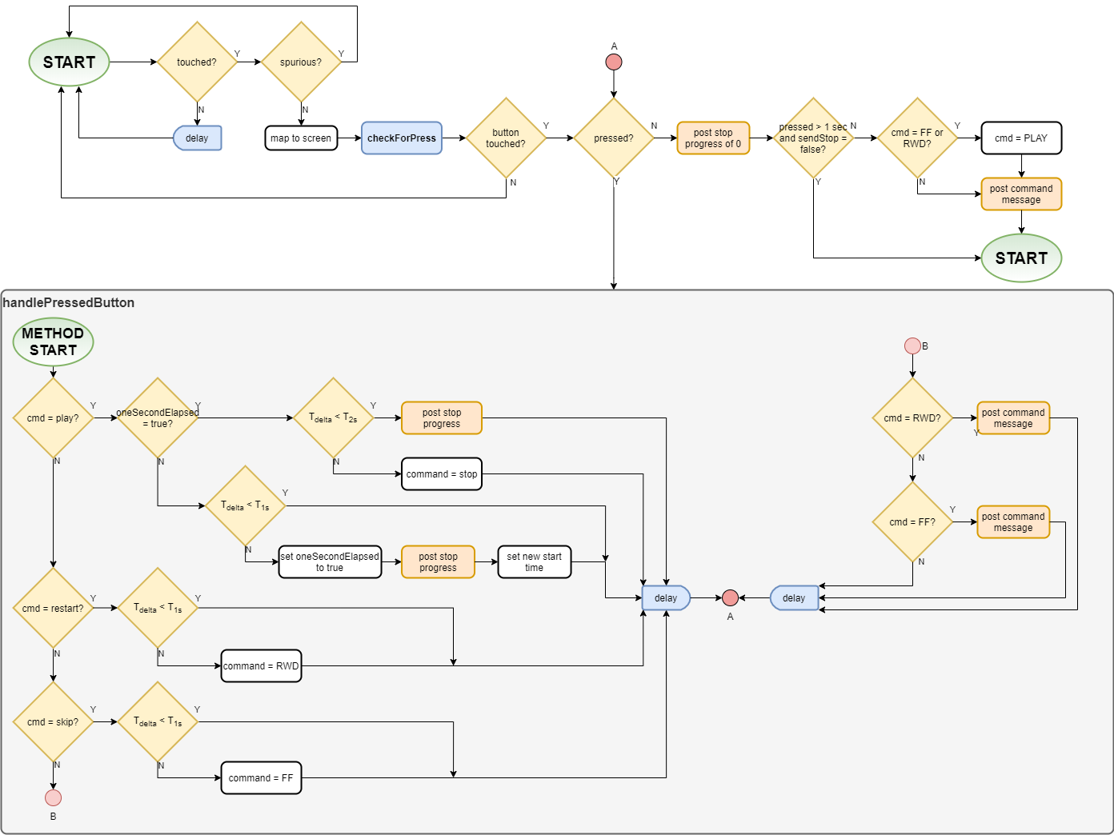
TouchPollingTask

Slide 12
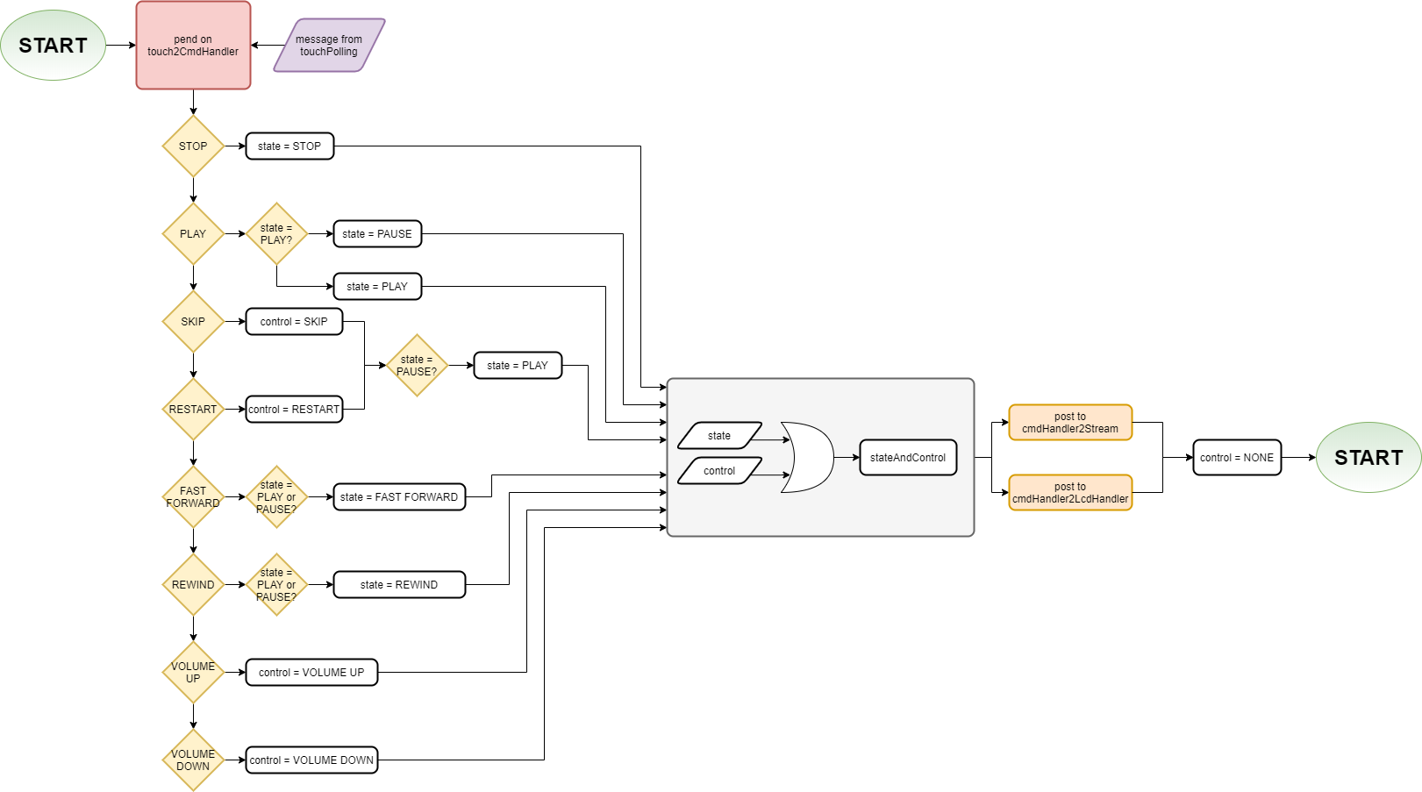
CommandHandlerTask

Slide 13
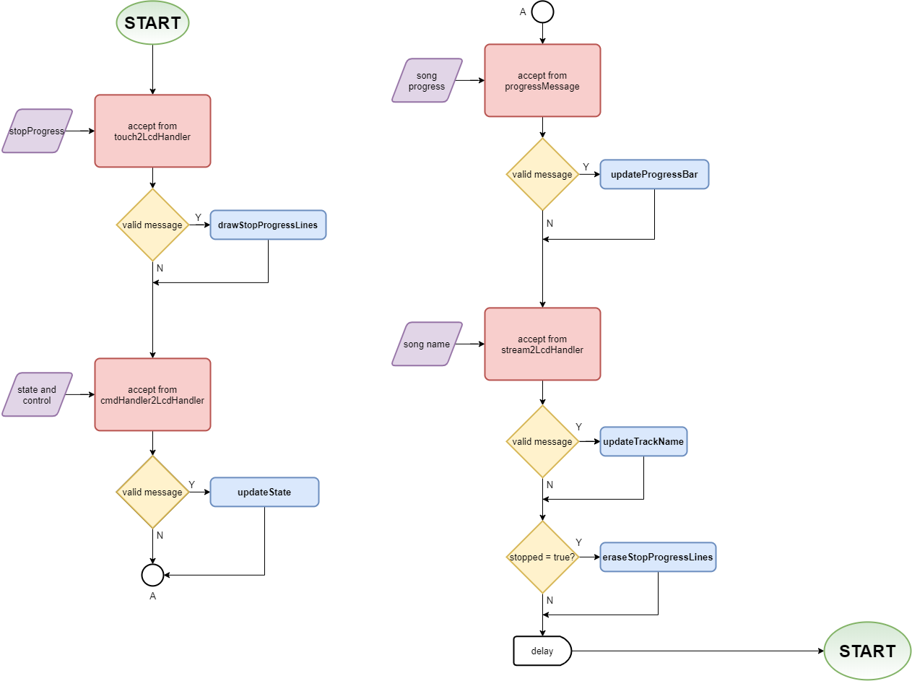
LcdHandlerTask

Slide 14
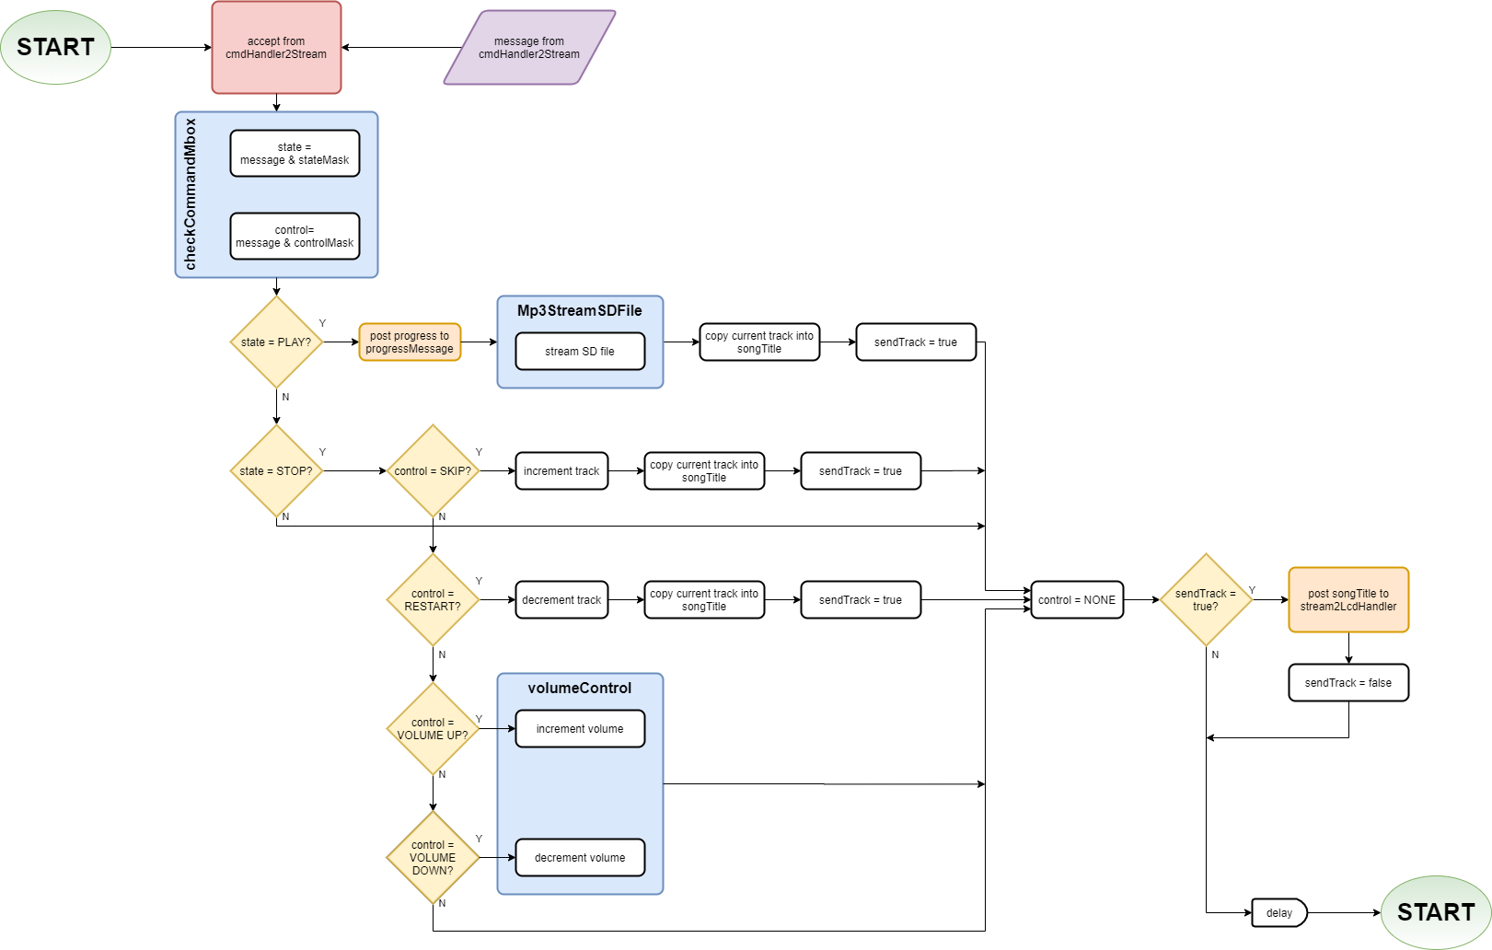
StreamingTask

Slide 15
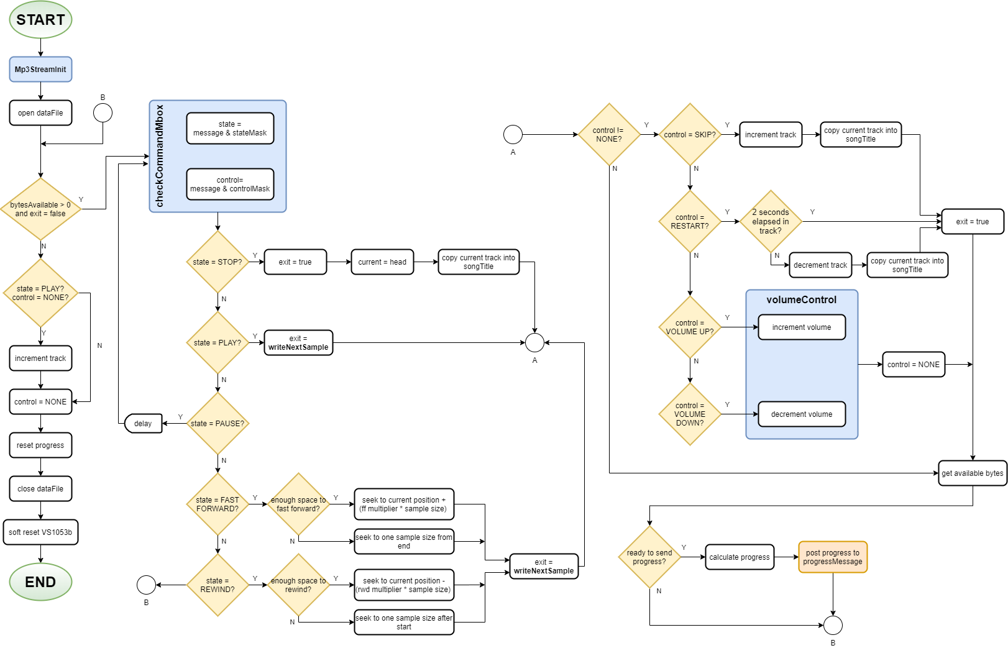
Mp3StreamSDFile

