Slide 1
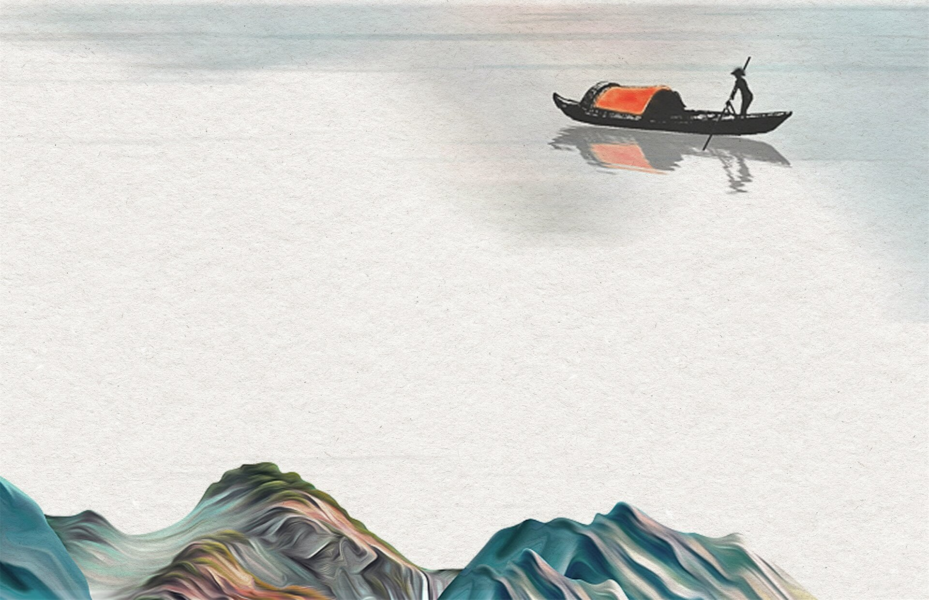
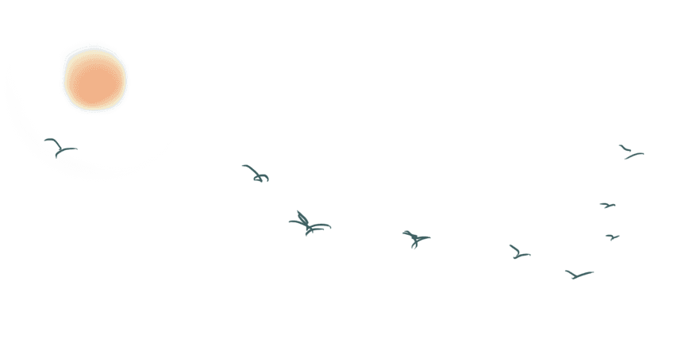

背景渐变

Slide 2


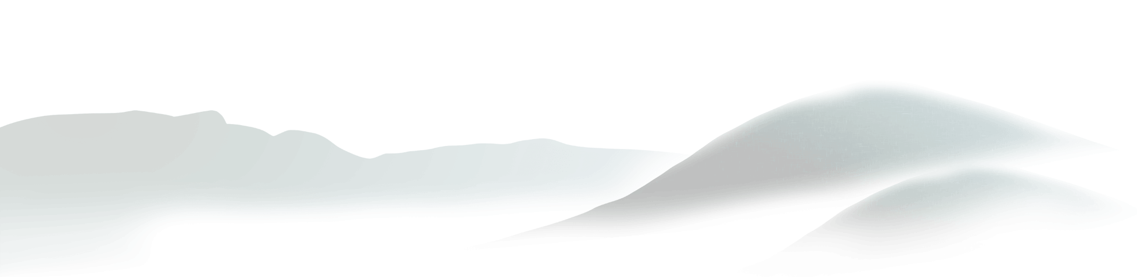
背景
径向渐变（Radial Gradients）- 由它们的中心定义
线性渐变（Linear Gradients）- 向下/向上/向左/向右/对角方向

Slide 3


线性
语法：background-image: linear-gradient(direction, color-stop1, color-stop2, ...);

Slide 4

线性渐变 - 从上到下（默认情况下）
线性渐变 - 从左到右
线性渐变 - 对角
使用角度
重复的线性渐变
background-image: linear-gradient(#e66465, #9198e5);
background-image: linear-gradient(to right, red , yellow);
background-image: linear-gradient(to bottom right, red, yellow);
background-image: linear-gradient(angle, color-stop1, color-stop2);
background-image: repeating-linear-gradient(red, yellow 10%, green 20%);

Slide 5
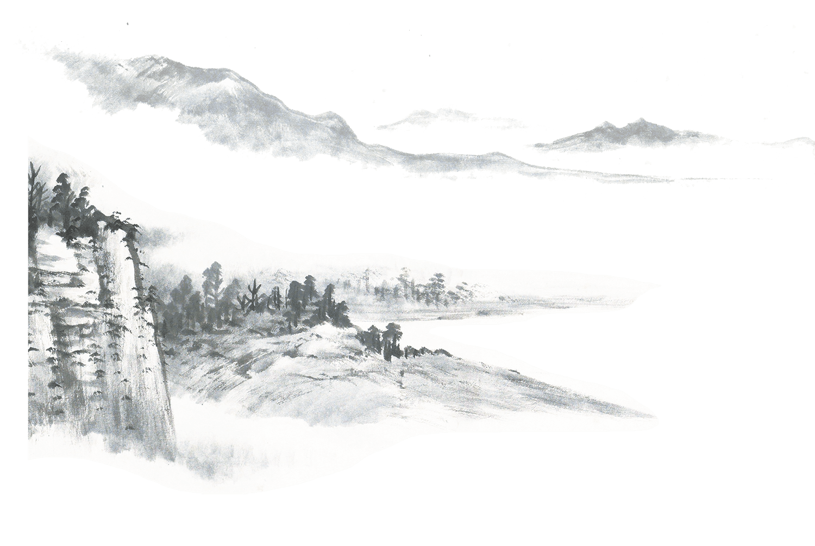
径向渐变
语法：background-image: radial-gradient(shape size at position, start-color, ..., last-color);
径向渐变 - 颜色节点均匀分布（默认情况下）：background-image: radial-gradient(red, yellow, green);
径向渐变 - 颜色节点不均匀分布：background-image: radial-gradient(red 5%, yellow 15%, green 60%);
设置形状：background-image: radial-gradient(circle, red, yellow, green);
不同尺寸大小关键字的使用：
background-image: radial-gradient(closest-side at 60% 55%, red, yellow, black);
closest-side / farthest-side / closest-corner /farthest-corner
重复的径向渐变：
background-image: repeating-radial-gradient(red, yellow 10%, green 15%);

Slide 6

THANK YOU

