Slide 1
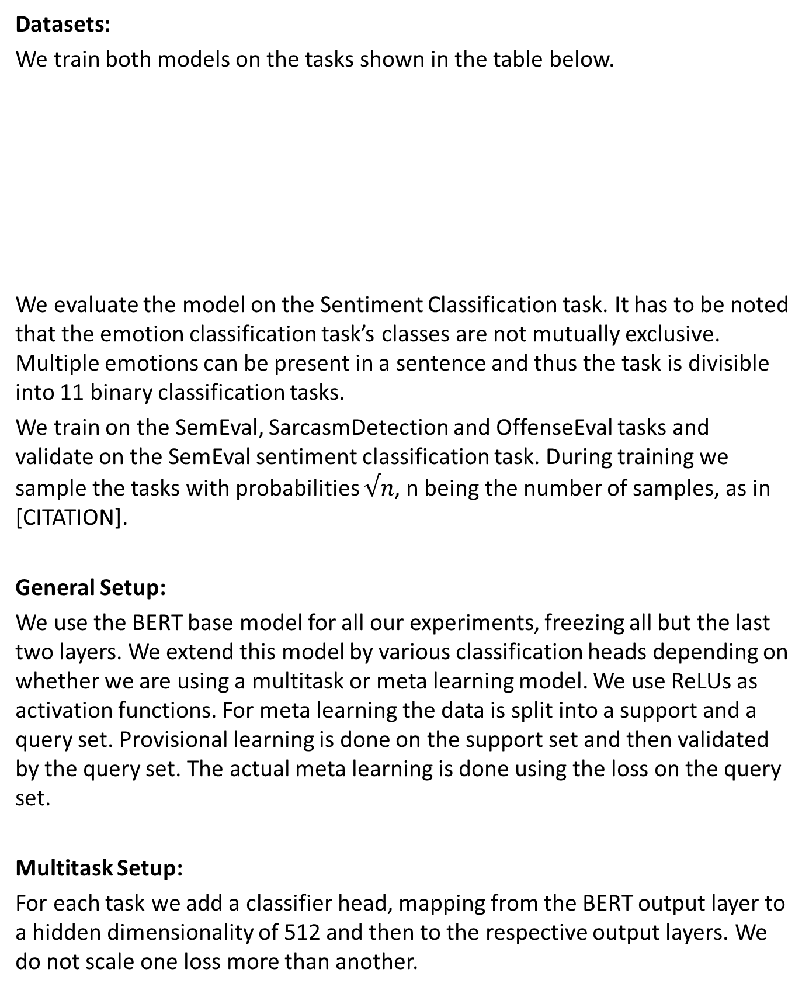
Meta-Learning for Pragmatics
Christoph Hönes, Daniel Rodríguez Baleato, Ard Snijders and Tamara Czinczoll
Advanced Topics in Computational Semantics – University of Amsterdam
INTRODUCTION (OR ABSTRACT)
Neural networks thrive with bigger and better datasets. Creating these datasets, however, usually comes with a lot of work and costs. Some problem domains already have vast datasets, e.g. sentiment analysis. Others do not, and are notoriously hard to annotate, like metaphor detection. As humans, we would immediately agree that most language information needed to successfully perform sentiment analysis is also needed for metaphor detection, and that the two tasks only deviate in a few aspects. The perfect model would reflect this, encoding all lower-level information in a generalized and easy-to-access way so that the model could adapt fast to new problems. Multitask learning can be a first step in that direction. While multitask training is performed on multiple tasks together with the hope that their respective information can (mutually) benefit each other, it is not specifically designed to adapt quickly to new before-unseen tasks. Meta learning, aka “learning to learn”, on the other hand, is set up exactly with that goal in mind. In this work, we compare a multitask-learned model with a meta-learned one in a few-shot set-up for tasks in the domain of pragmatics. Our results suggest that…
Meta Learning Setup:
We use two types of meta learning models, Prototype Learning and ProtoMAML.
Prototype Learning [CITATION] is a simple approach to meta learning. First, all samples in a batch are embedded in a high-dimensional space with the neural network. Then, for each label from all tasks a centroid (aka prototype) is computed by averaging the embeddings of the samples with that label using the support set. The usefulness of the embedding is evaluated by classifying all query set samples according to their nearest centroid and computing the loss based on these distances.
ProtoMAML [CITATION] takes a different approach and is a hybrid of MAML and prototype networks, which extends the MAML setup to tasks with a different number of classes. MAML has an inner and an outer training loop. In the inner loop the model simulates a training step for each task, retaining the gradients. In the outer loop the actual meta training takes place, updating the model with an aggregated version of the gradients from the inner loop. Updating based on all tasks’ gradients ensures that the model learns generalized parameters and does not specialize on one task. ProtoMAML uses the centroids computed for each label to initialize meaningful classifier heads for every task, reducing the number of exampled needed to train them.
We add an additional hidden linear layer to the BERT model for both meta models.
MODELS & EXPERIMENTS
Datasets:
We train both models on the tasks shown in the table below.
We evaluate the model on the Sentiment Classification task. It has to be noted that the emotion classification task’s classes are not mutually exclusive. Multiple emotions can be present in a sentence and thus the task is divisible into 11 binary classification tasks.
We train on the SemEval, SarcasmDetection and OffenseEval tasks and validate on the SemEval sentiment classification task. During training we sample the tasks with probabilities $√n$, n being the number of samples, as in [CITATION].
General Setup:
We use the BERT base model for all our experiments, freezing all but the last two layers. We extend this model by various classification heads depending on whether we are using a multitask or meta learning model. We use ReLUs as activation functions. For meta learning the data is split into a support and a query set. Provisional learning is done on the support set and then validated by the query set. The actual meta learning is done using the loss on the query set.
Multitask Setup:
For each task we add a classifier head, mapping from the BERT output layer to a hidden dimensionality of 512 and then to the respective output layers. We do not scale one loss more than another.
Name | Topic | # Classes | Size
SemEval | Emotion Classification | 11 | 6838
SarcasmDetection | Detecting sarcasm | 2 | 4018
OLID/OffenseEval | Task A: Offensive Language Detection | 2 | 46551
SemEval 2015 | Sentiment Classification | 3
OBJECTIVES
Our main objective is to train a model that provides general-purpose embeddings on the level of pragmatics that can adapt quickly to a new task. We want to find out if current meta learning approaches beat multitask learning on this.

