Slide 1
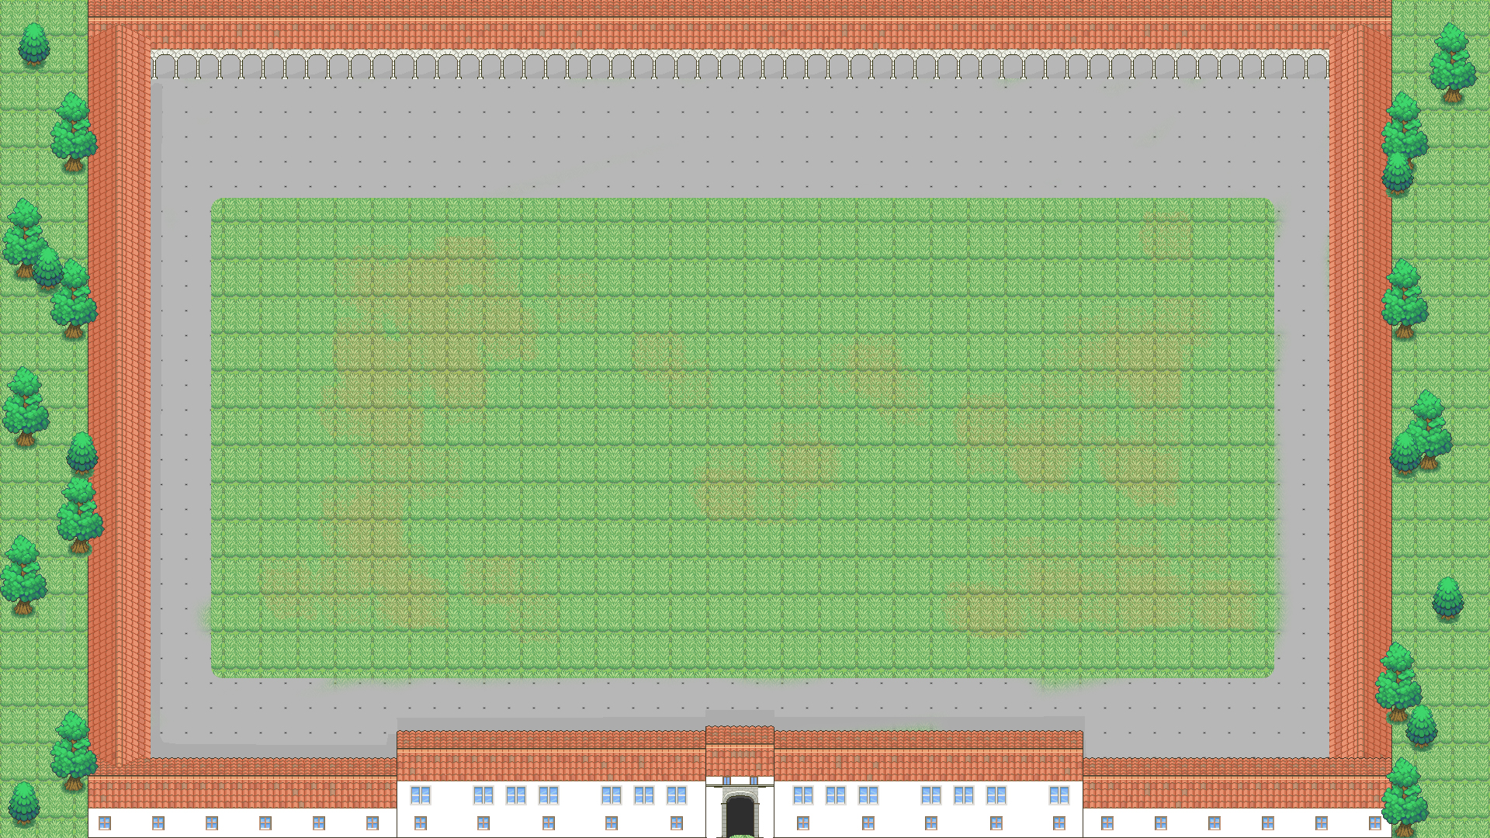


Managed container orchestration
in AWS
Sereno Balestra
Docker containers in AWS
Notes:
<numero>

Slide 2


Container
Definition
A container is a standard unit of software that packages up code and all its dependencies.
A Docker container image is a lightweight, standalone, executable package of software that includes everything needed to run an application:
- code (application code package),
- runtime (whatever application runtime Java,NodeJS,Go,Python...),
- system tools, system libraries (basic OS tools),
- settings (environment variables).
Notes:
<numero>

Slide 3
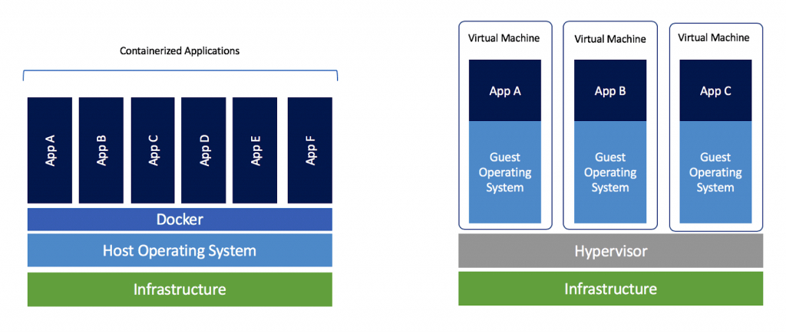
Container vs VM architecture
Notes:
<numero>

Slide 4
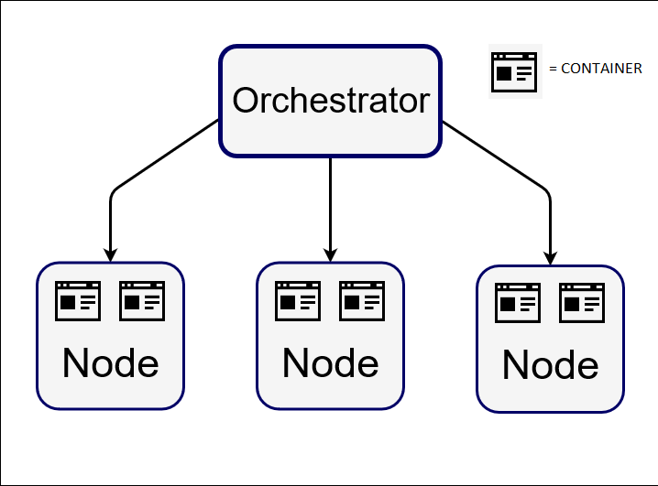
Container Orchestrator
Container orchestration automates the deployment, management, scaling, and networking of containers across many nodes in a cluster.
An orchestrator represents an automated way to manage up to hundreds of containers inside a Docker cluster, it also provides load balancing solutions for the services that containers are used to create.
The most popular container orchestrators:
Kubernetes,Docker Swarm,OpenShift,
AWS ECS
Notes:
<numero>

Slide 5
ECS
Amazon ECS is a scalable,fast container orchestrator that makes it easy to manage containers on a cluster in AWS public cloud.
Containers are defined in Task Definitions that can be launched with simple API calls.
Containers can be placed across a cluster based on resource needs, isolation/availability requirements.
Notes:
<numero>

Slide 6

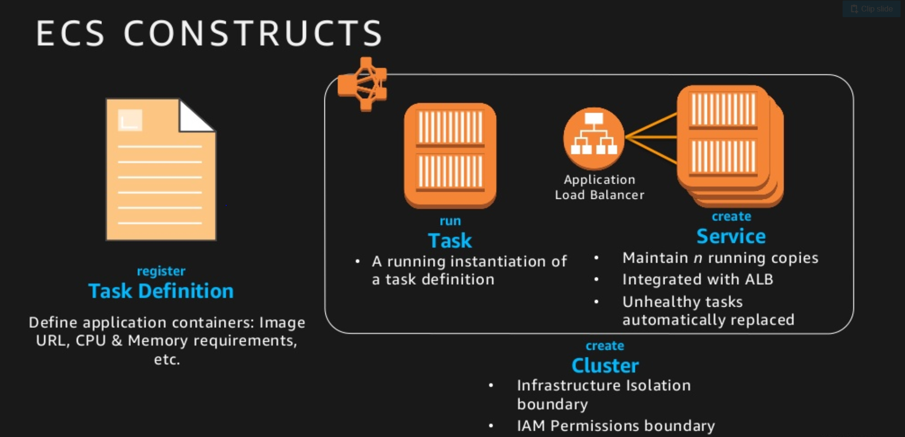
          Amazon ECS
Notes:
<numero>

Slide 7
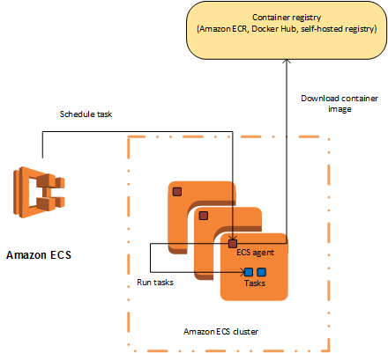
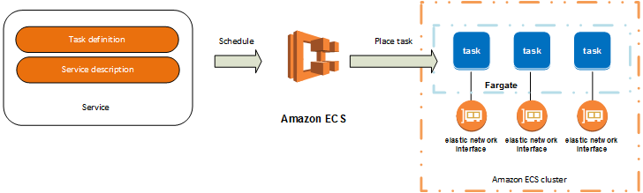
ECS
PAAS (Platform As A Service)
EC2 vs Fargate
SAAS (Software As A Service)
… or better yet CAAS (Container As A Service)
Notes:
<numero>

Slide 8
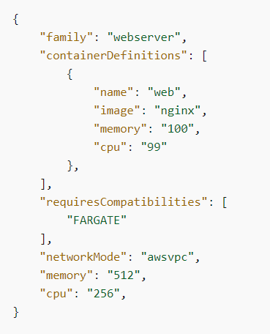
ECS task
An ECS task describes one or more containers to be run
as well as many other info, such as:
- Docker image to use with each container
- CPU&Memory task constraints
- Networking
- Data Volumes
- Logging configuration
- The command the container should run when it is started
- IAM role for the task
Notes:
<numero>

Slide 9
Sample application demonstration
In today’s demonstration we’re going to see a container-based AWS infrastructure simulating a real-case scenario of a simple website.
We take care of both creating the infrastructure and deploying the final application.
Notes:
<numero>

Slide 10
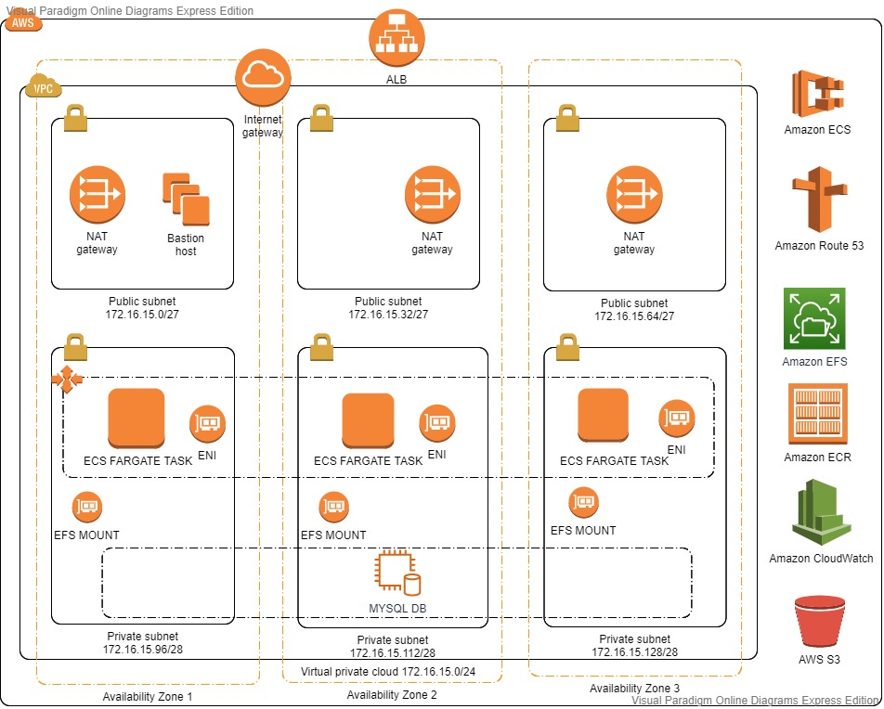
Infrastructure architecture
Notes:
<numero>

Slide 11
Services
We’ll use the following services for our application delivery
-ECS fargate : AWS managed Docker container orchestrator
-ECR: AWS managed Docker registry
-RDS : AWS managed SQL Database
-EFS: AWS managed block storage (NFS)
-S3: AWS managed object storage
-CloudWatch: AWS managed metrics/logs service
We’ll manage the infrastructure with the help of these tools:
-Terraform: IAC (infrastructure-as-code) tool
-CodeDeploy: AWS managed service for blue/green deployments
Notes:
<numero>

Slide 12
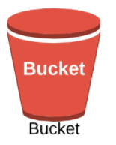




Application Overview
The application consists of a simple ReactJs frontend app and
a Go lang backend exposing REST-APIs.
The Go backend uses Gin as web framework, GORM for db access, aws-sdk-go for S3.
The application allows to register/delete users, each user can upload files, choosing where they’ll be stored , whether in S3 or filesystem (EFS).
Users and uploads data is stored in RDS MySQL db.
Notes:
<numero>

Slide 13
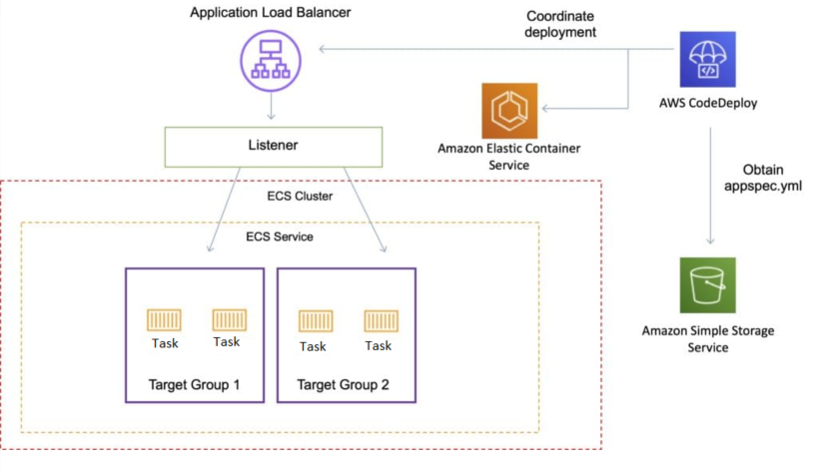
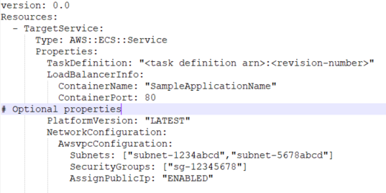
Application Deployment overview
AWS CodeDeploy with ECS
Notes:
<numero>

Slide 14
Hands-on
Let’s now try and create an ECS task via AWS console, starting off from a Docker image in ECR repository. The task will be exposed using an ECS service with Application Load Balancer.
Then we’ll explore some cool ECS features (like Autoscaling, integrated logging) and finally deploy a new application version with blue/green strategy.
Notes:
<numero>

Slide 15
Recap
Quick recap of what we’ve seen so far
-Container&Container orchestrators 101
-Managed container orchestrator (ECS)
-ECS logic/components overview
-Interaction among AWS services
-Practical test with code deployment
Notes:
<numero>

Slide 16
Useful links
- Application code (https://git.io/JUGyT)
- Terraform code (https://git.io/JUq9E)
- AWS container roadmap for updates (https://git.io/fhdO4)
- AWS ECS official developer guide
Notes:
<numero>

Slide 17

THANKS!
@Sereno Balestra
Notes:
<numero>

