Slide 1
15-453
FORMAL LANGUAGES, AUTOMATA AND COMPUTABILITY
www.cs.cmu.edu/~emc/flac09

Slide 2
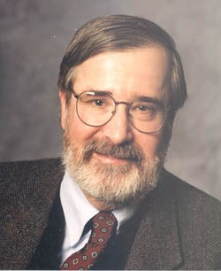
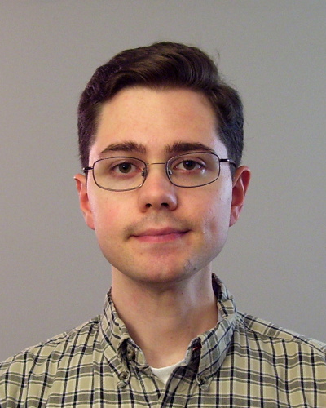
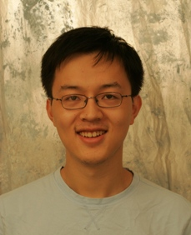
INSTRUCTORS
Edmund Clarke
Will Klieber
Yi Wu

Slide 3
Grading
Exams: 50%
- Final Exam: 25%
- Midterm Exam: 25%
Homework: 45%
Class Participation: 5%
Attendance is required.

Slide 4
HOMEWORK
Homework will be assigned every Thursday and will be due one week later at the beginning of class
You must list your collaborators and all references in every homework assignment.
Readings will be posted on the course website.
For next class: Read Chapters 0 and 1.1

Slide 5
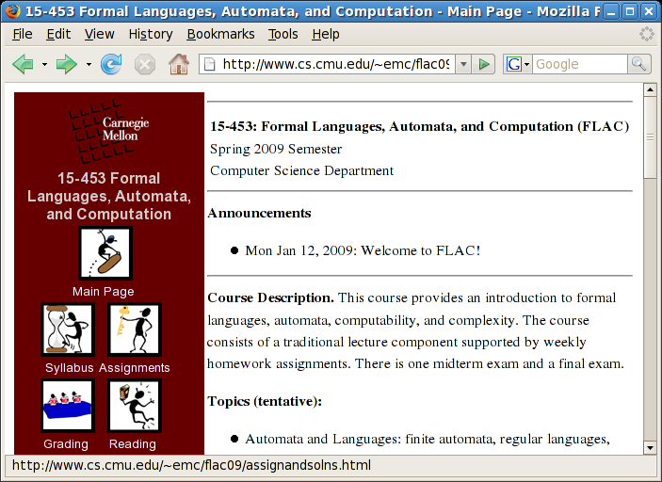
www.cs.cmu.edu/~emc/flac09

Slide 6
This class is about mathematical models of computation

Slide 7
WHY SHOULD I CARE?
WAYS OF THINKING
THEORY CAN DRIVE PRACTICE
Mathematical models of computation predated computers as we know them
THIS STUFF IS USEFUL

Slide 8
Course Outline
PART 1
Automata and Languages
PART 2
Computability Theory
PART 3
Complexity and Applications

Slide 9
Course Outline
PART 1
Automata and Languages:
finite automata, regular languages, pushdown automata, context-free languages, pumping lemmas.
PART 2
Computability Theory:
Turing Machines, decidability, reducibility, the arithmetic hierarchy, the recursion theorem, the Post correspondence problem.
PART 3
Complexity Theory and Applications:
time complexity, classes P and NP, NP-completeness, space complexity PSPACE, PSPACE-completeness, the polynomial hierarchy, randomized complexity, classes RP and BPP.

Slide 10
Mathematical Models of Computation
(predated computers as we know them)‏
PART 1
Automata and Languages: (1940’s)‏
finite automata, regular languages, pushdown automata, context-free languages, pumping lemmas.
PART 2
Computability Theory: (1930’s-40’s)‏
Turing Machines, decidability, reducibility, the arithmetic hierarchy, the recursion theorem, the Post correspondence problem.
PART 3
Complexity Theory and Applications: (1960’s-70’s)‏
time complexity, classes P and NP, NP-completeness, space complexity PPACE, PSPACE-completeness, the polynomial hierarchy, randomized complexity, classes RP and BPP.

Slide 11
This class will emphasize PROOFS
A good proof should be:
Easy to understand
Correct

Slide 12
Suppose A ⊆ {1, 2, …, 2n}
with |A| = n+1
TRUE or FALSE: There are always two numbers in A such that one divides the other
TRUE

Slide 13

LEVEL 1
HINT 1:
THE PIGEONHOLE PRINCIPLE
If you put 6 pigeons in 5 holes then at least one hole will have more than one pigeon

Slide 14
LEVEL 1
HINT 1:
THE PIGEONHOLE PRINCIPLE
If you put 6 pigeons in 5 holes then at least one hole will have more than one pigeon

Slide 15
LEVEL 1
HINT 1:
THE PIGEONHOLE PRINCIPLE
If you put 6 pigeons in 5 holes then at least one hole will have more than one pigeon
HINT 2:
Every integer a can be written as a = 2^{k}m, where m is an odd number

Slide 16
LEVEL 2
PROOF IDEA:
Given: A ⊆ {1, 2, …, 2n} and |A| = n+1
Show: There is an integer m and elements a₁ ≠ a₂ in A
such that a₁ = 2^{i}m and a₂ = 2^{j}m

Slide 17
LEVEL 3
PROOF:
Suppose A ⊆ {1, 2, …, 2n}
with |A| = n+1
Write every number in A as a = 2^{k}m, where m is an odd number
between 1 and 2n-1
How many odd numbers in {1, …, 2n-1}?
n
Since |A| = n+1, there must be two numbers in A with the same odd part
Say a₁ and a₂ have the same odd part m.
Then a₁ = 2^{i}m and a₂ = 2^{j}m, so one must divide the other

Slide 18
We expect your proofs to have three levels:
The first level should be a one-word or one-phrase “HINT” of the proof
(e.g. “Proof by contradiction,” “Proof by induction,”
“Follows from the pigeonhole principle”)‏
The second level should be a short one-paragraph description or “KEY IDEA”
The third level should be the FULL PROOF

Slide 19
DOUBLE STANDARDS?
During the lectures, my proofs will usually only contain the first two levels and maybe part of the third

Slide 20
DETERMINISTIC FINITE AUTOMATA

Slide 21
11
1
0
0,1
1
0111
111
1
0
0
Read string left to right
1
The machine accepts a string if the process ends in a double circle

Slide 22
A Deterministic Finite Automaton (DFA)
states
q₁
1
0
0,1
1
q₀
q₂
0
0
1
q₃
states
The machine accepts a string if the process ends in a double circle

Slide 23
A Deterministic Finite Automaton (DFA)
states
accept states (F)‏
q₁
1
0
0,1
1
q₀
q₂
0
0
1
start state (q₀)‏
states
q₃
The machine accepts a string if the process ends in a double circle

Slide 24
NOTATION
An alphabet Σ is a finite set (e.g., Σ = {0,1})‏
A string over Σ is a finite-length sequence of elements of Σ
Σ* denotes the set of finite length sequences of elements of Σ
For x a string, |x| is the length of x
The unique string of length 0 will be denoted by ε and will be called the empty or null string
A language over Σ is a set of strings over Σ, ie, a subset of Σ*

Slide 25
A deterministic finite automaton (DFA)
is represented by a 5-tuple M = (Q, Σ, δ, q₀, F) :
Q is the set of states (finite)‏
Σ is the alphabet (finite)‏
δ : Q × Σ → Q is the transition function
q₀ ∈ Q is the start state
F ⊆ Q is the set of accept states
Let w₁, ... , w_{n} ∈ Σ and w = w₁... w_{n} ∈ Σ*
Then M accepts w if there are r₀, r₁, ..., r_{n} ∈ Q, s.t.
r₀=q₀
δ(r_{i}, w_{i+1} ) = r_{i+1}, for i = 0, ..., n-1, and
r_{n} ∈ F

Slide 26
A deterministic finite automaton (DFA)
is represented by a 5-tuple M = (Q, Σ, δ, q₀, F) :
Q is the set of states (finite)‏
Σ is the alphabet (finite)‏
δ : Q × Σ → Q is the transition function
q₀ ∈ Q is the start state
F ⊆ Q is the set of accept states
L(M) = the language of machine M
= set of all strings machine M accepts

Slide 27
q₀
0,1
L(M) =
{0,1}*

Slide 28
0
0
1
q₀
q₁
1
L(M) =
{ w | w has an even number of 1s}

Slide 29
Build an automaton that accepts all and only those strings that contain 001
0,1
1
0
0
0
1
q
q₀
q₀₀
q₀₀₁
1

Slide 30
A language L is regular if it is recognized by a deterministic finite automaton (DFA),
i.e. if there is a DFA M such that L = L (M).
L = { w | w contains 001} is regular
L = { w | w has an even number of 1’s} is regular

Slide 31
UNION THEOREM
Given two languages, L₁ and L₂, define the union of L₁ and L₂ as
L₁ ∪ L₂ = { w | w ∈ L₁ or w ∈ L₂ }
Theorem: The union of two regular languages is also a regular language

Slide 32
Theorem: The union of two regular languages is also a regular language
Proof: Let
M₁ = (Q₁, Σ, δ₁, q₀, F₁) be finite automaton for L₁
and
M₂ = (Q₂, Σ, δ₂, q₀, F₂) be finite automaton for L₂
1
2
We want to construct a finite automaton
M = (Q, Σ, δ, q₀, F) that recognizes L = L₁ ∪ L₂

Slide 33
Idea: Run both M₁ and M₂ at the same time!
Q
= pairs of states, one from M₁ and one from M₂
= { (q₁, q₂) | q₁ ∈ Q₁ and q₂ ∈ Q₂ }
= Q₁ × Q₂
1
2
q₀ = (q₀, q₀)‏
F = { (q₁, q₂) | q₁ ∈ F₁ or q₂ ∈ F₂ }
δ( (q₁,q₂), σ) = (δ₁(q₁, σ), δ₂(q₂, σ))

Slide 34
Theorem: The union of two regular languages is also a regular language
0
0
1
q₀
q₁
1
1
1
0
p₀
p₁
0

Slide 35
1
q₀,p₀
q₁,p₀
1
0
0
0
0
1
q₀,p₁
q₁,p₁
1

Slide 36
Intersection THEOREM
Given two languages, L₁ and L₂, define the intersection of L₁ and L₂ as
L₁ ∩ L₂ = { w | w ∈ L₁ and w ∈ L₂ }
Theorem: The intersection of two regular languages is also a regular language

Slide 37
FLAC
Read Chapters 0 and 1.1
of the book for next time

