Slide 1
Complexity Theory
Lab Meeting - 11/07/2007
Nathan Young

Slide 2
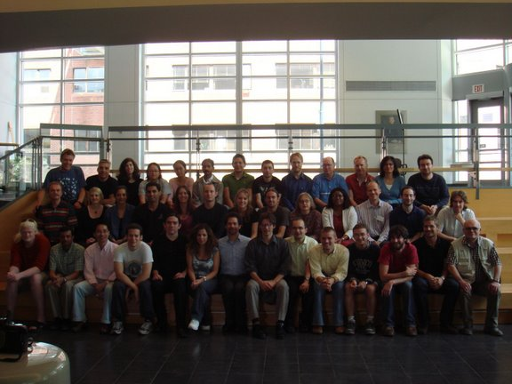
NECSI Summer Course

Slide 3
Complexity Overview
Emergence:
  How do local behaviors relate to macroscopic behavior?
Interdependence:
  What happens when you move/or remove a component of a multi-component system?
Multi-Scale Analysis
Complexity Theory
Patterns
Complex Networks
Evolution and Altruism

Slide 4
Theorems of complex systems
Theorem 1: Representing Function
  Environmental actions relationships to system behavior
    Corollary 1: Testing
      Validates specification of behavior
      If number of bits going into the system is less than one hundred bits the capability to test becomes difficult nearly impossible
      Design for testability
      Reduce dependency on environment
      Design as you go through testing (simulation)
    Corollary 2:
      Phenomenological approach to science is dead
      Phenomena is a small fraction of responses
Theorem 2: Requisite Variety
  Number of possibilities of a system must be the same as the number of possibilities of the environment requiring the response.
Theorem 3: Non-averaging
  Complex systems (in conditions) for which the number of possible realizations is less than the product of the number of states of the parts and greater than the number of states of the parts.
  Parts are interdependent
  No central limit theorem
  Forces on a part have indirect effects

Slide 5
Complexity Overview
Emergence:
  How do local behaviors relate to macroscopic behavior?
Interdependence:
  What happens when you move/or remove a component of a multi-component system?
Multi-Scale Analysis
Complexity Theory
Patterns
Complex Networks
Evolution and Altruism

Slide 6




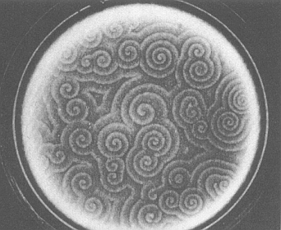
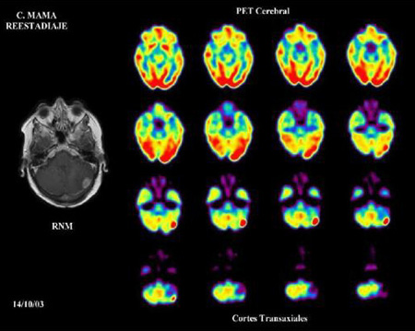
Complex Patterns
Emergence?

Slide 7
A pattern is simply ….
Sets of relationships
Simple rules give rise to diverse patterns
WHAT DOES THIS MEAN?
Engineering
  Idea: Use the natural dynamics of the system to generate (develop) or even design (evolution) the desired structure.

Slide 8
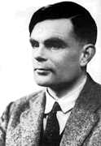
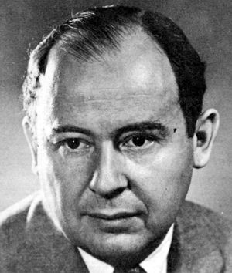
A few types of patterns
Turing Patterns
  Alan Turing – “First paper in patterns”
  Differential equations
  Chemicals, biology…etc.
Fractal Patterns – recursive generation (Koch curve)
  Coastlines – Stochastic fractal - “random walk” – statistically self-similar
  Mountains
  Fracture networks
Cellular Automata
  Von Neumann
  Rules
Key words
  Scale Free! Scale invariant behavior (Power Law)
  Renormalization (Ising Model) – Ken Wilson – Nobel Prize
  Universality Class (how micro maps to macro)

Slide 9
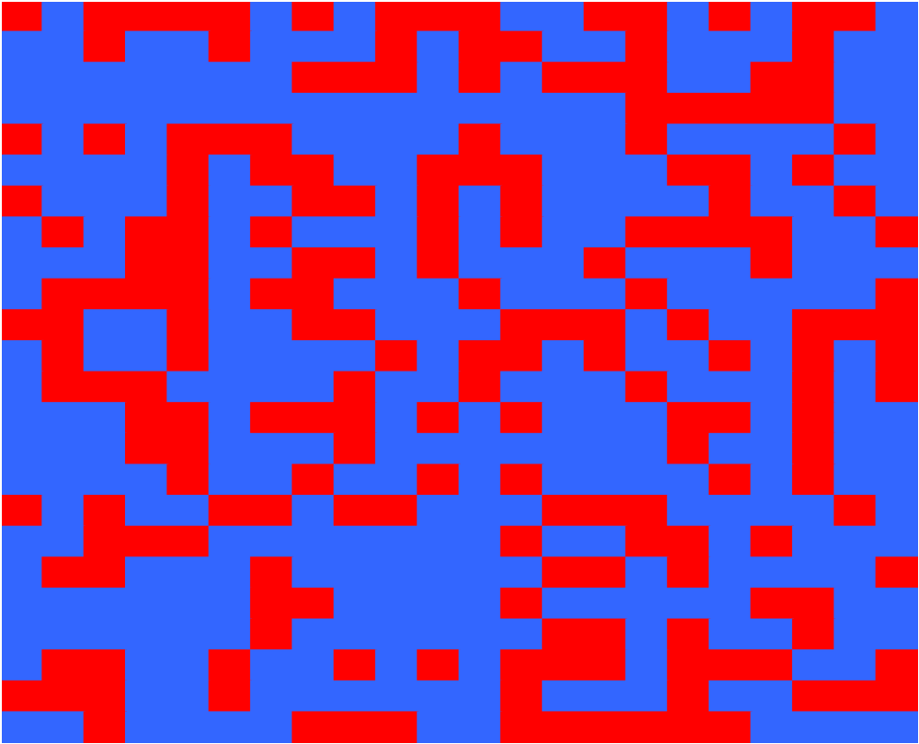
A quick pattern example

Slide 10
Pattern Formation
Patterns can be …
  Time dependent (periodic in time or space)
  Transient or persistent
  Free energy away from equilibrium to maintain pattern (thermo – dissipative structure)
Turing Theory and Pattern Formation
  Steady state stable to homogeneous perturbations
  Unstable to inhomogeneous perturbations
  Final structure stationary in time, periodic in space
  Intrinsic wavelength
  Inhibition diffuses faster than activation

Slide 11
Complexity Overview
Emergence:
  How do local behaviors relate to macroscopic behavior?
Interdependence:
  What happens when you move/or remove a component of a multi-component system?
Multi-Scale Analysis
Complexity Theory
Patterns
Complex Networks
Evolution and Altruism

Slide 12
Complex Systems on Multiple Scales
How complex is it?
Amount of information needed to describe it.
Amount of time needed to create it.
Definitions
To describe a system need to identify (pick) it out of a set of possibilities
# of possible descriptions must be = to # of possible systems
Complexity
Scale of observation
Level of detail in description (Resolution…like a zoom lens)

Slide 13
Multi-scale complexity profile
Complexity Profile
High Complexity fine scale
Independence
Randomness
High Complexity larger scale
Coherence
Correlation
Cooperation
Interdependence
Collective behavior is more complex than individual behavior !
HUMAN COMPLEXITY PROFILE
Amount of Information
Atomic Molecular Cellular Human Societal

Slide 14
Multi-scale modeling
Systematic Multi-Scale
  Small difference in scale
    Factor of 2
    Incremental scale difference
Various Multi-Scale Strategies
  Fourier representation
  Information theory with noise
  Clustering
  Multigrid
  Renormalization group and scaling
  Wavelets
  Scale Space
  Variable compression

Slide 15
Complexity Overview
Emergence:
  How do local behaviors relate to macroscopic behavior?
Interdependence:
  What happens when you move/or remove a component of a multi-component system?
Multi-Scale Analysis
Complexity Theory
Patterns
Complex Networks
Evolution and Altruism

Slide 16
Complex networks vocabulary
Type of network
  Regular
  Small world
  Random
Type of connections
  Directed/Undirected
Degree
  Input/Output/All
Characteristic path length
Clustering coefficient
Node centrality measures

Slide 17
Important network terms
Characteristic path length
  Mean path length
Clustering coefficient
  How clustered a network is about a node (vertex)
Node centrality measures
Motif = subsection of a graph

Slide 18
Complexity Overview
Emergence:
  How do local behaviors relate to macroscopic behavior?
Interdependence:
  What happens when you move/or remove a component of a multi-component system?
Multi-Scale Analysis
Complexity Theory
Patterns
Complex Networks
Evolution and Altruism

Slide 19
Gene Regulatory Networks
Origins of heredity
  Genes
Blueprint?
  Schematic
How about a program?
  Sequence of steps
Internal states and interactions are both responsible for both states and transitions
Self consistent state
  Set of interacting components whose interactions cause robustness of the state of the system. Persistence
  Dynamics – transitions between states

Slide 20
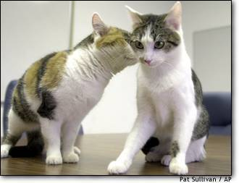

Gene Regulatory Networks
Complexity and the paradigm
  One gene – one phenotype ---not right
  One gene – thousands of phenotypes
Complexity lies in the organization of the gene network not the nature of the genes
Same genotype different phenotype (no mutation needed for diversity)
  Identical twins = have different fingerprints
  Cloned Cats = one fat one skinny – different phenotypes
One genome – thousands of phenotypes
  Attractor landscapes

Slide 21
Evolutionary Engineering
SYSTEMS DON’T DECOMPOSE – INTERFACES AND DETAILS ARE KEY
Recognize (limit) Complexity
  Number of possibilities, number of constraints
  Rate of change
Dynamics of Implementation – Evolution!!
  Incremental changes, iterative, feedback
  Design for multiple iterations
  Parallel competitive selection
Incremental Replacement
  Parallel/Redundant execution
  Run older systems past time it is not used.
  First Step: no effect but parallel
  Second Step: load transfer and competition
  Keep it longer than necessary

Slide 22
Questions????
?

Slide 23
NECSI Week 2 - Modeling Basics
Types of Models
  Course Scale – Key behaviors
  Fine Scale – Very detailed
Components of a Model
  Objects – states of an object
  Space – spatial arrangement of objects and interconnections
  Time
  Dynamics
Sources of Parameter Values
  First principles: calculate accurate description of subsystem, lots of work
  Measurement: measure experimentally isolated system. Lots of work
  Fit parameters to measured data – impossible for more than 3 parameters
  Educated guess: uncontrollable; testing for small numbers of parameters

Slide 24
NECSI Week 2 – Model Components
Modeling Objects
  Representation must accommodate possible states
  Objects:
      Distinguishable
      Indistinguishable (count)
  Continuous or discrete
Modeling Space
  Simplest case = no space
  Intuitive – 2D/3D vectors
  Discrete coordinates – lattice
  Graphs – connections are all that matters
  Boundaries
    Fixed – special status of boundary elements
    Periodic – model finite part of indefinite
Modeling Time
  When do changes occur?
  Continuous time – small change can occur all the time
  Discrete time – one object after another is chosen to be undated.
  Discrete time – all objects updated at the same time (synchronous)
Modeling Dynamics
  How do changes in the system occur?
  Movement: objects move
Interactions
  Continuous – differential equations
  Discrete
    Difference equations
    discrete probability distributions

Slide 25
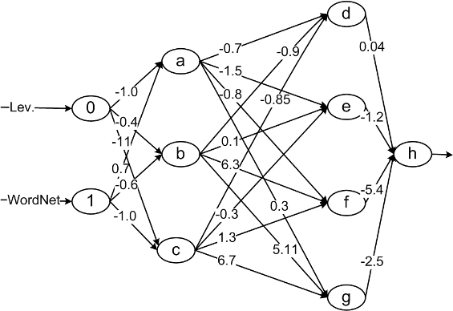
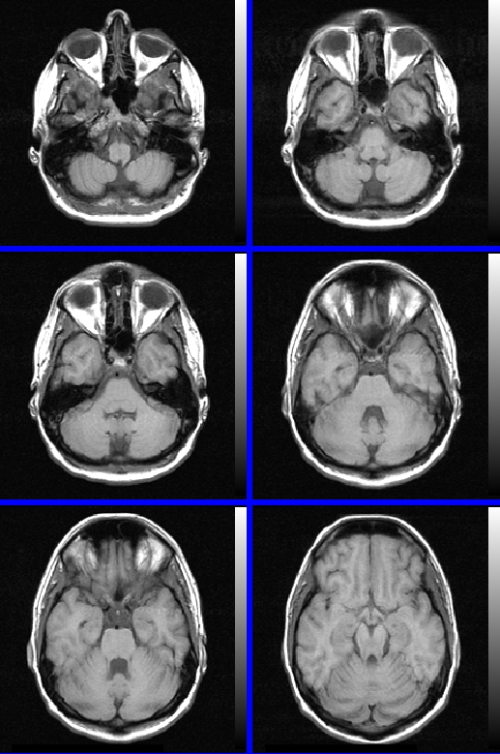
Networks in the brain
Patterns in Brain and Mind
  Neurons
    Firing and quiescent
    Pattern is a state of mind
  Synapses
    Mutual influence of neurons through synapses (connections)
    Excitatory and inhibitory synapses
    Evolution and neural state
Active Element Model
  Synaptic Plasticity
  Hebbian imprinting – sets weight of synapses Memory is a state of synapses
  Basic mechanism for learning
  Memory in synapses (essentially)
  Attractor and Feed forward – not true about brain
Attractor Networks
  Imprint a neural state
  Recover original state from part of it
    Content – addressable memory
  Basin-of-attraction
    Limited generalization
Functionality
  Content addressable memory
  Limited classifier
  Limited pattern recognition
  Limited generalization
Network Capacity and Overload
  Number of complete imprints

