Slide 1
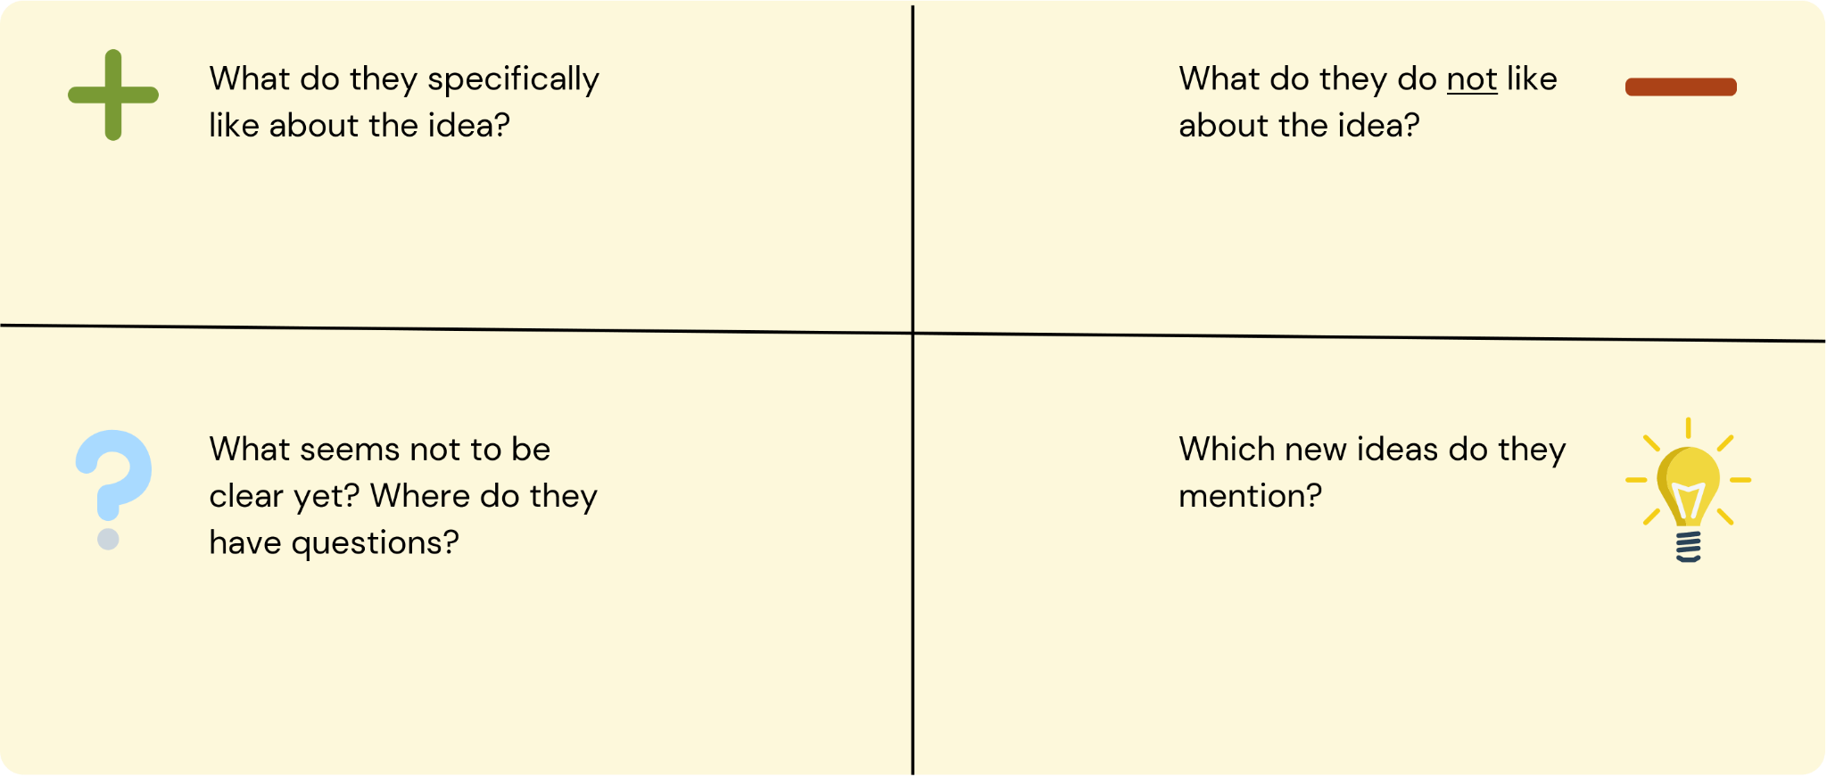
Feedback Grid
- The parking lot owner liked the way processes are automated within the system.
- The parking lot owner liked the mode of data management.
_The easy way of ticketing of customers.
-The way security is reinforced is also good.
The parking lot owner was concerned about the cost of implementation in the short run.
The other concern was about the recruitment of more staff to help within the management.
- The parking lot owner wasn’t sure of how they will be interacting with the whole system.
-How customers without smartphones will be helped
-The parking lot owner had concerns about the cost of implementation.
- The new mode of payment for the parking space i.e mobile money.
- The other idea was of digital receipts that are sent on the customer’s phones.

