Slide 1
Automation of Data Flow from Volkswagen BEON to SAP DocuLink
Presented by: Blagoja Pavleski
AQA intern
Mentor: Mitko Talevski
AQA

Slide 2





Project overview
The Challenge
A repetitive manual process required transferring customer response information between VW BEON Portal and SAP DocuLink.
The Solution
A two-stage Robotic Process Automation (RPA) solution developed using Microsoft Power Automate.
The Goal
Automate repetitive tasks, reduce manual data entry, and improve processing efficiency.

Slide 3
Technologies & RPA
Robotic Process Automation uses software robots to perform repetitive, rule-based tasks that would normally be performed manually.
Microsoft Power Automate is a platform used to create automated workflows and RPA processes across different applications and systems.
SAP Automation combines SAP, DocuLink, and SAP GUI Scripting to automate repetitive business processes.
Technology | Role
Volkswagen BEON | Source of customer response docs.
PDF | Input document
Microsoft Power Automate | RPA platform
Excel | Intermediate data and verification
SAP | ERP system
SAP DocuLink | Document registry
SAP GUI Scripting / VBScript | Programmable SAP interaction/execution

Slide 4








Before Automation: The Manual Workflow
Search for Material Number
VW BEON Portal
Excel Entry
PDF Upload
Manually type ~40 attributes per document into Excel.
Upload the corresponding PDF in another input mask.
Navigate portal and search customer reports.
Enter the material number in the input mask.
Download & Store PDF
Open Sap & Transaction
Enter Information
Repeat
Repeat the process for every material number.
Download PDF report and manually store data.
Log In and open the right transaction.
Enter information from Excel in multiple fields.
Process Drawbacks: Repetitive work • Manual data entry • Time consumption • Risk of human error

Slide 5
Proposed Solution
Volkswagen BEON Portal
Automation 1
Automation 2
PDF -> Excel
Excel -> SAP DocuLink
Download and Store PDF
Human Verification
Check extracted data for anomalies.

Slide 6
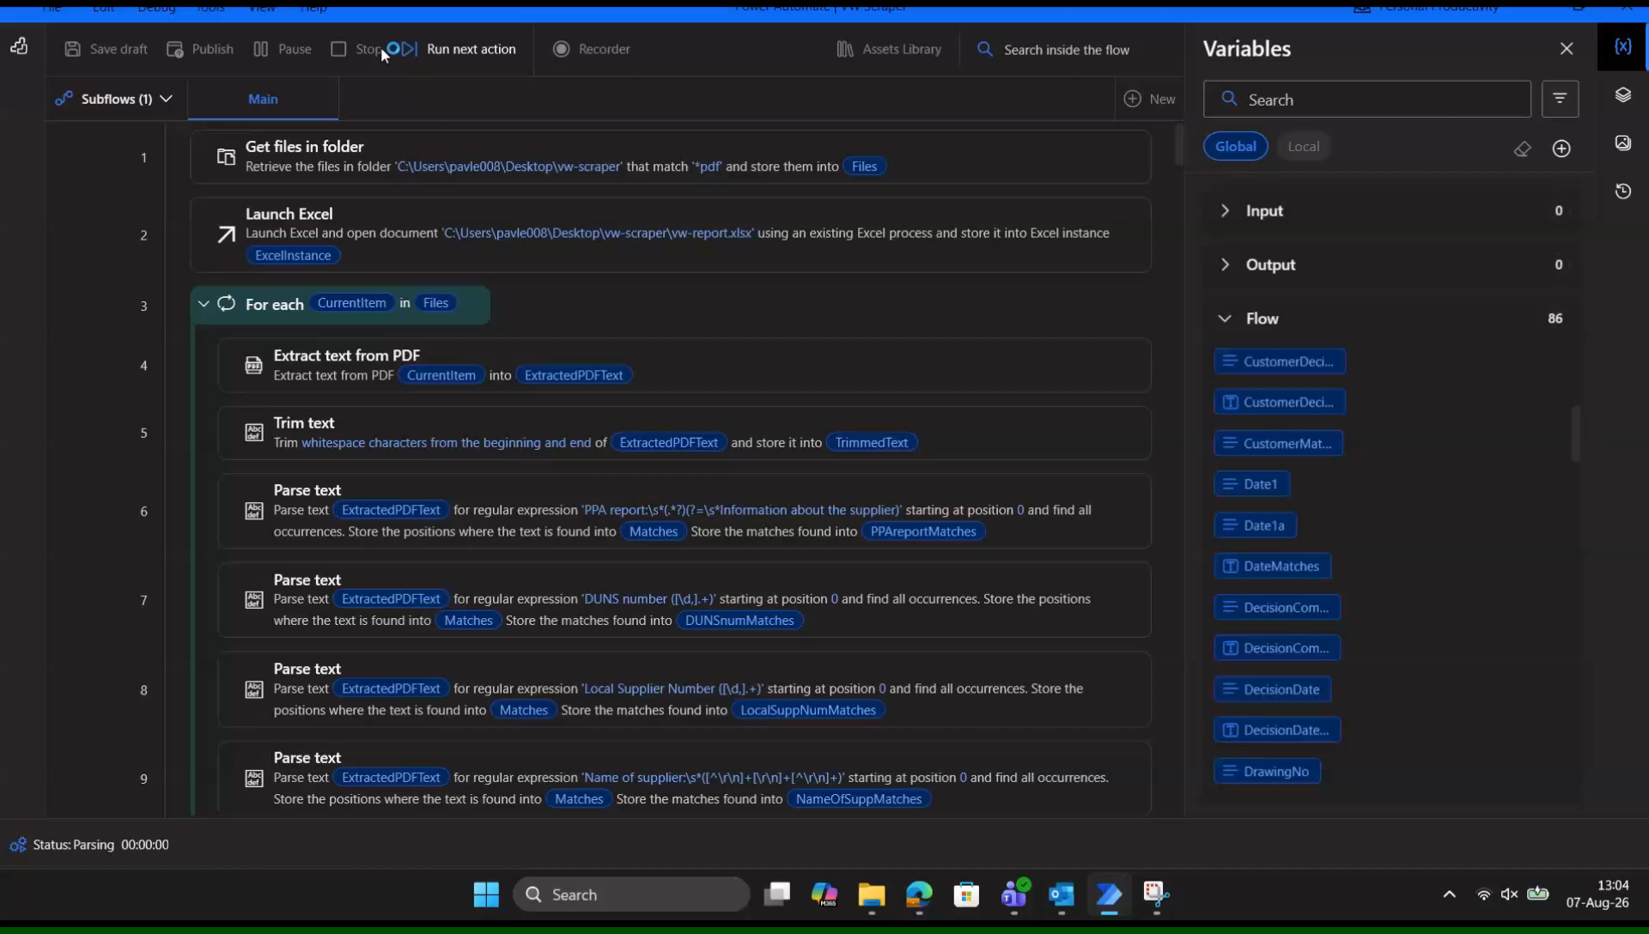
Automation 1 – PDF -> Excel
From Customer Response PDF to Structured Excel Data
Flow Video:
Get PDF Files from Directory
Extract Text from PDF
Parse ~40 Fields using Regular Expressions
Clean -> Format -> Validate Extracted Data
Find First Available Excel Row
Write Processed Data to Excel

Slide 7
Excel and Human Verification
The Excel file acts as a Intermediate Data Layer and connects the two automation stages.
Automation 1
Human Verification
Automation 2
With the Human Verification, we review extracted information for:
Missing values
Incorrect extraction
Unexpected Formatting
Other anomalies
Why including a verification step?
Because automation handles repetition, human validation provides control, ensures there are 0 mistakes before entering the information in SAP.

Slide 8
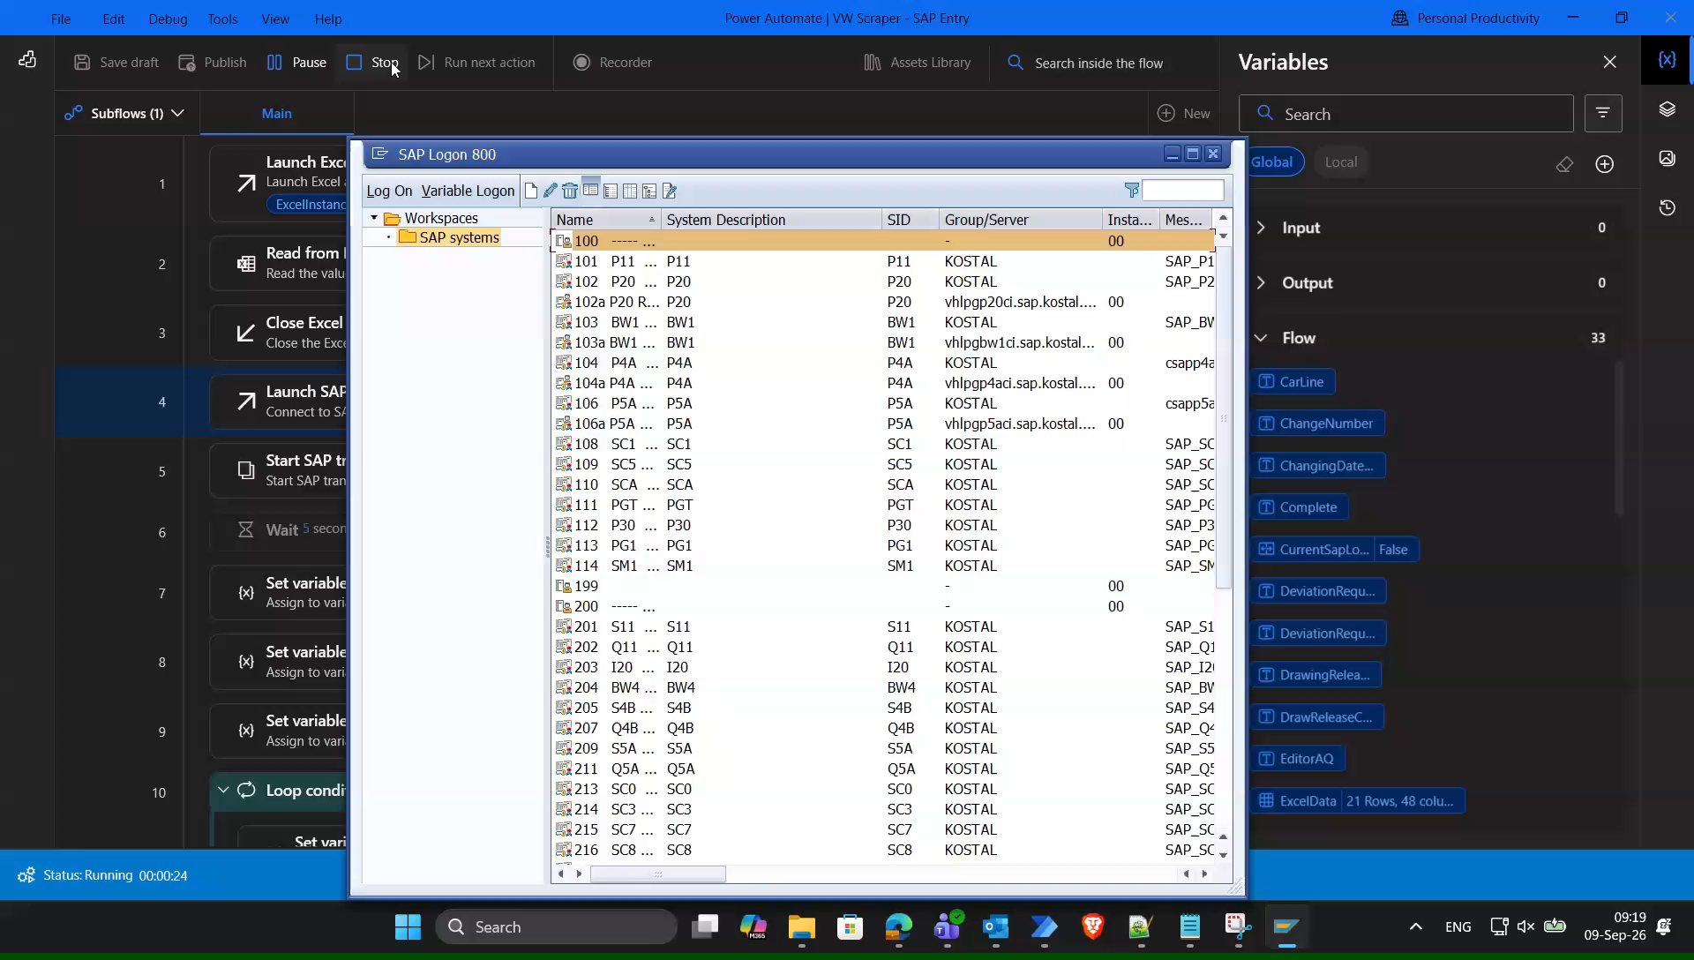
Automation 2 – Excel -> SAP Doculink
From Structured Excel Data to SAP
Flow Video:
Open and Read Excel Data
Open SAP, Log In and Open Transaction
Process the current Excel Row
Enter the Material Number in the first mask
Enter values in the second mask
Save the entry
Upload PDF in the third mask
Complete transaction
Continue with next row (Repeat)

Slide 9
Before vs. After
Before | After
Manually read PDFs | Automated PDF extraction
Manually enter Excel data | Automated Excel population
Manually search materials in SAP | Automated SAP navigation
Manually enter multiple fields | Automated field population
Manually upload documents | Automated PDF upload
Repeat every step for each material manually | Automatic processing
High manual interaction | Minimal manual interaction
User Interaction
Before: Manual processing throughout the entire workflow.
After: Start Automation 1 -> Verify Excel -> Start Automation 2

Slide 10



Results
Processing time per document
Process | Manual | Automated
PDF -> Excel | 7:35 | 0:20
Excel -> SAP | 2:45 | 0:10
Total | 10:20 | 0:30
Performance Improvement
95.2% less processing time
20.7 x faster
Time saved per document: 9:50
Accuracy
0 mistakes

Slide 11
Financial impact – Estimated Labor Cost Saving
Average gross salary at KOSTAL: 79000 MKD / month
Working time: 160 hours / month
Hourly labor cost: 493.15 MKD / hour
Cost Per Document
Manual: 10 min. 20s -> ~ 84.90 MKD
Automated: 30s -> ~ 4.94 MKD
Saving: 79.96 MKD per document
Example: 1000 Documents
Manual processing: 84,903 MKD
Automated processing: 4,938 MKD
Saving: 79,965 MKD ~ 1300€

Slide 12
Scalability
The current project was developed for the AQ customer response process.
AQ current reference is 1000 documents per year.
If similar repetitive processes exist in other departments, the same RPA approach can be applied.
This project is not only in use for KOMAK, it can be used in all of the Kostal departments across the world.
Ilustrative scenario: If each department in KOMAK had only 1000 documents per year:
6000 documents ~ 980 working hours ~ 480,000 MKD(~7850€) annual labor saving.
The value of the automation increases with the number of repetitive processes and documents it can handle.
The 6000 document figure is an illustrative scalability scenario, not a reported KOSTAL volume.

Slide 13
Future Applications
The same RPA methodology can be applied to other repetitive processes across KOSTAL.
Potential Areas:
AP – Automated processing of repetitive purchasing and supplier documents.
AQ – Automation of customer responses, quality documents, reports and data-entry workflows.
AR – Automated transfer of processing of engineering related data and documents.
GF – Automation of repetitive financial and administrative data-processing tasks.
H – Automation of repetitive administrative and document based processes.
HE – Automation of repetitive production related processes.
SCM – Automation of supply-chain and logistics-related processes.

Slide 14
Project Development and Mentorship
Mentor Contribution - Idea and Process Knowledge:
Original automation idea
Process and workflow explanation
SAP & DocuLink guidance
Daily monitoring and feedback
Testing and process validation
50+ hours of mentoring in person, with ongoing support during the whole internship.
My Contribution – Technical Design and Implementation:
Process analysis and automation design
Power Automate development
PDF data extraction and parsing
Excel data processing and validation
SAP GUI Scripting / VBScript Implementation
Testing, debugging and optimization
Result analysis and documentation.

Slide 15
Conclusion
The Problem:
A repetitive manual transfer of customer response information from PDFs to Excel to SAP DocuLink.
Solution:
A two stage RPA solution developed using Microsoft Power Automate.
Workflow:
PDF -> Excel -> Human Verification -> SAP DocuLink
Results:
95.2% reduction in processing time
20.7x faster
0 mistakes
Impact:
Reduced manual work, faster processing, reduced labor time and a scalable automation approach.

Slide 16
Thank You
Questions?

