Slide 1

FROM FORGETFUL
TO LEARNING
Building Smarter AI Agents with Hindsight
Hindsight Hackathon 2026 | Team Phoenix
Nikitha · Geetha · Hindu · Chandana · Manisha

Slide 2

The Problem: Forgetful AI Agents
Repeats the same questions
Users must explain themselves every session.
Loses important context
Each conversation starts from zero.
Cannot learn from experience
We need memory that lets agents remember, recall and improve.
Past mistakes and successes go unused.

Slide 3
Our Solution: Persistent Memory with Hindsight
1
2
3
4
Experience
Memory
Recall
Better Response
Agent interacts with the user and gathers information.
Relevant details are retained for future use.
Past knowledge is retrieved when it matters.
Answers become personal and context-aware.
Continuous learning: every loop makes the next response better.

Slide 4
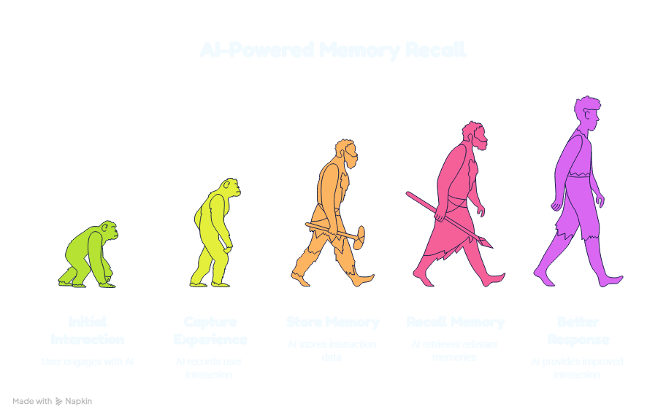
The Learning Cycle
From first interaction to better responses, each experience builds on the last.

Slide 5
Key Features
Persistent Memory
Intelligent Recall
Stores important information so the agent keeps context.
Retrieves the right memories at the right moment.
Continuous Learning
Personalized Responses
Uses past experience to improve over time.
Combines the current chat with relevant history.

Slide 6
Real-World Use Cases
Education AI Tutor
Career Guidance
Customer Support
Productivity Assistant
Remembers what each student struggles with.
Builds on skills, goals and past advice.
No more repeating the issue to every agent.
Learns routines and preferences.

Slide 7
Before vs After Hindsight
Session 1: "I'm vegetarian and like short answers." Session 2: "Suggest dinner."
Without memory
With Hindsight
"Sure! Do you have any dietary preferences? How detailed would you like the answer?"
"Try a quick chickpea curry: 20 minutes, fully vegetarian."
Asks again, wastes time
Recalled: vegetarian, prefers short answers

Slide 8
Benefits & Future Scope
Benefits
Future Scope
Better continuity across sessions
Personalized responses
Fewer repeated questions
Continuous improvement
Smarter, more adaptive agents
Multi-agent systems
More applications and domains

Slide 9
AI that doesn't just respond,
it remembers and improves.
Thank you
Team Phoenix · Hindsight Hackathon 2026

