Slide 1
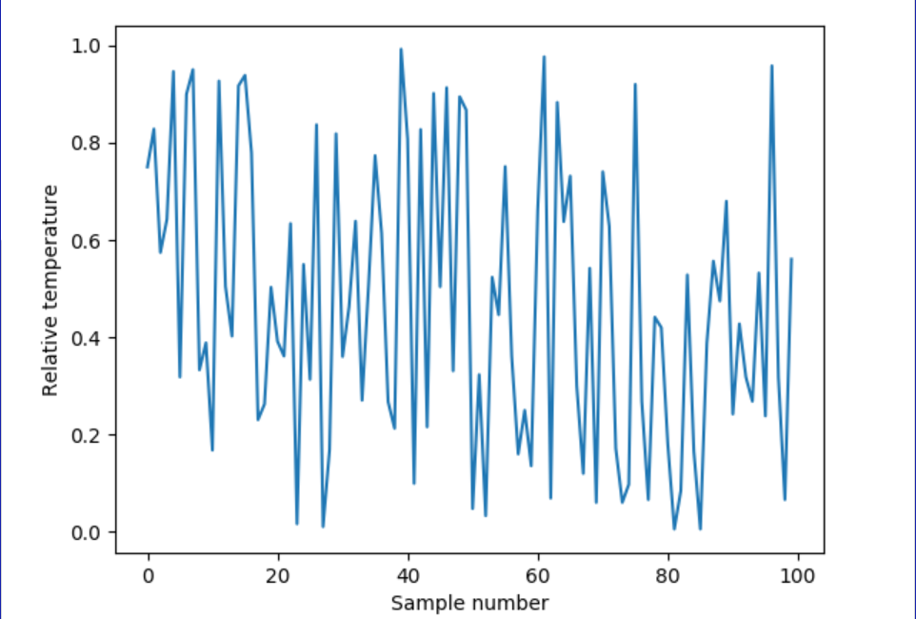
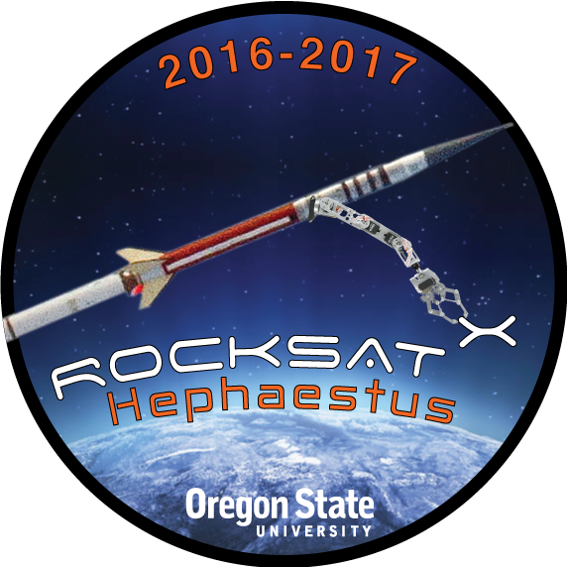
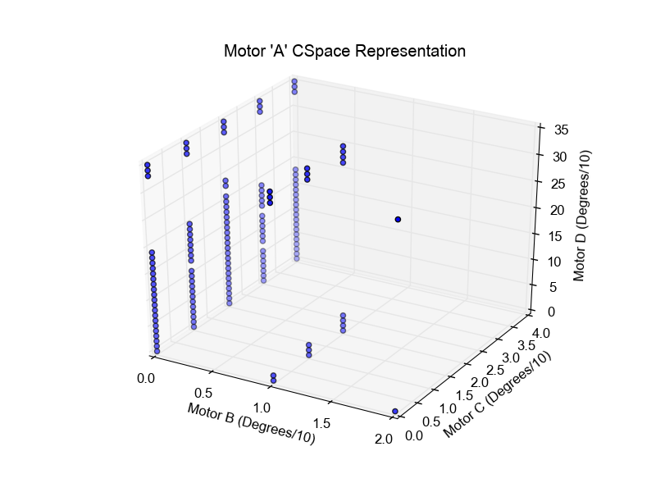
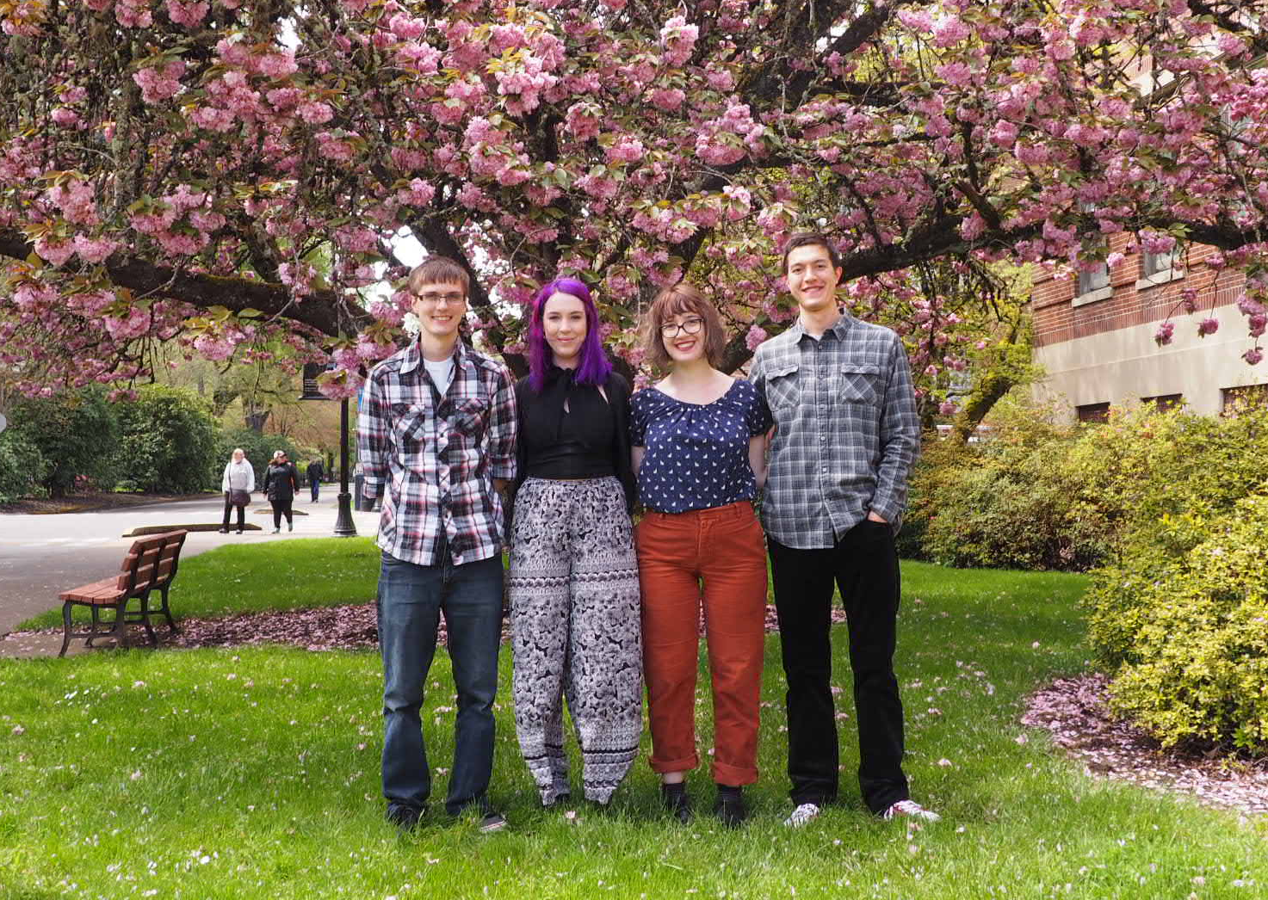

RockSat-X: Hephaestus
What We Are Doing
A Rocket-Mounted Autonomous Robotic Arm for Construction in Space
How We Are Accomplishing It
How We Measure Our Success
Building the Configuration Space
The Configuration Space is an IR4 array of Boolean values that represent every valid configuration of the arm’s motors. We will use this map to determine at which positions the arm can be located without colliding with the payload.
Creating the Configuration Space from Real Space Data
To map every valid configuration of the arm’s four motors we wired the motors to an Arduino UNO. We then moved the arm through every possible configuration and recorded the value using the Arduino. With this data we were able to construct a 4-Dimentional array of Boolean values. Each Boolean value represents an arm position and is either valid or invalid.
Telemetry
The telemetry component is responsible for collecting and sending data through the telemetry ports on the payload as well as saving a log file and collected data to the onboard SD card.
This component will transmit a numeric code to the telemetry pins whenever a significant event happens, e.g. contact is made with a touch sensor or a software milestone is reached. Additionally, the telemetry component will also save temperature data from two onboard temperature sensors to the onboard SD card at a rate of 1 sample per second. Finally, this component will save a detailed log of operations and failures to a file on the SD card. The log file will consist of a timestamp in tenths of seconds since power on and a string of text, terminating with a newline.
Data Processing
The Data Processing component will process the collected data from the telemetry lines and SD card and display the information in graphs and charts on a user interface. The graphs will display data collected from the two temperature sensors mounted on the payload. The graphs should display the actual temperature recorded in degrees Celsius, if such a value can be determined. Otherwise, it will display the relative voltage recorded, on a scale of 0-1. (See Figure 3.) The user interface will also include a timeline of messages recorded to the log file.
Figure 3: Sample data visualization graph populated with random data.
Results and Conclusion
The Hephaestus payload will launch from Wallops Flight Center in August of 2017 as part of the RockSat-X program. The payload will perform its scientific mission with the goal of proving the viability of construction in space using a robotic arm. We will not have results until after the launch.
Figure 1: Hephaestus mission logo
Future Work and Recommendations
The Hephaestus payload is a proof-of-concept experiment and is limited in its technical scope. As such, future missions could implement machine learning for improved pathfinding and a more robust and adaptive obstacle avoidance system.
Hephaestus Mission
The Oregon State University RockSat-X team will demonstrate that an autonomous robotic arm can locate predetermined targets around the payload under microgravity conditions by using precise movements. The technical actions performed by this demonstration will illustrate a proof of concept for construction, autonomous repairs, and performing experiments in space.
Mission Success Criteria
The Hephaestus mission must meet minimum success criteria to be considered successful.
Minimum Success Criteria
The arm assembly body shall deploy and a video sweep is successfully recorded.
The arm assembly body shall be fully retracted after data collection.
Maximum Success Criteria
The arm assembly body shall deploy and a video sweep is successfully recorded.
The arm shall make contact with two touch sensors on the payload.
The camera shall record all instances of contact between the arm and the targets.
The arm assembly body shall be fully retracted after data collection.
Our Team
Figure 2: Plot of Configuration Space
Data Storage
The Data Storage component is responsible for receiving data from the telemetry component and writing the data to a Transcend microSD card. The component shall utilize the FatFS library and use SPI to communicate between the ATMega128 microcontroller and the microSD card.
The program shall receive information from the telemetry component and open a log file to write the data to. The data shall be interpreted by the digit code that is sent to the component and translated into a string ending in a newline, along with a timestamp since power on. A separate file shall record data from the temperature sensors that are sampled at 1 reading per second.
Figure 4: Software Team Members from left to right: Michael Humphrey, Helena Bales, Amber Horvath, and James Wilson.
Pathfinding in an IR4 Configuration Space
Once the Configuration Space (C-Space) is built, the arm must find a path through the C-Space from its current position to its target position. This will be accomplished using Dijkstra’s algorithm.
Dijkstra’s Algorithm
Dijkstra’s algorithm is a pathfinding algorithm for finding the shortest path through a graph of equally-spaced nodes. It is a special case of the A* pathfinding algorithm. Dijkstra’s algorithm will be implemented on the On Board Computer (OBC) to find a path through the C-Space. The arm will then follow this path.
Sponsors
Software Overview
The software shall handle the payload’s scientific mission as well as insuring data security. It shall be responsible for moving the arm, recording video, writing data to the telemetry component, writing data to the SD Card for persistent data storage, and shall process the data after mission completion.
Notes:
If tri-fold mounting at SMS – make sure no text or image is in-between the two vertical guide lines; this space will be cut away. To view the vertical guide lines: Select “View” from the main menu, select “Guides” from the pull down menu, and lastly select “Static Guides”.

