Slide 1
Tahmin (Predict)
 | Diabet | Hypertension | Cholesterol
Diabet | 40 | 8 | 7
Hypertension | 4 | 35 | 1
Cholesterol | 2 | 3 | 45
Gerçek (Actual)

Slide 2
Tahmin (Predict)
DIABET
 | Diabet | Hypertension | Cholesterol
Diabet | 40 | 8 | 7
Hypertension | 4 | 35 | 1
Cholesterol | 2 | 3 | 45
TP = 40
FP = 6
FN = 15
TN = 84
Gerçek (Actual)
TOPLAM ÖRNEK SAYISI = 40 + 8 + 7 + 4 + 35 + 1 + 2 + 3 + 45 = 145

Slide 3
Tahmin (Predict)
HYPERTENSION
 | Diabet | Hypertension | Cholesterol
Diabet | 40 | 8 | 7
Hypertension | 4 | 35 | 1
Cholesterol | 2 | 3 | 45
TP = 35
FP = 11
FN = 5
TN = 94
Gerçek (Actual)
TOPLAM ÖRNEK SAYISI = 40 + 8 + 7 + 4 + 35 + 1 + 2 + 3 + 45 = 145

Slide 4
Tahmin (Predict)
CHOLESTEROL
 | Diabet | Hypertension | Cholesterol
Diabet | 40 | 8 | 7
Hypertension | 4 | 35 | 1
Cholesterol | 2 | 3 | 45
TP = 45
FP = 8
FN = 5
TN = 94
Gerçek (Actual)
TOPLAM ÖRNEK SAYISI = 40 + 8 + 7 + 4 + 35 + 1 + 2 + 3 + 45 = 145

Slide 5
 | TP | FP | FN | TN
Diabet | 40 | 6 | 15 | 84
Hypertension | 35 | 11 | 5 | 94
Cholesterol | 45 | 8 | 5 | 87

Slide 6
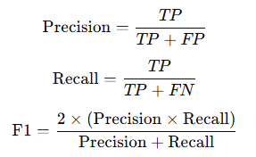
 | TP | FP | FN | TN
Diabet | 40 | 6 | 15 | 84
Hypertension | 35 | 11 | 5 | 94
Cholesterol | 45 | 8 | 5 | 87

Slide 7
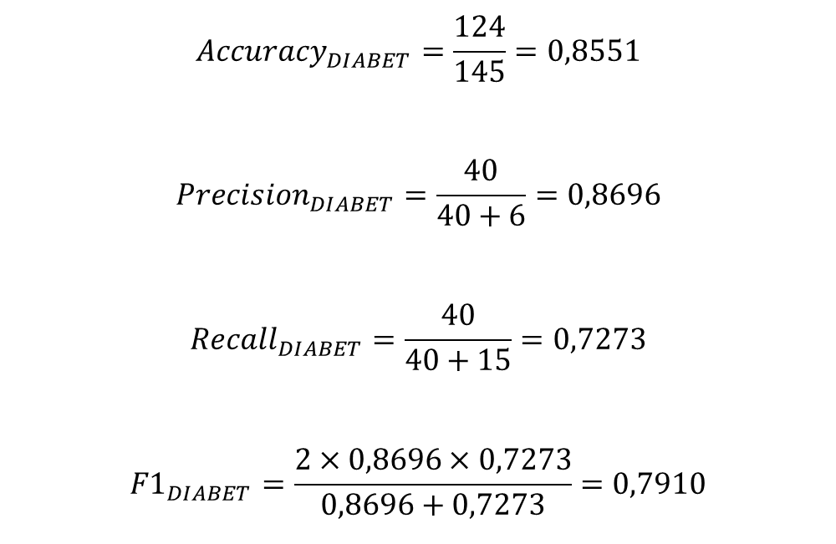
 | TP | FP | FN | TN
Diabet | 40 | 6 | 15 | 84
Hypertension | 35 | 11 | 5 | 94
Cholesterol | 45 | 8 | 5 | 87
DIABET
$${Accuracy}_{DIABET}=\frac{124}{145}=0,8551$$
$${Precision}_{DIABET}=\frac{40}{40+6}=0,8696$$
$${Recall}_{DIABET}=\frac{40}{40+15}=0,7273$$
$${F1}_{DIABET}=\frac{2×0,8696×0,7273}{0,8696+0,7273}=0,7910$$

Slide 8
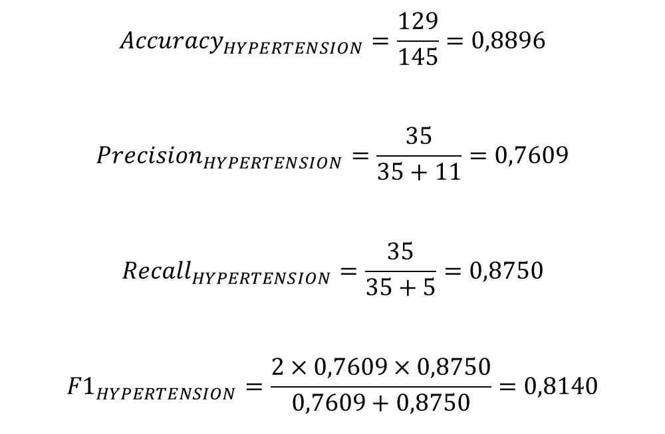
 | TP | FP | FN | TN
Diabet | 40 | 6 | 15 | 84
Hypertension | 35 | 11 | 5 | 94
Cholesterol | 45 | 8 | 5 | 87
HYPERTENSION
$${Accuracy}_{HYPERTENSION}=\frac{129}{145}=0,8896$$
$${Precision}_{HYPERTENSION}=\frac{35}{35+11}=0,7609$$
$${Recall}_{HYPERTENSION}=\frac{35}{35+5}=0,8750$$
$${F1}_{HYPERTENSION}=\frac{2×0,7609×0,8750}{0,7609+0,8750}=0,8140$$

Slide 9
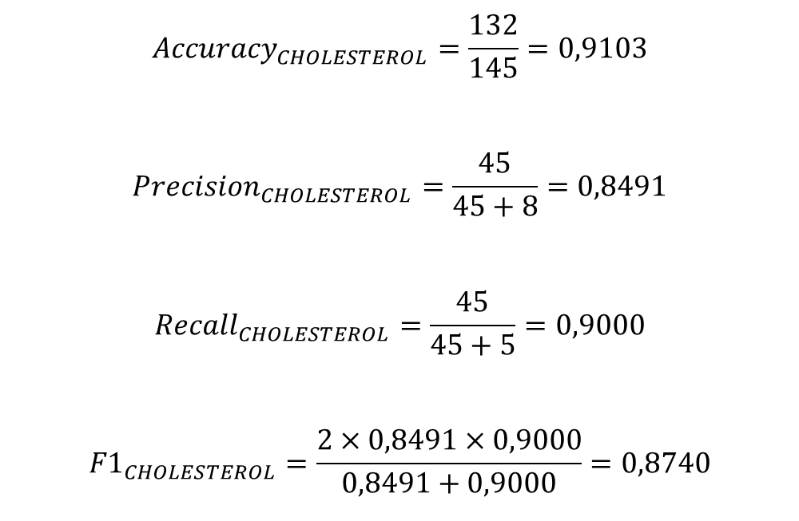
 | TP | FP | FN | TN
Diabet | 40 | 6 | 15 | 84
Hypertension | 35 | 11 | 5 | 94
Cholesterol | 45 | 8 | 5 | 87
CHOLESTEROL
$${Accuracy}_{CHOLESTEROL}=\frac{132}{145}=0,9103$$
$${Precision}_{CHOLESTEROL}=\frac{45}{45+8}=0,8491$$
$${Recall}_{CHOLESTEROL}=\frac{45}{45+5}=0,9000$$
$${F1}_{CHOLESTEROL}=\frac{2×0,8491×0,9000}{0,8491+0,9000}=0,8740$$

Slide 10
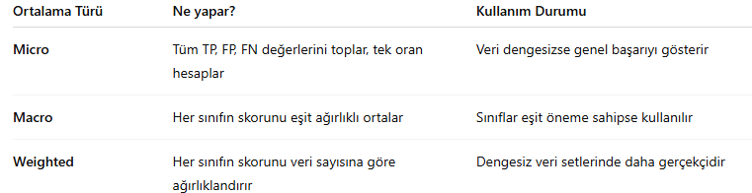
 | TP | FP | FN | TN
Diabet | 40 | 6 | 15 | 84
Hypertension | 35 | 11 | 5 | 94
Cholesterol | 45 | 8 | 5 | 87
$${Precision}_{WEIGHTED}=\frac{\left({Precision}_{DIABET}∗{Sample}_{DIABET}\right)+\left({Precision}_{HYPERTENSION}∗{Sample}_{HYPERTENSION}\right)+\left({Precision}_{CHOLESTEROL}∗{Sample}_{CHOLESTEROL}\right)}{{Sample}_{ALL}}$$
$${Precision}_{WEIGHTED}=\frac{\left(0,8696×55\right)+\left(0,7609×40\right)+\left(0,8491×50\right)}{145}=0,8325$$
$${Precision}_{MACRO}=\frac{0,8696+0,7609+0,8491}{3}=0,8265$$
$${Precision}_{MICRO}=\frac{120}{120+25}=0,8276$$

Slide 11
 | TP | FP | FN | TN
Diabet | 40 | 6 | 15 | 84
Hypertension | 35 | 11 | 5 | 94
Cholesterol | 45 | 8 | 5 | 87
$${Recall}_{WEIGHTED}=\frac{\left({Recall}_{DIABET}∗{Sample}_{DIABET}\right)+\left({Recall}_{HYPERTENSION}∗{Sample}_{HYPERTENSION}\right)+\left({Recall}_{CHOLESTEROL}∗{Sample}_{CHOLESTEROL}\right)}{{Sample}_{ALL}}$$
$${Recall}_{WEIGHTED}=0,8280$$
$${Recall}_{MACRO}=\frac{0,7273+0,8750+0,9000}{3}=0,8341$$
$${Recall}_{MICRO}=\frac{120}{120+25}=0,8276$$

Slide 12
 | TP | FP | FN | TN
Diabet | 40 | 6 | 15 | 84
Hypertension | 35 | 11 | 5 | 94
Cholesterol | 45 | 8 | 5 | 87
$${F1}_{WEIGHTED}=\frac{\left({F1}_{DIABET}∗{Sample}_{DIABET}\right)+\left({F1}_{HYPERTENSION}∗{Sample}_{HYPERTENSION}\right)+\left({F1}_{CHOLESTEROL}∗{Sample}_{CHOLESTEROL}\right)}{{Sample}_{ALL}}$$
$${F1}_{WEIGHTED}=8310$$
$${F1}_{MACRO}=\frac{0,7910+0,8140+0,8740}{3}=0,8260$$
$${Precision}_{MICRO}={Recall}_{MICRO}={F1}_{MICRO}$$

