Slide 1
t + 1
OBJECTIVES/STRATEGIES
Harvest control rules
DATA
Management regulation
OPERATING MODEL
Spatially explicit
GMACS
(2 areas)
ESTIMATION MODELS
Data generated from OM
Add Uncertainty
PERFORMANCE METRICS

Slide 2
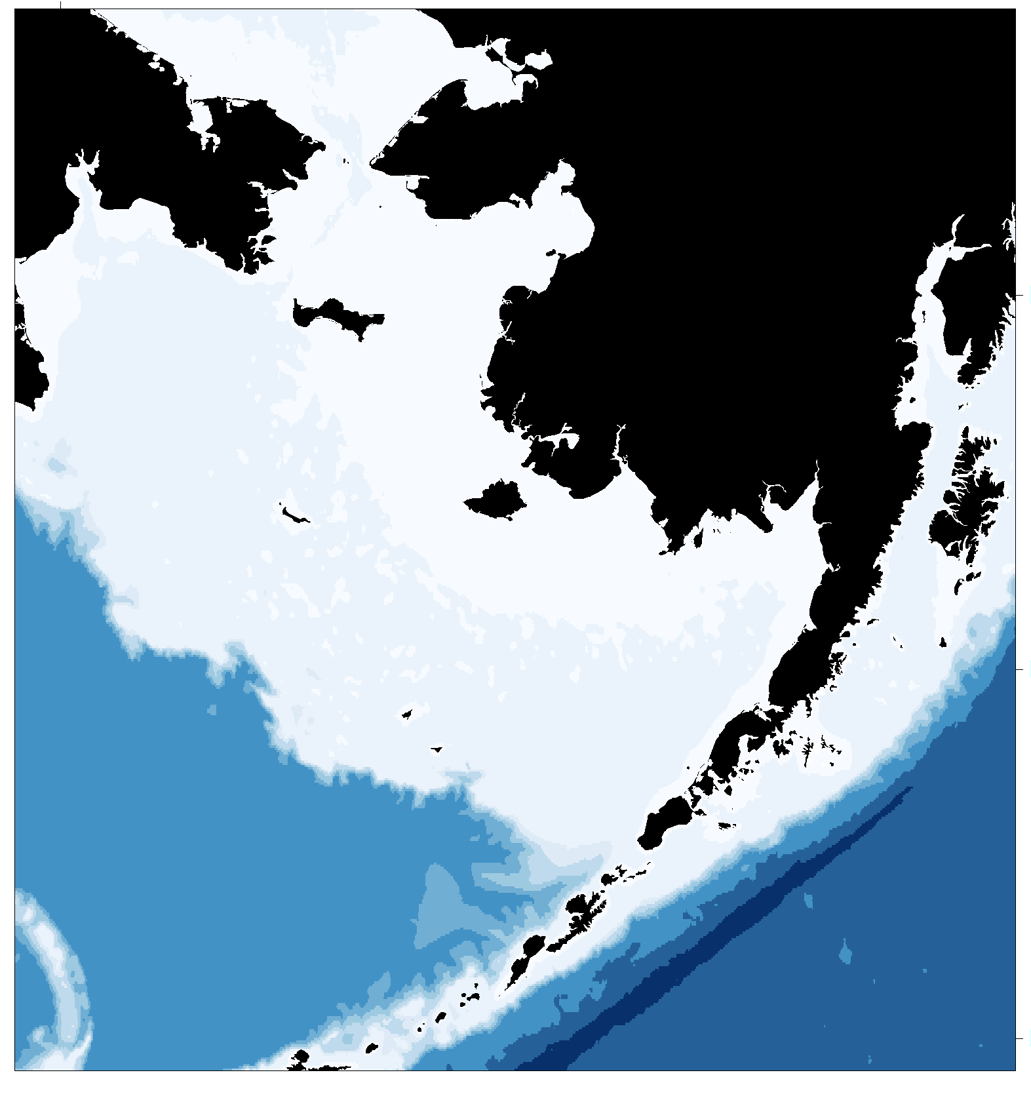




OPERATING MODEL
Population dynamics
Space : [i]
Recruitment [t,i,s,m,k]
Growth [t,i,s,m,k]
Terminal molt [t,i,s,m,k]
Maturity [t,i,s,m,k]
April
May
March
June
Fisheries [t,i,s,m,k]
Mate [t,i,s,m,k]
Feb.
N[t,i,s,m,k]
Jan.
Survey
July
Movement [t,i,s,m,k]
Dec.
Time [t]
Maturity [m]
Aug.
Months and years
Nov.
Sept.
Size [k]
Sex [s]
Oct.
Natural Mortality [t,i,s,m,k]
Notes:
and the idea is that all the process vary across time, space, sex, maturity stage and size

