Slide 1


AVISHKAR
J. SAILAJA 19P61A0588
CSE-B
P. SANJAY KUMAR 19P61A05H5
CSE-C

Slide 2
4D -VISUALIZATION

Slide 3
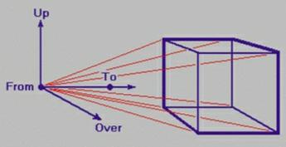
INTRODUCTION
“4D” is shorthand for “four-dimensional”- the fourth dimension being time. 4D visualization takes three-dimensional images and adds the element of time to the process. The important capabilities of new three-dimensional and four-dimensional medical imaging techniques along with computer reconstruction and multidimensional medical and histologic volume image data, to avoid the need for physical dissection of anatomy and provide powerful new opportunities for medical diagnosis and treatment, as well as for biological investigations.
In contrast to 3D imaging diagnostic processes, 4D allows doctor to visualize internal anatomy moving in real-time.
So physicians and sonographers can detect or rule out any number of issues, from vascular anomalies and genetic syndromes. Time will reveal the importance of 4d visualization.
For example: Movement patterns of fetuses allows conclusions to be drawn about their development.

Slide 4
QUERIES ?

Slide 5
THANK YOU

