Slide 1
Machine Translation: IBM Models and Word Alignment
USC VSoE CSCI 544: Applied Natural Language Processing
Jonathan May -- 梅約納
Nanyun (Violet) Peng -- 彭楠赟
November 2, 2018
slides from Philipp Koehn

Slide 2
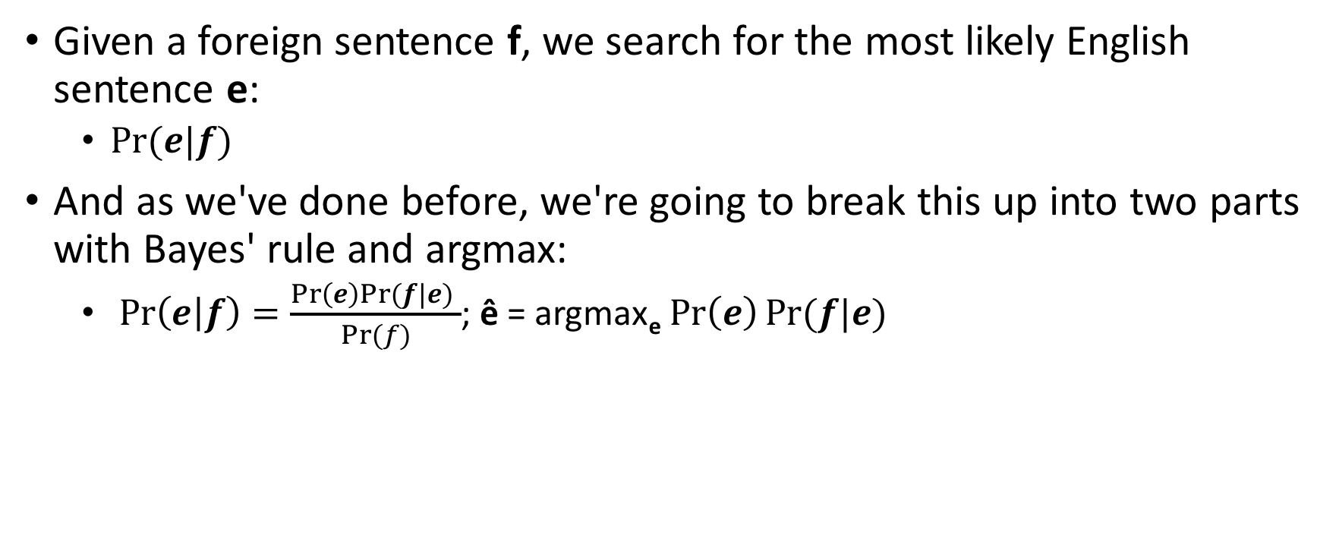
How To Generate A Translation
Given a foreign sentence f, we search for the most likely English sentence e:
$Pr⁡(e|f)$
And as we've done before, we're going to break this up into two parts with Bayes' rule and argmax:
$\operatorname{Pr}\left(e | f\right)=\frac{\operatorname{Pr}\left(e\right)Pr⁡(f|e) }{Pr⁡(f)}$; ê = argmax_{e} $\operatorname{Pr}\left(e\right)Pr⁡(f|e)$
translation model
language model
(previously covered)

Slide 3
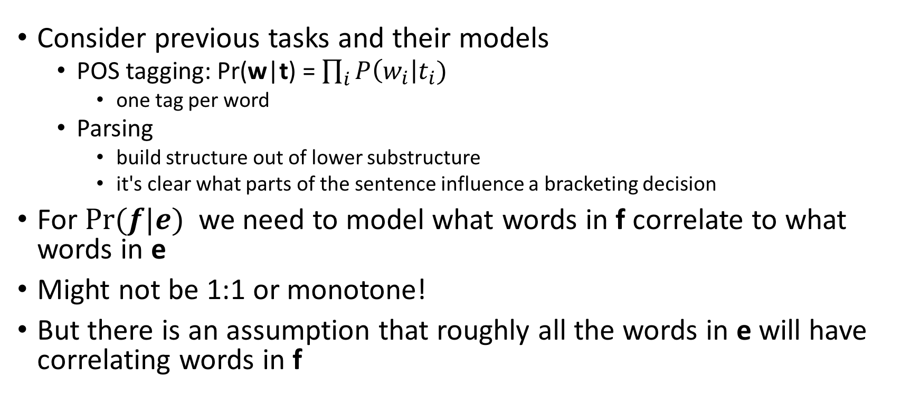
How To Model Translation
Consider previous tasks and their models
POS tagging: Pr(w|t) = $\prod_{i}{P\left(w_{i}\right|t_{i})}$
one tag per word
Parsing
build structure out of lower substructure
it's clear what parts of the sentence influence a bracketing decision
For $Pr⁡(f|e)$ we need to model what words in f correlate to what words in e
Might not be 1:1 or monotone!
But there is an assumption that roughly all the words in e will have correlating words in f

Slide 4
Word Alignment
Given two sentences (that are translations of each other), e = e₁, ..., e_{n} and f = f₁, ..., f_{m} alignment a is a mapping from positions j in f to positions i in e
Example:
1
2
3
4
f:
das
Haus
ist
klein
e:
the
house
is
small
1
2
3
4
a: {1 -> 1, 2 -> 2, 3 -> 3, 4 -> 4}

Slide 5
Reordering
Sometimes (usually) the relative word order is not the same
Example:
1
2
3
4
f:
klein
ist
das
Haus
How to read this:
a[3] = 1
means "word 3 of f translates to word 1 of e"
e:
the
house
is
small
1
2
3
4
In general, f_{i} <-> e_{a(i)}
a: {1 -> 4, 2 -> 3, 3 -> 1, 4 -> 2}

Slide 6
One-To-Many Translation
A source word can translate into multiple target words
Note: in this model, the reverse is not true
1
2
3
4
5
f:
es
ist
in
etwa
zehn
e:
it's
about
ten
1
2
3
a: {1 -> 1, 2 -> 1, 3 -> 2, 4 -> 2, 5->3}

Slide 7
Dropping Words
Words may be dropped when translated
Example: German article das is dropped
We map dropped words to a special NULL token (always word 0)
1
2
3
4
f:
das
Haus
ist
klein
e:
NULL
house
is
small
0
1
2
3
a: {1 -> 0, 2 -> 1, 3 -> 2, 4->3}

Slide 8
Inserting Words
Words may be added during translation
Example: English just does not have an equivalent in German
1
2
3
4
f:
das
Haus
ist
klein
e:
the
house
is
just
small
1
2
3
4
5
a: {1 -> 1, 2 -> 2, 3 -> 3, 4 -> 5}

Slide 9
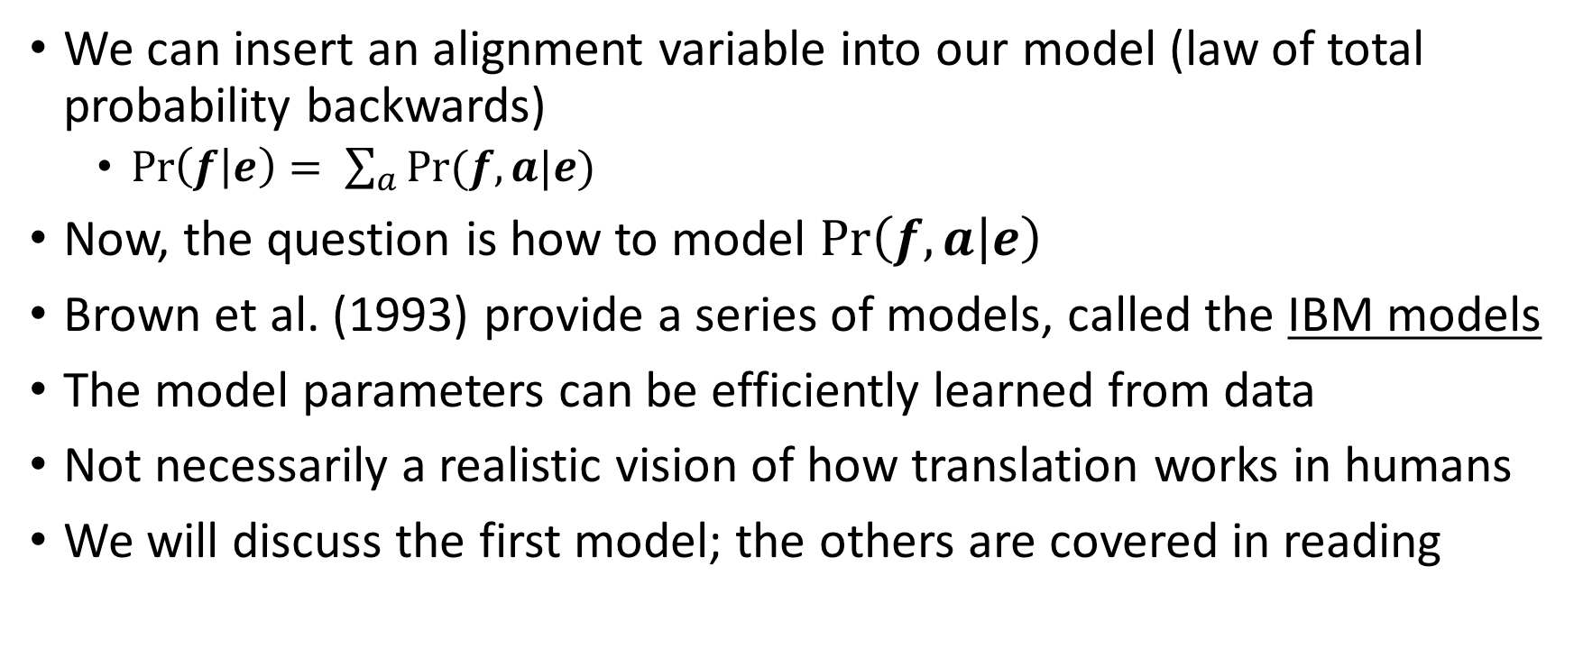
Modeling with Alignment
We can insert an alignment variable into our model (law of total probability backwards)
$\operatorname{Pr}\left(f | e\right)= \sum_{a}{Pr⁡(f, a|e)}$
Now, the question is how to model $\operatorname{Pr}\left(f, a | e\right)$
Brown et al. (1993) provide a series of models, called the IBM models
The model parameters can be efficiently learned from data
Not necessarily a realistic vision of how translation works in humans
We will discuss the first model; the others are covered in reading

Slide 10
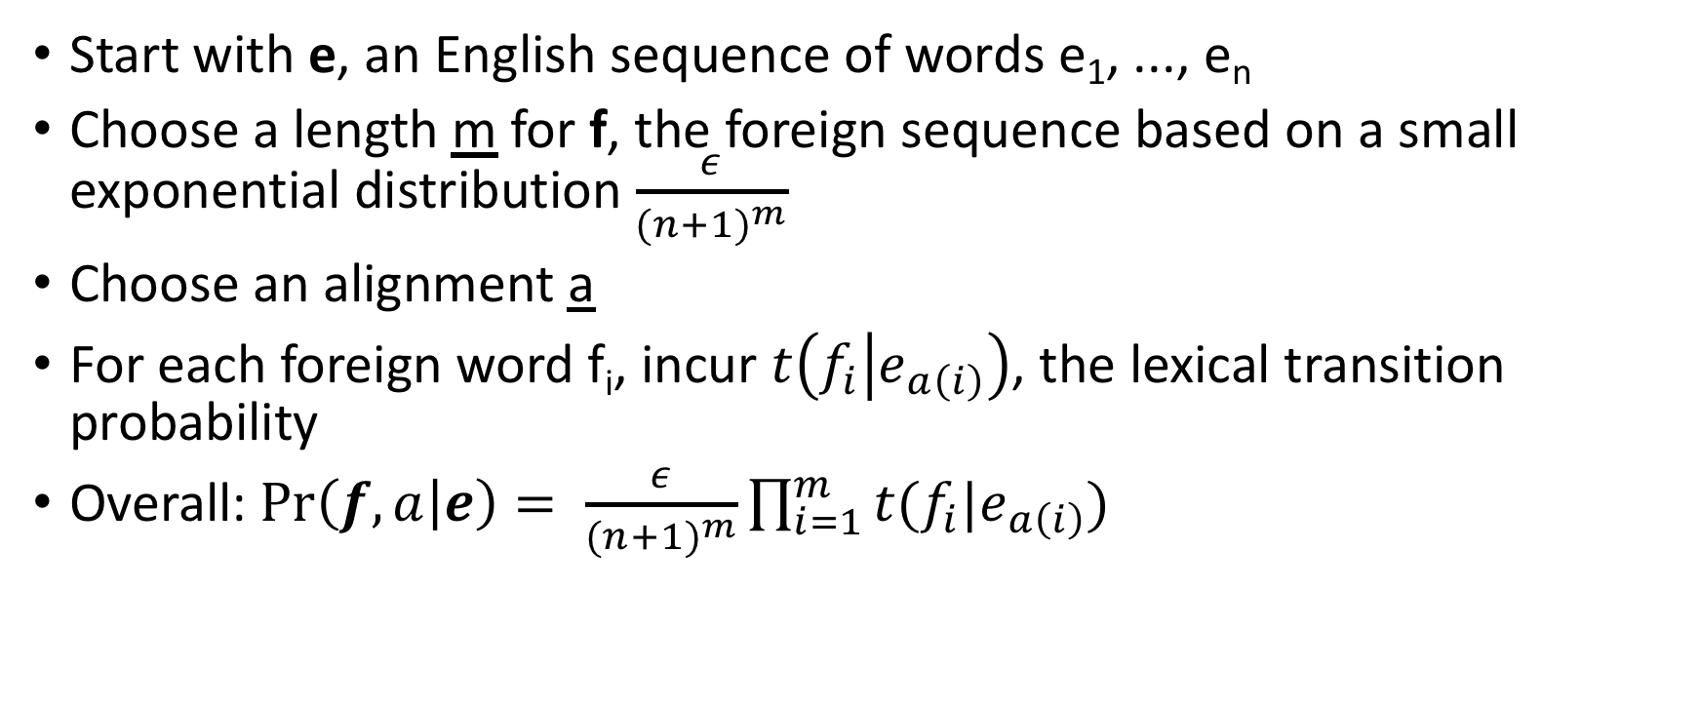
IBM Model 1 Generative Story for Pr(f, a|e)
Start with e, an English sequence of words e₁, ..., e_{n}
Choose a length m for f, the foreign sequence based on a small exponential distribution $\frac{ε}{{(n+1)}^{m}}$
Choose an alignment a
For each foreign word f_{i}, incur $t\left(f_{i} | e_{a\left(i\right)}\right)$, the lexical transition probability
Overall: $\operatorname{Pr}\left(f, a | e\right)= \frac{ε}{{(n+1)}^{m}}\prod_{i=1}^{m}{t(f_{i}|e_{a\left(i\right)})}$
the house is small
a: {1 -> 4, 2 -> 3, 3 -> 1, 4 -> 2}
klein
ist
das
Haus
____
____
____
____
ε/(5⁴)
* t(klein|small)
* t(ist|is)
* t(das|the)
* t(Haus|house)

Slide 11
Where do the transition probabilities come from?
This generative story is dependent on t(f|e), i.e. word-to-word probabilities. But we don't have them!
If we had a corpus of f, e pairs with alignments a, we could form t(f|e) via a maximum likelihood estimate. But we don't have alignments!
If we had t(f|e) we could use that to figure out the most likely alignment for a sentence pair. But see above...
la maison bleu
la, the = 12 13 | the = 45 46
maison, house = 7 8 | house = 14 15
bleu, blue = 6 7 | blue = 9
the blue house
la|the = 13/46 | la|blue = 0/46 | la | house = 2/46
maison| house = 8/15 | maison|the 0/15 | maison | blue = 0/15
la maison bleu
the blue house

Slide 12
EM Algorithm
Addresses the chicken-and-egg (i.e. incomplete data) problem:
If we had complete data we could estimate the model
If we had model, we could fill in the gaps in the data
Expectation Maximization (EM) in a nutshell:
initialize model parameters (e.g. uniform, random)
assign probabilities to the missing data
estimate model parameters from the completed data
repeat steps 2-3 until convergence

Slide 18
Quiz 3
What is pathlen(apple, tomato)?
6
5
4
3

Slide 19
Quiz 4, 5
We've observed counts of words in a corpus per the table
What is resnik similarity of (potato, tomato)?
What is resnik similarity of (apple, tomato)?
-log(1/2)
-log(4/5)
-log(1/5)
-log(5/8)
apple | 10
potato | 10
tomato | 20
vegetable | 10
food | 30

Slide 20
IBM Model 1 and EM
EM Algorithm consists of two steps
Expectation (E) Step: Apply model to data
parts of the model are hidden (here: alignments)
using the model, assign probabilities to possible values
think of this as 'creating data'
Maximization (M) Step: Estimate model from data
which data? the data we just created!
take the assigned values as fact
collect counts weighted by probabilities
estimate model from counts
think of this as 'count and divide'
Iterate these steps until convergence

Slide 21
IBM Model 1 and EM
We need to be able to compute:
E-Step: probabilitiy of alignments
M-Step: count collection

Slide 22
Assume we had a set of alignments
 | das | Buch
the | x
book |  | x
 | das | ein | Buch | Haus
the | 2/2
a |  | 1/1
book |  |  | 1/1
house |  |  |  | 2/2
 | das | Haus
the | x
house |  | x
 | ein | Haus
a | x
house |  | x
We could just collect counts and divide

Slide 23
We don't
 | das | Buch
the | ? | ?
book | ? | ?
 | das | Haus
the | ? | ?
house | ? | ?
 | ein | Haus
a | ? | ?
house | ? | ?

Slide 24
We don't
c | das | ein | Buch | Haus
the | .15+.5+... |  | .15+.05+...
a
book | .3+.05+... |  | .3+.5+...
house
 | das | Buch
the | x | x
book
 | das | Buch
the
book | x | x
 | das | Buch
the | x
book |  | x
 | das | Buch
the |  | x
book | x
* .15
* .3
* .5
* .05
 | das | Haus
the | x | x
house
...
 | ein | Haus
a | x | x
house
...
So we'll collect counts over every possible alignment
But we'll only trust the counts as much as we trust the alignment, i.e. Pr(a|e, f)

Slide 25
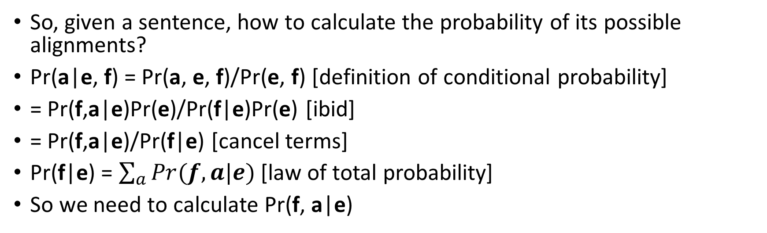
E-Step
 | das | Buch
the | x | x
book
 | das | Buch
the
book | x | x
 | das | Buch
the | x
book |  | x
 | das | Buch
the |  | x
book | x
?
?
?
?
So, given a sentence, how to calculate the probability of its possible alignments?
Pr(a|e, f) = Pr(a, e, f)/Pr(e, f) [definition of conditional probability]
= Pr(f,a|e)Pr(e)/Pr(f|e)Pr(e) [ibid]
= Pr(f,a|e)/Pr(f|e) [cancel terms]
Pr(f|e) = $\sum_{a}{Pr(f,a|e)}$ [law of total probability]
So we need to calculate Pr(f, a|e)

Slide 26
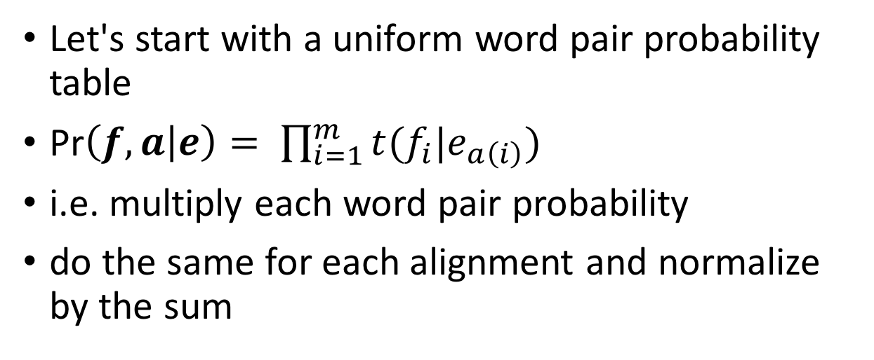
E-Step
 | das | Buch
the | x | x
book
 | das | Buch
the
book | x | x
 | das | Buch
the | x
book |  | x
 | das | Buch
the |  | x
book | x
?
?
?
?
.25*.25 = .0625
.0625
.0625
.0625
sum=.25
Let's start with a uniform word pair probability table
Pr$\left(f, a | e\right)= \prod_{i=1}^{m}{t(f_{i}|e_{a\left(i\right)})}$
i.e. multiply each word pair probability
do the same for each alignment and normalize by the sum
t₀ | das | ein | Buch | Haus
the | .25 | .25 | .25 | .25
a | .25 | .25 | .25 | .25
book | .25 | .25 | .25 | .25
house | .25 | .25 | .25 | .25

Slide 27
E-Step
 | das | Buch
the | x | x
book
 | das | Buch
the
book | x | x
 | das | Buch
the | x
book |  | x
 | das | Buch
the |  | x
book | x
.25
.25
.25
.25
 | das | Haus
the | x | x
house
 | das | Haus
the
house | x | x
 | das | Haus
the | x
house |  | x
 | das | Haus
the |  | x
house | x
.25
.25
.25
.25
 | ein | Haus
a | x | x
house
 | ein | Haus
a
house | x | x
 | ein | Haus
a | x
house |  | x
 | ein | Haus
a |  | x
house | x
.25
.25
.25
.25
(Pretty boring so far!)
Do the same thing for each sentence in the corpus

Slide 28
E-Step
c₁ | das | ein | Buch | Haus | SUM
the | .25*4 | 0 | .25*2 | .25*2 | .25*8
a | 0 | .25*2 | 0 | .25*2 | .25*4
book | .25*2 | 0 | .25*2 | 0 | .25*4
house | .25*2 | .25*2 | 0 | .25*4 | .25*8
 | das | Buch
the | x | x
book
 | das | Buch
the
book | x | x
 | das | Buch
the | x
book |  | x
 | das | Buch
the |  | x
book | x
.25
.25
.25
.25
 | das | Haus
the | x | x
house
 | das | Haus
the
house | x | x
 | das | Haus
the | x
house |  | x
 | das | Haus
the |  | x
house | x
.25
.25
.25
.25
 | ein | Haus
a | x | x
house
 | ein | Haus
a
house | x | x
 | ein | Haus
a | x
house |  | x
 | ein | Haus
a |  | x
house | x
.25
.25
.25
.25
Now collect counts, weighted by each alignment
Do the same thing for each sentence in the corpus

Slide 29
M-Step
t₀ | das | ein | Buch | Haus
the | .25 | .25 | .25 | .25
a | .25 | .25 | .25 | .25
book | .25 | .25 | .25 | .25
house | .25 | .25 | .25 | .25
c₁ | das | ein | Buch | Haus | SUM
the | 1 | 0 | .5 | .5 | 2
a | 0 | .5 | 0 | .5 | 1
book | .5 | 0 | .5 | 0 | 1
house | .5 | .5 | 0 | 1 | 2
t₁ | das | ein | Buch | Haus
the | .5 | 0 | .25 | .25
a | 0 | .5 | 0 | .5
book | .5 | 0 | .5 | 0
house | .25 | .25 | .0 | .5
Now we have counts for events
To form a parameter table (t₁), just count (done) and divide
Already starting to look better

Slide 30
E-Step (round 2)
 | das | Buch
the | x | x
book
 | das | Buch
the
book | x | x
 | das | Buch
the | x
book |  | x
 | das | Buch
the |  | x
book | x
?
?
?
?
.5*.25 = .125
.5*.5=.25
.5*.5=.25
.5*.25=.125
We need to re-calculate Pr(a|f,e) with our new table
sum=.75
t₁ | das | ein | Buch | Haus
the | .5 | 0 | .25 | .25
a | 0 | .5 | 0 | .5
book | .5 | 0 | .5 | 0
house | .25 | .25 | .0 | .5

Slide 31
E-Step (round 2)
t₁ | das | ein | Buch | Haus
the | .5 | 0 | .25 | .25
a | 0 | .5 | 0 | .5
book | .5 | 0 | .5 | 0
house | .25 | .25 | .0 | .5
 | das | Buch
the | x | x
book
 | das | Buch
the
book | x | x
 | das | Buch
the | x
book |  | x
 | das | Buch
the |  | x
book | x
.167
.333
.333
.167
.5*.25 = .125
.5*.5=.25
.5*.5=.25
.5*.25=.125
sum=.75
 | das | Haus
the | x | x
house
 | das | Haus
the
house | x | x
 | das | Haus
the | x
house |  | x
 | das | Haus
the |  | x
house | x
.222
.222
.444
.111
.5*.25 = .125
.5*.25 = .125
.5*.5=.25
.25*.25=.0625
sum=.5625
 | ein | Haus
a | x | x
house
 | ein | Haus
a
house | x | x
 | ein | Haus
a | x
house |  | x
 | ein | Haus
a |  | x
house | x
.333
.167
.333
.167
sum=.75
.5*.5=.25
.25*.5 = .125
.5*.5=.25
.25*.5 = .125

Slide 32
E-Step (round 2)
c₂ | das | ein | Buch | Haus | SUM
the | .167+.333+.222+.444 | 0 | .167+.167 | .222+.111 | 1.833
a | 0 | .333+.333 | 0 | .333+.167 | 1.167
book | .333+.167 | 0 | .333+.333 | 0 | 1.167
house | .222+.111 | .167+.167 | .0 | .167+.333+.222+.444 | 1.833
 | das | Buch
the | x | x
book
 | das | Buch
the
book | x | x
 | das | Buch
the | x
book |  | x
 | das | Buch
the |  | x
book | x
.167
.333
.333
.167
 | das | Haus
the | x | x
house
 | das | Haus
the
house | x | x
 | das | Haus
the | x
house |  | x
 | das | Haus
the |  | x
house | x
.222
.222
.444
.111
 | ein | Haus
a | x | x
house
 | ein | Haus
a
house | x | x
 | ein | Haus
a | x
house |  | x
 | ein | Haus
a |  | x
house | x
.333
.167
.333
.167

Slide 33
M-Step (round 2)
t₀ | das | ein | Buch | Haus
the | .25 | .25 | .25 | .25
a | .25 | .25 | .25 | .25
book | .25 | .25 | .25 | .25
house | .25 | .25 | .25 | .25
c₂ | das | ein | Buch | Haus | SUM
the | 1.167 | 0 | .333 | .333 | 1.833
a | 0 | .666 | 0 | .5 | 1.167
book | .5 | 0 | .666 | 0 | 1.167
house | .333 | .333 | .0 | 1.167 | 1.833
t₁ | das | ein | Buch | Haus
the | .5 | 0 | .25 | .25
a | 0 | .5 | 0 | .5
book | .5 | 0 | .5 | 0
house | .25 | .25 | .0 | .5
t₂ | das | ein | Buch | Haus
the | .636 | 0 | .182 | .182
a | 0 | .571 | 0 | .428
book | .428 | 0 | .571 | 0
house | .182 | .182 | .0 | .636
Already the argmax is the "right" answer
Few more rounds and we'll have perfectly sharp probabilities

Slide 34
(Note: this was actually run as Pr(e, a|f) which is why the probs don't line up with the previous example)

Slide 35
What about the other IBM Models?
Model 1: Lexical translation
Model 2: adds absolute reordering model
e.g. how likely is f-word '4' to be a translation of e-word '2' given the length of f is 10 and the length of e is 12?
Model 3: adds fertility model
consider how many times each e-word is used
Model 4: relative reordering model
instead of absolute word position, how likely are we to skip around n spots forward?
 | das | Buch
the | x | x
book
 | das | Buch
the | x
book |  | x
vs

Slide 36
Forming Word Alignments

Slide 41
Software
GIZA++ = popular implementation of IBM Models (~2000)
MGIZA = multithreaded rewrite (~2010)
You give it parallel data
It runs models 1-4 (with some changes) in both directions
It produces word alignments for your data and translation probability tables
Generally part of most statistical MT software packages
Moses (statmt.org/moses); maintained by univ. of Edinburgh
Joshua (search "joshua mt"); apache project maintained by jhu folks

Slide 42
Summary
IBM Models provide a way to learn word-to-word probabilities from a corpus of example sentence translations
The EM algorithm is used to induce these word alignments
These models are nominally models of end-to-end machine translation, however they are only used to learn the alignments
Phrase-based models (next) use data aligned with IBM models to do end-to-end MT

