Slide 1
Machine Translation for Low-Resource Languages based on: Morphological Analysis and Disambiguation for Dialectal Arabic Machine Translation for Arabic Dialects
Bashar Alhafni بشار الحفني))
Utkarsh Gera (أُتكارش جيرا)

Slide 2

Why this is a hard problem?
More than 22 spoken Arabic Dialects.
Different than the Modern Standard Arabic (MSA).
Very noisy and low in resources as oppose to MSA.
So what are the MT attempts for low-resource languages, especially Arabic Dialects?

Slide 3
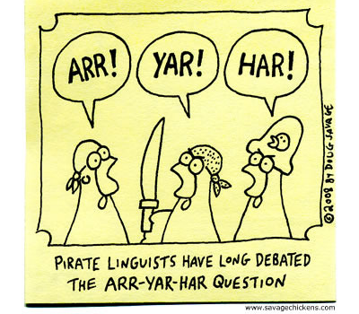
Morphological Analysis and Disambiguation for Dialectal Arabic
Modern Standard Arabic (MSA)
Dialectal Arabic like Levantine and Egyptian
MADA – Morphological Analysis & Disambiguation of Arabic
No orthographies or language academics for Dialects
Improved MSA analyzer to deal with Egyptian Dialects

Slide 4
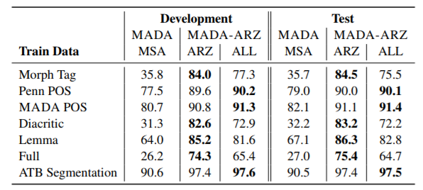
Results of MADA-ARZ

Slide 5
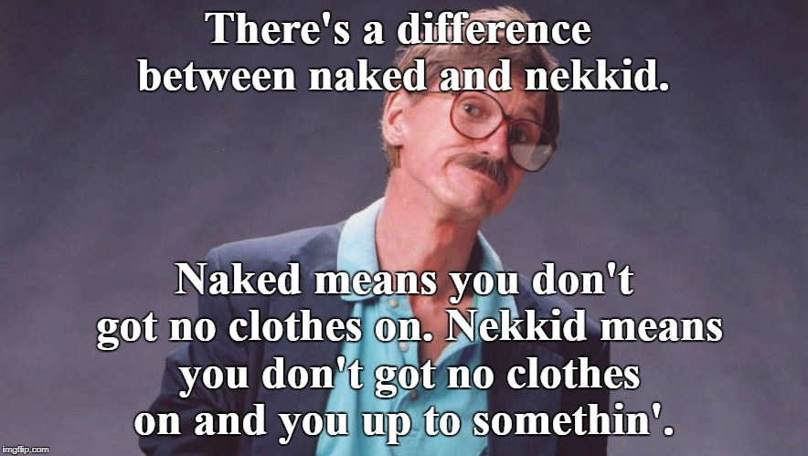
Machine Translation for Arabic Dialects
Improved the MT for Arabic Dialects by 6.3 to 7.0 BLEU
Constructed a Levantine-English and Egyptian-English corpora by using Amazon’s Mechanical Turk
Trained different system using the same methods, the same parameter and the same decoding

Slide 6
Transfer Learning for Low-Resource Neural Machine Translation
A very interesting idea! (way better than using Mechanical Turks ☺)
5.6 BLEU improvement over typical NMT!
Train a parent model on high-resource language (e.g. French - English)
Use the parameters of the parent model to fine tune the parameters of a low-resource language model, which is the child model in this case (e.g. Uzbek – English)

Slide 7
References:
Jonathan May, Kevin Knight, Deniz Yuret, Barret Zoph “Transfer Learning for Low-Resource Neural Machine Translation” https://aclweb.org/anthology/D16-1163.pdf
Rabih Zbib, Erika Malchiodi, Jacob Devlin, David Stallard, Spyros Matsoukas, Richard Schwartz, John Makhoul, Omar F. Zaidan, Chris Callison-Burch “Machine Translation of Arabic Dialects” http://www.aclweb.org/anthology/N12-1006
Nizar Habash, Ryan Roth, Owen Rambow, Ramy Eskander, and Nadi Tomeh “Morphological Analysis and Disambiguation for Dialectal Arabic” http://www.aclweb.org/anthology/N13-1044
Nizar Habash, Ramy Eskander and Abdelati Hawwari “A Morphological Analyzer for Egyptian Arabic” http://www.aclweb.org/anthology/W12-2301

Slide 8
Questions?

