Slide 1
OWL Macro use cases – why we need shortcut relations
Chris Mungall
Alan Ruttenberg
OBO Foundry

Slide 2
Background
Biology is complex
OWL2 provides some of the needed expressivity
Ontologies that model the necessary detail can be difficult to work with
Some kind of intermediate representation (IR) would help
Ideally this representation would live in OWL and be edited in common OWL tools

Slide 3
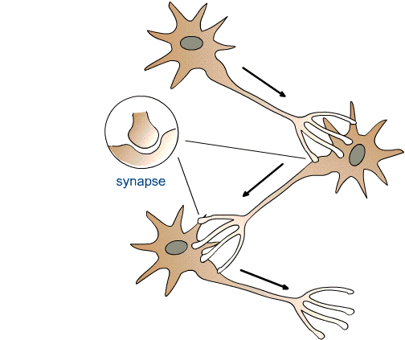
Example: High level modeling of (real) neural networks
N1
Class: N1
SubClassOf:
synapsed_to some N2
N2
N3
ObjectProperty: synapsed_to
Annotations: definition “Relation between a neuron and an anatomical structure it forms a chemical synapse to”
N4

Slide 4
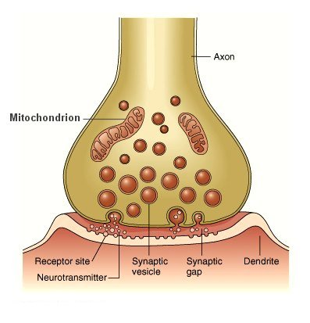
Modeling in more detail
We can model chemical synapsing in detail using
Gene Ontology classes:
pre-synaptic membrane
post-synaptic membrane
properties:
part_of & has_part
pre-synaptic membrane; GO_0042734
post-synaptic membrane; GO_0045211

Slide 5
Taking shortcuts
We would like to write:
N1 synapsed_to some N2
We want to infer this is equivalent to:
N1 SubclassOf (
has_part some (
‘pre-synaptic membrane ; GO_0042734’ that part_of some (
‘synapse ; GO_0045202’ that has_part some (
‘post-synaptic membrane ; GO_0045211’ that part_of some N2
))))

Slide 6
Is this a problem?
We don’t need a synapsed_to property
We can write the fully expanded axiom each time
…but this is tedious
We want to add 100s-1000s of axioms following this pattern
error prone
we might want to modify representation choices later on
Ideally we would have shortcut properties
expand to more complex axioms using macro definitions

Slide 7
Current approach: translating from external format
Domain experts use spreadsheets
We write translations that generate OWL from spreadsheets
Problem:
Not optimal for all communities
Many domain experts are semi-comfortable in OWL environments
we want to encourage this
original spreadsheet abstraction is lost

Slide 8
Hoehndorf et al approach
Limitations:
shortcut properties only existing in obo

Slide 9
Requirements
Use shortcut object properties within OWL
not translated from other syntax
use existing OWL environment
Expanding axioms should only produce new inferences

Slide 10
Implementation choices
Macro language
Embed?
Expansion of embedded expressions?
Replacement or addition
Reasoning over unexpanded ontology
Binary or n-ary?
if n-ary, how do we encode?
Queries?

Slide 11
Our current approach
domain experts author ontologies using shortcut relations
obo or owl
macros are embedded as annotation properties
expansion engine rewrites ontology
can reason over pre or post expanded ontology
we would like to do this in a standard way
which is why we’re here

Slide 12
Split to multiple slides
shortcut property | example | desired semantics
lacks part | erythrocyte SubClassOf lacks_part value(?) nucleus | erythrocyte has_part exactly 0 nucleus
lacks plasma membrane part | B1b-B cell EquivalentTo (B1-B cell and lacks plasma membrane part value(?) CD5) | B1b-B cell EquivalentTo (B1-B cell and has part exactly 0 (plasma membrane and has_part some CD5)

Slide 13
Conclusions
Hand authoring complex OWL is difficult
Different people approach this differently
We want a single standard solution

