Slide 1
OWL Macro use cases – why we need shortcut relations
Chris Mungall
Alan Ruttenberg
Open Bio Ontologies Foundry

Slide 2
Outline
Illustration of problem
Biological example: neural networks
Implementation choices and existing approaches
property chains
spreadsheet translation
OPPL/OPPL2
A proposed approach
Open discussion

Slide 3
Background
Biology is complex
modeling is hard
OWL2 provides some of the needed expressivity
…but ontologies that model the necessary detail can be difficult to work with
Some kind of intermediate representation (IR) would help
Ideally this representation would live in OWL and be edited in common OWL tools

Slide 4
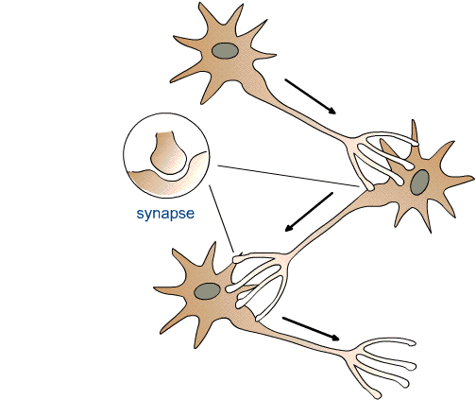
Example: High level modeling of (real) neural networks
N_ABC
ObjectProperty: synapsed_to
Annotations: definition “Relation between a neuron and an anatomical structure it forms a chemical synapse to”
N_DEF
N_JKL
N_GHI
Class: N_ABC
SubClassOf:
synapsed_to some N_DEF

Slide 5
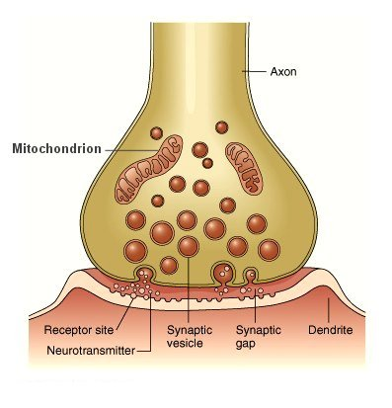
Modeling in more detail
We can model chemical synapsing in detail using
Gene Ontology classes:
pre-synaptic membrane
post-synaptic membrane
properties:
part_of & has_part
pre-synaptic membrane; GO_0042734
post-synaptic membrane; GO_0045211

Slide 6
Modeling in more detail
We can model chemical synapsing in detail using
Gene Ontology classes:
pre-synaptic membrane
post-synaptic membrane
properties:
part_of & has_part
pre-synaptic membrane; GO_0042734
Class: N_ABC
SubClassOf:
has_part some (‘pre-synaptic membrane ; GO_0042734’ that part_of some (‘synapse ; GO_0045202’ that has_part some (‘post-synaptic membrane ; GO_0045211’ that part_of some N_DEF))
post-synaptic membrane; GO_0045211

Slide 7
Taking shortcuts
We would like to write:
?X synapsed_to some ?Y
We want to infer this is equivalent to:
?X SubclassOf (
has_part some (
‘pre-synaptic membrane ; GO_0042734’ that part_of some (
‘synapse ; GO_0045202’ that has_part some (
‘post-synaptic membrane ; GO_0045211’ that part_of some ?Y))))

Slide 8
Is this a problem?
We don’t need a synapsed_to property
We can write the fully expanded axiom each time
But we want to add 100s-1000s of axioms following this pattern
error prone
obscures underlying pattern
we might want to modify representation choices later on
or defer (e.g. description graphs)
Ideally we would have shortcut properties
expand to more complex axioms using macro definitions

Slide 9
Requirements
Use shortcut object properties within OWL
not translated from other syntax
use existing OWL environment
Expanding axioms should only produce new inferences
Shortcuts should be able to annotation properties
Should be able to assert multiple statements, annotations (e.g. for provenance)
Expansions should be able to be re-definable, re-runnable (so debuggable)
(nice to have): Real abstraction/programming language

Slide 10
Implementation choices
Macro language
Where do the macros live?
Embed or first-class citizens
Expressivity?
Expansion of embedded expressions?
Expansion of axioms or parts of axioms?
Replacement or addition or GCIs
Reasoning over unexpanded ontology
allowed?
Binary or n-ary?
if n-ary, how do we encode?
Queries?

Slide 11
Property chains
Why not use property chains?
Reason 1
implication is unidirectional
Example: overlaps ← has_part o part_of
Reason 2
can’t be used for mixed constructs
E.g.
?X R ?Y → X subClassOf R1 some (R2 only ?Y)

Slide 12
Spreadsheet translation approach
Domain experts use spreadsheets
We write translations that generate OWL from spreadsheets
Problem:
Not optimal for all communities
Many domain experts are semi-comfortable in OWL environments
we want to encourage this
original spreadsheet abstraction is lost

Slide 13
obo2owl approach
Relational patterns in OWL and their application to OBO Robert Hoehndorf, Anika Oellrich, Michel Dumontier, Heinrich Herre and Dietrich Rebholz-Schuhmann
Ontology is authored in obo format
Macro expansion is part of obo2owl translation
Limitations:
shortcut properties only existing in obo
lost when translated to owl
does not deal with equivalence axioms

Slide 14
OPPL2 approach
Write OPPL2 queries:
?x: SELECT ?x SubClassOf synapsed_to some ?y
ADD ?X SubclassOf (
has_part some (
‘pre-synaptic membrane ; GO_0042734’ that part_of some (
‘synapse ; GO_0045202’ that has_part some (
‘post-synaptic membrane ; GO_0045211’ that part_of some ?Y))))
Expansion code doesn’t have a home?
Unclear whether we can we use rdfs:labels in expressions.
Can’t currently access or write annotations
No abstraction (e.g. functions to be reused)
One shortcut relation needs multiple OPPL scripts for each of SubClassOf, EquivalentTo, …

Slide 15
OPPL2 – embedded expressions
But trouble if the shortcut is embedded
Have to write another pattern and expansion
N1 connected_to some (synapsed_to some N2)
->
N1 SubclassOf
connected_to some (has_part some (‘pre-synaptic membrane’ that part_of some
(‘synapse’ that has_part some
(‘post-synaptic membrane’ that part_of some N2))))
select ?N1:Class ?N2:Class where ?N1 subclassOf connected_to some (synapsed_to some ?N2)
…

Slide 16
Our current approach
domain experts author ontologies using shortcut relations
obo or owl
macros are embedded as annotation properties
expansion engine rewrites ontology
can reason over pre or post expanded ontology
we would like to do this in a standard way
which is why we’re here

Slide 17
Example: synapses
O1
ObjectProperty: synapsed_to
Annotations: expandExpressionTo “ has_part some (
‘pre-synaptic membrane’ that part_of some ( ‘synapse’ that has_part some (‘post-synaptic membrane’ that part_of some ?Y))
”
Class: N_ABC
SubClassOf:
synapsed_to some N_DEF
O2
Class: N_ABC
SubClassOf:
has_part some (‘pre-synaptic membrane’ that part_of some (‘synapse’ that has_part some (‘post-synaptic membrane’ that part_of some N_DEF))

Slide 18
Also works for equivalence axioms
O1
ObjectProperty: synapsed_to
Annotations: expandExpressionTo “ has_part some (
‘pre-synaptic membrane’ that part_of some ( ‘synapse’ that has_part some (‘post-synaptic membrane’ that part_of some ?Y))
”
Class: Foo_synapsing_neuron
EquivalentTo:
neuron that
synapsed_to some N_Foo
O2
Class: N_ABC
EquivalentTo:
neuron that
has_part some (‘pre-synaptic membrane’ that part_of some (‘synapse’ that has_part some (‘post-synaptic membrane’ that part_of some N_DEF))

Slide 19
Chaining mixed constructs
O1
ObjectProperty: lacks_plasma_membrane_part
Annotations: expandExpressionTo “has part exactly 0 (‘plasma membrane’ and has_part some ?Y)
”
Class: ‘B1b-B cell’
EquivalentTo:
‘B1-B cell’ and lacks_plasma_membrane_part value CD5
O2
Class: ‘B1b-B cell’
EquivalentTo:
‘B1-B cell’ and has part exactly 0 (‘plasma membrane’ and has_part some CD5)

Slide 20
Expansion of axioms
O1
ObjectProperty: disconnected_from
Annotations: expandAssertionTo “ (part_of ?X) DisjointWith (part_of ?Y ) ”
Class: cell nucleus
Annotations: disconnected_from cytoplasm
O2
(part_of ‘cell nucleus’) DisjointWith (part_of ‘cytoplasm’)

Slide 21
Open Bio Ontologies Relation Ontology
Collection of object properties for use in the biological and biomedical sciences
Principles:
relations must be defined in terms of more basic primitive relations
these basic relations live in BFO (Basic Formal Ontology)
We are using the macro expansions as definitions

Slide 22
Open Discussion
Do others find authoring complex OWL axioms difficult/repetitive?
What approach do you use?
Should we have a standard solution?
Expansion in queries?

