Slide 1

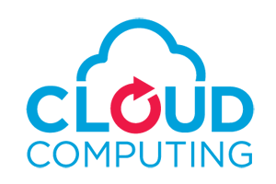
Chapter 1
Introduction
Notes:
1

Slide 2
Cloud Computing Definition
Cloud computing is like renting computing power. This includes servers, storage, databases, networking, software, analytics and intelligence.
Cloud computing is a model for enabling convenient, on-demand network access to a shared pool of configurable computing resources (e.g., networks, servers, storage, applications, and services) that can be rapidly provisioned and released with minimal management effort or service provider interaction.
This cloud model promotes availability and is composed of
Five essential characteristics,
Three service models, and
Four deployment models.

Slide 3
Motivation: Business Drivers
The origins and inspirations of many of the characteristics, models, and mechanisms covered throughout subsequent chapters can be traced back to the upcoming business drivers
Capacity Planning:
process of determining and fulfilling future demands of an organization’s IT resources, products, and services.
capacity represents the maximum amount of work that an IT resource is capable of delivering in a given period of time.
Discrepancy between the capacity of an IT resource and its demand can result in a system becoming
inefficient (over-provisioning) or
unable to fulfill user needs (under-provisioning).
Capacity planning is focused on minimizing this discrepancy to achieve predictable efficiency and performance.
9/23/2022

Slide 4
Motivation: Business Drivers
Different capacity planning strategies exist:
• Lead Strategy – adding capacity to an IT resource in anticipation of demand
• Lag Strategy – adding capacity when the IT resource reaches its full capacity
• Match Strategy – adding IT resource capacity in small increments, as demand increases
2. Cost Reduction: Two costs need to be accounted for:
the cost of acquiring new infrastructure,
the cost of its ongoing ownership.
Operational overhead represents a considerable share of IT budgets, often exceeding up-front investment costs. Example:
technical personnel, upgrades and patches (additional testing and deployment cycles), utility bills for power and cooling, security and access control measures, administrative and accounts staff that may be required to keep track of licenses and support arrangements
3. Organizational Agility
9/23/2022

Slide 5
Motivation: Business Drivers
3. Organizational Agility: Organizational agility is the measure of an organization’s responsiveness to change.
9/23/2022

Slide 6
Essential Characteristics:
On-demand self-service.
A consumer can unilaterally provision computing capabilities, such as server time and network storage, as needed automatically.
Does not require human interaction with each service’s provider.
Broad network access.
Capabilities are available over the network
Capabilities are accessed through standard mechanisms that promote use by heterogeneous thin or thick client platforms (e.g., mobile phones, laptops, and PDAs).
9/23/2022

Slide 7
Essential Characteristics:
Resource pooling.
The provider’s computing resources are pooled to serve multiple consumers using a multi-tenant model.
Different physical and virtual resources dynamically assigned and reassigned according to consumer demand.
There is a sense of location independence in that the customer generally has no control or knowledge over the exact location of the provided resources but may be able to specify location at a higher level of abstraction (e.g., country, state, or datacenter).
Examples of resources include storage, processing, memory, network bandwidth, and virtual machines.
9/23/2022

Slide 8
Essential Characteristics:
Rapid elasticity.
Capabilities can be rapidly & elastically provisioned, in some cases automatically, to quickly scale out & rapidly released to quickly scale in.
For consumers, the capabilities available for provisioning often appear to be unlimited and can be purchased in any quantity at any time.
Measured Service.
Cloud systems automatically control and optimize resource use by leveraging a metering capability at some level of abstraction appropriate to the type of service (e.g., storage, processing, bandwidth, and active user accounts).
Resource usage can be monitored, controlled, and reported providing transparency for both the provider and consumer of the utilized service.
9/23/2022

Slide 9
Cloud Service Models
Cloud Software as a Service (SaaS).
The capability provided to the consumer is to use the provider’s applications running on a cloud infrastructure.
The applications are accessible from various client devices through a thin client interface such as a web browser (e.g., web-based email).
The consumer does not manage or control the underlying cloud infrastructure including network, servers, operating systems, storage, or even individual application capabilities, with the possible exception of limited user-specific application configuration settings
9/23/2022

Slide 10
Cloud Service Models
Cloud Platform as a Service (PaaS).
The capability provided to the consumer is to deploy onto the cloud infrastructure consumer-created or acquired applications created using programming languages and tools supported by the provider.
The consumer does not manage or control the underlying cloud infrastructure including network, servers, operating systems, or storage, but has control over the deployed applications and possibly application hosting environment configurations.
9/23/2022

Slide 11
Cloud Service Models
Cloud Infrastructure as a Service (IaaS).
The capability provided to the consumer is to provision processing, storage, networks, and other fundamental computing resources where the consumer is able to deploy and run arbitrary software, which can include operating systems and applications.
The consumer does not manage or control the underlying cloud infrastructure but has control over operating systems, storage, deployed applications, and possibly limited control of select networking components (e.g., host firewalls).
9/23/2022

Slide 12
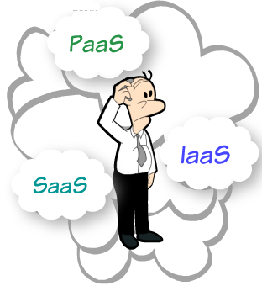
9/23/2022

Slide 13



Comparison of SAAS PASS IAAS
SaaS
PaaS
IaaS
End-user Utilization
Software Development
System Architecture
9/23/2022

Slide 14
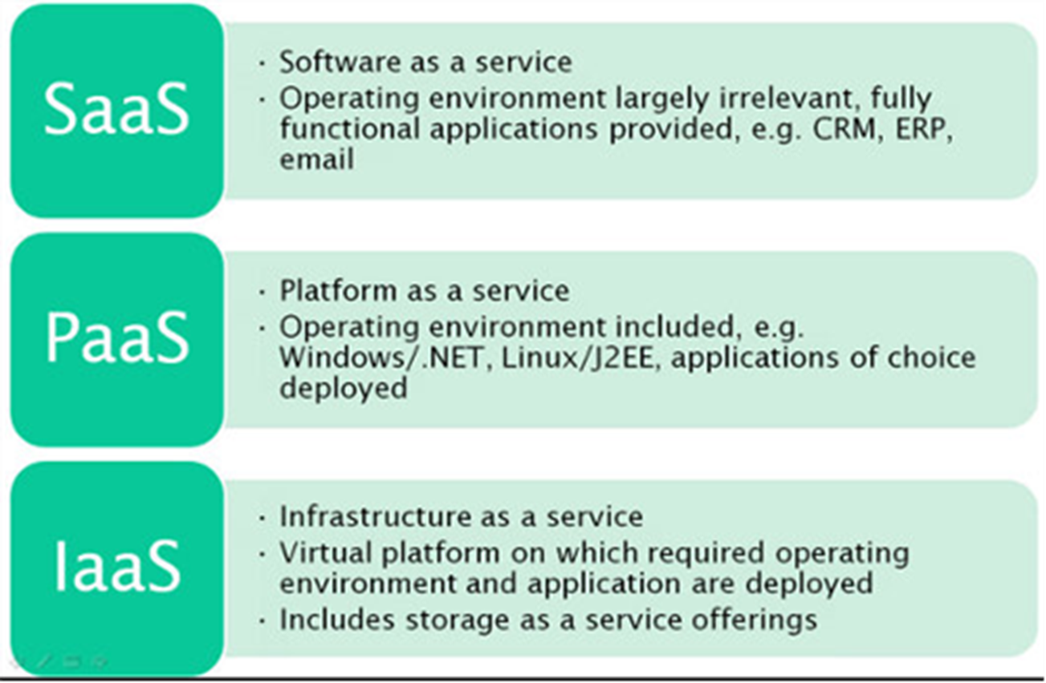
Comparison of SAAS PASS IAAS
9/23/2022

Slide 15
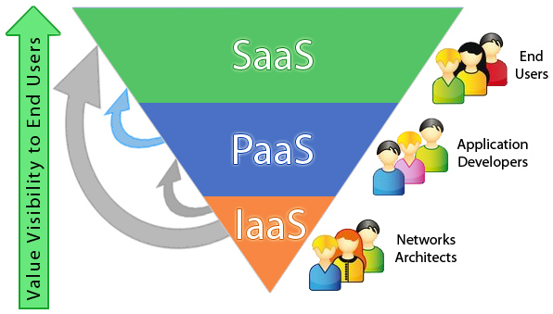
9/23/2022

Slide 16
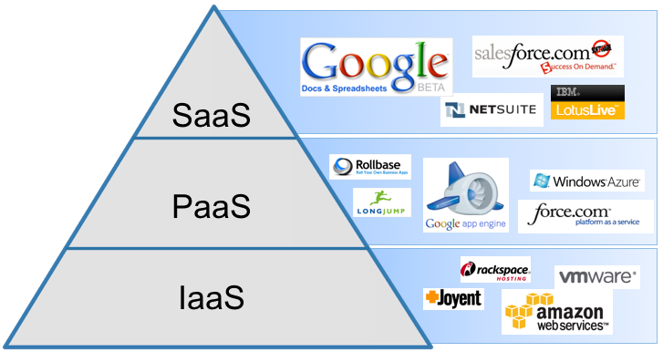
Example of vendors
9/23/2022

Slide 17
Deployment Models (Cloud Types)
Private cloud.
The cloud infrastructure is operated solely for an organization. It may be managed by the organization or a third party and may exist on premise or off premise.
Public cloud.
The cloud infrastructure is made available to the general public or a large industry group and is owned by an organization selling cloud services.
Hybrid cloud.
The cloud infrastructure is a composition of two or more clouds (private, community, or public) that remain unique entities but are bound together by standardized or proprietary technology that enables data and application portability (e.g., cloud bursting for load-balancing between clouds).
Community cloud.
The cloud infrastructure is shared by several organizations and supports a specific community that has shared concerns (e.g., mission, security requirements, policy, and compliance considerations). It may be managed by the organizations or a third party and may exist on premise or off premise.
9/23/2022

Slide 18
The Pros and Cons of Cloud Computing
Pros of cloud computing:
No cost on infrastructure
Minimum management and cost (Cost Saving)
Forget about administrative or management hassles
Accessibility and pay per use
Reliability
Cons of cloud computing:
Requires good speed internet with good bandwidth
Limited control on infrastructure
Ongoing costs
Security
9/23/2022

Slide 19
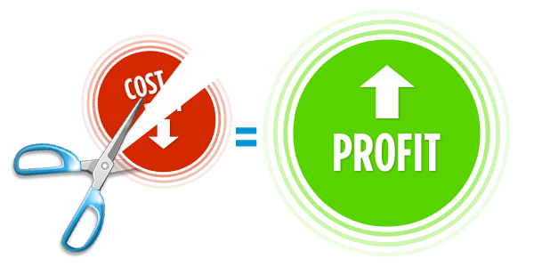



Benefits of CC
Global Infrastructure Savings
Smart Resource Provisioning
Better Delivery Time
Transparent Workflow
19
9/23/2022

Slide 20

Thank You
9/23/2022

