Slide 1

Chapter 20
IP Security
Notes:
There are application-specific security mechanisms for a number of application
areas, including electronic mail (S/MIME, PGP), client/server (Kerberos), Web access
(Secure Sockets Layer), and others. However, users have security concerns that
cut across protocol layers. For example, an enterprise can run a secure, private IP
network by disallowing links to untrusted sites, encrypting packets that leave the
premises, and authenticating packets that enter the premises. By implementing security
at the IP level, an organization can ensure secure networking not only for
applications that have security mechanisms but also for the many security-ignorant
applications.
IP-level security encompasses three functional areas: authentication, confidentiality,
and key management. The authentication mechanism assures that a received
packet was, in fact, transmitted by the party identified as the source in the packet
header. In addition, this mechanism assures that the packet has not been altered in
transit. The confidentiality facility enables communicating nodes to encrypt messages
to prevent eavesdropping by third parties. The key management facility is concerned
with the secure exchange of keys.

Slide 2
“If a secret piece of news is divulged by a spy before the time is ripe, he must be put to death, together with the man to whom the secret was told.”
—The Art of War,
Sun Tzu
Notes:
We begin this chapter with an overview of IP security (IPsec) and an introduction
to the IPsec architecture. We then look at each of the three functional areas in
detail. Appendix L reviews Internet protocol.

Slide 3
IP Security Overview
RFC 1636
“Security in the Internet Architecture”
Issued in 1994 by the Internet Architecture Board (IAB)
Identifies key areas for security mechanisms
Need to secure the network infrastructure from unauthorized monitoring and control of network traffic
Need to secure end-user-to-end-user traffic using authentication and encryption mechanisms
IAB included authentication and encryption as necessary security features in the next generation IP (IPv6)
The IPsec specification now exists as a set of Internet standards
Notes:
In 1994, the Internet Architecture Board (IAB) issued a report titled “Security in
the Internet Architecture” (RFC 1636). The report identified key areas for security
mechanisms. Among these were the need to secure the network infrastructure from
unauthorized monitoring and control of network traffic and the need to secure end-user-
to-end-user traffic using authentication and encryption mechanisms.
To provide security, the IAB included authentication and encryption as necessary
security features in the next-generation IP, which has been issued as IPv6.
Fortunately, these security capabilities were designed to be usable both with the
current IPv4 and the future IPv6. This means that vendors can begin offering these
features now, and many vendors now do have some IPsec capability in their products.
The IPsec specification now exists as a set of Internet standards.

Slide 4
Applications of IPsec
IPsec provides the capability to secure communications across a LAN, private and public WANs, and the Internet
Principal feature of IPsec is that it can encrypt and/or authenticate all traffic at the IP level
Thus all distributed applications (remote logon, client/server, e-mail, file transfer, Web access) can be secured
Examples include:
Secure branch office connectivity over the Internet
Secure remote access over the Internet
Establishing extranet and intranet connectivity with partners
Enhancing electronic commerce security
Notes:
IPsec provides the capability to secure communications across a LAN, across private
and public WANs, and across the Internet. Examples of its use include:
• Secure branch office connectivity over the Internet: A company can build a
secure virtual private network over the Internet or over a public WAN. This
enables a business to rely heavily on the Internet and reduce its need for private
networks, saving costs and network management overhead.
• Secure remote access over the Internet: An end user whose system is equipped
with IP security protocols can make a local call to an Internet Service Provider
(ISP) and gain secure access to a company network. This reduces the cost of
toll charges for traveling employees and telecommuters.
• Establishing extranet and intranet connectivity with partners: IPsec can be
used to secure communication with other organizations, ensuring authentication
and confidentiality and providing a key exchange mechanism.
• Enhancing electronic commerce security: Even though some Web and electronic
commerce applications have built-in security protocols, the use of IPsec
enhances that security. IPsec guarantees that all traffic designated by the network
administrator is both encrypted and authenticated, adding an additional
layer of security to whatever is provided at the application layer.
The principal feature of IPsec that enables it to support these varied applications
is that it can encrypt and/or authenticate all traffic at the IP level. Thus, all
distributed applications (including remote logon, client/server, e-mail, file transfer,
Web access, and so on) can be secured.

Slide 5
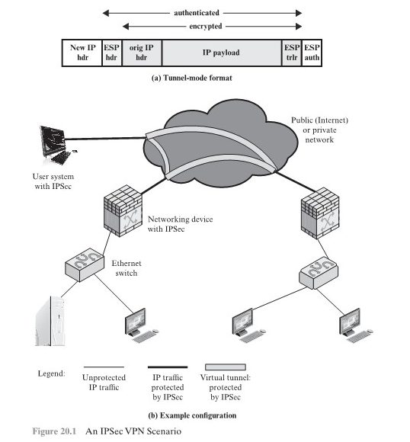
Notes:
Figure 20.1 is a typical scenario of IPsec usage. An organization maintains
LANs at dispersed locations. Nonsecure IP traffic is conducted on each LAN. For
traffic offsite, through some sort of private or public WAN, IPsec protocols are used.
These protocols operate in networking devices, such as a router or firewall, that
connect each LAN to the outside world. The IPsec networking device will typically
encrypt and compress all traffic going into the WAN and decrypt and decompress
traffic coming from the WAN; these operations are transparent to workstations and
servers on the LAN. Secure transmission is also possible with individual users who
dial into the WAN. Such user workstations must implement the IPsec protocols to
provide security.

Slide 6
Benefits of IPSec
Some of the benefits of IPsec:
When IPsec is implemented in a firewall or router, it provides strong security that can be applied to all traffic crossing the perimeter
Traffic within a company or workgroup does not incur the overhead of security-related processing
IPsec in a firewall is resistant to bypass if all traffic from the outside must use IP and the firewall is the only means of entrance from the Internet into the organization
IPsec is below the transport layer (TCP, UDP) and so is transparent to applications
There is no need to change software on a user or server system when IPsec is implemented in the firewall or router
IPsec can be transparent to end users
There is no need to train users on security mechanisms, issue keying material on a per-user basis, or revoke keying material when users leave the organization
IPsec can provide security for individual users if needed
This is useful for offsite workers and for setting up a secure virtual subnetwork within an organization for sensitive applications
Notes:
Some of the benefits of IPsec:
• When IPsec is implemented in a firewall or router, it provides strong security
that can be applied to all traffic crossing the perimeter. Traffic within
a company or workgroup does not incur the overhead of security-related
processing.
• IPsec in a firewall is resistant to bypass if all traffic from the outside must use
IP and the firewall is the only means of entrance from the Internet into the
organization.
• IPsec is below the transport layer (TCP, UDP) and so is transparent to applications.
There is no need to change software on a user or server system when
IPsec is implemented in the firewall or router. Even if IPsec is implemented in
end systems, upper-layer software, including applications, is not affected.
• IPsec can be transparent to end users. There is no need to train users on security
mechanisms, issue keying material on a per-user basis, or revoke keying
material when users leave the organization.
• IPsec can provide security for individual users if needed. This is useful for offsite
workers and for setting up a secure virtual subnetwork within an organization
for sensitive applications.

Slide 7
Routing Applications
IPsec can play a vital role in the routing architecture required for internetworking
IPsec can assure that:
A router advertisement comes from an authorized router
A router seeking to establish or maintain a neighbor relationship with a router in another routing domain is an authorized router
A redirect message comes from the router to which the initial IP packet was sent
A routing update is not forged
Notes:
In addition to supporting end users and protecting premises systems and networks,
IPsec can play a vital role in the routing architecture required for internetworking.
[HUIT98] lists the following examples of the use of IPsec. IPsec can assure that
• A router advertisement (a new router advertises its presence) comes from an
authorized router.
• A neighbor advertisement (a router seeks to establish or maintain a neighbor
relationship with a router in another routing domain) comes from an authorized
router.
• A redirect message comes from the router to which the initial IP packet was sent.
• A routing update is not forged.
Without such security measures, an opponent can disrupt communications or
divert some traffic. Routing protocols such as Open Shortest Path First (OSPF) should
be run on top of security associations between routers that are defined by IPsec.

Slide 8
IPsec Documents
Covers the general concepts, security requirements, definitions, and mechanisms defining IPsec technology
The current specification is RFC4301, Security Architecture for the Internet Protocol
Authentication Header (AH)
An extension header to provide message authentication
The current specification is RFC 4302, IP Authentication Header
Encapsulating Security Payload (ESP)
Consists of an encapsulating header and trailer used to provide encryption or combined encryption/authentication
The current specification is RFC 4303, IP Encapsulating Security Payload (ESP)
A collection of documents describing the key management schemes for use with IPsec
The main specification is RFC 5996, Internet Key Exchange (IKEv2) Protocol, but there are a number of related RFCs
Cryptographic algorithms
This category encompasses a large set of documents that define and describe cryptographic algorithms for encryption, message authentication, pseudorandom functions (PRFs), and cryptographic key exchange
Other
There are a variety of other IPsec-related RFCs, including those dealing with security policy and management information base (MIB) content
Architecture
Internet Key Exchange (IKE)
Notes:
IPsec encompasses three functional areas: authentication, confidentiality, and key
management. The totality of the IPsec specification is scattered across dozens of
RFCs and draft IETF documents, making this the most complex and difficult to
grasp of all IETF specifications. The best way to grasp the scope of IPsec is to consult
the latest version of the IPsec document roadmap, which as of this writing is RFC
6071 [IP Security (IPsec) and Internet Key Exchange (IKE) Document Roadmap ,
February 2011]. The documents can be categorized into the following groups.
• Architecture: Covers the general concepts, security requirements, definitions,
and mechanisms defining IPsec technology. The current specification is RFC
4301, Security Architecture for the Internet Protocol .
• Authentication Header (AH): AH is an extension header to provide message
authentication. The current specification is RFC 4302, IP Authentication
Header . Because message authentication is provided by ESP, the use of AH
is deprecated. It is included in IPsecv3 for backward compatibility but should
not be used in new applications. We do not discuss AH in this chapter.
• Encapsulating Security Payload (ESP): ESP consists of an encapsulating
header and trailer used to provide encryption or combined encryption/authentication.
The current specification is RFC 4303, IP Encapsulating Security
Payload (ESP) .
• Internet Key Exchange (IKE): This is a collection of documents describing the
key management schemes for use with IPsec. The main specification is RFC
5996, Internet Key Exchange (IKEv2) Protocol , but there are a number of
related RFCs.
• Cryptographic algorithms: This category encompasses a large set of documents
that define and describe cryptographic algorithms for encryption, message authentication,
pseudorandom functions (PRFs), and cryptographic key exchange.
• Other: There are a variety of other IPsec-related RFCs, including those dealing
with security policy and management information base (MIB) content.

Slide 9
IPsec Services
IPsec provides security services at the IP layer by enabling a system to:
Select required security protocols
Determine the algorithm(s) to use for the service(s)
Put in place any cryptographic keys required to provide the requested services
RFC 4301 lists the following services:
Access control
Connectionless integrity
Data origin authentication
Rejection of replayed packets (a form of partial sequence integrity)
Confidentiality (encryption)
Limited traffic flow confidentiality
Notes:
IPsec provides security services at the IP layer by enabling a system to select required
security protocols, determine the algorithm(s) to use for the service(s), and
put in place any cryptographic keys required to provide the requested services. Two
protocols are used to provide security: an authentication protocol designated by the
header of the protocol, Authentication Header (AH); and a combined encryption/
authentication protocol designated by the format of the packet for that protocol,
Encapsulating Security Payload (ESP). RFC 4301 lists the following services:
• Access control
• Connectionless integrity
• Data origin authentication
• Rejection of replayed packets (a form of partial sequence integrity)
• Confidentiality (encryption)
• Limited traffic flow confidentiality

Slide 10
Transport and Tunnel Modes
Transport Mode
Tunnel Mode
Provides protection primarily for upper-layer protocols
Examples include a TCP or UDP segment or an ICMP packet
Typically used for end-to-end communication between two hosts
ESP in transport mode encrypts and optionally authenticates the IP payload but not the IP header
AH in transport mode authenticates the IP payload and selected portions of the IP header
Provides protection to the entire IP packet
Used when one or both ends of a security association (SA) are a security gateway
A number of hosts on networks behind firewalls may engage in secure communications without implementing IPsec
ESP in tunnel mode encrypts and optionally authenticates the entire inner IP packet, including the inner IP header
AH in tunnel mode authenticates the entire inner IP packet and selected portions of the outer IP header
Notes:
Both AH and ESP support two modes of use: transport and tunnel mode. The operation
of these two modes is best understood in the context of a description of ESP,
which is covered in Section 20.3. Here we provide a brief overview.
Transport mode provides protection primarily for upper-layer
protocols. That is, transport mode protection extends to the payload of an IP packet.
Examples include a TCP or UDP segment or an ICMP packet, all of which operate
directly above IP in a host protocol stack. Typically, transport mode is used for endto-
end communication between two hosts (e.g., a client and a server, or two workstations).
When a host runs AH or ESP over IPv4, the payload is the data that normally
follow the IP header. For IPv6, the payload is the data that normally follow both the
IP header and any IPv6 extensions headers that are present, with the possible exception
of the destination options header, which may be included in the protection.
ESP in transport mode encrypts and optionally authenticates the IP payload
but not the IP header. AH in transport mode authenticates the IP payload and selected
portions of the IP header.
Tunnel mode provides protection to the entire IP packet. To achieve
this, after the AH or ESP fields are added to the IP packet, the entire packet plus
security fields is treated as the payload of new outer IP packet with a new outer IP
header. The entire original, inner, packet travels through a tunnel from one point of
an IP network to another; no routers along the way are able to examine the inner IP
header. Because the original packet is encapsulated, the new, larger packet may have
totally different source and destination addresses, adding to the security. Tunnel
mode is used when one or both ends of a security association (SA) are a security
gateway, such as a firewall or router that implements IPsec. With tunnel mode, a
number of hosts on networks behind firewalls may engage in secure communications
without implementing IPsec. The unprotected packets generated by such hosts
are tunneled through external networks by tunnel mode SAs set up by the IPsec
software in the firewall or secure router at the boundary of the local network.
ESP in tunnel mode encrypts and optionally authenticates the entire inner IP
packet, including the inner IP header. AH in tunnel mode authenticates the entire
inner IP packet and selected portions of the outer IP header.

Slide 11
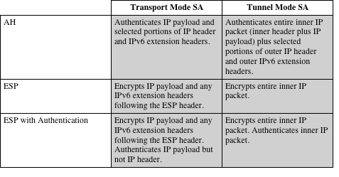
Table 20.1
Tunnel Mode and Transport Mode Functionality
Notes:
Table 20.1 summarizes transport and tunnel mode functionality.

Slide 12
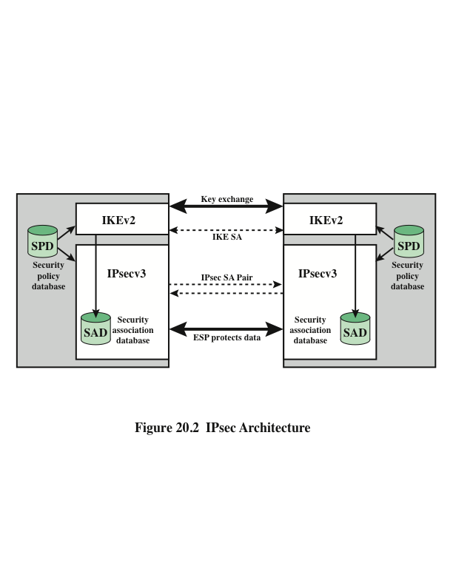
Notes:
Fundamental to the operation of IPsec is the concept of a security policy applied
to each IP packet that transits from a source to a destination. IPsec policy is determined
primarily by the interaction of two databases, the security association
database (SAD) and the security policy database (SPD) . This section provides an
overview of these two databases and then summarizes their use during IPsec operation.
Figure 20.2 illustrates the relevant relationships.

Slide 13
Security Association (SA)
A one-way logical connection between a sender and a receiver that affords security services to the traffic carried on it
In any IP packet, the SA is uniquely identified by the Destination Address in the IPv4 or IPv6 header and the SPI in the enclosed extension header (AH or ESP)
Uniquely identified by three parameters:
Security Parameters Index (SPI)
A 32-bit unsigned integer assigned to this SA and having local significance only
IP Destination Address
Address of the destination endpoint of the SA, which may be an end-user system or a network system such as a firewall or router
Security protocol identifier
Indicates whether the association is an AH or ESP security association
Notes:
A key concept that appears in both the authentication and confidentiality mechanisms
for IP is the security association (SA). An association is a one-way logical
connection between a sender and a receiver that affords security services to the traffic
carried on it. If a peer relationship is needed for two-way secure exchange, then
two security associations are required.
A security association is uniquely identified by three parameters.
• Security Parameters Index (SPI): A 32-bit unsigned integer assigned to this
SA and having local significance only. The SPI is carried in AH and ESP headers
to enable the receiving system to select the SA under which a received
packet will be processed.
• IP Destination Address: This is the address of the destination endpoint of the
SA, which may be an end-user system or a network system such as a firewall
or router.
• Security Protocol Identifier: This field from the outer IP header indicates
whether the association is an AH or ESP security association.
Hence, in any IP packet, the security association is uniquely identified by the
Destination Address in the IPv4 or IPv6 header and the SPI in the enclosed extension
header (AH or ESP).

Slide 14
Security Association Database (SAD)
Defines the parameters associated with each SA
Normally defined by the following parameters in a SAD entry:
Security parameter index
Sequence number counter
Sequence counter overflow
Anti-replay window
AH information
ESP information
Lifetime of this security association
IPsec protocol mode
Path MTU
Notes:
In each IPsec implementation, there is a nominal Security Association Database
that defines the parameters associated with each SA. A security association is normally
defined by the following parameters in an SAD entry.
• Security Parameter Index: A 32-bit value selected by the receiving end of an
SA to uniquely identify the SA. In an SAD entry for an outbound SA, the SPI
is used to construct the packet’s AH or ESP header. In an SAD entry for an
inbound SA, the SPI is used to map traffic to the appropriate SA.
• Sequence Number Counter: A 32-bit value used to generate the Sequence
Number field in AH or ESP headers, described in Section 20.3 (required for
all implementations).
• Sequence Counter Overflow: A flag indicating whether overflow of the
Sequence Number Counter should generate an auditable event and prevent
further transmission of packets on this SA (required for all implementations).
• Anti-Replay Window: Used to determine whether an inbound AH or ESP
packet is a replay, described in Section 20.3 (required for all implementations).
• AH Information: Authentication algorithm, keys, key lifetimes, and related
parameters being used with AH (required for AH implementations).
• ESP Information: Encryption and authentication algorithm, keys, initialization
values, key lifetimes, and related parameters being used with ESP
(required for ESP implementations).
• Lifetime of this Security Association: A time interval or byte count after
which an SA must be replaced with a new SA (and new SPI) or terminated,
plus an indication of which of these actions should occur (required for all
implementations).
• IPsec Protocol Mode: Tunnel, transport, or wildcard.
• Path MTU: Any observed path maximum transmission unit (maximum size of
a packet that can be transmitted without fragmentation) and aging variables
(required for all implementations).
The key management mechanism that is used to distribute keys is coupled to
the authentication and privacy mechanisms only by way of the Security Parameters
Index (SPI). Hence, authentication and privacy have been specified independent of
any specific key management mechanism.
IPsec provides the user with considerable flexibility in the way in which IPsec
services are applied to IP traffic. As we will see later, SAs can be combined in a
number of ways to yield the desired user configuration. Furthermore, IPsec provides
a high degree of granularity in discriminating between traffic that is afforded
IPsec protection and traffic that is allowed to bypass IPsec, as in the former case
relating IP traffic to specific SAs.

