Slide 1
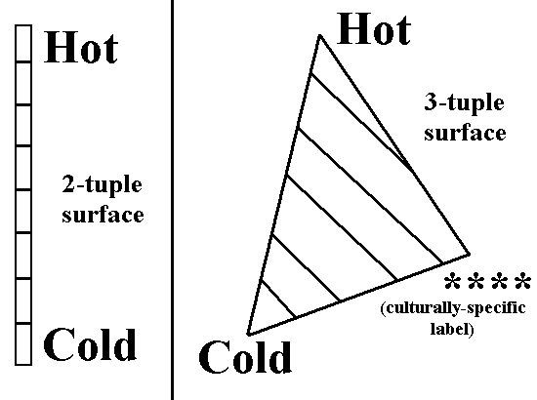
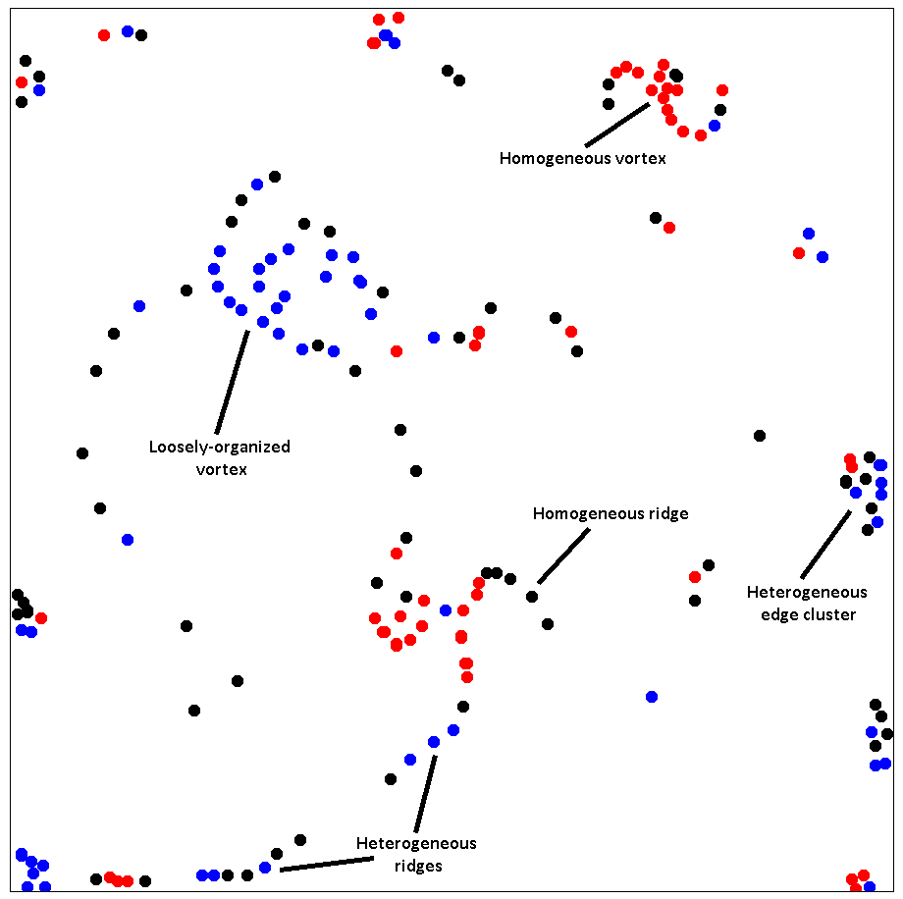

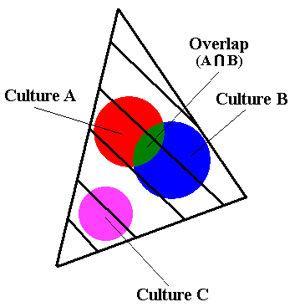
Contextual Geometric Structures
abstractions of cognition and culture
Bradly Alicea
http://publish.Illinois.edu/bradly-alicea

Slide 2
Abstract
The Contextual Geometric Structure (CGS) approach allows for the bridging of dynamical cognitive models with the larger-scale process of population-wide cultural evolution. This involves a geometric representation that combines the spatial environment, cognitive classification, and evolutionary computation. The CGS approach is a form of artificial life inspired by structural anthropology and soft computation. As hybrid models, CGSs not only resemble features of complex societies, but can represent scenarios such as cultural contact to epistemic closure. CGS models exist as an alternative to both more traditional models of cultural evolution based on population genetics and evolutionarily-static cognitive models. Since the dynamics of CGSs are fundamentally geometric, the resulting cultures have defined "shapes", can "intersect", and can "collapse" and "disintegrate". As an evolutionary model, the CGS approach allows us to explore both the structure and function of so-called cultural behaviors. Yet CGS models also allow us to connect the short-term diffusion of beliefs and ideas with longer-term processes such as natural selection. To make this point more explicit for purposes of future research directions, links between population dynamics and physical models will also be discussed.

Slide 3
What is the essence of culture?
Heredity (beliefs that propagate)? Adaptability? Self-reference?
Structuralists, post-structuralists: “structures” transcend cultural transmission and cognition, but fundamentally shape that features of culture.
Structures are ubiquitous:
* language and concepts (natural world defined as sets of discrete oppositions).
* settlement patterns, architecture (can define or sharpen distinctions between cultural groups, but can also act to integrate cultural traditions -- syncretism).
* underlying constraints (specifies how cultures CANNOT adapt).

Slide 4
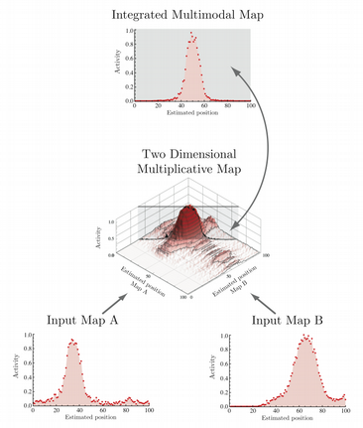
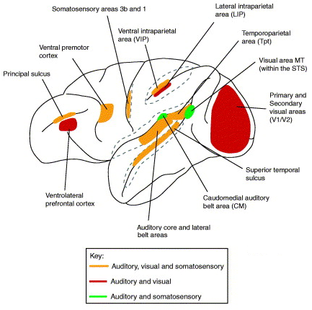

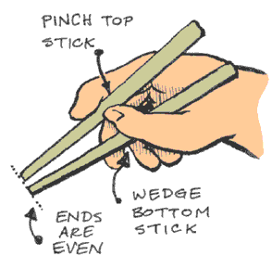
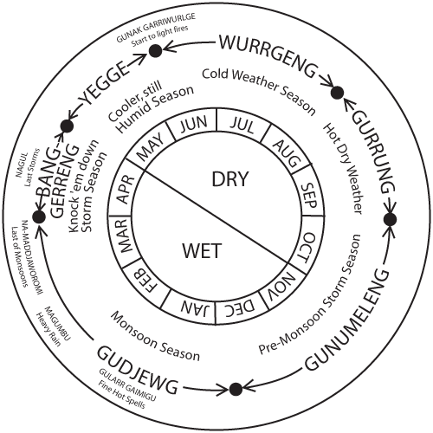
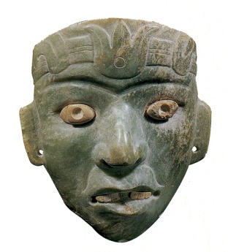
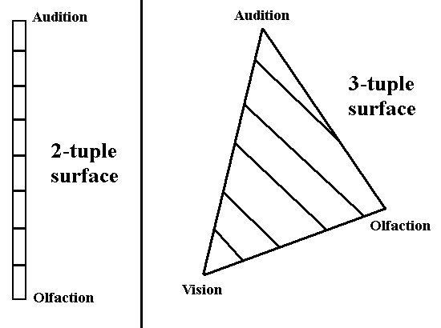
How does the brain “represent” sensory information to perform a cultural “operation”?
* n-tuple surfaces with a soft classification scheme (all possible combinations).
Cultural phenomenon: symbol, practice, or artifact.
* What is the membership of cultural phenomenon x in this space?
LEFT: http://www.bccn-munich.de/research/projects-1/multisensory-integration. RIGHT: Ghanzanfar and Schroeder (2006). Trends in Cognitive Science, 10(6), 278–285

Slide 5
Hybrid (Soft Classification, LCS) Model
Contextual Geometric Structures: modeling the fundamental components of cultural behavior. Proceedings of Artificial Life, 13, 147-154.
Two components of this model:
1) Soft classificatory kernel
* soft classification (all phenomena = degree of membership).
* halfway between light and dark (50% light, 50% dark). Attributes of both.
2) Lagrangian Coherent Structure (LCS) model
* second-order Lagrangian (LCS = recently discovered Physical model).
* hydrodynamic-inspired field model. Currents lead to patterns of movement and aggregation.

Slide 6
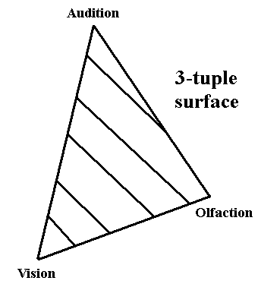
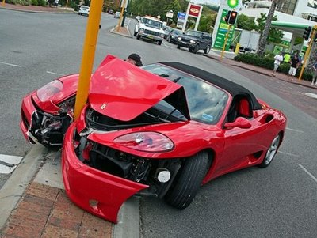
Example of Soft Classification
Each object being classified = continuous membership function (0-100%) in each category (n-tuple space).
* categories are not transitive nor independent.
EXAMPLE: car crash in a 3-tuple space.
* membership functions: vision (80%), audition (80%), olfaction (10%).
* creates a bounding polygon (all possible responses to sensory stimuli) within which all individual experiences will reside.
In general, subspaces can be defined by culture-specific, context-specific instances.

Slide 7
Soft (fuzzy) classification:
* membership function on interval {0,1}. NOT a probability.
* does NOT require transitivity, distributivity, or symmetry
TRANSITIVITY
A
B
C
SYMMETRY
A
=
B
B
=
A
DISTRIBUTIVITY
A
*
(B
+
C)
=
(A
*
B)
+
(A
C)
*

Slide 8
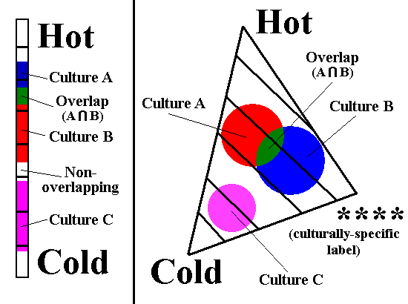
Conceptual Automata
Inspired by the concept of Habitus (Pierre Bourdieu, “Logic of Practice”):
* definitions: “durable, transposable dispositions”….”generative”….”organizes practices and representations adaptively”.
Computational objective: a scheme that transforms physical phenomena into operations that can be compared in an evolutionary context.

Slide 9
Lagrangian Coherent Structures (LCS)
Key concept for LCS: finite-time and finite-size Lyapunov exponents (FTLE or FSLE):
* FTLE = evolution of collective particle trajectories over time (find distance for given time interval).
* FSLE = evolution of collective particle trajectories across space (find time for given set of distances).
LCS field models are a flexible dynamical system:
* Lagrangian representation of kinematics (special case of classical mechanics). Compare with Eulerian, Hamiltonian representations?
Points in a flow have an initial position. The relationship between these points deformed (flow travels apart) over time:
* distance between points quantified using Lyapunov exponent.
* ridges form in flow map over time/space = coherent structures.

Slide 10
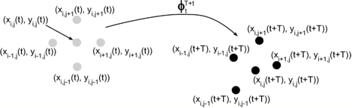
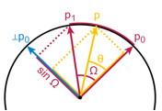
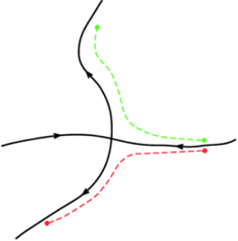
Lagrangian Coherent Structures (LCS)
Finite Lyapunov exponent (related to γ, key parameter in dynamical systems) defined by
Lyapunov exponent
(scalar value)
Movement of particles (advection)
Coordinate system
(interpolation)
http://amath.colorado.edu/index.php?page=finite-time-lyapunov-exponents-ftle

Slide 11


Lagrangian Coherent Structures (LCS)
Finite Lyapunov exponent (related to γ, key parameter in dynamical systems)
A matter of diffusion…..
* particles diffuse across a coordinate system at rate r.
* if underlying order, particles will aggregate into larger-scale structures.
* stochastic component (diffusion speed), deterministic component (interface between regimes).

Slide 12
2-D Cultural Landscape
2-dimensional flow field:
* all dots begin in center of field, diffuse w.r.t. time.
* each dot in figure represent singular automata.
* vortices, ridges, and clusters predicted.
* aggregation due to common soft classification scheme (based on kernel values).

Slide 13
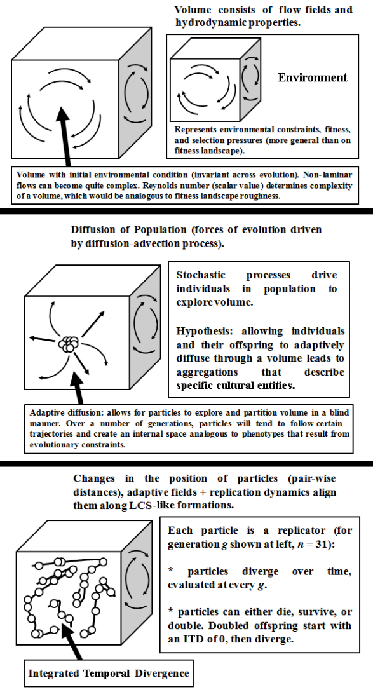
Environment is determined by flow conditions (simulated flow field):
* can be determined in advance (flow jets produce laminar to turbulent regimes).
* represents environmental constrains (e.g. physical boundaries.

Slide 14
Environment is determined by flow conditions (simulated flow field):
* can be determined in advance (flow jets produce laminar to turbulent regimes).
* represents environmental constrains (e.g. physical boundaries.
Initial condition: environment is seeded with particles (automata), all clustered in same location:
* one seed per population (can simulate multiple populations).

Slide 15
Environment is determined by flow conditions (simulated flow field):
* can be determined in advance (flow jets produce laminar to turbulent regimes).
* represents environmental constrains (e.g. physical boundaries.
Initial condition: environment is seeded with particles (automata), all clustered in same location:
* one seed per population (can simulate multiple populations).
Over time (integrated temporal divergence), divergence and co-location of particles leads to “structure” formation:
* structures are composed of particles that survive time evolution (conditional features favor certain conditions to emerge).

Slide 16
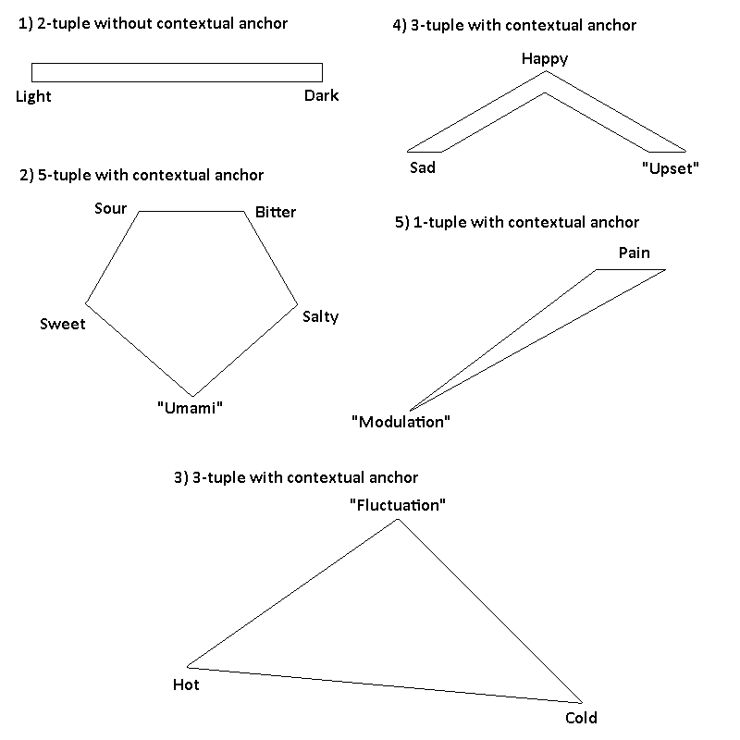
Examples of Contextual Structures
1) 2-tuple without contextual anchor.
2) 5-tuple with contextual anchor.
3) 3-tuple with contextual anchor.
4) 3-tuple with contextual anchor.
5) 1-tuple with contextual anchor.

Slide 17
Integrative Communication between automata (agents)
CGS models of market-mediated economic
Value (MMEV) using Minimal Markets:
Contextual and Structural Representations
of Market-mediated Economic Value. arXiv,
1403.7021.
A
B
i
j
A is a specialist in i, B is a specialist in j. Combinatorial resource pool.
Two agents can randomly exchange, retain resource.
What information favors trading or retaining?
A’
B’
Model originally in: Noe, van Hooft,
Hammerstein – Economics in Nature (2006).

Slide 18
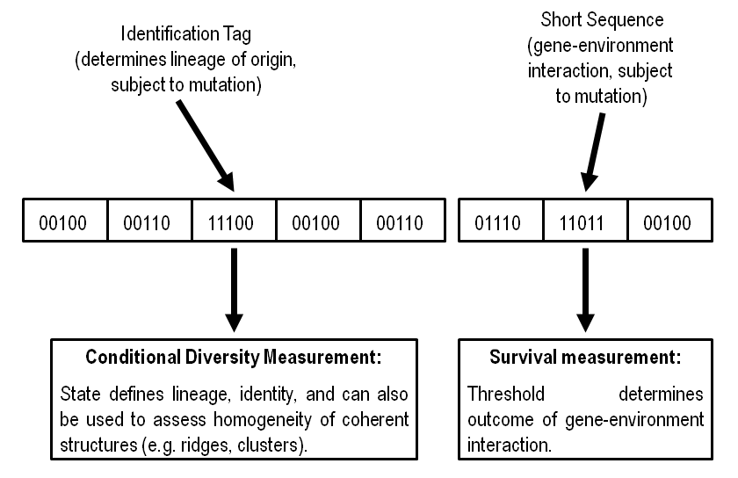
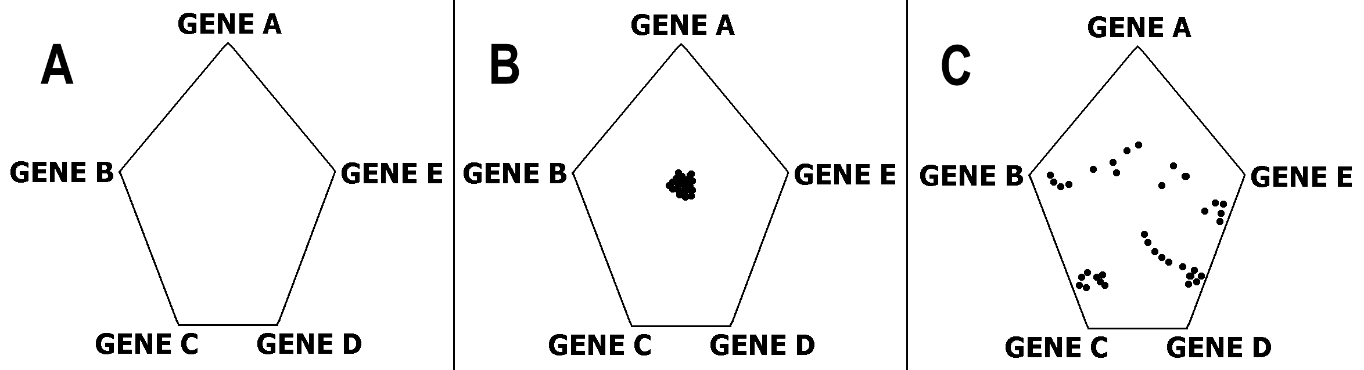
LCS-like Models May Describe Evolvable Frontiers
Lagrangian Coherent Structures (LCS) may describe evolvable frontiers in
natural populations. arXiv: 1101.6071.
Particle Genomes

Slide 19
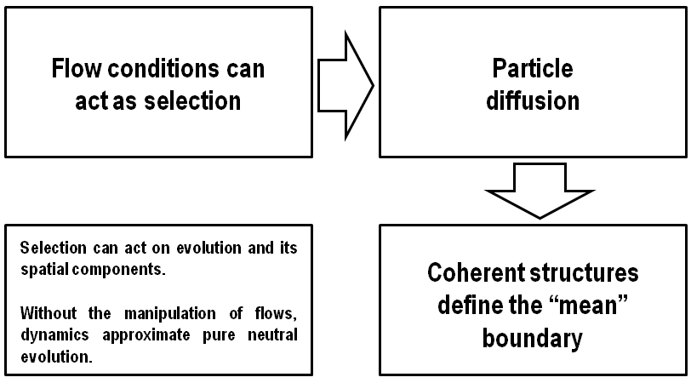
LCS-like Models May Describe Evolvable Frontiers
Lagrangian Coherent Structures (LCS) may describe evolvable frontiers in
natural populations. arXiv: 1101.6071.
Particle Genomes
Evolution

Slide 20
Missing Component of Neural Modeling
Existing models of what the brain does:
1) pattern and category recognition (connectionism).
2) intelligence as prediction (HTM Models).
3) emergent representations (development, evolution)
This approach:
Differencing and integration functions related to symbolic behavior (an emergent approach?).
* event-based selective inhibition in memory, attentional circuitry.
* sensory integration (suppressive, superadditive)

Slide 21
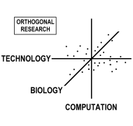


Acknowledgements
Orthogonal Research: independent
research start-up
Artificial Life community
Conceptual Support, Feedback
http://github.com/balicea/
Thank you! Questions?

